Slide 1
AP Biology – Ch. 8 – Metabolism
How to tackle AP Exam Questions

Slide 2
Overview
Today, we’ll be answering and analyzing real AP biology multiple choice exam questions on metabolism (Ch. 8.1-8.5).
I will walk us through questions 1-3.
We will complete questions 4-8 as a class in groups.
You will complete questions 9-15 independently using the strategies learned today.

Slide 3
Bloom’s taxonomy
Levels of Questions
Level 1: Knowledge/comprehension
Level 2: Application/analysis
Level 3: Synthesis/evaluation

Slide 4
Let’s start off simple…
Which term most precisely describes the cellular process of breaking down large molecules into smaller ones?
A) catabolism (catabolic pathways)
B) metabolism
C) anabolism (anabolic pathways)
D) dehydration
Section: 8.1

Slide 5
Let’s start off simple…
Which term most precisely describes the cellular process of breaking down large molecules into smaller ones?
A) catabolism (catabolic pathways)
B) metabolism
C) anabolism (anabolic pathways)
D) dehydration
Bloom's Taxonomy: Knowledge/Comprehension
Section: 8.1

Slide 6
Question 2
Which of the following types of reactions would decrease the entropy within a cell?
A) anabolic reactions
B) hydrolysis
C) digestion
D) catabolic reactions
Section: 8.1

Slide 7
Question 2
Which of the following types of reactions would decrease the entropy within a cell?
A) anabolic reactions
B) hydrolysis
C) digestion
D) catabolic reactions
Bloom's Taxonomy: Application/Analysis
Section: 8.1

Slide 8
Question 3
For living organisms, which of the following is an important consequence of the first law of thermodynamics?
A) The energy content of an organism is constant.
B) The organism ultimately must obtain all of the necessary energy for life from its environment.
C) The entropy of an organism decreases with time as the organism grows in complexity.
D) Organisms grow by converting energy into organic matter.
Section: 8.1

Slide 9
Question 3
For living organisms, which of the following is an important consequence of the first law of thermodynamics?
A) The energy content of an organism is constant.
B) The organism ultimately must obtain all of the necessary energy for life from its environment.
C) The entropy of an organism decreases with time as the organism grows in complexity.
D) Organisms grow by converting energy into organic matter.
Bloom's Taxonomy: Synthesis/Evaluation
Section: 8.1

Slide 10
For the next 5 questions…
Work in your groups to come up with ONE consensus answer
Be prepared to explain your reasoning! (one “volunteer”)

Slide 11
Question 4
Choose the pair of terms that correctly completes this sentence: Catabolism is to anabolism as _____ is to _____.
A) exergonic; spontaneous
B) exergonic; endergonic
C) free energy; entropy
D) work; energy
Bloom's Taxonomy: Knowledge/Comprehension
Section: 8.2

Slide 12
Question 4
Choose the pair of terms that correctly completes this sentence: Catabolism is to anabolism as _____ is to _____.
A) exergonic; spontaneous
B) exergonic; endergonic
C) free energy; entropy
D) work; energy
Bloom's Taxonomy: Knowledge/Comprehension
Section: 8.2

Slide 13
Question 5
In solution, why do hydrolysis reactions occur more readily than condensation reactions?
A) Hydrolysis increases entropy and is exergonic.
B) Hydrolysis raises G, or Gibbs free energy.
C) Hydrolysis decreases entropy and is exergonic.
D) Hydrolysis increases entropy and is endergonic.
Bloom's Taxonomy: Application/Analysis
Section: 8.2

Slide 14
Question 5
In solution, why do hydrolysis reactions occur more readily than condensation reactions?
A) Hydrolysis increases entropy and is exergonic.
B) Hydrolysis raises G, or Gibbs free energy.
C) Hydrolysis decreases entropy and is exergonic.
D) Hydrolysis increases entropy and is endergonic.
Bloom's Taxonomy: Application/Analysis
Section: 8.2

Slide 15
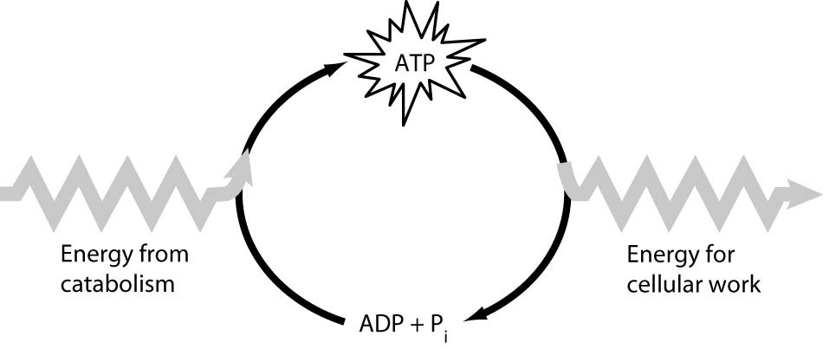
Question 6
Which of the following is the most correct interpretation of the figure?
A) Energy from catabolism can be used directly for performing cellular work.
B) ADP + Pi are a set of molecules that store energy for catabolism.
C) ATP is a molecule that acts as an intermediary to store energy for cellular work.
D) Pi acts as a shuttle molecule to move energy from ATP to ADP.
Bloom's Taxonomy: Application/Analysis
Section: 8.3

Slide 16
Question 6
Which of the following is the most correct interpretation of the figure?
A) Energy from catabolism can be used directly for performing cellular work.
B) ADP + Pi are a set of molecules that store energy for catabolism.
C) ATP is a molecule that acts as an intermediary to store energy for cellular work.
D) Pi acts as a shuttle molecule to move energy from ATP to ADP.
Bloom's Taxonomy: Application/Analysis
Section: 8.3

Slide 17
Question 7
An important group of peripheral membrane proteins are enzymes such as the phospholipases that cleave the head groups of phospholipids. What properties must these enzymes exhibit?
A) resistance to degradation
B) independence from cofactor interaction
C) water solubility
D) lipid solubility
Topic: Concept 8.5
Skill: Synthesis/Evaluation

Slide 18
Question 7
An important group of peripheral membrane proteins are enzymes such as the phospholipases that cleave the head groups of phospholipids. What properties must these enzymes exhibit?
A) resistance to degradation
B) independence from cofactor interaction
C) water solubility
D) lipid solubility
Topic: Concept 8.5
Skill: Synthesis/Evaluation

Slide 19
Question 8
Chemical equilibrium is relatively rare in living cells. Which of the following could be an example of a reaction at chemical equilibrium in a cell?
A) a reaction in which the free energy at equilibrium is higher than the energy content at any point away from equilibrium
B) a chemical reaction in which the entropy change in the reaction is just balanced by an opposite entropy change in the cell's surroundings
C) an endergonic reaction in an active metabolic pathway where the energy for that reaction is supplied only by heat from the environment
D) a chemical reaction in which both the reactants and products are not being produced or used in any active metabolic pathway
Topic: Concept 8.2
Skill: Synthesis/Evaluation

Slide 20
Question 8
Chemical equilibrium is relatively rare in living cells. Which of the following could be an example of a reaction at chemical equilibrium in a cell?
A) a reaction in which the free energy at equilibrium is higher than the energy content at any point away from equilibrium
B) a chemical reaction in which the entropy change in the reaction is just balanced by an opposite entropy change in the cell's surroundings
C) an endergonic reaction in an active metabolic pathway where the energy for that reaction is supplied only by heat from the environment
D) a chemical reaction in which both the reactants and products are not being produced or used in any active metabolic pathway
Topic: Concept 8.2
Skill: Synthesis/Evaluation

Slide 21
Questions 9-15
Independently complete these questions. Be sure to use the strategies we’ve discussed!

Slide 22
Questions 9-15 Answers
9. C
10. B
11.B
12. D
13. A
14. A
15. C

Slide 23
Exit Ticket
In groups, come up with your own multiple choice question/answer from any topic covered thus far.
Be sure to appropriately classify it using Bloom’s taxonomy.
Level 1: Knowledge/comprehension
Level 2: Application/analysis
Level 3: Synthesis/evaluation

