Slide 1
0
9
Cellular Respiration and Fermentation

Slide 2
YOU MUST KNOW
INPUTS + OUTPUTS OF MAJOR STEPS
CELLULAR LOCATIONS OF MAJOR STEPS
DO NOT MEMORIZE ENZYMES AND/OR MOLECULAR STRUCTURES/NAMES

Slide 3
Life is Work
Energy flows into an ecosystem as sunlight and leaves as heat
Photosynthesis generates O₂ and organic molecules, which are used in cellular respiration
Cells use CHEMICAL ENERGY stored in organic molecules to generate ATP, which powers work

Slide 4
Overview
Concept 9.1: Catabolic pathways yield energy by oxidizing organic fuels
Concept 9.2: Glycolysis harvests chemical energy by oxidizing glucose to pyruvate
Concept 9.3: After pyruvate is oxidized, the citric acid cycle completes the energy-yielding oxidation of organic molecules
Concept 9.4: During oxidative phosphorylation, chemiosmosis couples electron transport to ATP synthesis
Concept 9.5: Fermentation and anaerobic respiration enable cells to produce ATP WITHOUT the use of oxygen

Slide 5
Overview
Concept 9.1: Catabolic pathways yield energy by oxidizing organic fuels
Concept 9.2: Glycolysis harvests chemical energy by oxidizing glucose to pyruvate
Concept 9.3: After pyruvate is oxidized, the citric acid cycle completes the energy-yielding oxidation of organic molecules
Concept 9.4: During oxidative phosphorylation, chemiosmosis couples electron transport to ATP synthesis
Concept 9.5: Fermentation and anaerobic respiration enable cells to produce ATP WITHOUT the use of oxygen

Slide 6
Concept 9.1: Catabolic pathways yield energy by oxidizing organic fuels
Catabolic pathways RELEASE stored energy by BREAKING DOWN complex molecules
Electron transfer plays a major role in these pathways
These processes are central to cellular respiration

Slide 7
Catabolic Pathways and Production of ATP
The BREAKDOWN of organic molecules is EXERGONIC
Aerobic respiration consumes organic molecules and O₂ and yields ATP
Fermentation is a partial degradation of sugars that occurs without O₂

Slide 8
Catabolic Pathways and Production of ATP
Cellular respiration includes BOTH aerobic and anaerobic respiration but is often used to refer to aerobic respiration
Although carbohydrates, fats, and proteins are all consumed as fuel, it is helpful to trace cellular respiration with the sugar GLUCOSE
C₆H₁₂O₆ + 6 O₂ → 6 CO₂ + 6 H₂O + Energy (ATP + heat)

Slide 9
The Principle of Redox
Chemical reactions that transfer electrons between reactants are called oxidation-reduction reactions, or redox reactions
In oxidation, a substance loses electrons, or is oxidized
In reduction, a substance gains electrons, or is reduced (the amount of positive charge is reduced)
OIL RIG

Slide 10
Figure 9.UN01
The Principle of Redox
becomes oxidized
(loses electron)
becomes reduced
(gains electron)
Notes:
Figure 9.UN01 In-text figure, NaCl redox reaction, p. 164

Slide 11
The Principle of Redox
The electron DONOR is called the reducing agent
(REDUCING AGENT GETS OXIDIZED BECAUSE OIL)
The electron ACCEPTOR is called the oxidizing agent
(OXIDIZING AGENT GETS REDUCED BECAUSE RIG)

Slide 12
Oxidation of Organic Fuel Molecules During Cellular Respiration
During cellular respiration…
Glucose (fuel) = reducing agent = gets oxidized = loses electrons
O₂ = oxidizing agent = gets reduced = gains electrons
oxidation
reduction

Slide 13
The Stages of Cellular Respiration: A Preview
Harvesting of energy from glucose has FOUR stages
Glycolysis (breaks down glucose into two molecules of pyruvate)
Pyruvate oxidation (converts pyruvates into acetyl CoA’s)
The citric acid cycle (completes the breakdown of glucose)
Oxidative phosphorylation (accounts for most of the ATP synthesis)

Slide 14
Figure 9.UN05
1.
GLYCOLYSIS (color-coded blue throughout the chapter)
2.
PYRUVATE OXIDATION and the CITRIC ACID CYCLE
(color-coded orange)
3.
OXIDATIVE PHOSPHORYLATION: Electron transport and
chemiosmosis (color-coded purple)
Notes:
Figure 9.UN05 In-text figure, color code for stages of cellular respiration, p. 166

Slide 15
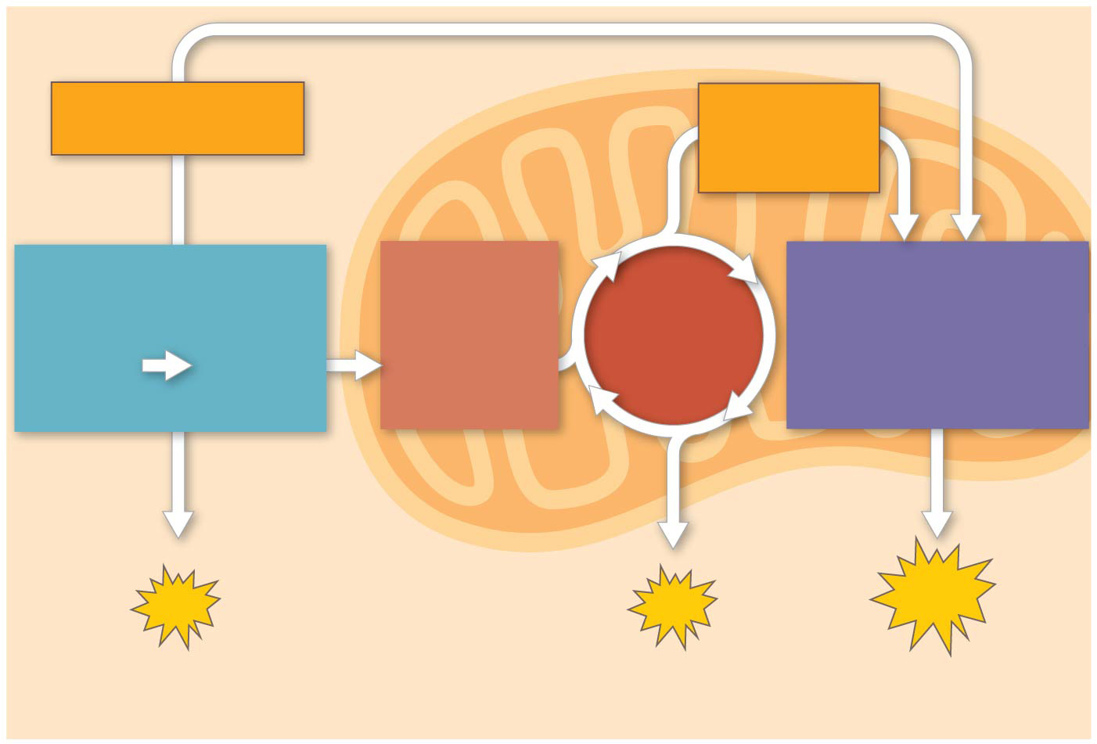
Figure 9.6-3
Electrons
via NADH
Electrons
via NADH
and FADH₂
GLYCOLYSIS
PYRUVATE
OXIDATION
OXIDATIVE
PHOSPHORYLATION
CITRIC
ACID
CYCLE
Glucose
Pyruvate
Acetyl CoA
(Electron transport
and chemiosmosis)
CYTOSOL
MITOCHONDRION
ATP
ATP
ATP
Substrate-level
Substrate-level
Oxidative
Notes:
Figure 9.6-3 An overview of cellular respiration (step 3)

Slide 16
Notes:
The complete reactions of cellular respiration in the presence of oxygen (C6H12O6 + 6 O2 → 6 CO2 + 6 H2O + energy) result in which of the following?
https://www.polleverywhere.com/multiple_choice_polls/PNMkDWKHP4dhH0v

Slide 17
Notes:
When a glucose molecule loses a hydrogen atom as the result of an oxidation-reduction reaction, the glucose molecule becomes
https://www.polleverywhere.com/multiple_choice_polls/S2x5d7Phsv0JAVJ

Slide 18
Notes:
The complete oxidation of glucose (C6H12O6) to carbon dioxide and water in aerobic respiration consumes how many molecules of oxygen (O2)?
https://www.polleverywhere.com/multiple_choice_polls/RmV7EhWhLdN4L3l

Slide 19
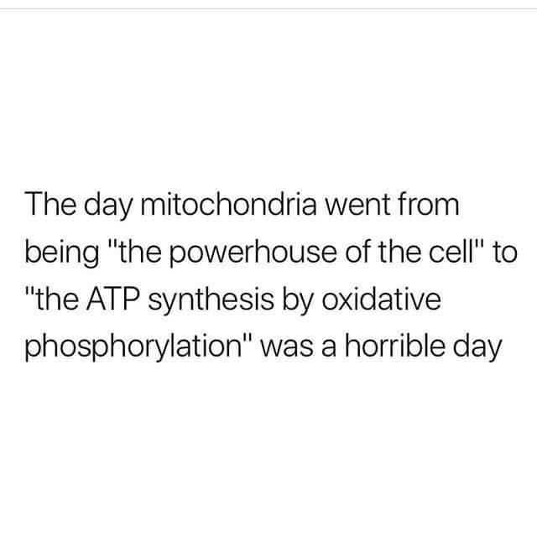
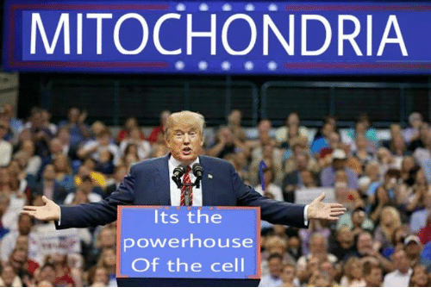

Slide 20
MITOCHONDRION
BEAUTIFUL
ON

Slide 21
Notes:
The complete oxidation of glucose in aerobic respiration occurs through which of the following sequence of metabolic reactions
https://www.polleverywhere.com/multiple_choice_polls/bIpB6XzuFe5wzIb

Slide 22
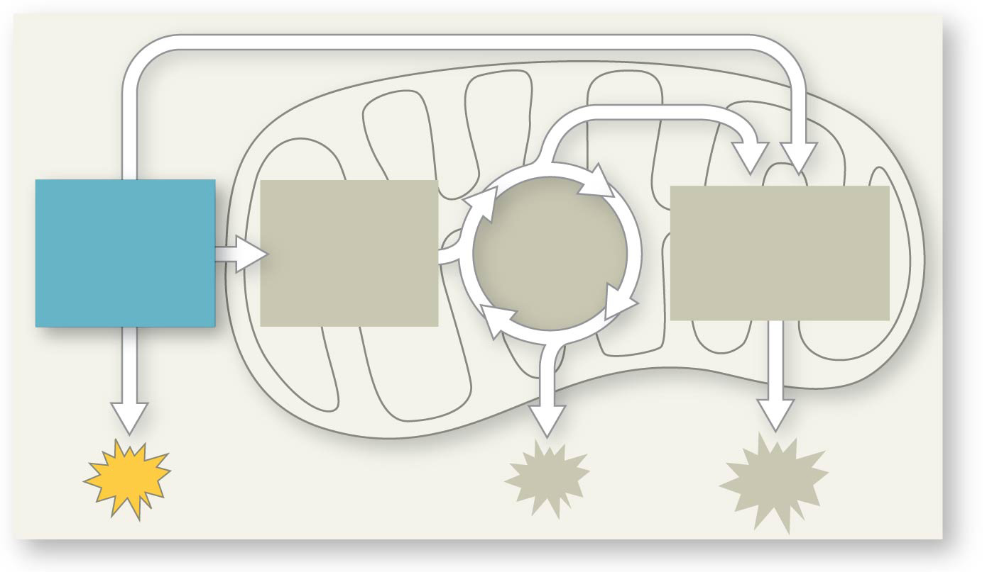
Figure 9.UN06
PYRUVATE
OXIDATION
CITRIC
ACID
CYCLE
OXIDATIVE
PHOSPHORYL-
ATION
GLYCOLYSIS
ATP
Notes:
Figure 9.UN06 In-text figure, mini-map, glycolysis, p. 168

Slide 23
Overview
Concept 9.1: Catabolic pathways yield energy by oxidizing organic fuels
Concept 9.2: Glycolysis harvests chemical energy by oxidizing glucose to pyruvate
Concept 9.3: After pyruvate is oxidized, the citric acid cycle completes the energy-yielding oxidation of organic molecules
Concept 9.4: During oxidative phosphorylation, chemiosmosis couples electron transport to ATP synthesis
Concept 9.5: Fermentation and anaerobic respiration enable cells to produce ATP WITHOUT the use of oxygen

Slide 24
Concept 9.2: Glycolysis harvests chemical energy by oxidizing glucose to pyruvate
Glycolysis (“sugar splitting”) breaks down glucose into two molecules of pyruvate in the CYTOSOL
Glycolysis occurs in the cytoplasm and has two major phases
Energy investment phase
Energy payoff phase
GLYCOLYSIS OCCURS WHETHER OR NOT O₂ IS PRESENT

Slide 25
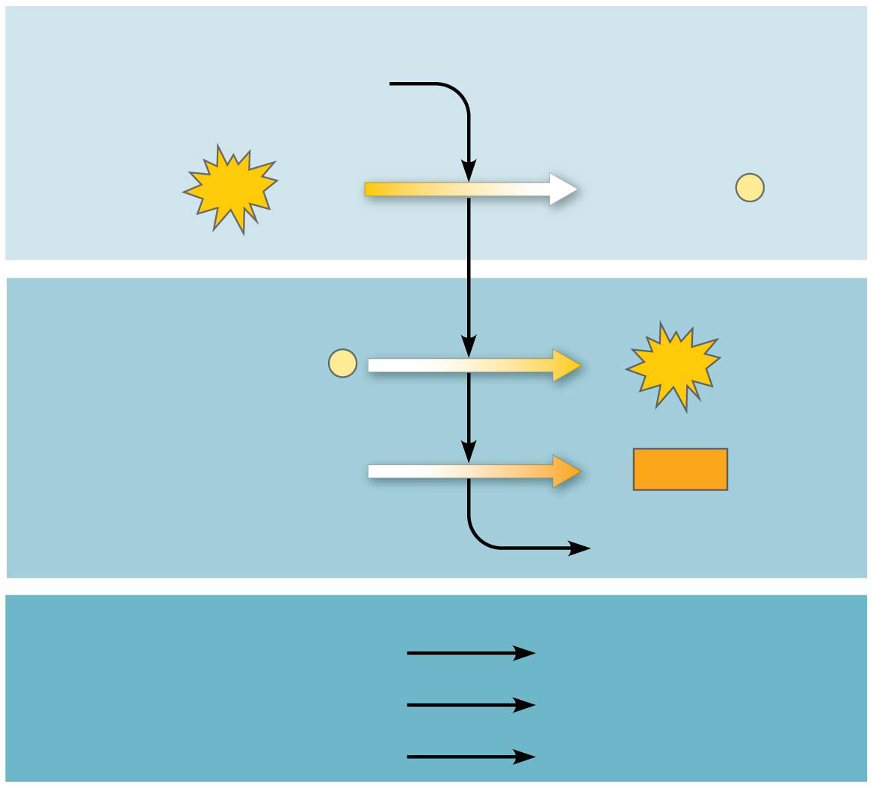
Figure 9.8
Energy Investment Phase
Glucose
2
ATP
used
2 ADP
+
2
P
Energy Payoff Phase
4
ADP
+
4
P
4
ATP
formed
2
NAD⁺
+
4 e⁻
+
4 H⁺
2
NADH
+
2 H⁺
2
Pyruvate
+
2
H₂O
Net
Glucose
2
Pyruvate
+
2
H₂O
4
ATP formed
−
2
ATP used
2
ATP
2
4
e⁻
4
H⁺
2
2 NAD⁺
+
+
NADH
+
2
H⁺
Notes:
Figure 9.8 The energy input and output of glycolysis

Slide 26
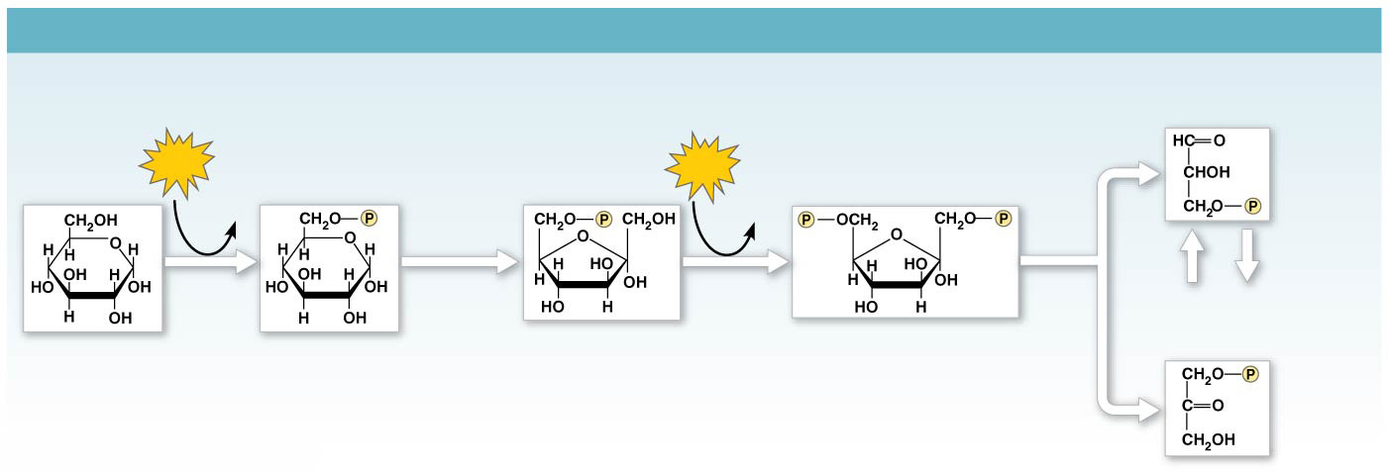
Figure 9.9a
GLYCOLYSIS: Energy Investment Phase
Glyceraldehyde
3-phosphate (G3P)
ATP
Glucose
6-phosphate
Fructose
6-phosphate
ATP
Fructose
1,6-bisphosphate
Glucose
ADP
ADP
Isomerase
Hexokinase
Phosphogluco-
isomerase
Phospho-
fructokinase
Aldolase
5
Dihydroxyacetone
phosphate (DHAP)
1
2
3
4
Notes:
Figure 9.9a A closer look at glycolysis (part 1: investment phase)

Slide 27
Figure 9.9b
GLYCOLYSIS: Energy Payoff Phase
2
ATP
2
2
ATP
2
NADH
H₂O
2
ADP
ADP
2 NAD⁺
+
2 H⁺
2
2
2
2
2
2
Triose
phosphate
dehydrogenase
Phospho-
glycerokinase
Phospho-
glyceromutase
Enolase
Pyruvate
kinase
2
9
7
8
10
Glycer-
aldehyde
3-phosphate
(G3P)
6
1,3-Bisphospho-
glycerate
3-Phospho-
glycerate
2-Phospho-
glycerate
Phosphoenol-
pyruvate (PEP)
Pyruvate
Notes:
Figure 9.9b A closer look at glycolysis (part 2: payoff phase)

Slide 28
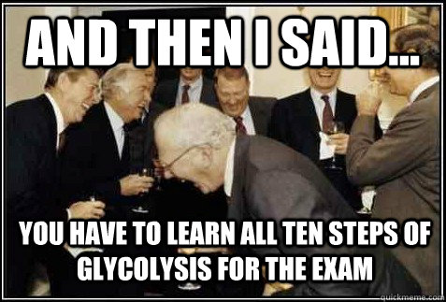

Slide 29
Figure 9.UN06
PYRUVATE
OXIDATION
CITRIC
ACID
CYCLE
OXIDATIVE
PHOSPHORYL-
ATION
GLYCOLYSIS
ATP
Notes:
Figure 9.UN06 In-text figure, mini-map, glycolysis, p. 168

Slide 30
Notes:
In animal cells, glycolysis occurs in the
https://www.polleverywhere.com/multiple_choice_polls/GZHvVCmOHXw5CcC

Slide 31
Notes:
In addition to ATP, what are the end products of glycolysis?
https://www.polleverywhere.com/multiple_choice_polls/KfF6iYUiexVmOXr

Slide 32
Notes:
In glycolysis, for each molecule of glucose oxidized to pyruvate,
https://www.polleverywhere.com/multiple_choice_polls/3iIoFJpHVpgaS2o

Slide 33
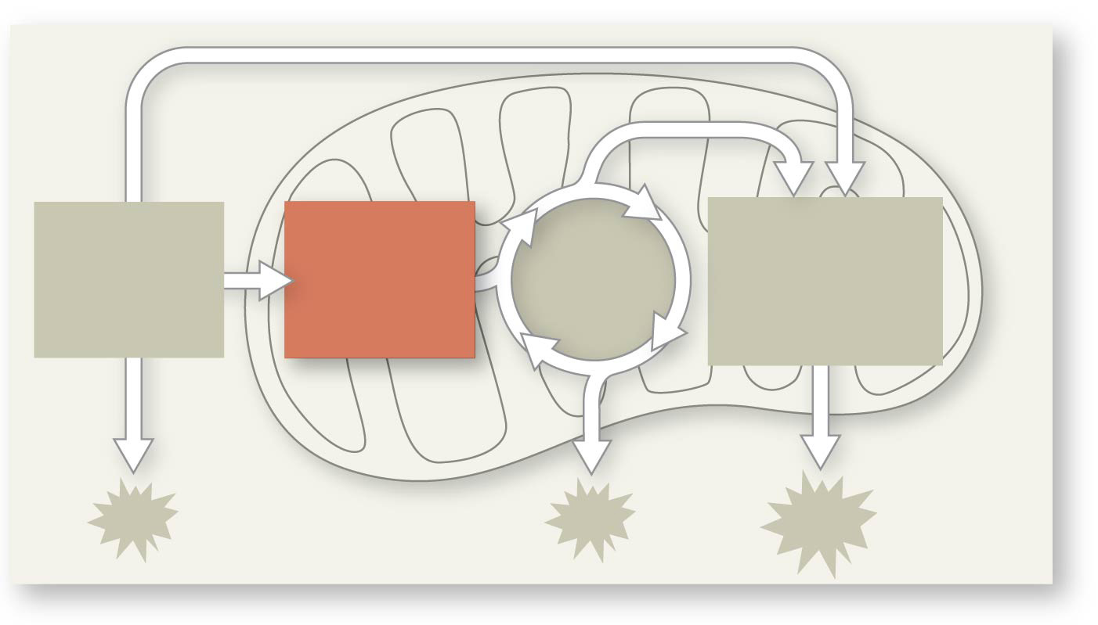
Figure 9.UN07
PYRUVATE
OXIDATION
CITRIC
ACID
CYCLE
OXIDATIVE
PHOSPHORYL-
ATION
GLYCOLYSIS
Notes:
Figure 9.UN07 In-text figure, mini-map, pyruvate oxidation, p. 169

Slide 34
Oxidation of Pyruvate to Acetyl CoA
In the presence of O₂, pyruvate ENTERS THE MITOCHONDRION (in eukaryotic cells) where the oxidation of glucose is completed
Before the citric acid cycle can begin, pyruvate must be CONVERTED to acetyl Coenzyme A (acetyl CoA), which links glycolysis to the citric acid cycle
This step is carried out by a multienzyme complex that catalyzes three reactions (PDH complex)

Slide 35
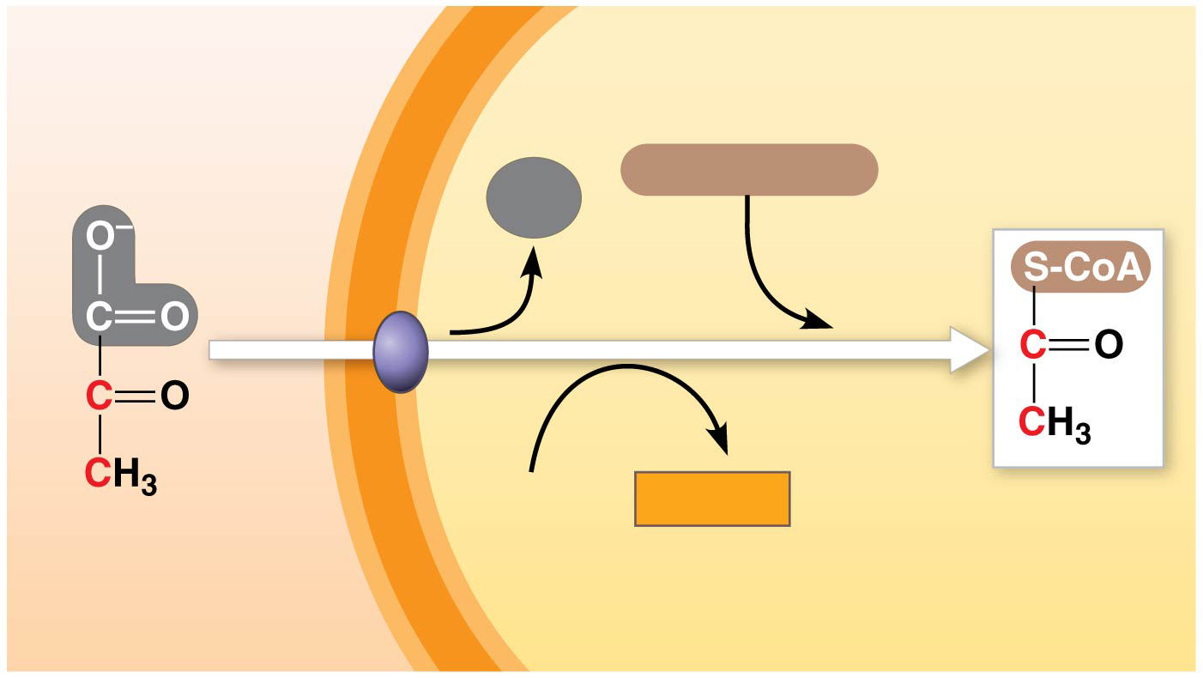
Figure 9.10
Oxidation of Pyruvate to Acetyl CoA
MITOCHONDRION
CYTOSOL
Coenzyme A
CO₂
1
3
2
NAD⁺
NADH
+
H⁺
Acetyl CoA
Pyruvate
Transport protein
(pyruvate translocase)
Notes:
Figure 9.10 Oxidation of pyruvate to acetyl CoA, the step before the citric acid cycle

Slide 36
Notes:
How many carbon atoms are fed into the citric acid cycle as a result of the oxidation of one molecule of pyruvate?
https://www.polleverywhere.com/multiple_choice_polls/X3cRBPlTKP2qblt

Slide 37
Figure 9.UN07
PYRUVATE
OXIDATION
CITRIC
ACID
CYCLE
OXIDATIVE
PHOSPHORYL-
ATION
GLYCOLYSIS
Notes:
Figure 9.UN07 In-text figure, mini-map, pyruvate oxidation, p. 169

Slide 38
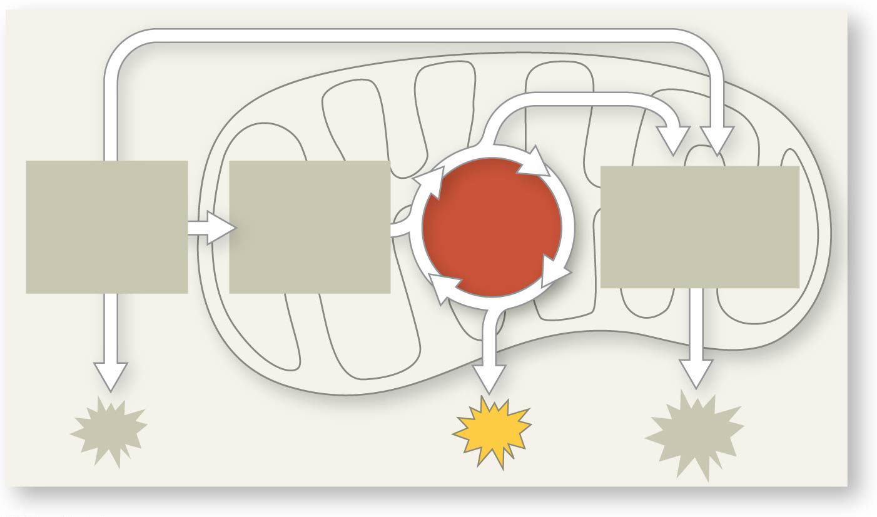
Figure 9.UN08
PYRUVATE
OXIDATION
CITRIC
ACID
CYCLE
OXIDATIVE
PHOSPHORYL-
ATION
GLYCOLYSIS
ATP
Notes:
Figure 9.UN08 In-text figure, mini-map, citric acid cycle, p. 171

Slide 39
Overview
Concept 9.1: Catabolic pathways yield energy by oxidizing organic fuels
Concept 9.2: Glycolysis harvests chemical energy by oxidizing glucose to pyruvate
Concept 9.3: After pyruvate is oxidized, the citric acid cycle completes the energy-yielding oxidation of organic molecules
Concept 9.4: During oxidative phosphorylation, chemiosmosis couples electron transport to ATP synthesis
Concept 9.5: Fermentation and anaerobic respiration enable cells to produce ATP WITHOUT the use of oxygen

Slide 40
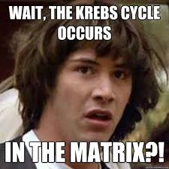
The Citric Acid Cycle
The citric acid cycle, also called the Krebs cycle, completes the break down of pyruvate to CO₂
The cycle oxidizes organic fuel derived from pyruvate, generating 1 ATP, 3 NADH, and 1 FADH₂ per turn IN THE MITOCHONDRIAL MATRIX

Slide 41
The Citric Acid Cycle
The citric acid cycle has eight steps, each catalyzed by a specific enzyme
The acetyl group of acetyl CoA joins the cycle by combining with oxaloacetate, forming CITRATE
The next seven steps decompose the citrate BACK TO OXALOACETATE, making the process a cycle
The NADH and FADH₂ produced by the cycle relay electrons extracted from fuel to the electron transport chain

Slide 42
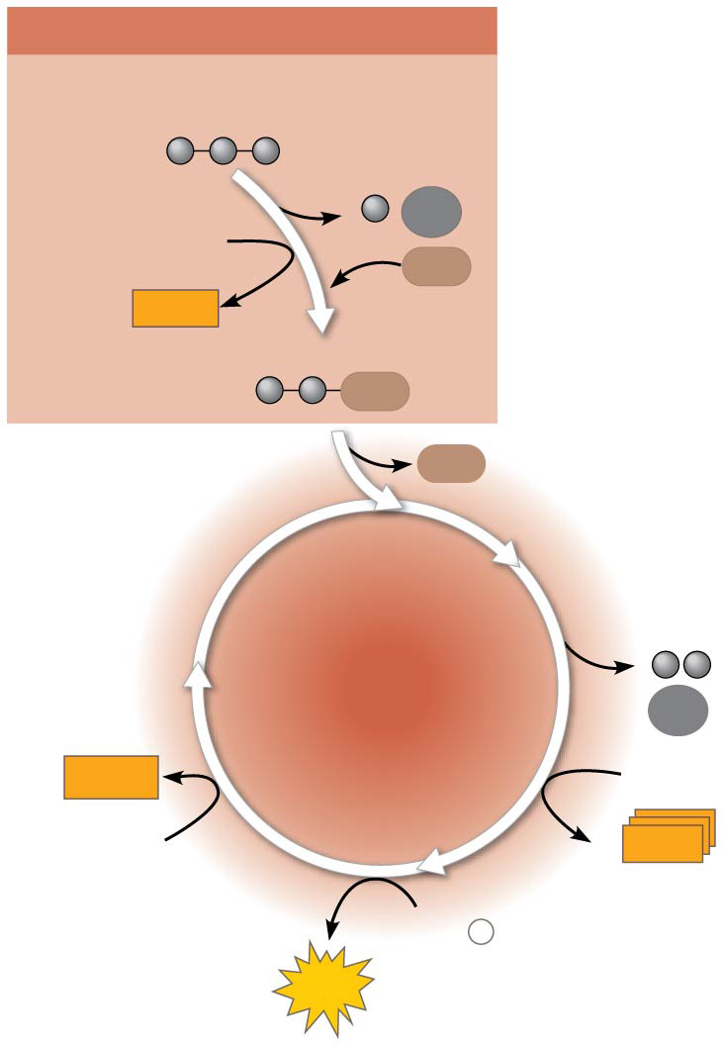
Figure 9.11
PYRUVATE OXIDATION
Pyruvate (from glycolysis,
2 molecules per glucose)
CO₂
NAD⁺
CoA
NADH
+ H⁺
Acetyl CoA
CoA
CoA
CITRIC
ACID
CYCLE
CO₂
2
FADH₂
3
NAD⁺
FAD
CoA
3
NADH
+
3 H⁺
ADP
+
P
i
ATP
Notes:
Figure 9.11 An overview of pyruvate oxidation and the citric acid cycle

Slide 43
PYRUVATE
OXIDATION
CITRIC
ACID
CYCLE
OXIDATIVE
PHOSPHORYL-
ATION
GLYCOLYSIS
ATP
Notes:
Figure 9.UN08 In-text figure, mini-map, citric acid cycle, p. 171

Slide 44
Notes:
Carbon dioxide (CO2) is released during which of the following stages of cellular respiration?
https://www.polleverywhere.com/multiple_choice_polls/wM9fNwkdsWuGv9t

Slide 45
Notes:
What fraction of the carbon dioxide exhaled by animals is generated by the reactions of the citric acid cycle, if glucose is the sole energy source?
https://www.polleverywhere.com/multiple_choice_polls/RkQiowvYnXNNxK2

Slide 46
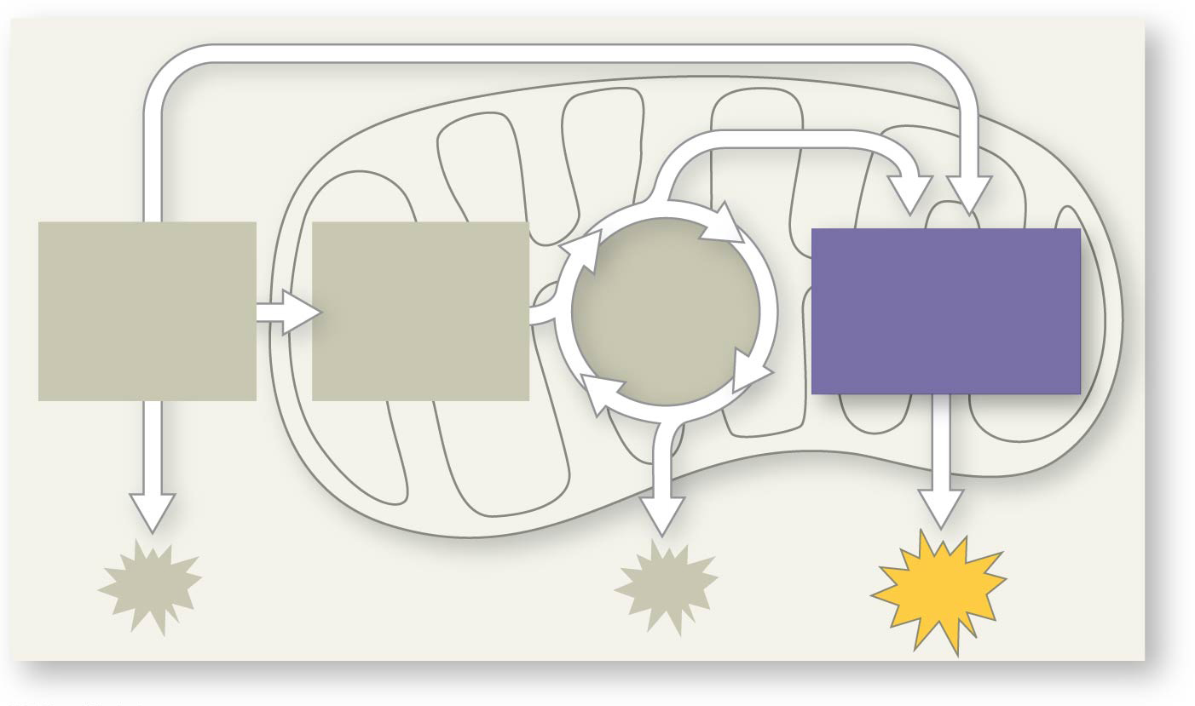
Figure 9.UN09
PYRUVATE
OXIDATION
CITRIC
ACID
CYCLE
OXIDATIVE
PHOSPHORYL-
ATION
GLYCOLYSIS
ATP
Notes:
Figure 9.UN09 In-text figure, mini-map, oxidative phosphorylation, p. 172

Slide 47
Overview
Concept 9.1: Catabolic pathways yield energy by oxidizing organic fuels
Concept 9.2: Glycolysis harvests chemical energy by oxidizing glucose to pyruvate
Concept 9.3: After pyruvate is oxidized, the citric acid cycle completes the energy-yielding oxidation of organic molecules
Concept 9.4: During oxidative phosphorylation, chemiosmosis couples electron transport to ATP synthesis
Concept 9.5: Fermentation and anaerobic respiration enable cells to produce ATP WITHOUT the use of oxygen

Slide 48
Concept 9.4: During oxidative phosphorylation, chemiosmosis couples electron transport to ATP synthesis
Following glycolysis and the citric acid cycle, NADH and FADH₂ account for most of the energy extracted from food
These two electron carriers donate electrons to the electron transport chain, which powers ATP synthesis via oxidative phosphorylation

Slide 49
The Pathway of Electron Transport
The electron transport chain is in the INNER MEMBRANE (CRISTAE) OF THE MITOCHONDRION
Most of the chain’s components are proteins, which exist in multiprotein complexes
The carriers alternate from reduced and oxidized states as they accept and donate electrons (REDOX!!!)
Electrons “drop” in free energy as they go “down” the chain and are finally passed to O₂, forming H₂O

Slide 50
The Pathway of Electron Transport
Electrons are TRANSFERRED from NADH or FADH₂ to the electron transport chain
Electrons are passed through a number of proteins including cytochromes (each with an iron atom) to O₂
The electron transport chain generates no ATP “directly”
It breaks the large free-energy drop from food to O₂ into smaller steps that release energy in manageable amounts

Slide 51
Chemiosmosis: The Energy-Coupling Mechanism
Electron transfer in the electron transport chain causes proteins to pump H⁺ FROM the mitochondrial matrix TO the intermembrane space
H+ then MOVES BACK ACROSS THE MEMBRANE, passing through the protein complex, ATP synthase
ATP synthase uses the exergonic flow of H⁺ to drive phosphorylation of ATP
This is an example of chemiosmosis, the use of energy in a H⁺ gradient to drive cellular work

Slide 52
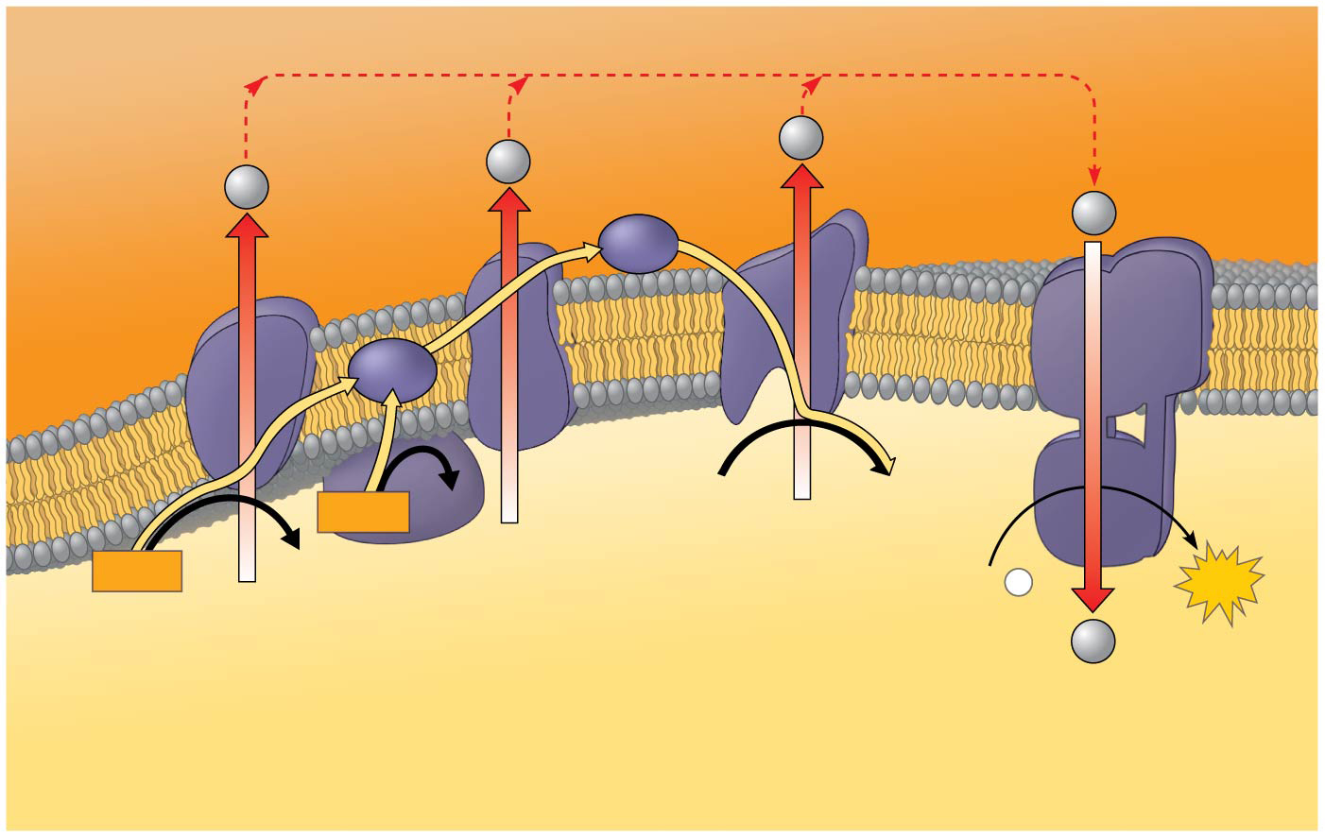
Figure 9.15
H⁺
ATP
synthase
Protein
complex
of electron
carriers
H⁺
H⁺
H⁺
Cyt c
Q
IV
I
III
II
2 H⁺ + ½ O₂
H₂O
FADH₂
FAD
NADH
NAD⁺
ADP
+
P
ATP
(carrying
electrons
from
food)
i
H⁺
1
Electron transport chain
2
Chemiosmosis
Oxidative phosphorylation
Notes:
Figure 9.15 Chemiosmosis couples the electron transport chain to ATP synthesis

Slide 53
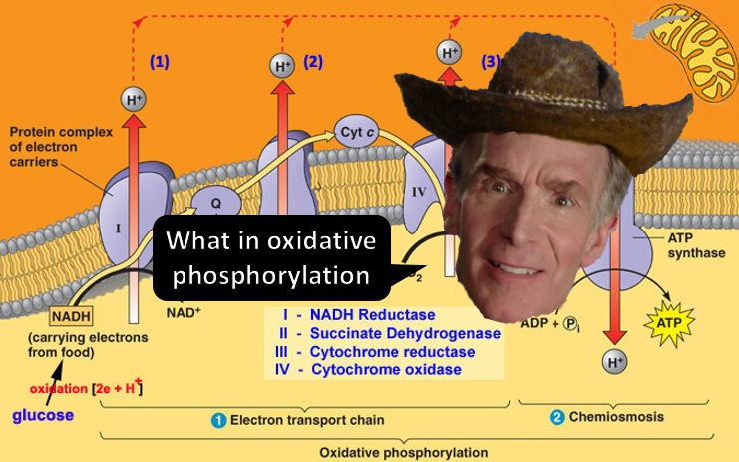
Notes:
Figure 9.15 Chemiosmosis couples the electron transport chain to ATP synthesis

Slide 54
Chemiosmosis: The Energy-Coupling Mechanism
The energy stored in a H⁺ gradient across a membrane couples the redox reactions of the electron transport chain to ATP synthesis
The H+ gradient is referred to as a proton-motive force, emphasizing its capacity to do work

Slide 55
PYRUVATE
OXIDATION
CITRIC
ACID
CYCLE
OXIDATIVE
PHOSPHORYL-
ATION
GLYCOLYSIS
ATP
Notes:
Figure 9.UN09 In-text figure, mini-map, oxidative phosphorylation, p. 172

Slide 56
Notes:
Where are the proteins of the electron transport chain located?
https://www.polleverywhere.com/multiple_choice_polls/qZvrqABqwu0bcaV

Slide 57
Notes:
The primary role of oxygen in cellular respiration is to
https://www.polleverywhere.com/multiple_choice_polls/oLvJmlq6NIA6UOI

Slide 58
Notes:
Inside an active mitochondrion, most electrons follow which pathway?
https://www.polleverywhere.com/multiple_choice_polls/29n5FH9xHem7RuN

Slide 59
Notes:
In chemiosmosis, what is the most direct source of energy that is used to convert ADP + ℗i to ATP?
https://www.polleverywhere.com/multiple_choice_polls/TE3T2YShlI0oSGc

Slide 60
The Stages of Cellular Respiration: RECAP
Harvesting of energy from glucose has FOUR stages
Glycolysis (breaks down glucose into two molecules of pyruvate)
Pyruvate oxidation (converts pyruvates into acetyl CoA’s)
The citric acid cycle (completes the breakdown of glucose)
Oxidative phosphorylation (accounts for most of the ATP synthesis)

Slide 61
WHAT ABOUT ALL THAT ATP?!

Slide 62
An Accounting of ATP Production by Cellular Respiration
During cellular respiration, most energy flows in this sequence:
glucose → NADH → electron transport chain → proton-motive force → ATP
About 34% of the energy in a glucose molecule is transferred to ATP during cellular respiration, making about 30-32 ATP

Slide 63
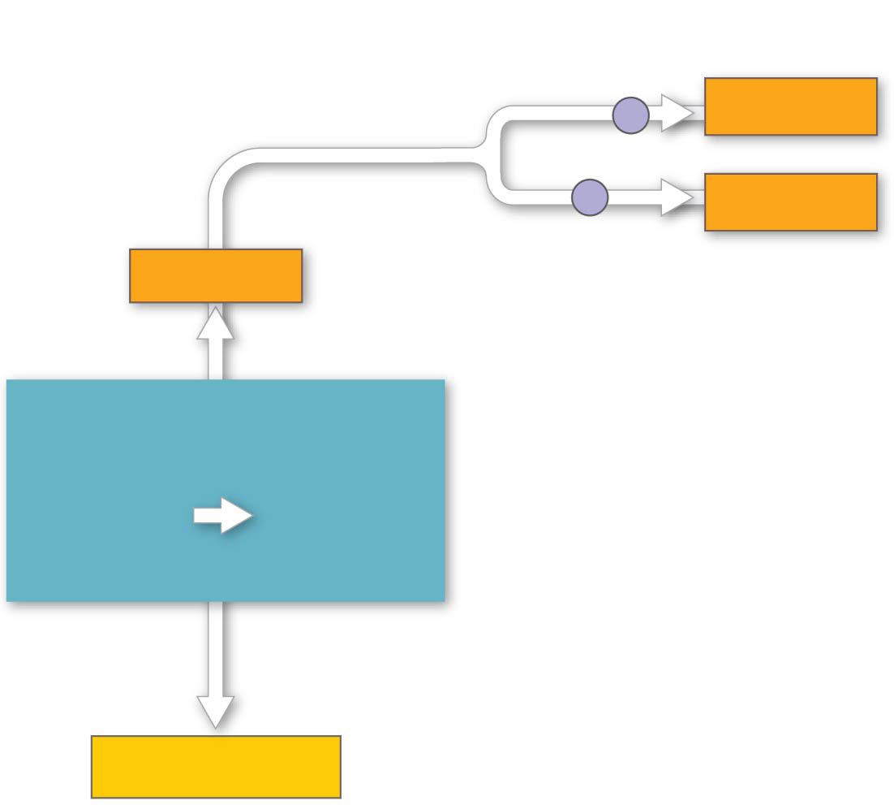
Figure 9.16a
Electron shuttles
span membrane
2 NADH
or
2 FADH₂
2 NADH
GLYCOLYSIS
Glucose
2
Pyruvate
+ 2 ATP
Notes:
Figure 9.16a ATP yield per molecule of glucose at each stage of cellular respiration (part 1: glycolysis)

Slide 64
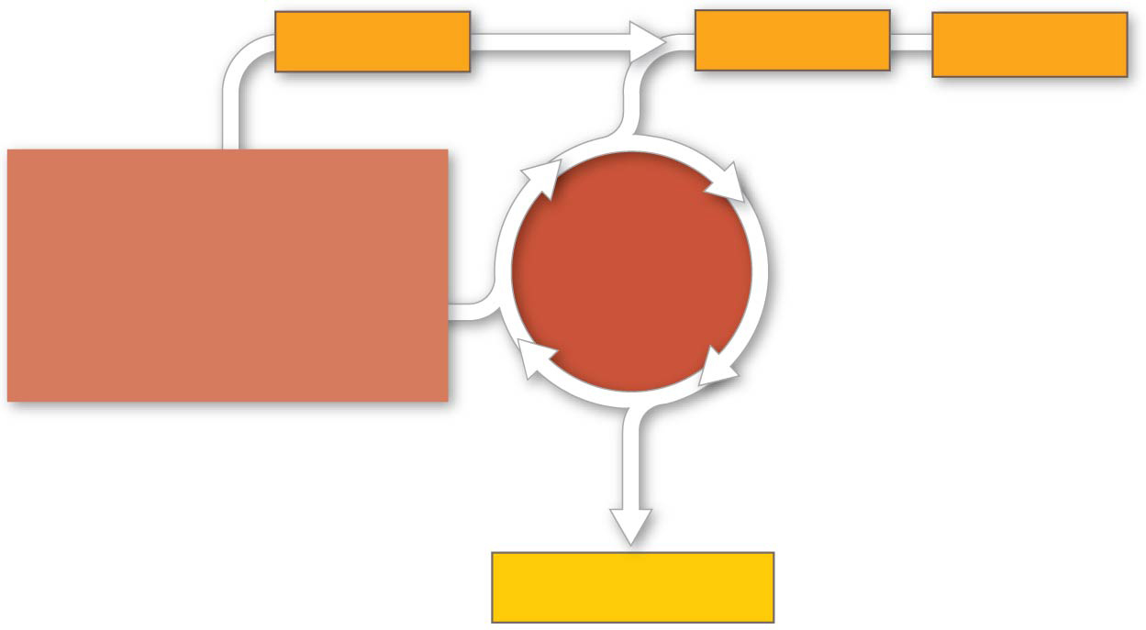
Figure 9.16b
2 NADH
6 NADH
2 FADH₂
PYRUVATE
OXIDATION
2 Acetyl CoA
CITRIC
ACID
CYCLE
+ 2 ATP
Notes:
Figure 9.16b ATP yield per molecule of glucose at each stage of cellular respiration (part 2: citric acid cycle)

Slide 65
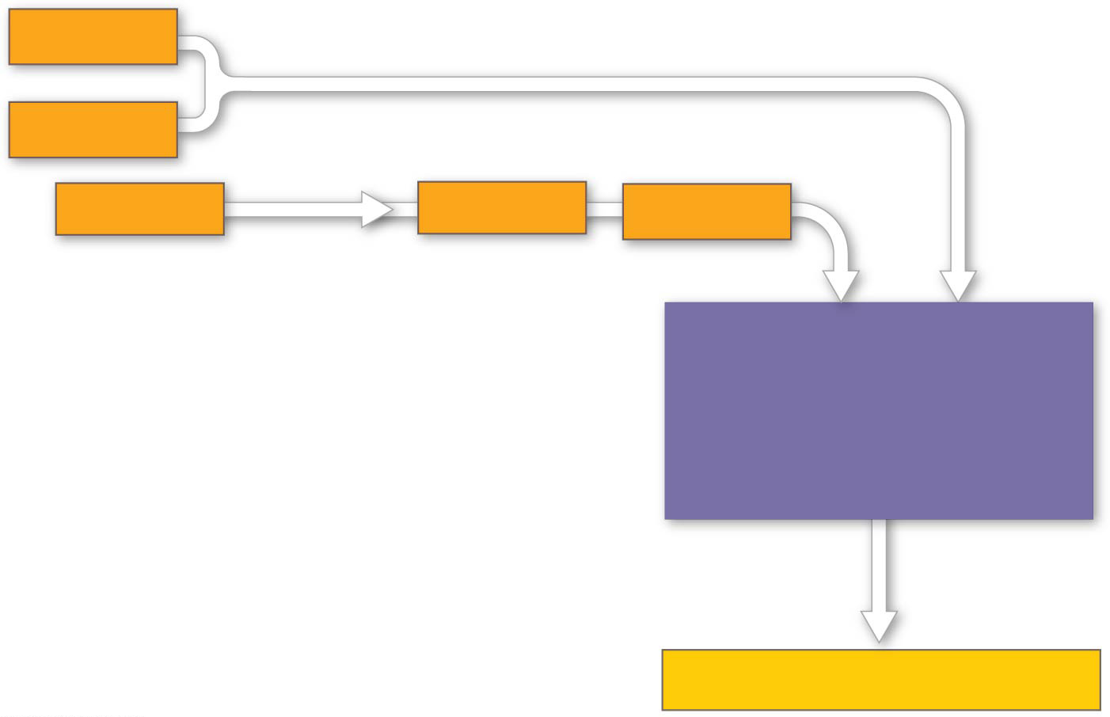
Figure 9.16c
2 NADH
or
2 FADH₂
2 NADH
6 NADH
2 FADH₂
OXIDATIVE
PHOSPHORYLATION
(Electron transport
and chemiosmosis)
+ about 26 or 28 ATP
Notes:
Figure 9.16c ATP yield per molecule of glucose at each stage of cellular respiration (part 3: oxidative phosphorylation)

Slide 66
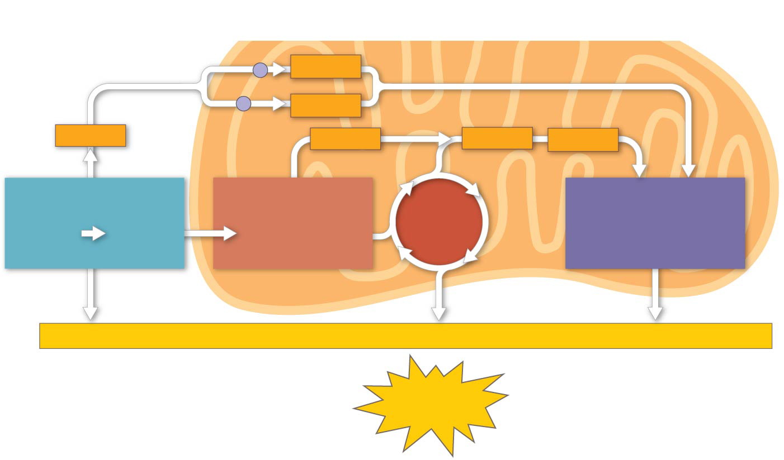
Figure 9.16
Electron shuttles
span membrane
CYTOSOL
2 NADH
MITOCHONDRION
or
2 FADH₂
2 NADH
2 NADH
6 NADH
2 FADH₂
GLYCOLYSIS
PYRUVATE
OXIDATION
2 Acetyl CoA
CITRIC
ACID
CYCLE
OXIDATIVE
PHOSPHORYLATION
(Electron transport
and chemiosmosis)
Glucose
2
Pyruvate
+ 2 ATP
+ 2 ATP
+ about 26 or 28 ATP
Maximum per glucose:
About
30 or 32 ATP
Notes:
Figure 9.16 ATP yield per molecule of glucose at each stage of cellular respiration

Slide 67
Overview
Concept 9.1: Catabolic pathways yield energy by oxidizing organic fuels
Concept 9.2: Glycolysis harvests chemical energy by oxidizing glucose to pyruvate
Concept 9.3: After pyruvate is oxidized, the citric acid cycle completes the energy-yielding oxidation of organic molecules
Concept 9.4: During oxidative phosphorylation, chemiosmosis couples electron transport to ATP synthesis
Concept 9.5: Fermentation and anaerobic respiration enable cells to produce ATP WITHOUT the use of oxygen

Slide 68
Concept 9.5: Fermentation and anaerobic respiration enable cells to produce ATP WITHOUT the use of oxygen
Most cellular respiration requires O₂ to produce ATP
Without O₂, the electron transport chain will cease to operate
O₂ = TERMINAL ELECTRON ACCEPTOR
In that case, glycolysis couples with anaerobic respiration or fermentation to produce ATP

Slide 69
Types of Fermentation
Fermentation uses substrate-level phosphorylation instead of an electron transport chain to generate ATP
Fermentation consists of glycolysis plus reactions that regenerate NAD⁺, which can be reused by glycolysis
Two common types:
Alcohol fermentation (pyruvate → ethanol + CO2)
Lactic acid fermentation (pyruvate → lactate)

Slide 70
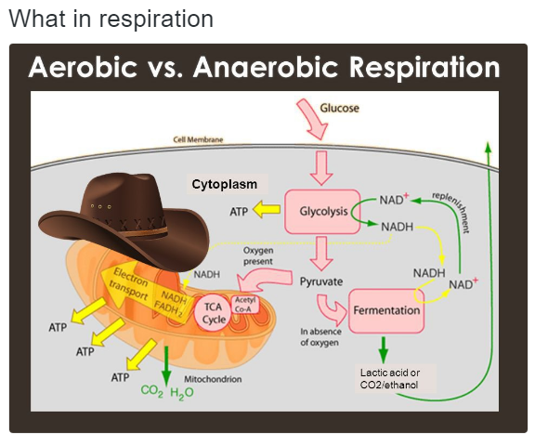
Comparing Fermentation and Aerobic Respiration
Cellular respiration produces ~30-32 ATP per glucose molecule; fermentation produces 2 ATP per glucose molecule

Slide 71
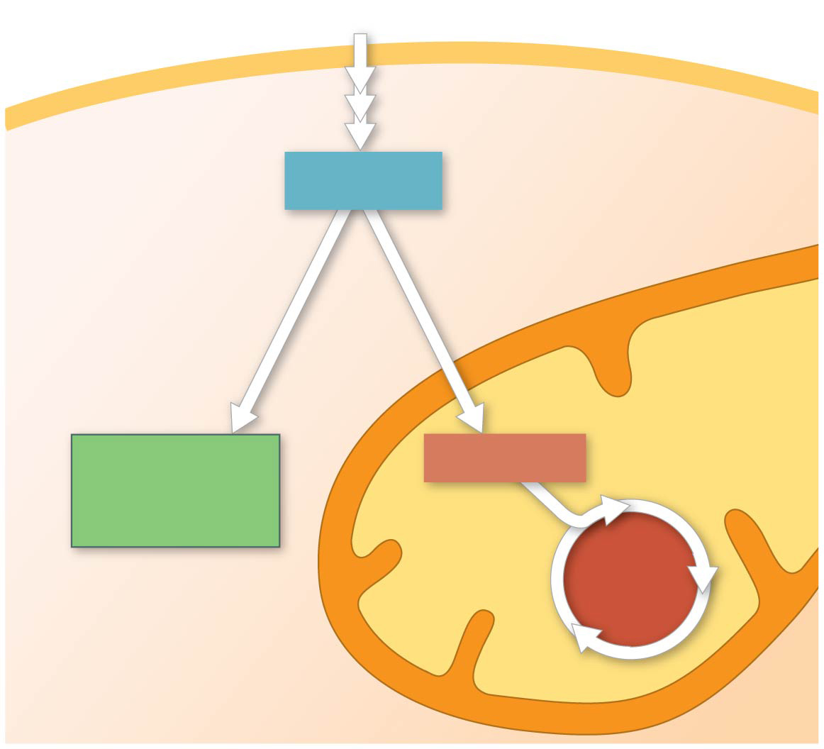
Figure 9.18
Glucose
Glycolysis
CYTOSOL
Pyruvate
No O₂ present:
Fermentation
O₂ present:
Aerobic cellular
respiration
MITOCHONDRION
Ethanol,
lactate, or
other products
Acetyl CoA
CITRIC
ACID
CYCLE
Notes:
Figure 9.18 Pyruvate as a key juncture in catabolism

Slide 72
Notes:
Which of the following normally occurs regardless of whether or not oxygen (O2) is present?
https://www.polleverywhere.com/multiple_choice_polls/QwY05FV8B8UoMco

Slide 73
Notes:
Which of the following occurs in the cytosol of a eukaryotic cell?
https://www.polleverywhere.com/multiple_choice_polls/xffN4HqdGoRiAar

Slide 74
Overview
Concept 9.1: Catabolic pathways yield energy by oxidizing organic fuels
Concept 9.2: Glycolysis harvests chemical energy by oxidizing glucose to pyruvate
Concept 9.3: After pyruvate is oxidized, the citric acid cycle completes the energy-yielding oxidation of organic molecules
Concept 9.4: During oxidative phosphorylation, chemiosmosis couples electron transport to ATP synthesis
Concept 9.5: Fermentation and anaerobic respiration enable cells to produce ATP WITHOUT the use of oxygen

Slide 75
YOU MUST KNOW
INPUTS + OUTPUTS OF MAJOR STEPS
CELLULAR LOCATIONS OF MAJOR STEPS
DO NOT MEMORIZE ENZYMES AND/OR MOLECULAR STRUCTURES/NAMES

Slide 76
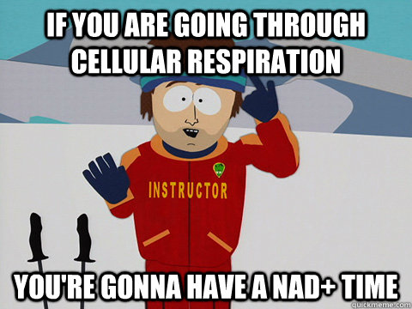
The next three slides further explain the role of NAD+ in cell respiration further

Slide 77
Stepwise Energy Harvest via NAD⁺ and the Electron Transport Chain
Electrons from organic compounds are usually first transferred to NAD⁺, a coenzyme
As an electron ACCEPTOR, NAD⁺ functions as an OXIDIZING AGENT (gets reduced, gains electrons!) during cellular respiration
Each NADH (the reduced form of NAD⁺) represents stored energy that is tapped to synthesize ATP

Slide 78
Figure 9.UN04
Dehydrogenase
Notes:
Figure 9.UN04 In-text figure, dehydrogenase reaction, p. 165

Slide 79
Stepwise Energy Harvest via NAD⁺ and the Electron Transport Chain
NADH passes the electrons to the electron transport chain
Unlike an uncontrolled reaction, the electron transport chain passes electrons in a SERIES OF STEPS instead of one explosive reaction
O₂ pulls electrons down the chain in an energy-yielding tumble
The energy yielded is used to regenerate ATP

Slide 80
Animation: Cellular Respiration

