Slide 1
0
10
Photosynthesis

Slide 2
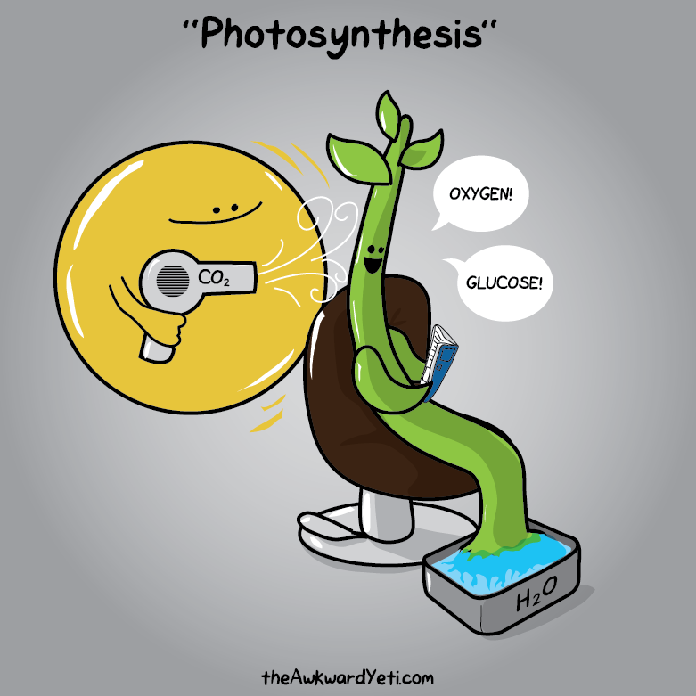
YOU MUST KNOW
INPUTS + OUTPUTS OF MAJOR STEPS
CELLULAR LOCATIONS OF MAJOR STEPS
DO NOT MEMORIZE ENZYMES AND/OR MOLECULAR STRUCTURES/NAMES

Slide 3
The Process That Feeds the Biosphere
Photosynthesis is the process that converts solar energy into chemical energy
Directly or indirectly, photosynthesis nourishes almost the entire living world

Slide 4
The Process That Feeds the Biosphere
Autotrophs sustain themselves without eating anything derived from other organisms
Autotrophs are the PRODUCERS of the biosphere, producing organic molecules from CO₂ and other inorganic molecules
Almost all plants are photoautotrophs, using the energy of sunlight to make organic molecules

Slide 5
The Process That Feeds the Biosphere
Heterotrophs obtain their organic material from other organisms
Heterotrophs are the CONSUMERS of the biosphere
Almost all heterotrophs, including humans, depend on photoautotrophs for food and O₂

Slide 6
Overview
Concept 10.1: Photosynthesis converts light energy to the chemical energy of food
Concept 10.2: The light reactions CONVERT solar energy to the chemical energy of ATP and NADPH
Concept 10.3: The Calvin cycle uses the chemical energy of ATP and NADPH to reduce CO₂ to sugar

Slide 7
Overview
Concept 10.1: Photosynthesis converts light energy to the chemical energy of food
Concept 10.2: The light reactions CONVERT solar energy to the chemical energy of ATP and NADPH
Concept 10.3: The Calvin cycle uses the chemical energy of ATP and NADPH to reduce CO₂ to sugar

Slide 8
Concept 10.1: Photosynthesis converts light energy to the chemical energy of food
Chloroplasts are structurally similar to and likely evolved from photosynthetic bacteria
The structural organization of these organelles allows for the chemical reactions of photosynthesis (form + function!!!)

Slide 9
Chloroplasts: The Sites of Photosynthesis in Plants
Leaves are the major locations of photosynthesis
Chloroplasts are found mainly in cells of the mesophyll, the interior tissue of the leaf
Each mesophyll cell contains 30–40 chloroplasts
CO₂ enters and O₂ exits the leaf through microscopic pores called stomata

Slide 10
Chloroplasts: The Sites of Photosynthesis in Plants
A chloroplast has an envelope of two membranes surrounding a dense fluid called the stroma
Thylakoids are connected sacs in the chloroplast which compose a third membrane system
Thylakoids may be stacked in columns called grana
Chlorophyll, the pigment which gives leaves their green color, resides in the thylakoid membranes

Slide 11
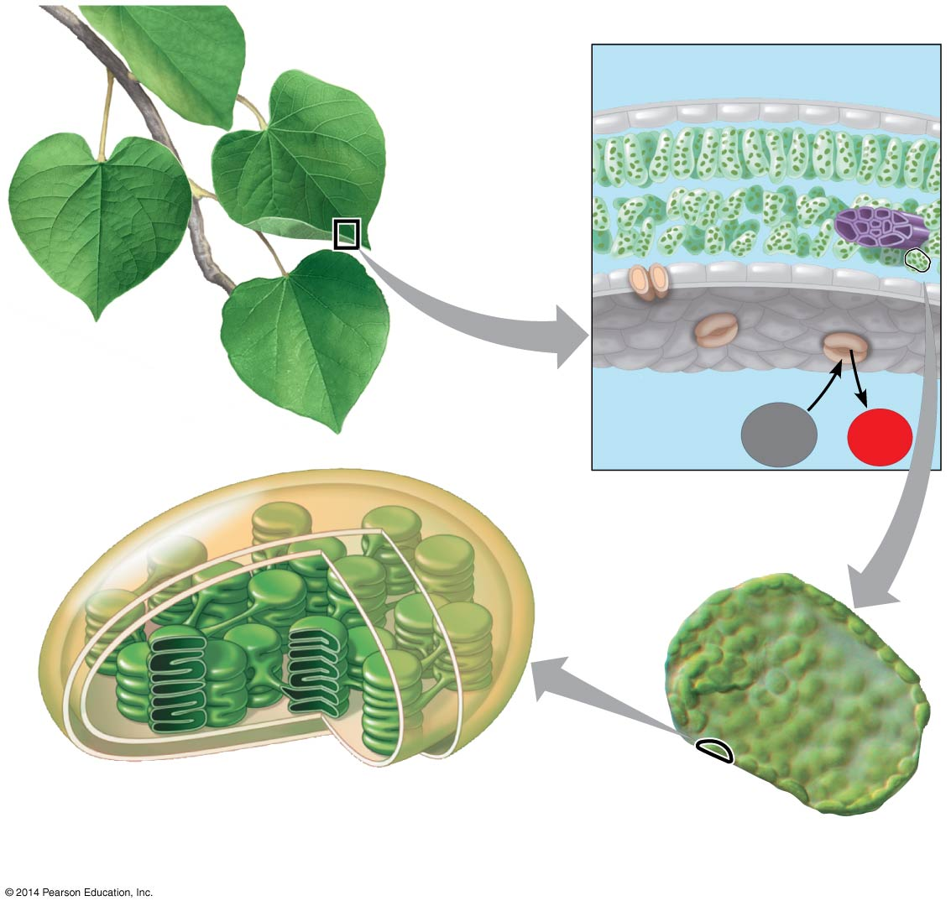
Figure 10.4a
Leaf cross section
Chloroplasts
Vein
Mesophyll
Stomata
CO₂
O₂
Chloroplast
Mesophyll
cell
20 μm
Notes:
Figure 10.4a Zooming in on the location of photosynthesis in a plant (part 1: detail of art)

Slide 12
Tracking Atoms Through Photosynthesis
Photosynthesis is a complex series of reactions that can be summarized as the following equation:
6 CO₂ + 12 H₂O + Light energy → C₆H₁₂O₆ + 6 O₂ + 6 H₂O
The overall chemical change during photosynthesis is the REVERSE of the one that occurs during cellular respiration
Chloroplasts SPLIT H₂O into hydrogen and oxygen, incorporating the electrons of hydrogen into sugar molecules and RELEASING OXYGEN as a by-product

Slide 13
Figure 10.5
Tracking Atoms Through Photosynthesis
Reactants:
6 CO₂
12 H₂O
Products:
C₆H₁₂O₆
6 H₂O
6 O₂
Notes:
Figure 10.5 Tracking atoms through photosynthesis

Slide 14
Photosynthesis as a Redox Process
Photosynthesis reverses the direction of electron flow compared to respiration
Photosynthesis is a REDOX PROCESS (OIL RIG)
H₂O is oxidized (loses electrons)
CO₂ is reduced (gains electrons)
Photosynthesis is an ENDERGONIC process
How can it happen so often by so many plants?
The energy “boost” is provided by LIGHT

Slide 15
Figure 10.UN01
Photosynthesis as a Redox Process
becomes reduced
becomes oxidized
Notes:
Figure 10.UN01 In-text figure, photosynthesis equation, p. 189

Slide 16
The Two Stages of Photosynthesis: A Preview
Photosynthesis consists of:
The LIGHT REACTIONS (the photo part) in the THYLAKOIDS
(thy-light-koids)
The CALVIN CYCLE (the synthesis part) in the STROMA
(strom-alvin cycle)

Slide 17
Notes:
Which of the following are products of the light reactions of photosynthesis that are utilized in the Calvin cycle?
https://www.polleverywhere.com/multiple_choice_polls/iRDAeHG9UCgtLpO

Slide 18
Notes:
Which of the following statements is a correct distinction between autotrophs and heterotrophs?
https://www.polleverywhere.com/multiple_choice_polls/A2Kz0nBDpF4gp1A

Slide 19
Overview
Concept 10.1: Photosynthesis converts light energy to the chemical energy of food
Concept 10.2: The light reactions CONVERT solar energy to the chemical energy of ATP and NADPH
Concept 10.3: The Calvin cycle uses the chemical energy of ATP and NADPH to reduce CO₂ to sugar

Slide 20
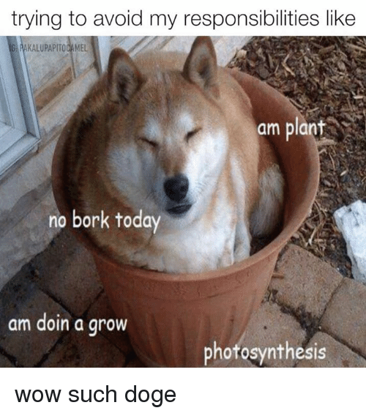
Concept 10.2: The light reactions CONVERT solar energy to the chemical energy of ATP and NADPH
Chloroplasts are solar-powered chemical factories
Their thylakoids transform light energy into the chemical energy of ATP and NADPH (WOW!!!)

Slide 21
Concept 10.2: The light reactions CONVERT solar energy to the chemical energy of ATP and NADPH
Visible light consists of wavelengths (including those that drive photosynthesis) that produce colors we can see
Light behaves as though it consists of discrete particles, called photons

Slide 22
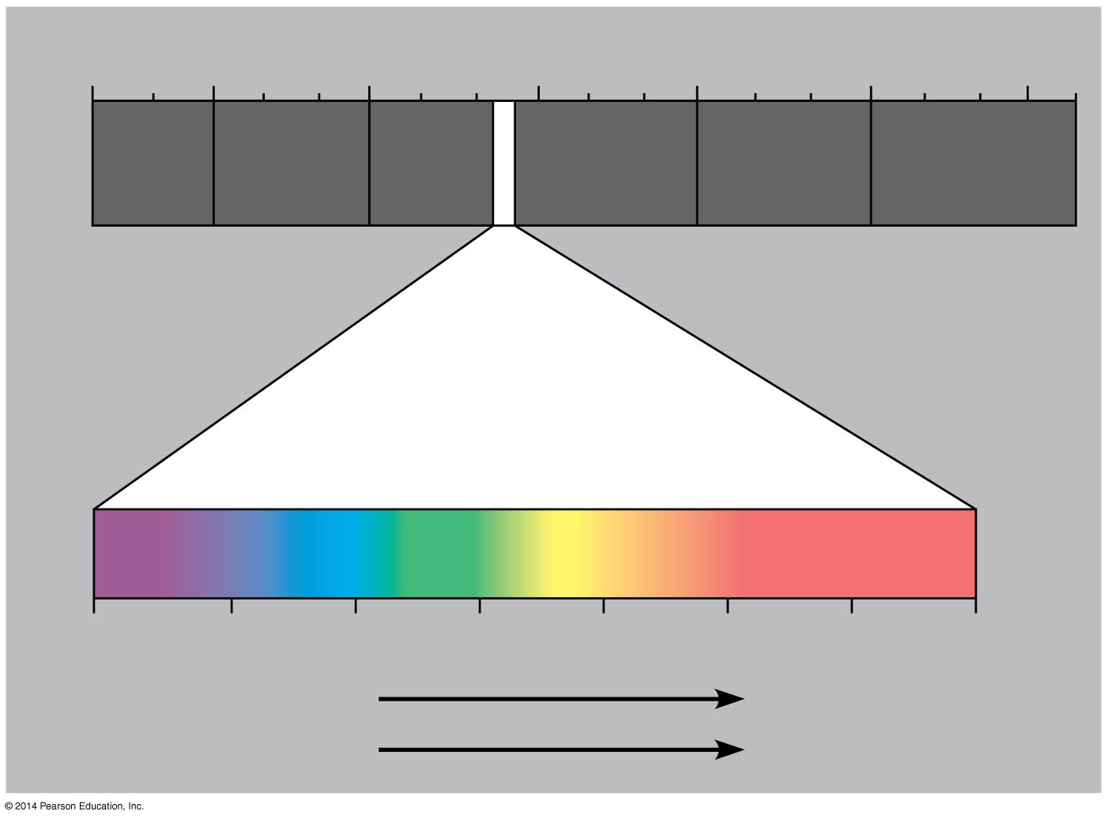
Figure 10.7
1 m
10⁻
nm
10⁻
nm
1 nm
10
nm
10
nm
(10
nm)
10
m
⁵
³
³
⁶
⁹
³
Gamma
rays
Micro-
waves
Radio
waves
X-rays
UV
Infrared
Visible light
380
450
500
550
600
650
700
750
nm
Shorter wavelength
Longer wavelength
Higher energy
Lower energy
Notes:
Figure 10.7 The electromagnetic spectrum

Slide 23
Photosynthetic Pigments: The Light Receptors
Pigments are substances that ABSORB visible light
Different pigments absorb different wavelengths
Wavelengths that are NOT absorbed are reflected or transmitted
Leaves appear green because chlorophyll REFLECTS AND TRANSMITS GREEN LIGHT

Slide 24
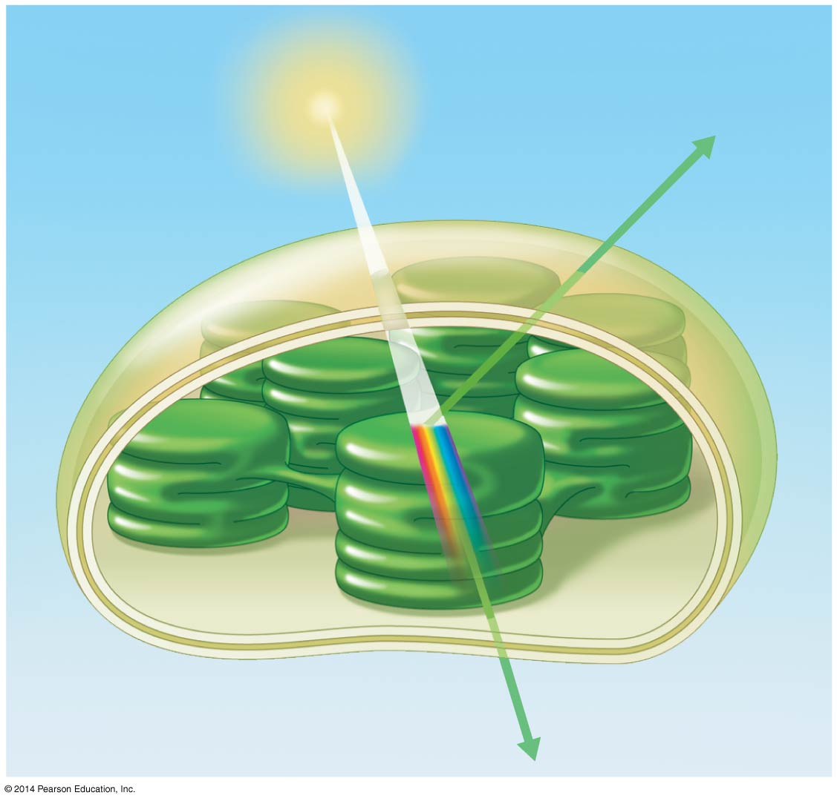
Figure 10.8
Light
Reflected
light
Chloroplast
Absorbed
light
Granum
Transmitted
light
Notes:
Figure 10.8 Why leaves are green: interaction of light with chloroplasts

Slide 25
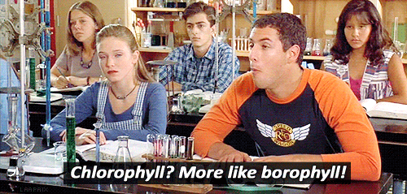
Photosynthetic Pigments: The Light Receptors
Chlorophyll a is the main photosynthetic pigment
Accessory pigments, such as chlorophyll b, broaden the spectrum used for photosynthesis
Accessory pigments called carotenoids function in photoprotection; they absorb excessive light that would damage chlorophyll

Slide 26
Excitation of Chlorophyll by Light
When a pigment absorbs light, it goes from a GROUND STATE → EXCITED STATE
This is unstable!!! Needs to be “accepted” by something!

Slide 27
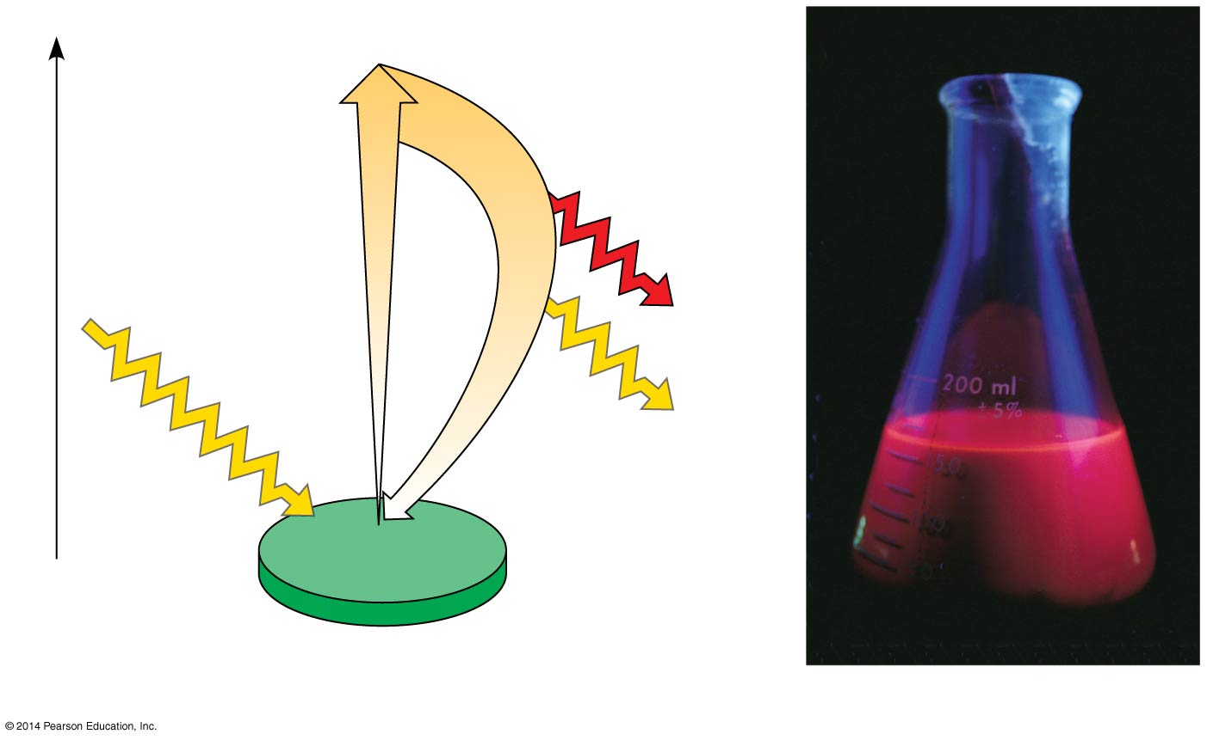
Figure 10.12
AHHH! NEED TO ACCEPT!
Excited
state
e⁻
Heat
Energy of electron
Photon
(fluorescence)
Photon
Ground
state
Chlorophyll
molecule
(a) Excitation of isolated chlorophyll molecule
(b) Fluorescence
Notes:
Figure 10.12 Excitation of isolated chlorophyll by light

Slide 28
A Photosystem: A Reaction-Center Complex Associated with Light-Harvesting Complexes
A photosystem consists of a reaction-center complex (a type of protein complex) surrounded by light-harvesting complexes
The light-harvesting complexes (pigment molecules bound to proteins) transfer the energy of photons to the reaction center

Slide 29
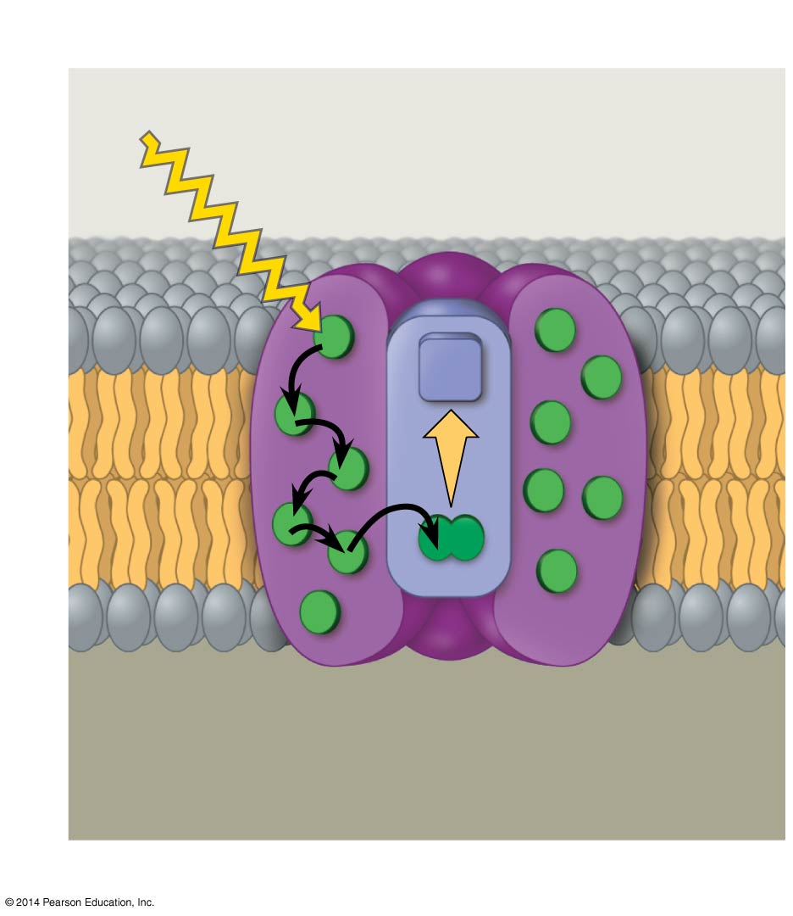
Figure 10.13a
Photosystem
Light-
harvesting
complexes
Reaction-
center
complex
STROMA
Photon
Primary
electron
acceptor
e⁻
Thylakoid membrane
Transfer
of energy
Special pair of chloro-
phyll a molecules
Pigment
molecules
THYLAKOID SPACE
(INTERIOR OF THYLAKOID)
(a) How a photosystem harvests light
Notes:
Figure 10.13a The structure and function of a photosystem (part 1: function)

Slide 30
Photosystems Overview
Solar-powered transfer of an electron from a chlorophyll a molecule to the primary electron acceptor is the FIRST STEP of the light reactions
A primary electron acceptor in the reaction center accepts excited electrons and is REDUCED as a result (RIG)

Slide 31
Photosystems Overview
There are two types of photosystems in the thylakoid membrane
Photosystem II (PS II) functions FIRST (the numbers reflect order of discovery) and is best at absorbing a wavelength of 680 nm
The reaction-center chlorophyll a of PS II is called P680

Slide 32
Photosystems Overview
Photosystem I (PS I) is best at absorbing a wavelength of 700 nm
The reaction-center chlorophyll a of PS I is called P700

Slide 33
Types of Electron Flow
During the LIGHT REACTIONS, there are two possible routes for electron flow
Linear Electron Flow
Cyclic Electron Flow

Slide 34
Types of Electron Flow
During the LIGHT REACTIONS, there are two possible routes for electron flow
Linear Electron Flow
Cyclic Electron Flow

Slide 35
Linear Electron Flow
Linear electron flow, the primary pathway, involves BOTH PHOTOSYSTEMS
Produces ATP and NADPH using light energy

Slide 36
Linear Electron Flow
There are 8 steps in linear electron flow:
A photon hits a pigment and its energy excites P680 (aka PSII)
An excited electron from P680 is transferred to the primary electron acceptor (we now call it [angry] P680⁺)
H₂O is split by enzymes, and the electrons are transferred from the hydrogen atoms to P680⁺, thus reducing it back to [happy] P680 (original state)
P680⁺ is the strongest known biological oxidizing agent
O₂ IS RELEASED AS A BY-PRODUCT OF THIS REACTION!!! THANK YOU P680!
Notes:
OEC

Slide 37
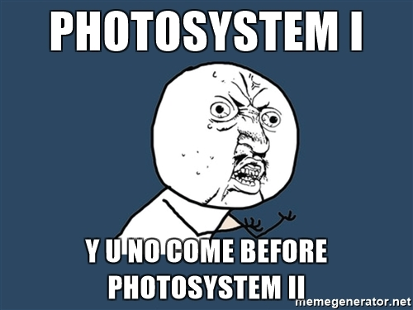
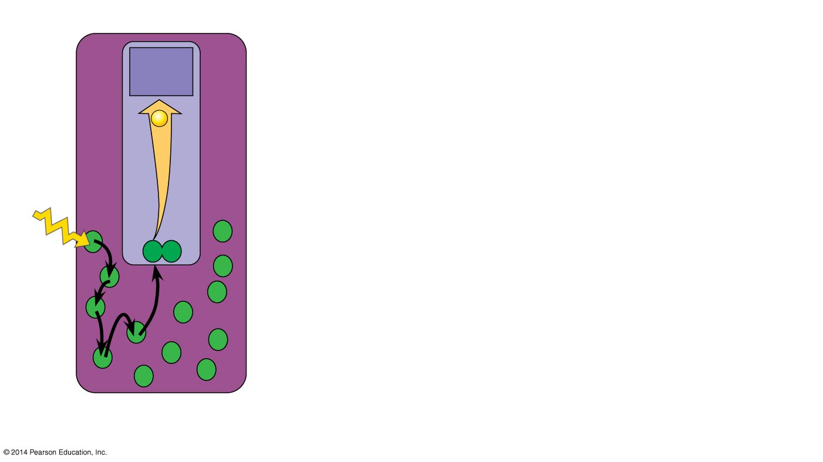
Figure 10.14-1
Primary
acceptor
e⁻
2
1
P680
Light
Pigment
molecules
Photosystem II
(PS II)
Notes:
Figure 10.14-1 How linear electron flow during the light reactions generates ATP and NADPH (step 1)

Slide 38
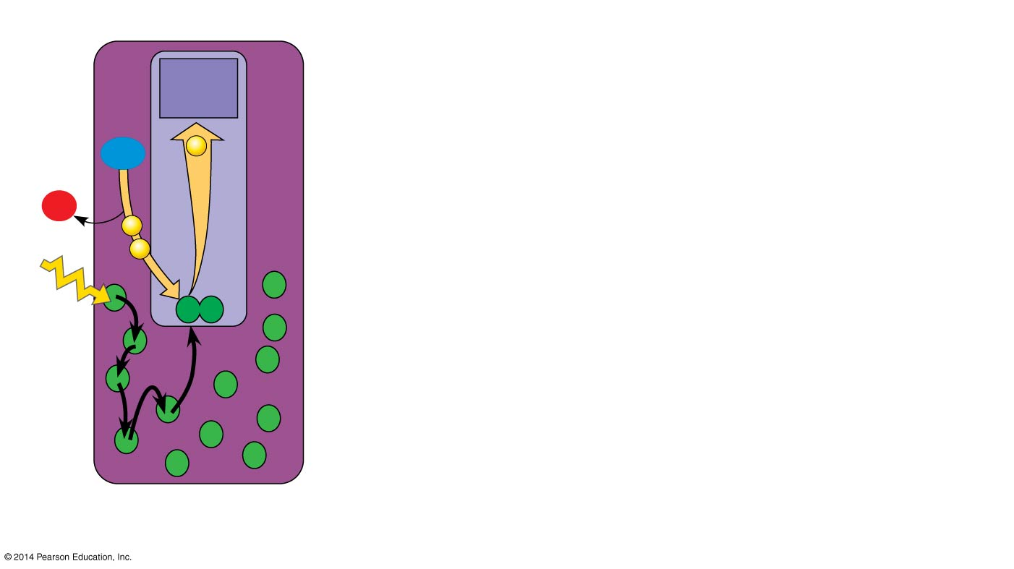
Figure 10.14-2
OMG! Output Oxygen for us!
Primary
acceptor
2 H⁺
e⁻
2
+
H₂O
½
O₂
3
e⁻
1
e⁻
P680
Light
Pigment
molecules
Photosystem II
(PS II)
Notes:
Figure 10.14-2 How linear electron flow during the light reactions generates ATP and NADPH (step 2)

Slide 39
Linear Electron Flow
Each electron “falls” down an electron transport chain from the primary electron acceptor of PS II to PS I
Energy released by the fall drives the creation of a proton gradient across the thylakoid membrane
Diffusion of H⁺ (protons) across the membrane drives ATP synthesis
In PS I (like PS II), light energy ALSO excites P700, which loses an electron to an electron acceptor
P700⁺ (P700 that is missing an electron) accepts an electron passed down from PS II via the electron transport chain

Slide 40
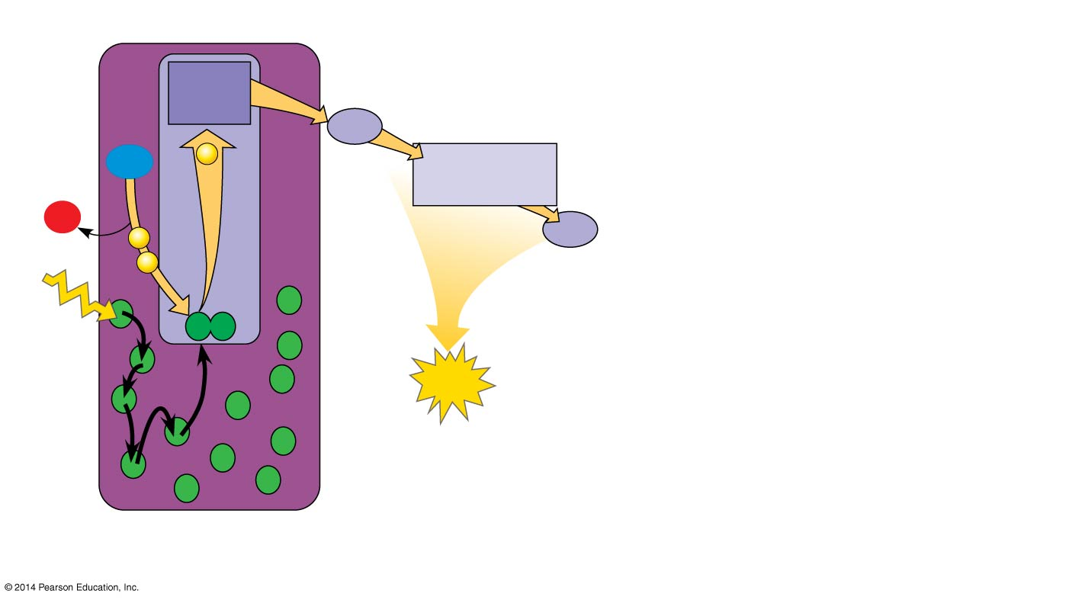
Figure 10.14-3
OMG! Output Oxygen for us!
4
Electron
transport
chain
Primary
acceptor
2
Pq
2 H⁺
H₂O
e⁻
Cytochrome
complex
+
½
O₂
3
e⁻
Pc
1
e⁻
P680
5
Light
ATP
Pigment
molecules
Photosystem II
(PS II)
WHOA! Output!!!
Notes:
Figure 10.14-3 How linear electron flow during the light reactions generates ATP and NADPH (step 3)

Slide 41
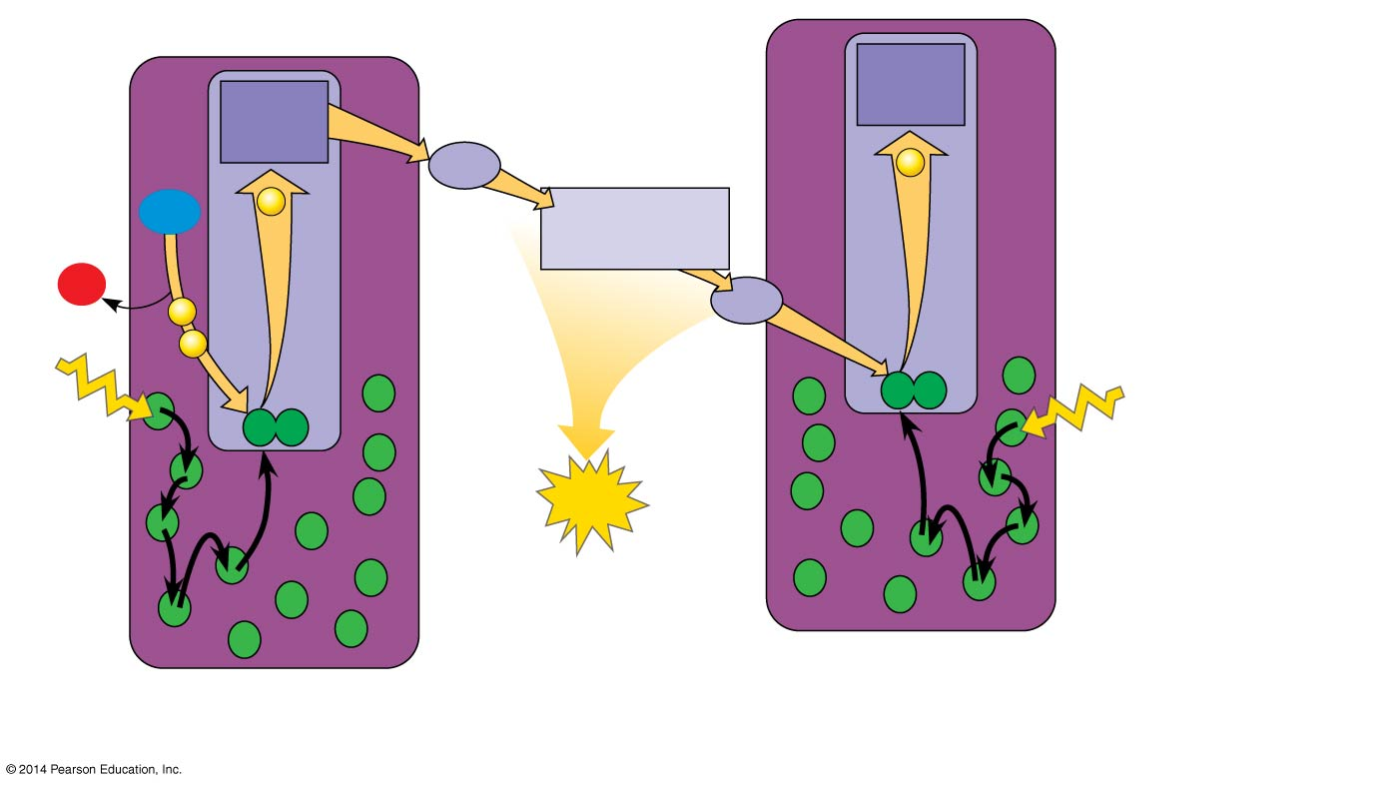
Figure 10.14-4
OMG! Output Oxygen for us!
4
Electron
transport
chain
Primary
acceptor
Primary
acceptor
Pq
e⁻
2 H⁺
e⁻
2
+
H₂O
Cytochrome
complex
½
O₂
3
e⁻
Pc
P700
1
e⁻
P680
5
Light
Light
6
ATP
Pigment
molecules
Photosystem I
(PS I)
Photosystem II
(PS II)
WHOA! Output!!!
Notes:
Figure 10.14-4 How linear electron flow during the light reactions generates ATP and NADPH (step 4)

Slide 42
Linear Electron Flow
Each electron “falls” down an electron transport chain from the primary electron acceptor of PS I to the protein ferredoxin (Fd)
The electrons are then transferred to NADP⁺ and reduce it to NADPH
The electrons of NADPH are available for the reactions of the Calvin cycle

Slide 43
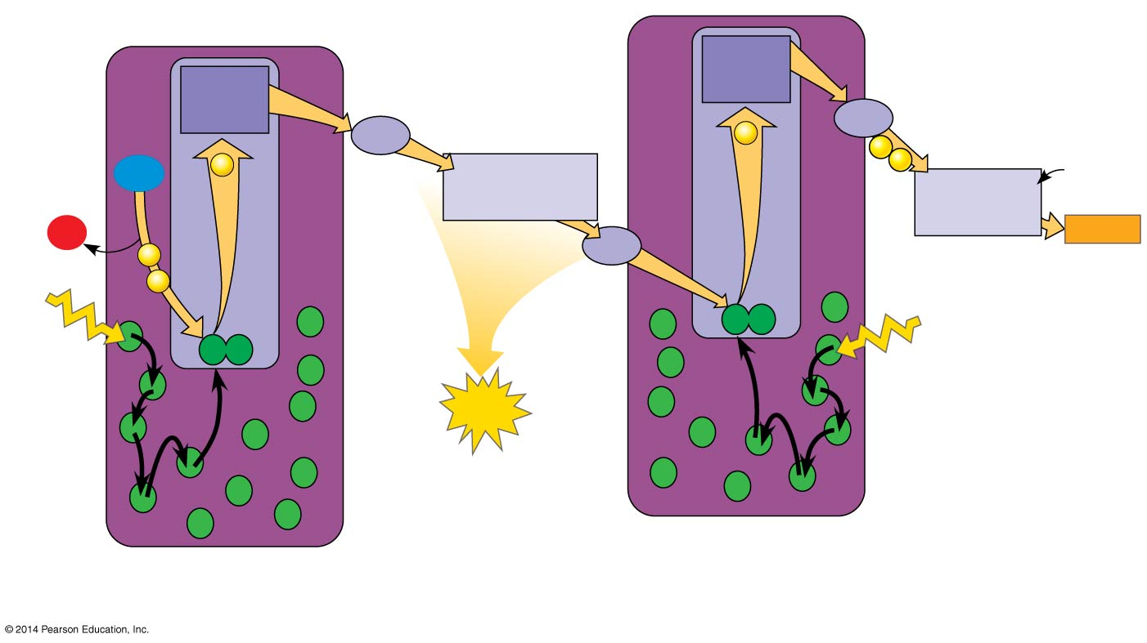
Figure 10.14-5
OMG! Output Oxygen for us!
4
Electron
transport
chain
7
Electron
transport
chain
Primary
acceptor
Primary
acceptor
Pq
e⁻
Fd
2
e⁻
8
NADP⁺
+ H⁺
2 H⁺
e⁻
e⁻
+
H₂O
Cytochrome
complex
NADP⁺
reductase
½
O₂
3
NADPH
e⁻
Pc
P700
1
e⁻
P680
5
Light
Light
6
ATP
Pigment
molecules
Photosystem I
(PS I)
WHOA! Output!!!
Photosystem II
(PS II)
WHOA! Output!!!
Notes:
Figure 10.14-5 How linear electron flow during the light reactions generates ATP and NADPH (step 5)

Slide 44
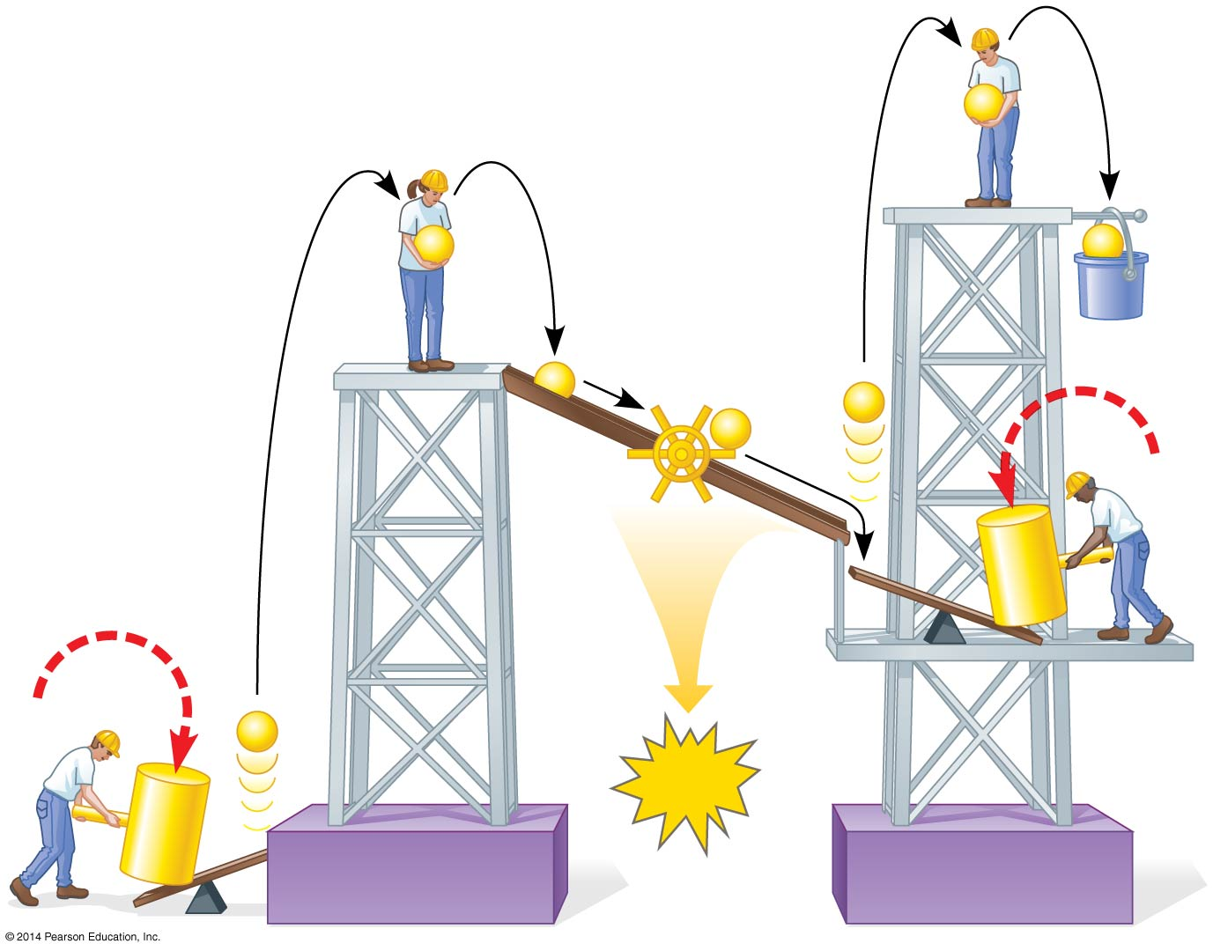
Figure 10.15
Summary of LINEAR Electron Flow
e⁻
e⁻
e⁻
Mill
makes
ATP
NADPH
e⁻
e⁻
e⁻
Photon
e⁻
ATP
Photon
Photosystem II
Photosystem I
Notes:
Figure 10.15 A mechanical analogy for linear electron flow during the light reactions

Slide 45
Types of Electron Flow
During the LIGHT REACTIONS, there are two possible routes for electron flow
Linear Electron Flow
Cyclic Electron Flow

Slide 46
Cyclic Electron Flow
In cyclic electron flow, electrons cycle back from Fd to the PS I reaction center
Cyclic electron flow uses ONLY PHOTOSYSTEM I
Produces ATP, but not NADPH
NO OXYGEN IS RELEASED

Slide 47
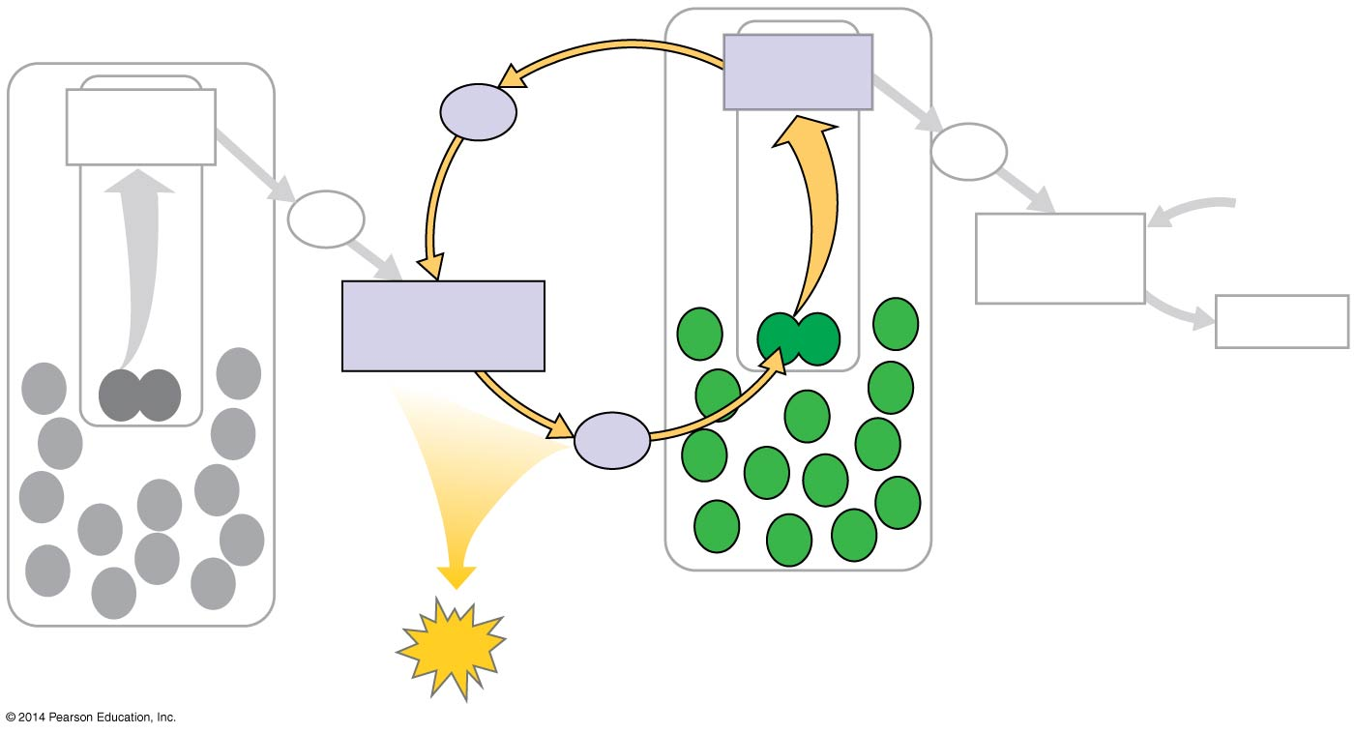
Figure 10.16
Cyclic Electron Flow
Primary
acceptor
Primary
acceptor
Fd
Fd
Pq
NADP⁺
+ H⁺
NADP⁺
reductase
Cytochrome
complex
NADPH
Pc
Photosystem I
Photosystem II
ATP
WHOA! Output!!!
Notes:
Figure 10.16 Cyclic electron flow

Slide 48
Types of Electron Flow
During the LIGHT REACTIONS, there are two possible routes for electron flow
Linear Electron Flow
Cyclic Electron Flow

Slide 49
Summary of Electron Flow (Light-dependent Reactions)
ATP and NADPH are produced on the side facing the stroma, where the Calvin cycle takes place
In summary, light reactions generate ATP and increase the potential energy of electrons by moving them from H₂O to NADPH
THIS IS WHY WE WATER PLANTS!

Slide 50
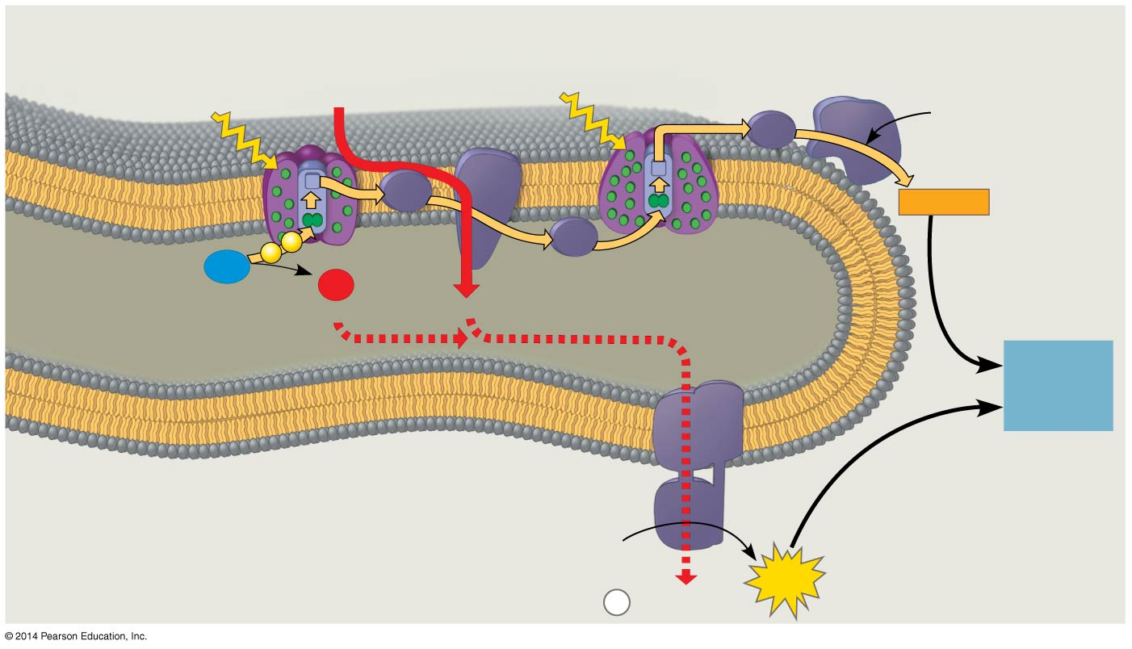
Figure 10.18
Photosystem II
Cytochrome
complex
Photosystem I
NADP⁺
reductase
4 H⁺
Light
3
Light
NADP⁺
+ H⁺
Fd
Pq
NADPH
e⁻
e⁻
2
Pc
H₂O
1
O₂
THYLAKOID SPACE
(high H⁺ concentration)
½
+2 H⁺
4 H⁺
To
Calvin
Cycle
Thylakoid
membrane
ATP
synthase
STROMA
(low H⁺ concentration)
ADP
+
ATP
P
H⁺
i
WHY?!
Notes:
Figure 10.18 The light reactions and chemiosmosis: Current model of the organization of the thylakoid membrane

Slide 51
Notes:
Which of the following is directly associated with photosystem I?
https://www.polleverywhere.com/multiple_choice_polls/9cGrWQCDpngdGj1

Slide 52
Notes:
What are the products of linear electron flow?
https://www.polleverywhere.com/multiple_choice_polls/lMKdJq6WEhgYkue

Slide 53
Notes:
In a plant cell, where are ATP synthase complexes located?
https://www.polleverywhere.com/multiple_choice_polls/XiBCybmKnljEdHc

Slide 54
Overview
Concept 10.1: Photosynthesis converts light energy to the chemical energy of food
Concept 10.2: The light reactions CONVERT solar energy to the chemical energy of ATP and NADPH
Concept 10.3: The Calvin cycle uses the chemical energy of ATP and NADPH to reduce CO₂ to sugar

Slide 55
Concept 10.3: The Calvin cycle uses the chemical energy of ATP and NADPH to reduce CO₂ to sugar
The Calvin cycle, like the citric acid cycle, REGENERATES its starting material after molecules enter and leave the cycle
The cycle builds sugar from smaller molecules by using ATP and the reducing power of electrons carried by NADPH

Slide 56
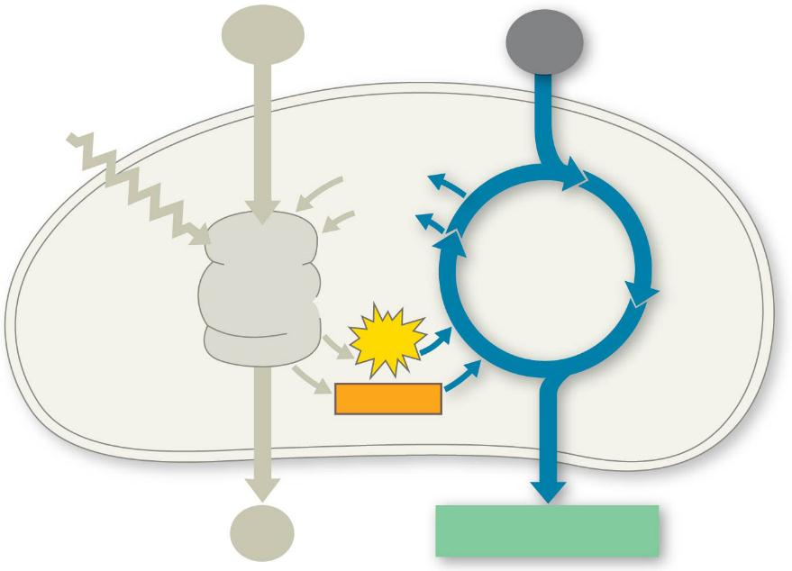
Figure 10.UN03
H₂O
CO₂
Light
NADP⁺
ADP
CALVIN
CYCLE
LIGHT
REACTIONS
ATP
NADPH
FINALLY! SWEET VICTORY!
O₂
[CH₂O] (sugar)
Notes:
Figure 10.UN03 In-text figure, Calvin cycle schematic, p. 200

Slide 57
Concept 10.3: The Calvin cycle
Carbon enters the cycle as CO₂ and leaves as a sugar named glyceraldehyde 3-phospate (G3P)
For net synthesis of 1 G3P, the cycle must take place three times, fixing 3 molecules of CO₂
The Calvin cycle has three phases
Carbon fixation (catalyzed by RuBisCO)
Reduction
Regeneration of the CO₂ acceptor (RuBP)

Slide 58
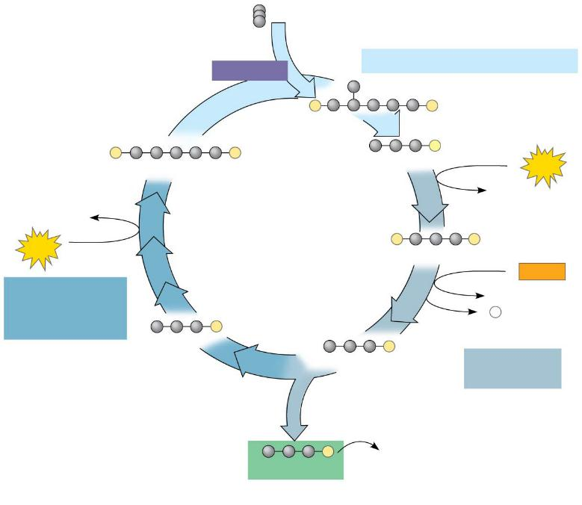
Figure 10.19-3
Input 3 CO₂, entering one per cycle
Phase 1: Carbon fixation
Rubisco
3
P
P
3
P
P
6
P
RuBP
3-Phosphoglycerate
6
ATP
6 ADP
3 ADP
Calvin
Cycle
3
ATP
6
P
P
1,3-Bisphosphoglycerate
6
NADPH
Phase 3:
Regeneration
of RuBP
6 NADP⁺
6
P
5
P
i
G3P
6
P
G3P
Phase 2:
Reduction
1
P
Glucose and
other organic
compounds
G3P
Output
Notes:
Figure 10.19-3 The Calvin cycle (step 3)

Slide 59
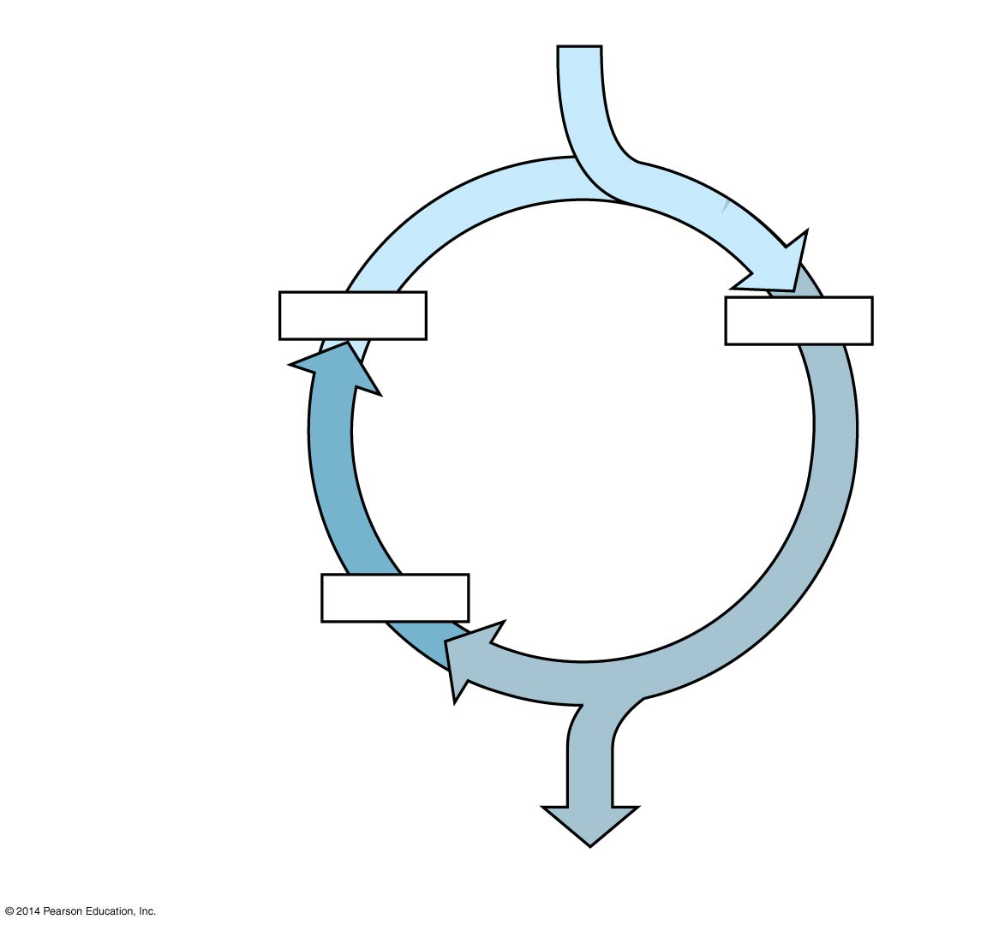
Figure 10.UN06
3 CO₂
Carbon fixation
3 x 5C
6 x 3C
Calvin
Cycle
Regeneration of
CO₂ acceptor
5 x 3C
Reduction
1 G3P (3C)
Notes:
Figure 10.UN06 Summary of key concepts: Calvin cycle

Slide 60
Notes:
What is the primary function of the Calvin cycle?
https://www.polleverywhere.com/multiple_choice_polls/RyVHjcsBSVAT5aB

Slide 61
Notes:
Where do the enzymatic reactions of the Calvin cycle take place?
https://www.polleverywhere.com/multiple_choice_polls/EMiXSkQagT60ScA

Slide 62
Notes:
Reactions that consume CO2 take place in
https://www.polleverywhere.com/multiple_choice_polls/J5MnYAzZeNbzUHs

Slide 63
Overview
Concept 10.1: Photosynthesis converts light energy to the chemical energy of food
Concept 10.2: The light reactions CONVERT solar energy to the chemical energy of ATP and NADPH
Concept 10.3: The Calvin cycle uses the chemical energy of ATP and NADPH to reduce CO₂ to sugar
http://www.jayhosler.com/jshblog/?p=937

Slide 64
REVIEW
Photosynthesis consists of the light reactions (the photo part) and Calvin cycle (the synthesis part)
The light reactions (IN THE THYLAKOIDS)
Split H₂O
Release O₂
Reduce the electron acceptor NADP⁺ to NADPH
Generate ATP from ADP by photophosphorylation

Slide 65
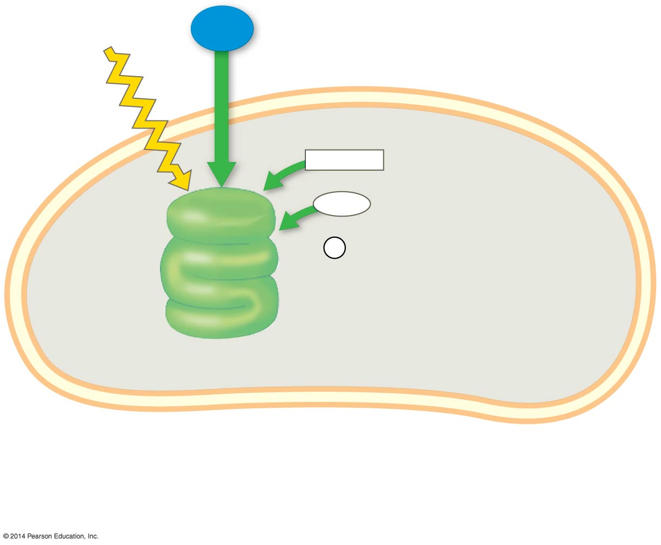
Figure 10.6-1
Light
H₂O
LIGHT RXN INPUTS
NADP⁺
ADP
+
LIGHT
REACTIONS
P _{i}
Thylakoid
Stroma
Chloroplast
Notes:
Figure 10.6-1 An overview of photosynthesis: cooperation of the light reactions and the Calvin cycle (step 1)

Slide 66
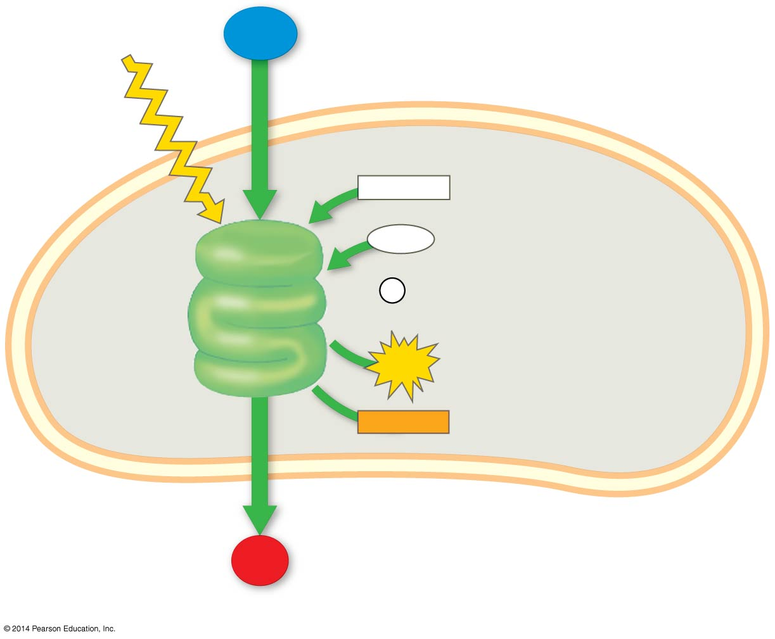
Figure 10.6-2
Light
H₂O
NADP⁺
ADP
+
LIGHT
REACTIONS
P _{i}
ATP
Stroma
Thylakoid
NADPH
Chloroplast
O₂
LIGHT RXN OUTPUTS
Notes:
Figure 10.6-2 An overview of photosynthesis: cooperation of the light reactions and the Calvin cycle (step 2)

Slide 67
REVIEW
The Calvin cycle (IN THE STROMA) forms sugar from CO₂, using ATP and NADPH
The Calvin cycle begins with (1). carbon fixation, incorporating CO₂ into organic molecules, and then completes (2). reduction and (3). RuBP regeneration

Slide 68
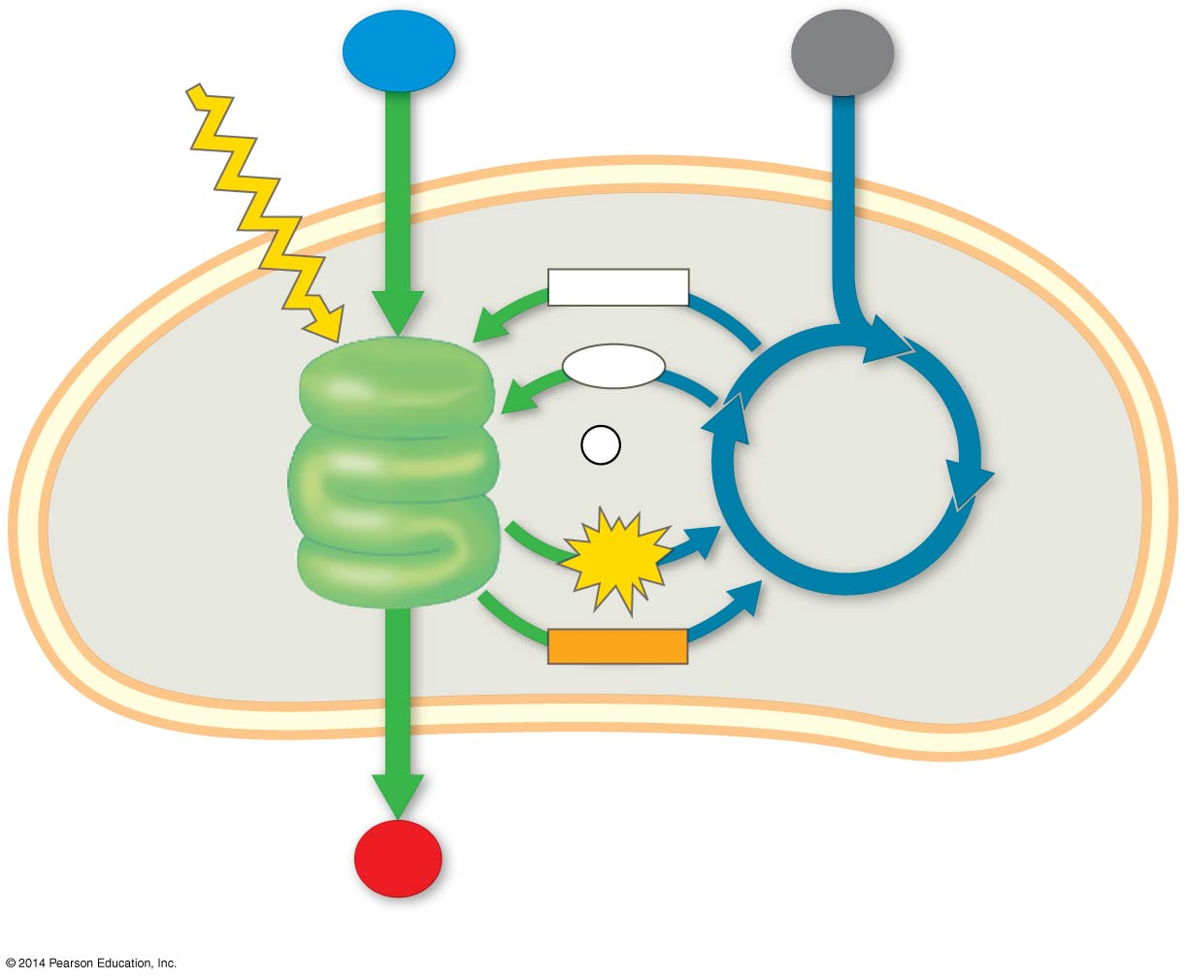
Figure 10.6-3
Light
H₂O
CO₂
CC INPUTS
NADP⁺
ADP
+
LIGHT
REACTIONS
P _{i}
CALVIN
CYCLE
ATP
Stroma
Thylakoid
NADPH
Chloroplast
O₂
Notes:
Figure 10.6-3 An overview of photosynthesis: cooperation of the light reactions and the Calvin cycle (step 3)

Slide 69
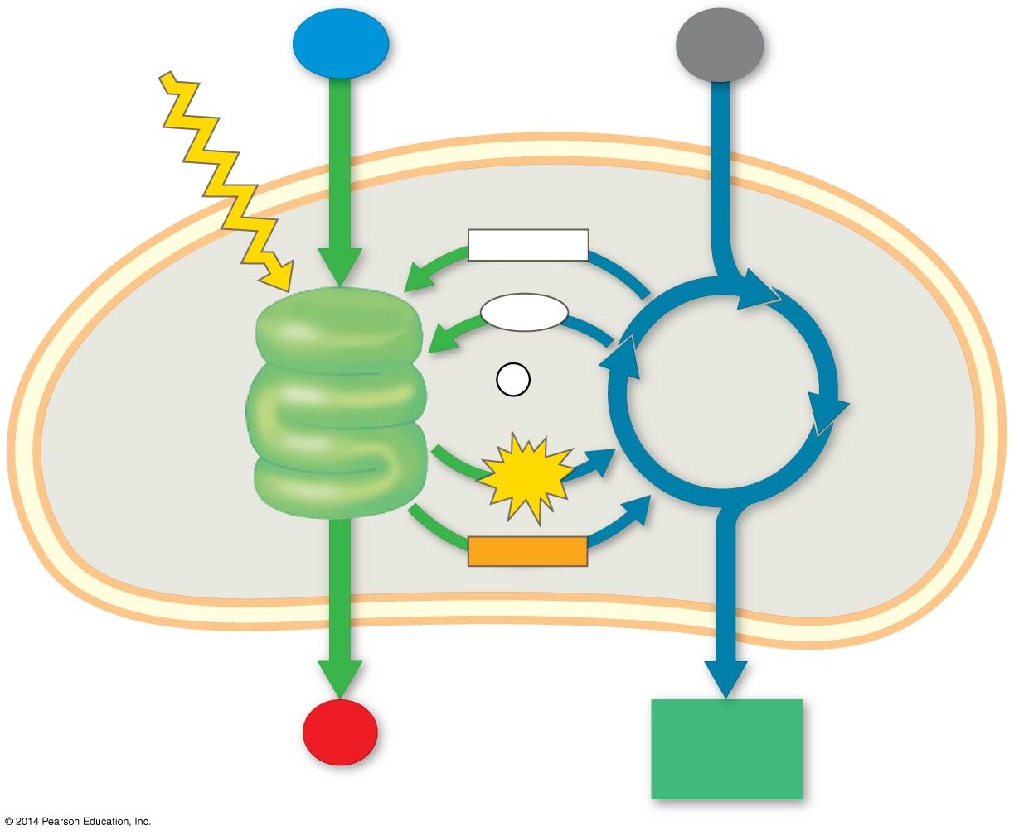
Figure 10.6-4
Light
H₂O
CO₂
NADP⁺
ADP
+
LIGHT
REACTIONS
P _{i}
CALVIN
CYCLE
ATP
Stroma
Thylakoid
NADPH
Chloroplast
O₂
[CH₂O]
(sugar)
CC OUTPUT
Notes:
Figure 10.6-4 An overview of photosynthesis: cooperation of the light reactions and the Calvin cycle (step 4)

Slide 70
Notes:
Which of the following statements best represents the relationships between the light reactions and the Calvin cycle?
https://www.polleverywhere.com/multiple_choice_polls/Ry8MKlDLQZqYfMY

Slide 71
Notes:
Which of the following sequences correctly represents the flow of electrons during photosynthesis?
https://www.polleverywhere.com/multiple_choice_polls/tUukKyywC6tjicQ

Slide 72
Notes:
In the thylakoid membranes, what is the main role of the pigment molecules in a light-harvesting complex?
https://www.polleverywhere.com/multiple_choice_polls/sr3PRuGo7rr8lHI

Slide 73
Animation: Photosynthesis

Slide 74
The Importance of Photosynthesis: A Review
The energy entering chloroplasts as sunlight gets stored as chemical energy in organic compounds
Sugar made in the chloroplasts supplies chemical energy and carbon skeletons to synthesize the organic molecules of cells
Plants store excess sugar as starch in structures such as roots, tubers, seeds, and fruits
In addition to food production, photosynthesis produces the O₂ in our atmosphere

Slide 75
Figure 10.22b
LIGHT REACTIONS
CALVIN CYCLE REACTIONS
Are carried out by molecules in the thylakoid membranes
Take place in the stroma
Use ATP and NADPH to convert CO₂ to the sugar G3P
Convert light energy to the chemical energy of ATP and NADPH
Return ADP, inorganic phosphate, and NADP⁺ to the light reactions
Split H₂O and release O₂ to the atmosphere
Notes:
Figure 10.22b A review of photosynthesis (part 2)

Slide 76
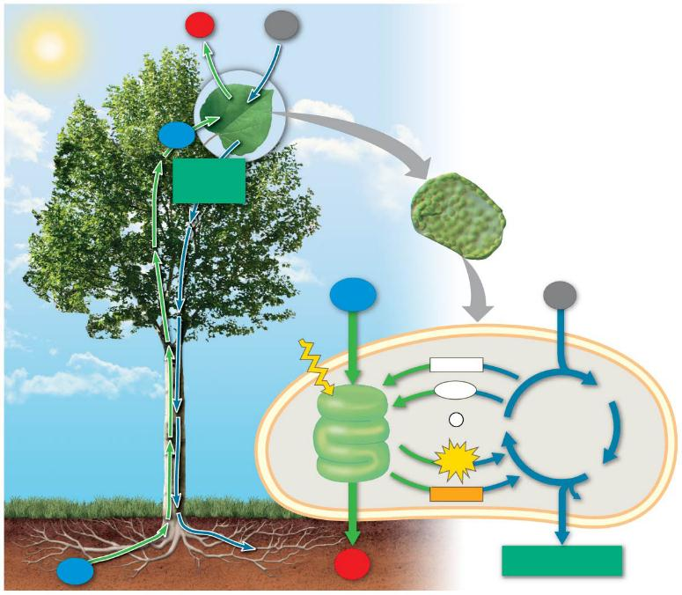
Figure 10.22a
O₂
CO₂
H₂O
Sucrose
(export)
Mesophyll cell
H₂O
Chloroplast
CO₂
Light
NADP⁺
ADP
3-Phosphoglycerate
LIGHT
REACTIONS: Photosystem II
Electron transport
chain
+
P
RuBP
CALVIN
CYCLE
i
ATP
G3P
Photosystem I
Electron transport
chain
NADPH
Starch
(storage)
H₂O
O₂
Sucrose (export)
Notes:
Figure 10.22a A review of photosynthesis (part 1)

Slide 77
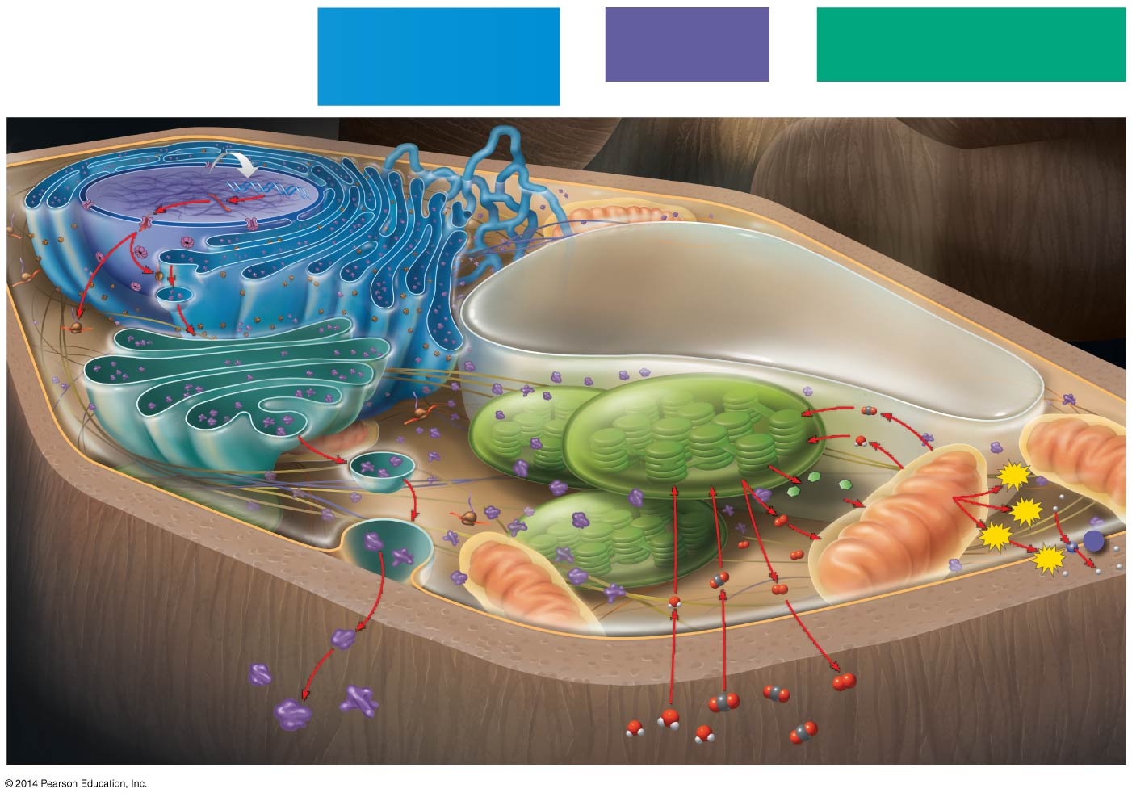
Figure 10.23
MAKE CONNECTIONS
Flow of Genetic Information
in the Cell:
DNA → RNA → Protein
(Chapters 5–7)
Movement Across
Cell Membranes
(Chapter 7)
Energy Transformations in the Cell:
Photosynthesis and Cellular
Respiration (Chapters 8–10)
The Working Cell
Nucleus
1
DNA
Nuclear
pore
mRNA
2
Protein
Rough endoplasmic
reticulum (ER)
3
Protein
in vesicle
Ribosome
mRNA
Vacuole
4
Vesicle
forming
7
Photosynthesis
in chloroplast
CO₂
Golgi
apparatus
Protein
H₂O
6
Organic
molecules
ATP
Transport
pump
Plasma
membrane
8
ATP
5
O₂
Cellular respiration
in mitochondrion
ATP
11
ATP
9
10
Cell wall
O₂
H₂O
CO₂
Notes:
Figure 10.23 Make connections: the working cell

Slide 78
The following slides compare and contrast chemiosmosis in chloroplasts and mitochondria

Slide 79
A Comparison of Chemiosmosis in Chloroplasts and Mitochondria
Chloroplasts and mitochondria generate ATP by chemiosmosis, but use different sources of energy
Mitochondria transfer chemical energy from food to ATP
Chloroplasts transform light energy into the chemical energy of ATP

Slide 80
A Comparison of Chemiosmosis in Chloroplasts and Mitochondria
In mitochondria, protons are pumped to the intermembrane space and drive ATP synthesis as they diffuse back into the mitochondrial matrix
In chloroplasts, protons are pumped into the thylakoid space and drive ATP synthesis as they diffuse back into the stroma

Slide 81
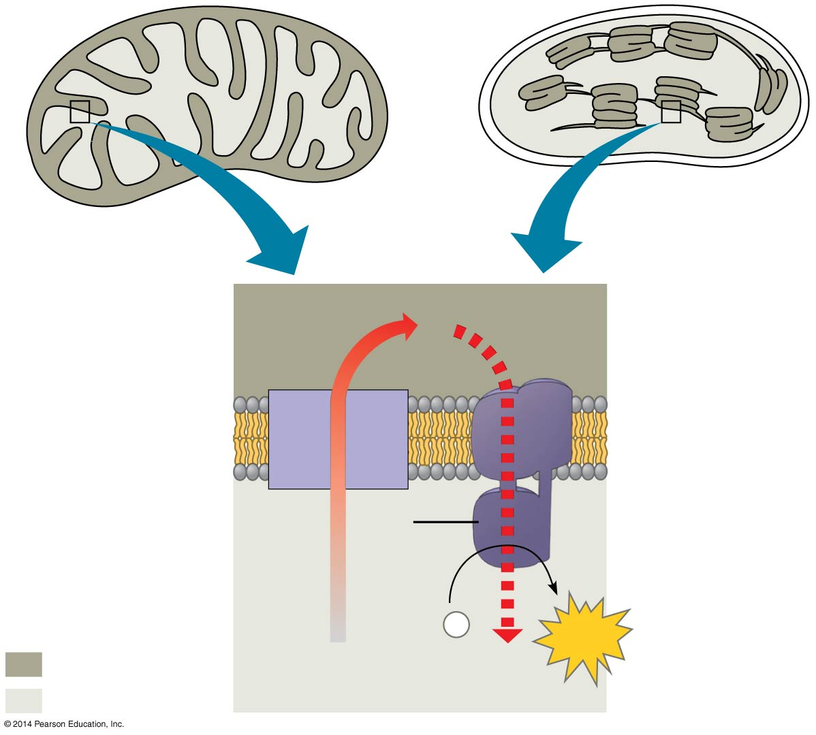
Figure 10.17
MITOCHONDRION
STRUCTURE
CHLOROPLAST
STRUCTURE
Inter-
membrane
space
H⁺
Diffusion
Thylakoid
space
Inner
membrane
Electron
transport
chain
Thylakoid
membrane
ATP
synthase
Matrix
Stroma
Key
ADP +
P
ATP
i
Higher [H⁺]
H⁺
Lower [H⁺]
Notes:
Figure 10.17 Comparison of chemiosmosis in mitochondria and chloroplasts

