Slide 1
0
11
Cell Communication

Slide 2
How to explain text messaging
Use a device
Select recipient
Type a combination of letters that mean something (a message)
Press send to send the message to recipient
See if they got the message
Wait for response
Possibly receive a response
Read response, interpret response, reply

Slide 3
Cellular Messaging
Cells can SIGNAL to each other and INTERPRET the signals they receive from other cells and the environment
Signals are most often chemicals
The SAME small set of cell signaling mechanisms shows up in diverse species and processes

Slide 4
Overview
Concept 11.1: External signals are converted to responses within the cell
Concept 11.2: Reception: A signaling molecule binds to a receptor protein, causing it to change shape
Concept 11.3: Transduction: Cascades of molecular interactions relay signals from receptors to target molecules in the cell
Concept 11.4: Response: Cell signaling leads to regulation of transcription or cytoplasmic activities
Concept 11.5: Apoptosis integrates multiple cell-signaling pathways

Slide 5
Overview
Concept 11.1: External signals are converted to responses within the cell
Concept 11.2: Reception: A signaling molecule binds to a receptor protein, causing it to change shape
Concept 11.3: Transduction: Cascades of molecular interactions relay signals from receptors to target molecules in the cell
Concept 11.4: Response: Cell signaling leads to regulation of transcription or cytoplasmic activities
Concept 11.5: Apoptosis integrates multiple cell-signaling pathways

Slide 6
Concept 11.1: External signals are converted to responses within the cell
Cells in a multicellular organism communicate via local and long-distance SIGNALING MOLECULES

Slide 7
Concept 11.1: External signals are converted to responses within the cell
Local Signaling:
In local signaling, animal cells may communicate by DIRECT CONTACT
Animal and plant cells have cell junctions that DIRECTLY connect the cytoplasm of adjacent cells
Signaling molecules in the cytosol can pass freely between adjacent cells
These cells can also undergo cell-cell recognition (another form of local signaling via direct contact)

Slide 8
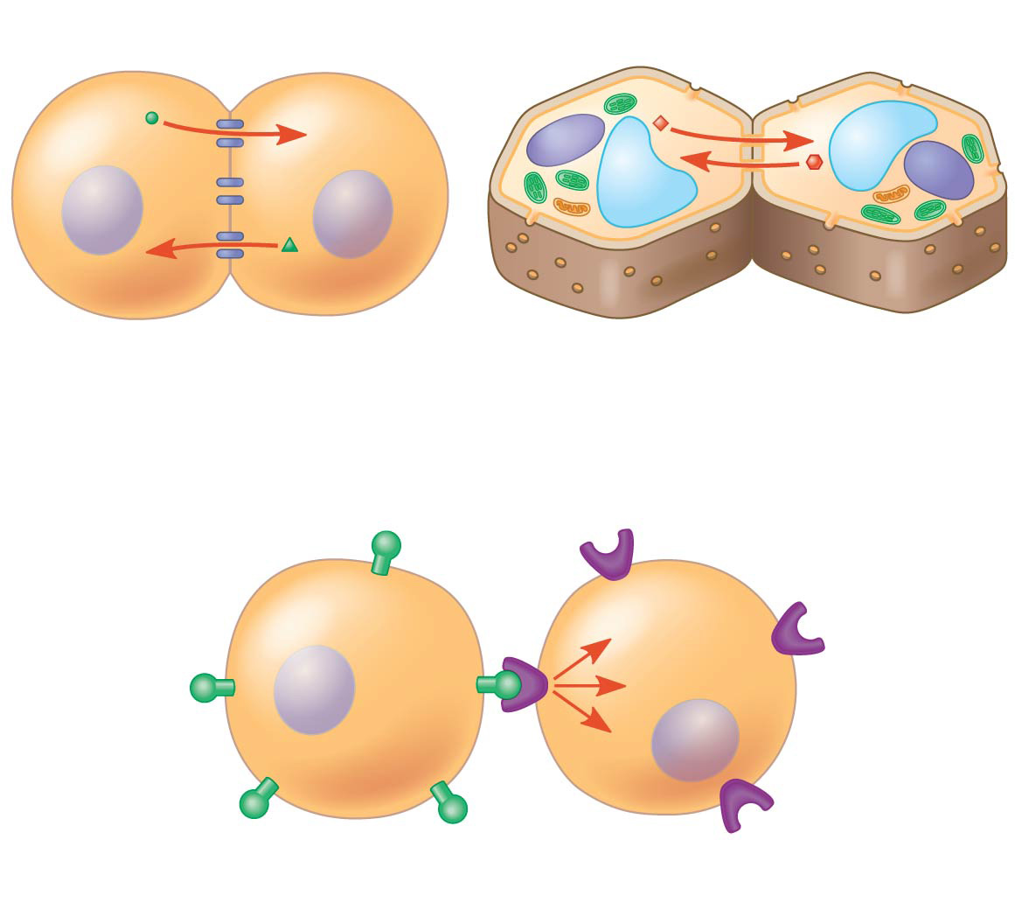
Figure 11.4
Cell wall
Plasma membranes
Gap junctions between animal cells
Plasmodesmata between plant cells
(a) Cell junctions
(b) Cell-cell recognition
Notes:
Figure 11.4 Communication by direct contact between cells

Slide 9
Concept 11.1: External signals are converted to responses within the cell
Long-distance signaling:
Plants and animals use signaling molecules called hormones
Hormonal signaling = endocrine signaling

Slide 10
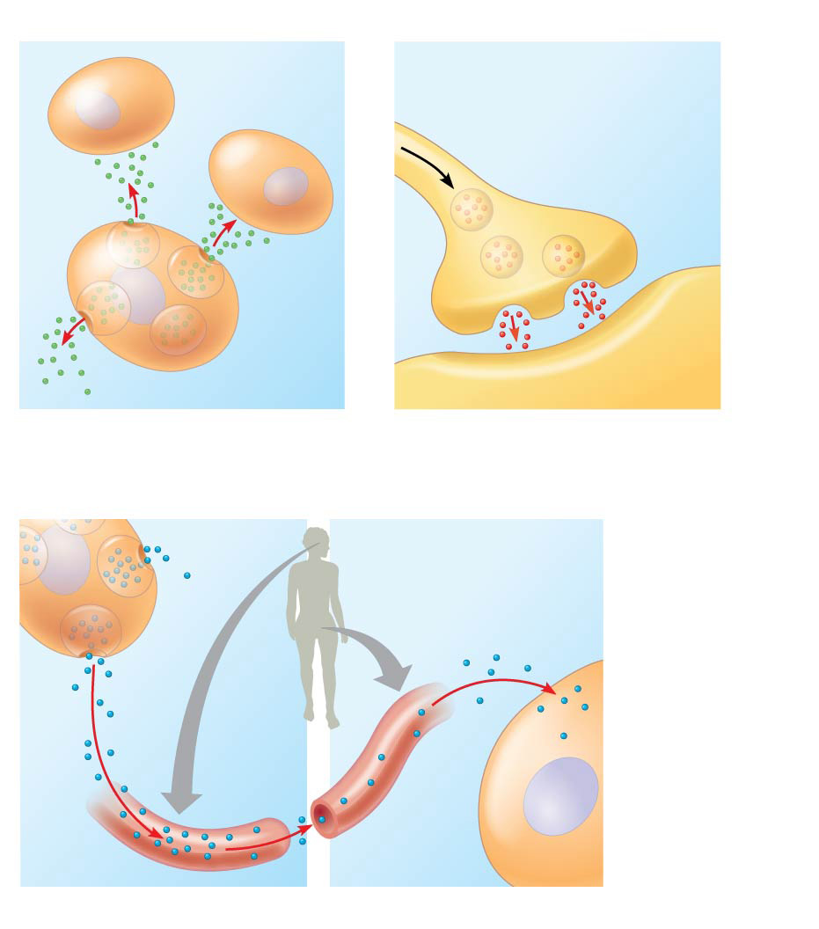
Figure 11.5
Local signaling
Target cells
Electrical signal triggers release of neurotransmitter.
Neurotransmitter diffuses across synapse.
Secreting cell
Secretory vesicles
Local regulator
Target cell
(a) Paracrine signaling
(b) Synaptic signaling
Long-distance signaling
Endocrine cell
Target cell specifically binds hormone.
Hormone travels in bloodstream.
Blood vessel
(c) Endocrine (hormonal) signaling
Notes:
Figure 11.5 Local and long-distance cell signaling by secreted molecules in animals

Slide 11
Concept 11.1: External signals are converted to responses within the cell
The ability of a cell to RESPOND to any signal (local or long-distance) depends on whether or not it has a SPECIFIC RECEPTOR to that signal…

Slide 12
PREVIEW: The Three Stages of Cell Signaling
Cells receiving signals go through THREE processes
1. Reception
2. Transduction
3. Response

Slide 13
Notes:
Which of the following is a type of local signaling in which a cell secretes a signal molecule that affects neighboring cells?
https://www.polleverywhere.com/multiple_choice_polls/IrtwNIW0IXLMx3u

Slide 14
Notes:
Hormones are chemical substances produced in one organ that are released into the bloodstream and affect the function of a target organ. For the target organ to respond to a particular hormone, it must _____.
https://www.polleverywhere.com/multiple_choice_polls/CGGmxunX4ffw9UK

Slide 15
Notes:
When a neuron responds to a particular neurotransmitter by opening gated ion channels, the neurotransmitter is serving as which part of the signal pathway?
https://www.polleverywhere.com/multiple_choice_polls/9ghB36Gt5xGQtmu

Slide 16
Overview
Concept 11.1: External signals are converted to responses within the cell
Concept 11.2: Reception: A signaling molecule binds to a receptor protein, causing it to change shape
Concept 11.3: Transduction: Cascades of molecular interactions relay signals from receptors to target molecules in the cell
Concept 11.4: Response: Cell signaling leads to regulation of transcription or cytoplasmic activities
Concept 11.5: Apoptosis integrates multiple cell-signaling pathways

Slide 17
Concept 11.2: Reception: A signaling molecule binds to a receptor protein, causing it to change shape
The binding between a signal molecule (ligand) and receptor is HIGHLY SPECIFIC
A shape change in a receptor is often the initial “transduction” of the signal
Transduction = CONVERTING a message/signal into a different form
Most signal receptors are plasma membrane proteins

Slide 18
Receptors in the Plasma Membrane
Most signal molecules bind to specific sites on receptor proteins that span the plasma membrane
G protein-coupled receptors (GPCRs) are the largest family of cell-surface receptors

Slide 19
Receptors in the Plasma Membrane
G protein-coupled receptors (GPCRs) are cell surface transmembrane receptors that work with the help of a G protein
G proteins bind the energy-rich GTP
G proteins are all very similar in structure
GPCR systems are extremely widespread and diverse in their functions

Slide 20
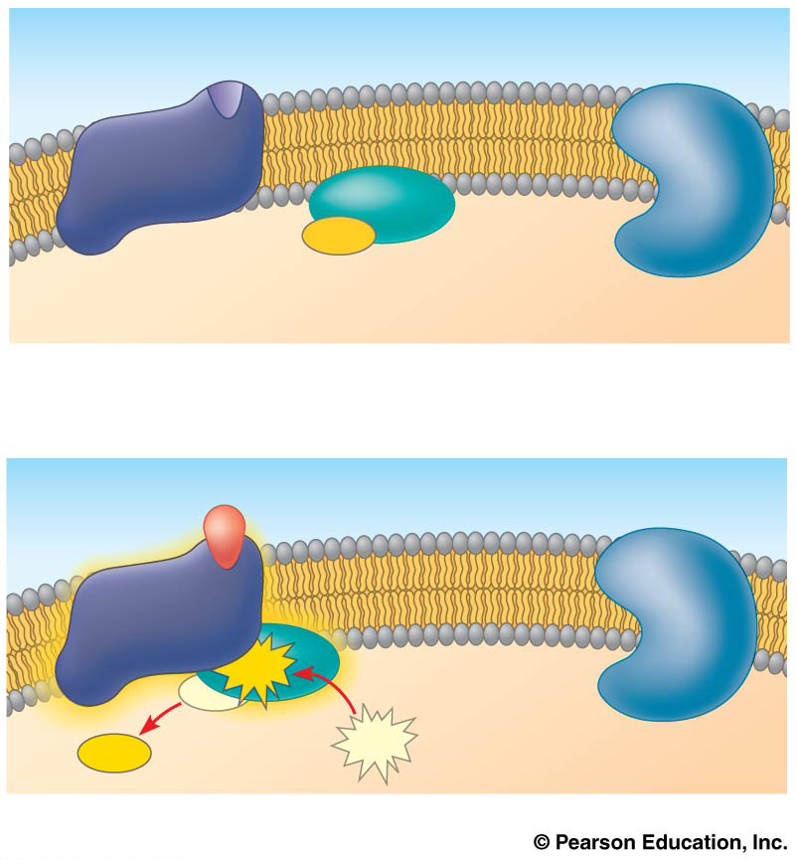
Figure 11.8ba
G protein-coupled receptor
Plasma membrane
GDP
G protein (inactive)
CYTOPLASM
Enzyme
1
Signaling molecule
Inactive enzyme
Activated receptor
GTP
GDP
GDP
GTP
2
Notes:
Figure 11.8ba Exploring cell-surface transmembrane receptors (part 2a: GPCR signaling, activation)

Slide 21
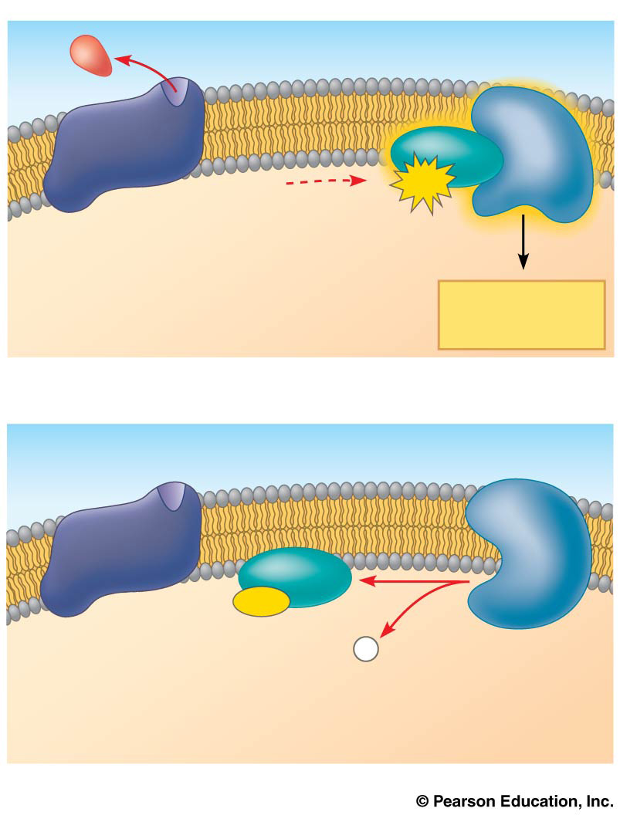
Figure 11.8bb
Activated enzyme
GTP
Cellular response
3
GDP
P
i
4
Notes:
Figure 11.8bb Exploring cell-surface transmembrane receptors (part 2b: GPCR signaling, cellular response and hydrolysis)

Slide 22
Intracellular Receptors
Intracellular receptor proteins are found in the CYTOPLASM OR NUCLEUS of target cells
Small or hydrophobic chemical messengers can readily cross the membrane and activate intracellular receptors
Ex: Steroids = Hydrophobic messengers
An activated hormone-receptor complex can act as a transcription factor
TFs can “turn on” (activate) specific genes

Slide 23
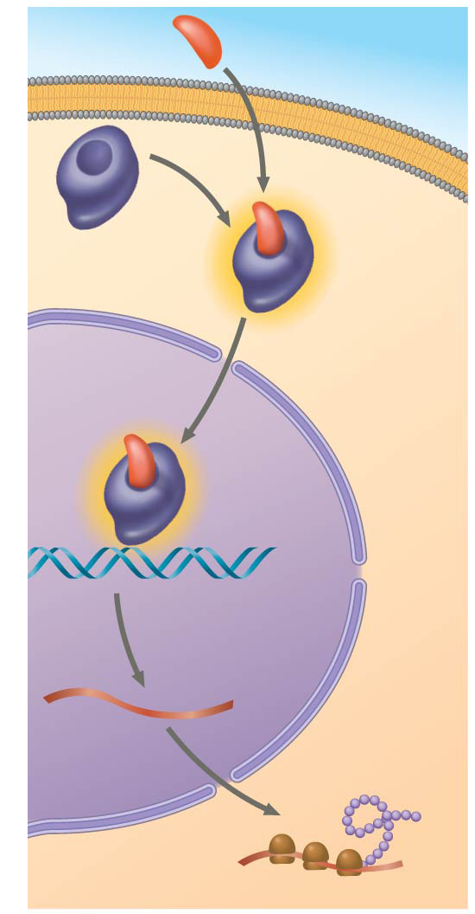
Figure 11.9
Hormone (aldosterone)
EXTRA- CELLULAR FLUID
Plasma
membrane
Receptor protein
Hormone- receptor complex
DNA
mRNA
New protein
NUCLEUS
CYTOPLASM
Notes:
Figure 11.9 Steroid hormone interacting with an intracellular receptor

Slide 24
Notes:
A G-protein receptor with GTP bound to it _____.
https://www.polleverywhere.com/multiple_choice_polls/y2LRJ5kyS7Bcyiy

Slide 25
Notes:
Testosterone functions inside a cell by _____.
https://www.polleverywhere.com/multiple_choice_polls/6eaZkVExO9UiGWM

Slide 26
Notes:
A drug designed to inhibit the response of cells to testosterone would most likely result in _____.
https://www.polleverywhere.com/multiple_choice_polls/Ogj7R47vwNxjW7P

Slide 27
REMEMBER: The Three Stages of Cell Signaling
Cells receiving signals go through THREE processes
1. Reception
2. Transduction
3. Response

Slide 28
Overview
Concept 11.1: External signals are converted to responses within the cell
Concept 11.2: Reception: A signaling molecule binds to a receptor protein, causing it to change shape
Concept 11.3: Transduction: Cascades of molecular interactions relay signals from receptors to target molecules in the cell
Concept 11.4: Response: Cell signaling leads to regulation of transcription or cytoplasmic activities
Concept 11.5: Apoptosis integrates multiple cell-signaling pathways

Slide 29
Concept 11.3: Transduction: Cascades of molecular interactions relay signals from receptors to target molecules in the cell
STEP 2 OF CELL SIGNALING
Signal transduction usually involves MULTIPLE STEPS
Multistep pathways can greatly AMPLIFY a signal
Multistep pathways provide more opportunities for coordination and regulation of the cellular response
© 2014 Pearson Education, Inc.

Slide 30
Signal Transduction Pathways (STEP 2)
Remember…Step 1 = Reception = The binding of a signaling molecule to a receptor triggers the first step in a chain of molecular interactions
Like falling dominoes, the receptor activates another protein, which activates another one (DJ Khaled voice), and so forth, until the desired protein producing the desired response is ACTIVATED
At each step, the signal is TRANSDUCED (chemically converted) into a different form
This transduction causes SHAPE CHANGES in proteins

Slide 31
Signal Transduction Pathways (STEP 2) – Phosphorylation
Phosphorylation of proteins is an example of a cellular mechanism for regulating protein activity VIA SIGNAL TRANSDUCTION
Protein kinases TRANSFER PHOSPHATES from ATP to protein, a process called “phosphorylation”
Many relay molecules in signal transduction pathways are protein kinases, creating a phosphorylation CASCADE

Slide 32
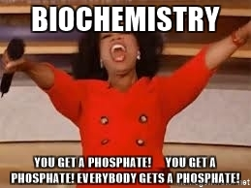
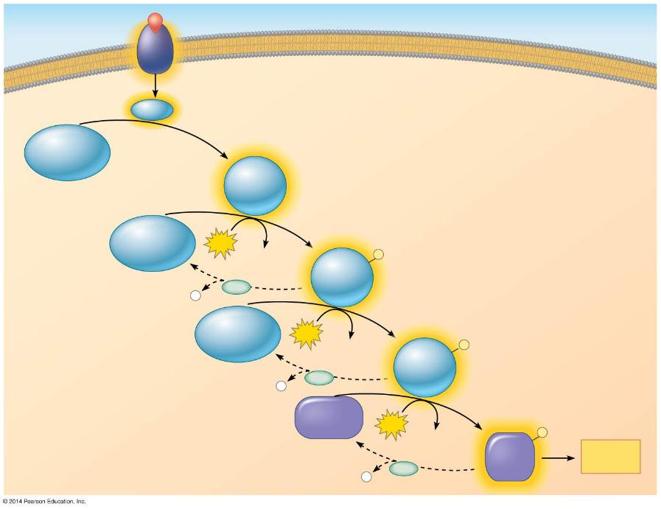
Figure 11.10
Signaling molecule
Receptor
Activated relay
molecule
Inactive protein kinase 1
Active protein kinase 1
Inactive protein kinase 2
ATP
Phosphorylation cascade
ADP
Active protein kinase 2
P
P
PP
i
Inactive protein kinase 3
ATP
ADP
Active protein kinase 3
P
P
PP
i
Inactive protein
ATP
P
ADP
Active protein
Cellular
response
P
PP
i
Notes:
Figure 11.10 A phosphorylation cascade

Slide 33
Signal Transduction Pathways (STEP 2) – DEphosphorylatyion
Protein phosphatases rapidly REMOVE THE PHOSPHATES from proteins, a process called “dephosphorylation”
Phosphorylation + dephosphorylation = molecular “switches”
Both can turn cell activities on and off or up or down, as required (AKA CELL REGULATION)

Slide 34
Signal Transduction Pathways (STEP 2) – Second Messengers (helpers)
Many signaling pathways involve “second messengers”
Second messengers are small, NONPROTEIN, water-soluble molecules (or ions) that spread throughout a cell by diffusion
Second messengers participate in pathways initiated by GPCRs
Cyclic AMP = common second messenger

Slide 35
Signal Transduction Pathways (STEP 2) – cAMP
Cyclic AMP (cAMP) is one of the most widely used second messengers
Adenylyl cyclase, an enzyme in the plasma membrane, converts ATP → cAMP in RESPONSE to an EXTRACELLULAR SIGNAL

Slide 36
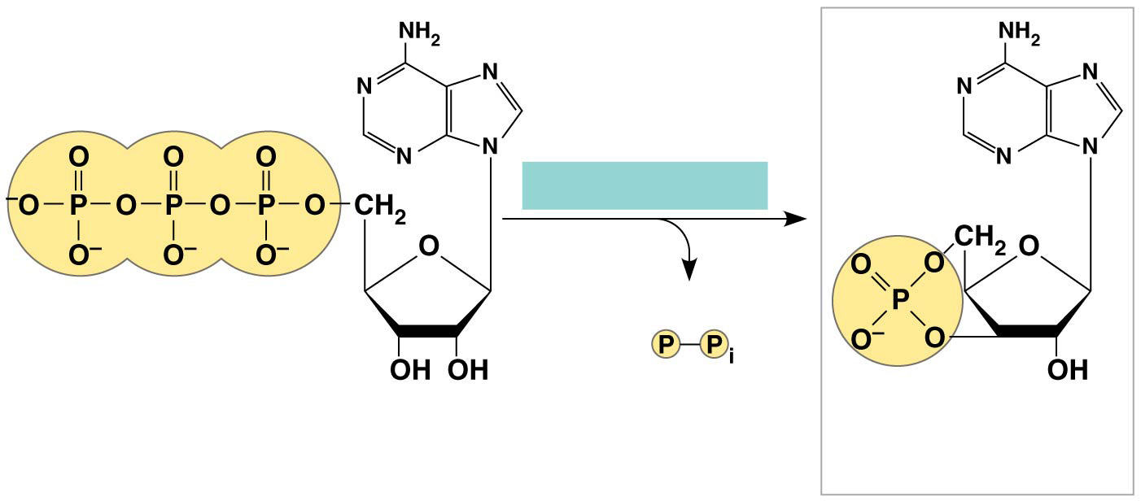
Figure 11.11a
Adenylyl cyclase
Pyrophosphate
ATP
cAMP
Notes:
Figure 11.11a Cyclic AMP (part 1: adenylyl cyclase)

Slide 37
Signal Transduction Pathways (STEP 2) – cAMP
Many signal molecules trigger formation of cAMP
cAMP usually ACTIVATES PROTEIN KINASE A, which phosphorylates various other proteins
Other components of cAMP pathways are:
G proteins
G protein-coupled receptors
Protein kinases

Slide 38
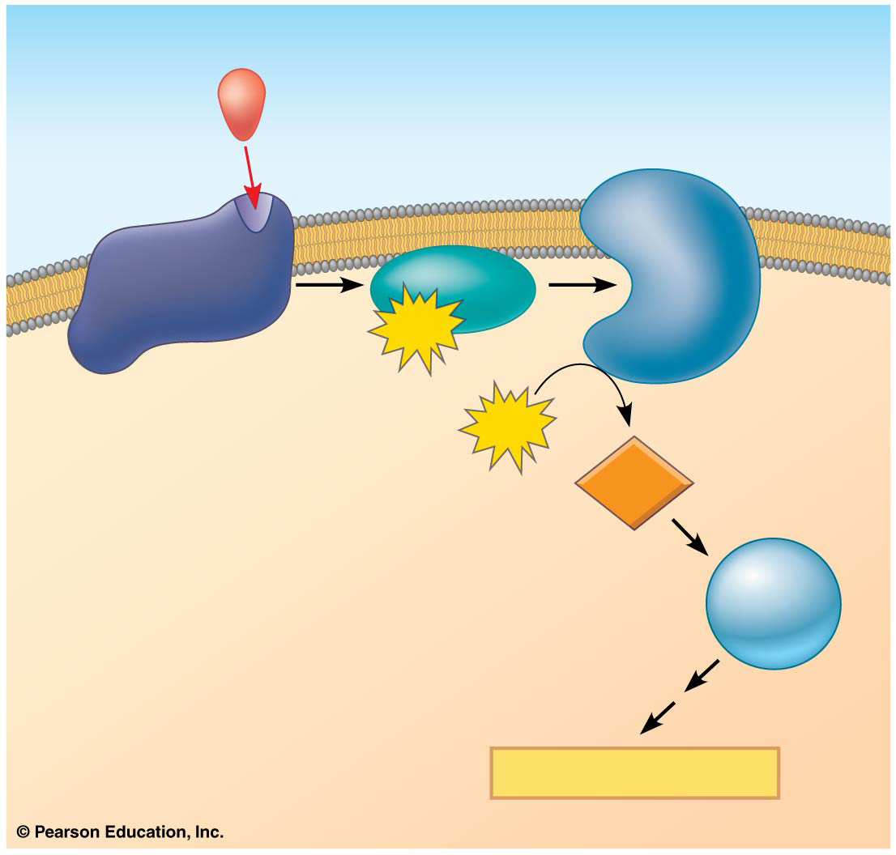
Figure 11.12
First messenger (signaling molecule such as epinephrine)
Adenylyl cyclase
G protein
GTP
G protein-coupled receptor
ATP
Second messenger
cAMP
Protein kinase A
Cellular responses
Notes:
Figure 11.12 cAMP as a second messenger in a G protein signaling pathway

Slide 39
Signal Transduction Pathways (STEP 2) – cAMP
The cholera bacterium, Vibrio cholerae, produces a toxin that MODIFIES a G protein so that it is STUCK IN ITS ACTIVE FORM
This modified G protein CONTINUALLY makes cAMP
Intestinal cells CONTINUALLY secrete large amounts of salt into the intestines
Water follows by osmosis and an untreated person can soon DIE from loss of water and salt

Slide 40
Notes:
Protein phosphorylation is commonly involved with all of the following EXCEPT _____.
https://www.polleverywhere.com/multiple_choice_polls/mTrPmA35tpARpjY

Slide 41
Notes:
In general, a signal transmitted via phosphorylation of a series of proteins _____.
https://www.polleverywhere.com/multiple_choice_polls/4wzzDHB1wtU9xdV

Slide 42
Notes:
The toxin of Vibrio cholerae causes profuse diarrhea because it _____.
https://www.polleverywhere.com/multiple_choice_polls/GqkDjdySGBgRG5x

Slide 43
Notes:
Protein kinase is an enzyme that _____.
https://www.polleverywhere.com/multiple_choice_polls/vDiueTOZTop9DmR

Slide 44
Notes:
In signal transduction, phosphatases _____.
https://www.polleverywhere.com/multiple_choice_polls/nrTk8IJI81FWQYX

Slide 45
REMEMBER: The Three Stages of Cell Signaling
Cells receiving signals go through THREE processes
1. Reception
2. Transduction
3. Response

Slide 46
Overview
Concept 11.1: External signals are converted to responses within the cell
Concept 11.2: Reception: A signaling molecule binds to a receptor protein, causing it to change shape
Concept 11.3: Transduction: Cascades of molecular interactions relay signals from receptors to target molecules in the cell
Concept 11.4: Response: Cell signaling leads to regulation of transcription or cytoplasmic activities
Concept 11.5: Apoptosis integrates multiple cell-signaling pathways

Slide 47
Concept 11.4: Response: Cell signaling leads to regulation of transcription or cytoplasmic activities
The cell’s response to an extracellular signal is called the “output response”
© 2014 Pearson Education, Inc.

Slide 48
Nuclear and Cytoplasmic Responses
The desired response of steps 1-3 may occur in the cytoplasm or in the nucleus
Ultimately, a signal transduction pathway leads to REGULATION of cellular activities
Many signaling pathways regulate the synthesis of enzymes or other proteins, usually by TURNING GENES ON OR OFF in the nucleus
The final activated molecule in the signaling pathway may function as a TRANSCRIPTION FACTOR

Slide 49
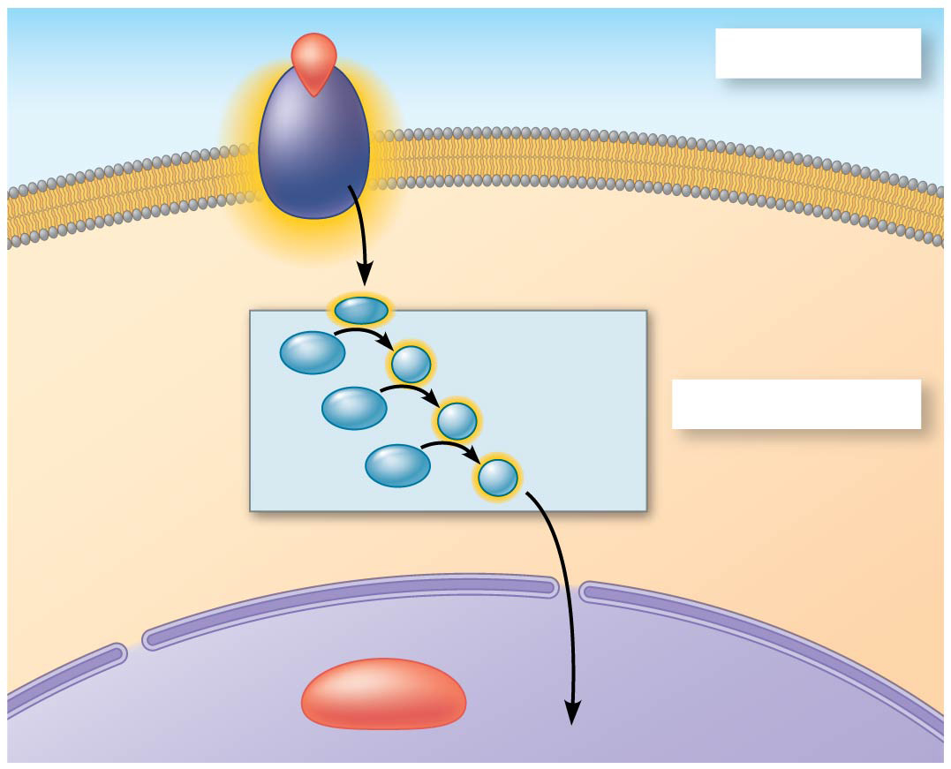
Figure 11.15a
Growth factor
Reception
Receptor
Phospho- rylation cascade
Transduction
CYTOPLASM
Inactive transcription factor
NUCLEUS
Notes:
Figure 11.15a Nuclear responses to a signal: the activation of a specific gene by a growth factor (part 1: cytoplasm)

Slide 50
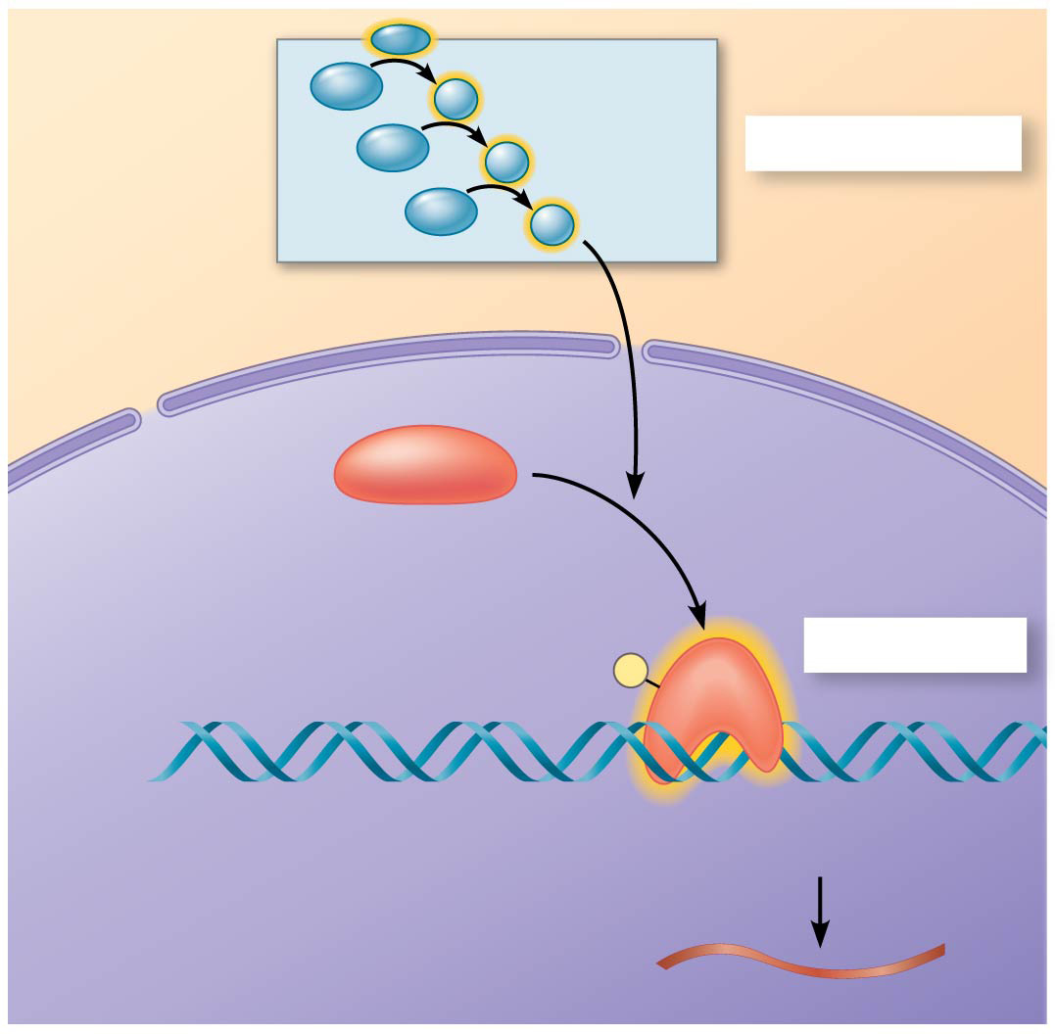
Figure 11.15b
Phospho- rylation cascade
Transduction
CYTOPLASM
Inactive transcription factor
Active transcription factor
Response
P
DNA
Gene
NUCLEUS
mRNA
Notes:
Figure 11.15b Nuclear responses to a signal: the activation of a specific gene by a growth factor (part 2: nucleus)

Slide 51
Nuclear and Cytoplasmic Responses
Some signaling pathways affect the overall BEHAVIOR of a cell
Ex: a signal could lead to cell division
Some signaling pathways regulate the ACTIVITY of enzymes
For example, a signal could a change in cell metabolism…

Slide 52
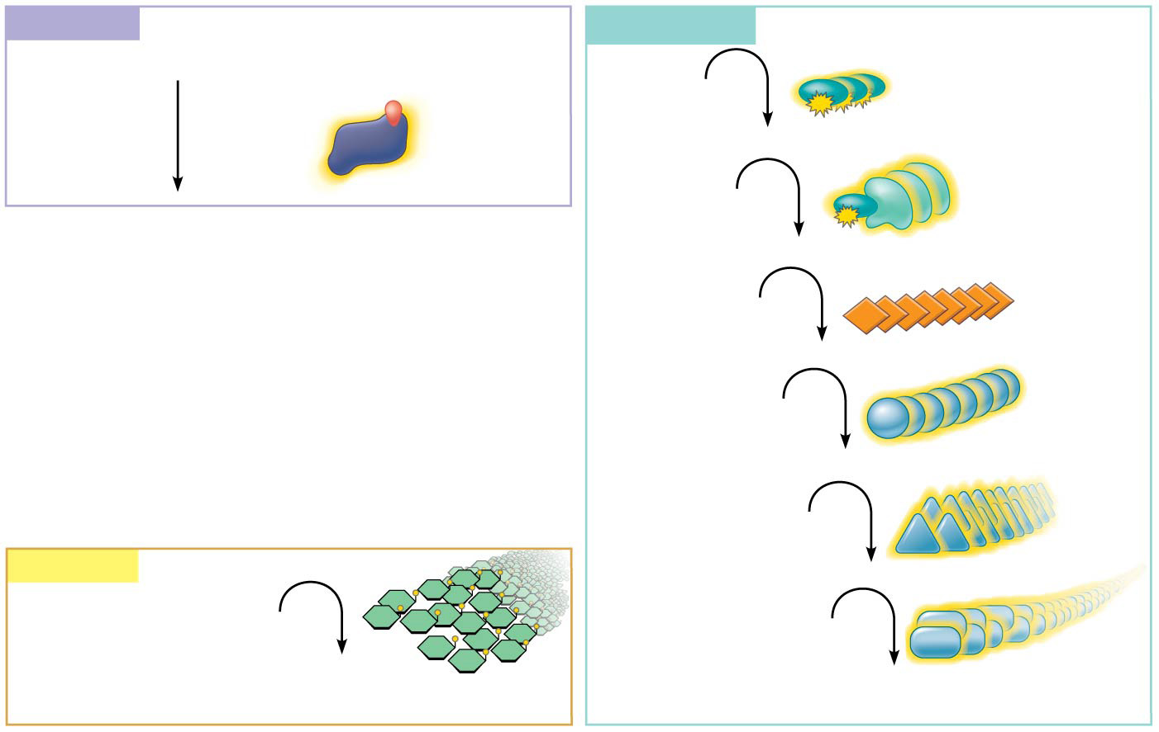
Figure 11.16
Reception
Transduction
Binding of epinephrine to G protein-coupled receptor (1 molecule)
Inactive G protein
Active G protein (10² molecules)
Inactive adenylyl cyclase
Active adenylyl cyclase (10²)
ATP
Cyclic AMP (10⁴)
Inactive protein kinase A
Active protein kinase A (10⁴)
Inactive phosphorylase kinase
Response
Active phosphorylase kinase (10⁵)
Glycogen
Inactive glycogen phosphorylase
Glucose 1-phosphate (10⁸ molecules)
Active glycogen phosphorylase (10⁶)
Notes:
Figure 11.16 Cytoplasmic response to a signal: the stimulation of glycogen breakdown by epinephrine (adrenaline)

Slide 53
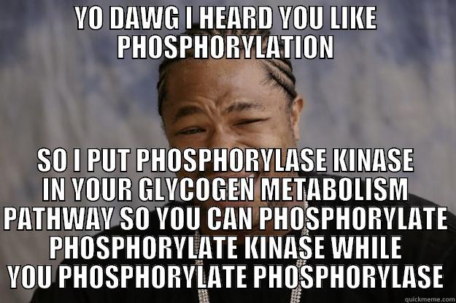

Slide 54
REMEMBER: The Three Stages of Cell Signaling
Cells receiving signals go through THREE processes
1. Reception
2. Transduction
3. Response

Slide 55
Notes:
Transcription factors _____.
https://www.polleverywhere.com/multiple_choice_polls/erB7coWP4kqo9Bd

Slide 56
Notes:
Phosphorylation cascades involving a series of protein kinases are useful for cellular signal transduction because they _____.
https://www.polleverywhere.com/multiple_choice_polls/CUy5WELejW8SpqS

Slide 57
Overview
Concept 11.1: External signals are converted to responses within the cell
Concept 11.2: Reception: A signaling molecule binds to a receptor protein, causing it to change shape
Concept 11.3: Transduction: Cascades of molecular interactions relay signals from receptors to target molecules in the cell
Concept 11.4: Response: Cell signaling leads to regulation of transcription or cytoplasmic activities
Concept 11.5: Apoptosis integrates multiple cell-signaling pathways

Slide 58
Concept 11.5: Apoptosis integrates multiple cell-signaling pathways
Cells that are infected or damaged or have reached the end of their functional lives often undergo “programmed cell death” called apoptosis
Components of the cell are chopped up and packaged into vesicles that are digested by scavenger cells
Apoptosis prevents enzymes from leaking out of a dying cell and damaging neighboring cells

Slide 59
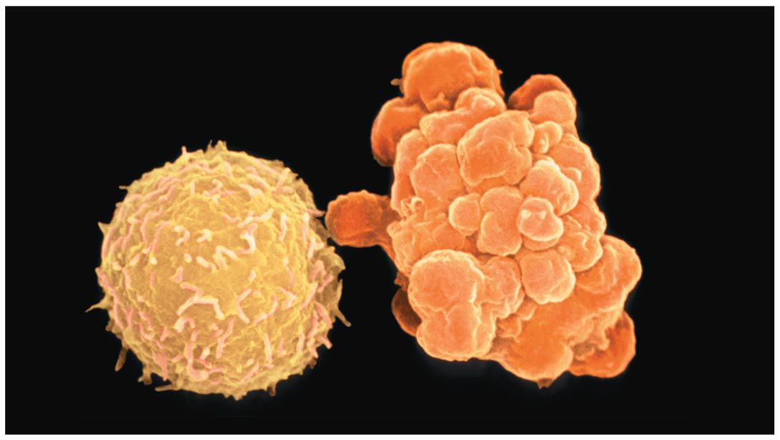
Figure 11.19
2 µm
Notes:
Figure 11.19 Apoptosis of a human white blood cell

Slide 60
Concept 11.5: Apoptosis integrates multiple cell-signaling pathways
Apoptosis evolved early in animal evolution and is essential for the DEVELOPMENT AND MAINTENANCE of all animals
For example, apoptosis is a normal part of development of hands and feet in humans (and paws in other mammals)
Apoptosis may be involved in some diseases (for example, Parkinson’s and Alzheimer’s); interference with apoptosis may contribute to some cancers

Slide 61
Figure 11.21
Cells undergoing apoptosis
Space between digits
Interdigital tissue
1 mm
Notes:
Figure 11.21 Effect of apoptosis during paw development in the mouse

Slide 62
Notes:
Which of the following describes the events of apoptosis?
https://www.polleverywhere.com/multiple_choice_polls/1qJTQwrYRLPi8Qv

Slide 63
Notes:
Why is apoptosis potentially threatening to the healthy "neighbors" of a dying cell?
https://www.polleverywhere.com/multiple_choice_polls/90vOiDOuj4Vuut4

Slide 64
REVIEW

Slide 65
LET’S REVIEW: The Three Stages of Cell Signaling
Cells receiving signals go through three processes
1. Reception: the target cell detects a signaling molecule that binds to a receptor protein on the cell surface

Slide 66
Figure 11.6-1
EXTRACELLULAR FLUID
CYTOPLASM
Plasma membrane
1
Reception
Receptor
Signaling molecule
Notes:
Figure 11.6-1 Overview of cell signaling (step 1)

Slide 67
LET’S REVIEW: The Three Stages of Cell Signaling
Cells receiving signals go through three processes
1. Reception: the target cell detects a signaling molecule that binds to a receptor protein on the cell surface
2. Transduction: the binding of the signaling molecule alters the receptor and initiates a signal transduction pathway; transduction often occurs in a series of steps

Slide 68
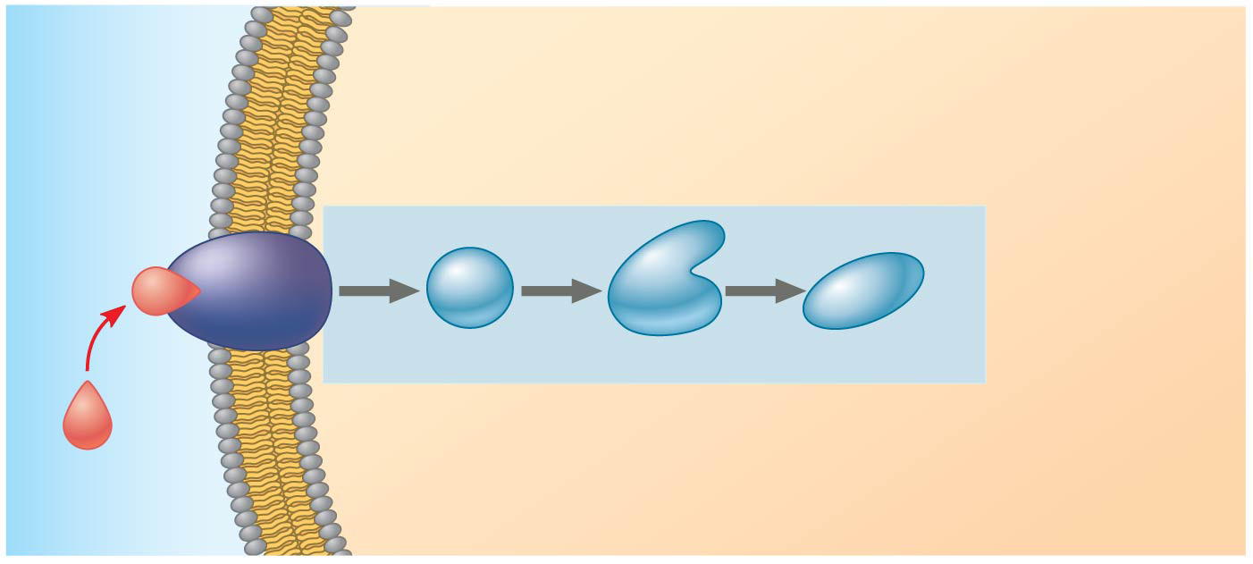
Figure 11.6-2
EXTRACELLULAR FLUID
CYTOPLASM
Plasma membrane
1
Reception
2
Transduction
Receptor
1
2
3
Relay molecules
Signaling molecule
Notes:
Figure 11.6-2 Overview of cell signaling (step 2)

Slide 69
LET’S REVIEW: The Three Stages of Cell Signaling
Cells receiving signals go through three processes
1. Reception: the target cell detects a signaling molecule that binds to a receptor protein on the cell surface
2. Transduction: the binding of the signaling molecule alters the receptor and initiates a signal transduction pathway; transduction often occurs in a series of steps
3. Response: the transduced signal triggers a specific response in the target cell

Slide 70
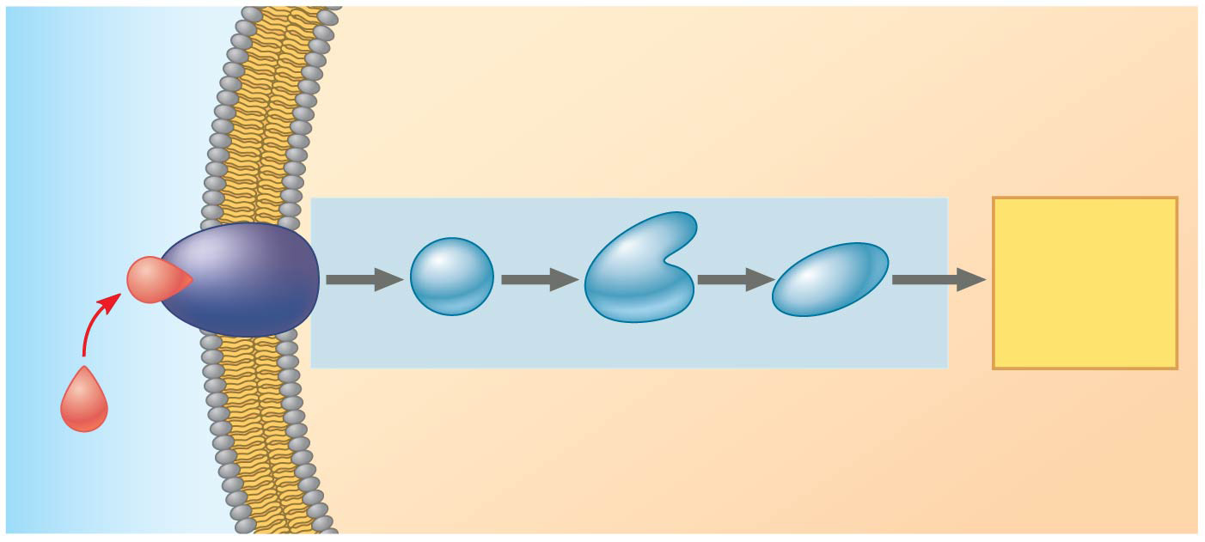
Figure 11.6-3
EXTRACELLULAR FLUID
CYTOPLASM
Plasma membrane
1
Reception
2
Transduction
3
Response
Receptor
Activation of cellular response
1
2
3
Relay molecules
Signaling molecule
Notes:
Figure 11.6-3 Overview of cell signaling (step 3)

Slide 71
DO THIS
http://www.wiley.com/legacy/college/boyer/0470003790/animations/signal_transduction/signal_transduction.htm
http://bcs.whfreeman.com/webpub/Ektron/pol1e/Animated%20Tutorials/at0505/at_0505_sig_trans_path.html

