Slide 1
0
12
The Cell Cycle

Slide 2
The Key Roles of Cell Division
The ability of organisms to produce more of their own kind best distinguishes living things from nonliving matter
The continuity of life is based on the reproduction of cells, or cell division

Slide 3
The Key Roles of Cell Division
In unicellular organisms, division of one cell reproduces the ENTIRE organism
Multicellular eukaryotes depend on cell division for
Development from a fertilized cell
Growth
Repair
Cell division is an integral part of the cell cycle, the life of a cell from formation to its own division

Slide 4
Overview
Concept 12.1: Most cell division results in genetically identical daughter cells
Concept 12.2: The mitotic phase alternates with interphase in the cell cycle
Concept 12.3: The eukaryotic cell cycle is regulated by a molecular control system

Slide 5
Overview
Concept 12.1: Most cell division results in genetically identical daughter cells
Concept 12.2: The mitotic phase alternates with interphase in the cell cycle
Concept 12.3: The eukaryotic cell cycle is regulated by a molecular control system

Slide 6
Concept 12.1: Most cell division results in genetically identical daughter cells
Most cell division results in daughter cells with IDENTICAL genetic information, DNA
The exception is meiosis, a special type of division that can produce sperm and egg cells

Slide 7
Cellular Organization of the Genetic Material
ALL THE DNA in a cell constitutes the cell’s genome
A genome can consist of:
A SINGLE DNA molecule (common in PROKARYOTIC cells) OR…
SEVERAL DNA molecules (common in EUKARYOTIC cells)

Slide 8
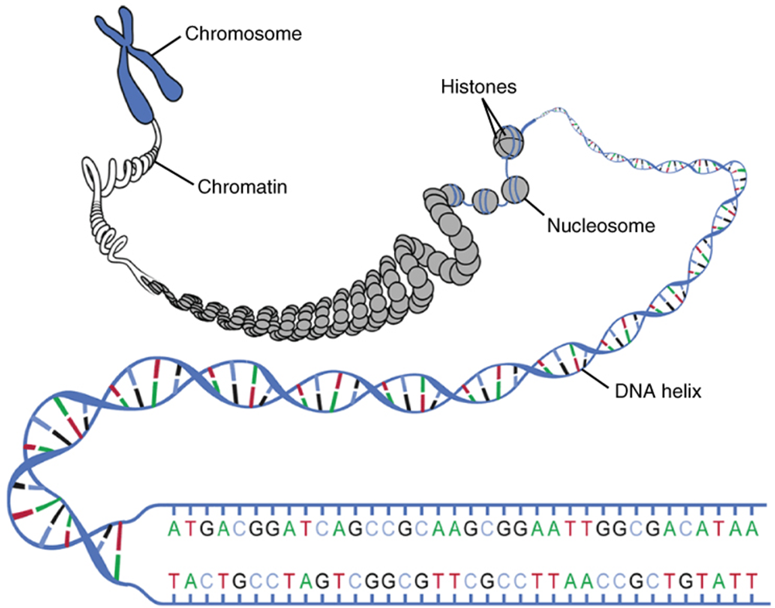
Cellular Organization of the Genetic Material
DNA molecules in a cell are packaged into chromosomes
Eukaryotic chromosomes consist of chromatin, a complex of DNA AND PROTEIN that condenses during cell division

Slide 9
Cellular Organization of the Genetic Material
Every eukaryotic species has a CHARACTERISTIC NUMBER of chromosomes in each cell nucleus
Somatic cells (“body” cells) have TWO SETS of chromosomes
Human somatic cells = 46 chromosomes
Gametes (sex cells: sperm and eggs) have HALF as many chromosomes as somatic cells
Human gamete cells = 23 chromosomes

Slide 10
Distribution of Chromosomes During Eukaryotic Cell Division
In preparation for cell division, DNA is REPLICATED and CONDENSES
Chromatin → condenses + replicates → duplicated chromosome
Each duplicated chromosome has two sister chromatids
JOINED COPIES of the original chromosome, attached along their lengths by cohesins
The centromere is the narrow “waist” of the duplicated chromosome, where the two sister chromatids are most CLOSELY ATTACHED

Slide 11
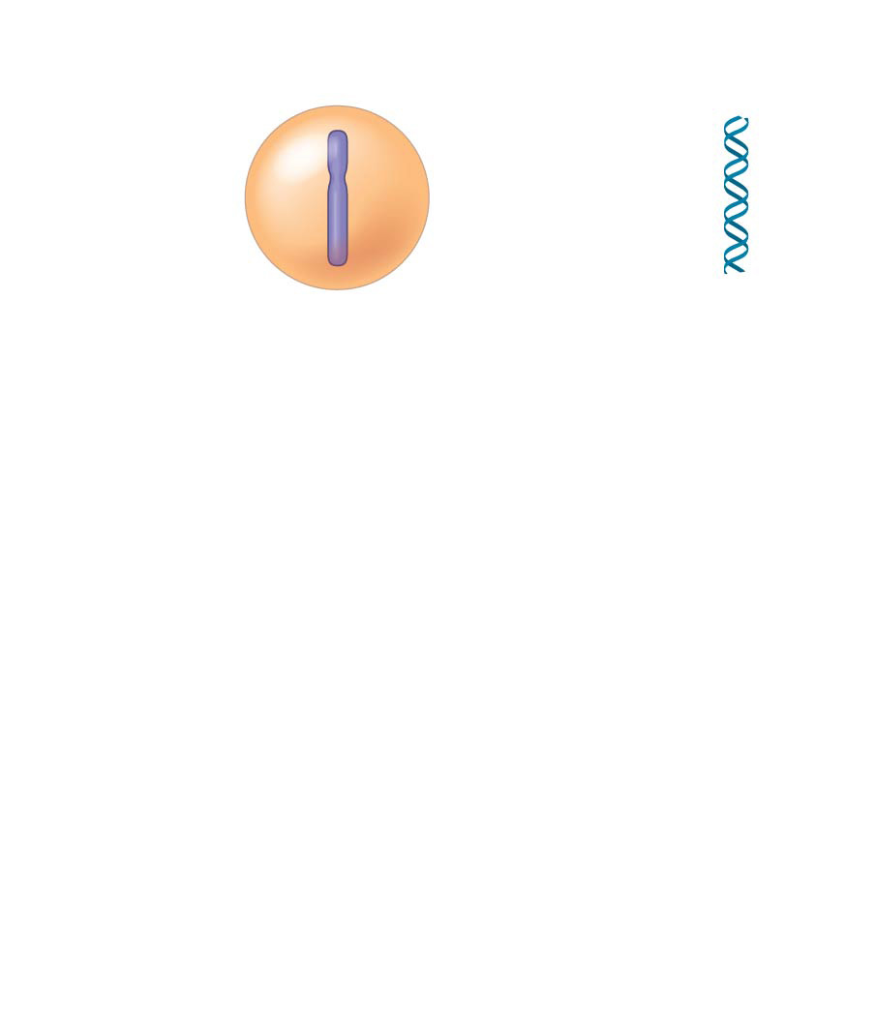
Figure 12.5-1
Chromosomal DNA molecules
Chromosomes
1
Centromere
Chromosome arm
Notes:
Figure 12.5-1 Chromosome duplication and distribution during cell division (step 1)

Slide 12
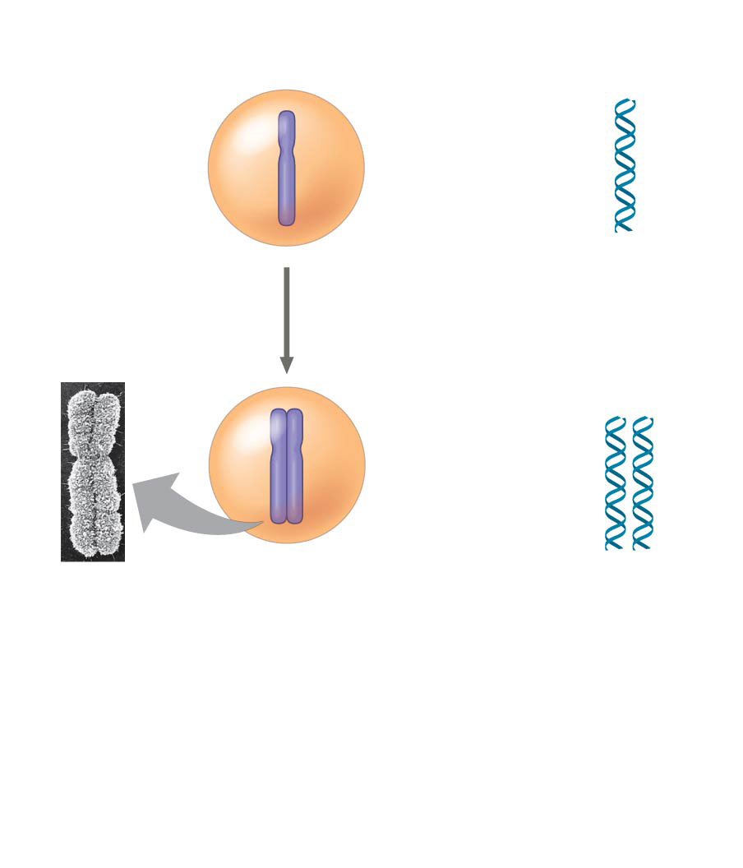
Figure 12.5-2
Chromosomal DNA molecules
Chromosomes
1
Centromere
Chromosome arm
Chromosome duplication
2
Sister chromatids
Notes:
Figure 12.5-2 Chromosome duplication and distribution during cell division (step 2)

Slide 13
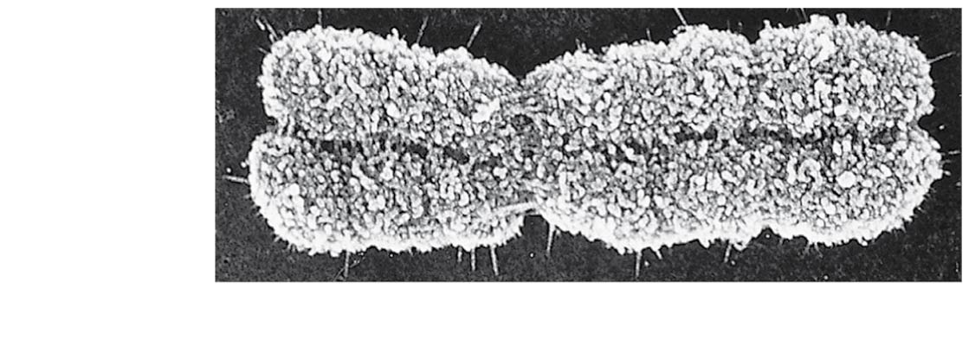
Figure 12.4
Distribution of Chromosomes During Eukaryotic Cell Division
Sister chromatids
Centromere
0.5 μm
Notes:
Figure 12.4 A highly condensed, duplicated human chromosome (SEM)

Slide 14
Distribution of Chromosomes During Eukaryotic Cell Division
During cell division, the two sister chromatids of each duplicated chromosome SEPARATE AND MOVE into two nuclei
Once separate, the chromatids are now called CHROMOSOMES

Slide 15
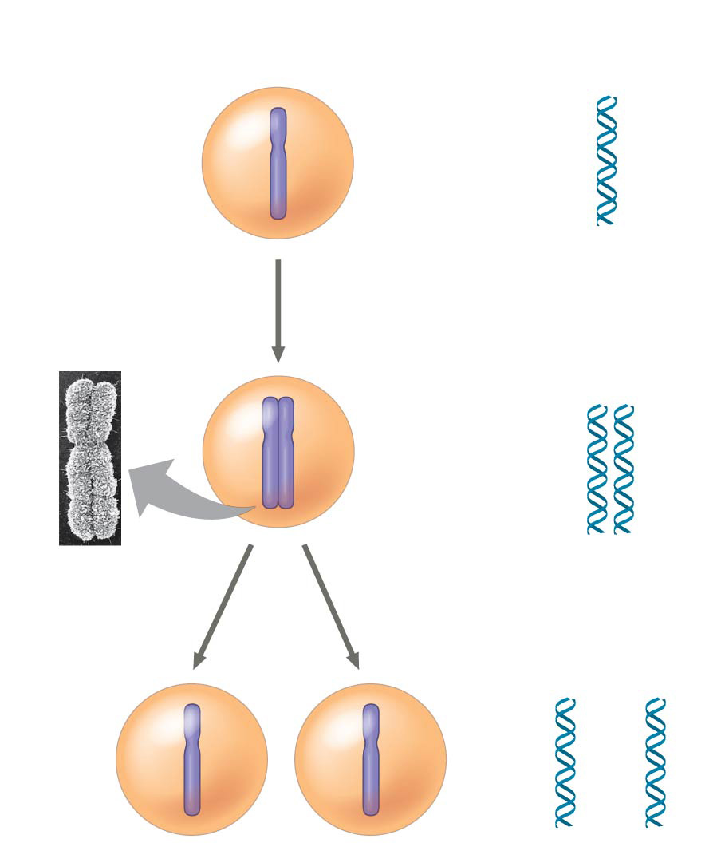
Figure 12.5-3
Chromosomal DNA molecules
Chromosomes
1
Centromere
Chromosome arm
Chromosome duplication
2
Sister chromatids
Separation of sister chromatids
3
Notes:
Figure 12.5-3 Chromosome duplication and distribution during cell division (step 3)

Slide 16
Notes:
Beginning with a fertilized egg (zygote), a series of five cell divisions would produce an early embryo with how many cells?
https://www.polleverywhere.com/multiple_choice_polls/UKwPED9erCmXc0P

Slide 17
Notes:
Before the start of the cell division cycle, a cell contains 20 chromatids. How many centromeres are present in this cell?
https://www.polleverywhere.com/multiple_choice_polls/TnbVEjurACYZRB6

Slide 18
Notes:
Eukaryotic chromatin is composed of
https://www.polleverywhere.com/multiple_choice_polls/PYPQDlnLimMzzX4

Slide 19
Notes:
Compared to most prokaryotic cells, eukaryotic cells typically have
https://www.polleverywhere.com/multiple_choice_polls/opO7AHeHprWnwe4

Slide 20
Overview
Concept 12.1: Most cell division results in genetically identical daughter cells
Concept 12.2: The mitotic phase alternates with interphase in the cell cycle
Concept 12.3: The eukaryotic cell cycle is regulated by a molecular control system

Slide 21
Concept 12.2: The mitotic phase alternates with interphase in the cell cycle
The cell cycle consists of
Interphase: Cell growth and copying of chromosomes in PREPARATION for cell division
Mitotic (M) phase: Mitosis & cytokinesis
2a. Mitosis = the division of the genetic material in the NUCLEUS
2b. Cytokinesis = the division of the CYTOPLASM

Slide 22
Concept 12.2: The mitotic phase alternates with interphase in the cell cycle
Interphase (about 90% (!!!) of the cell cycle) can be divided into sub-phases
G₁ phase: “first gap” phase = cell growth
S phase: “synthesis” phase = cell growth + CHROMOSOMAL DUPLICATION
G₂ phase: “second gap” phase = cell growth

Slide 23
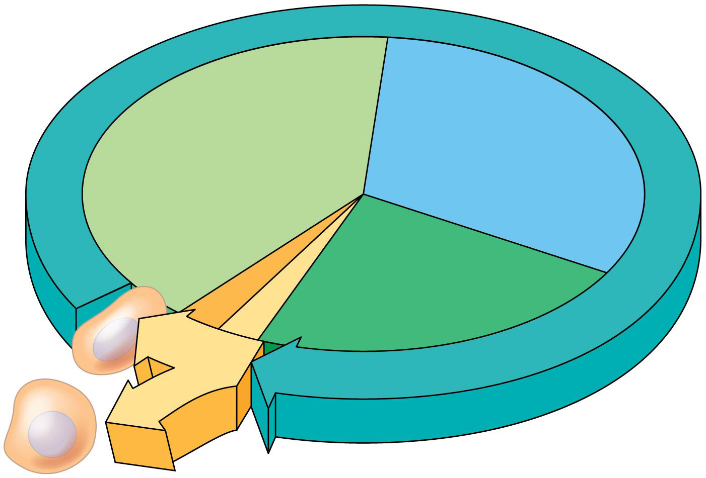
Figure 12.6
S
G₁
(DNA synthesis)
Cytokinesis
G₂
Mitosis
MITOTIC
(M) PHASE
Notes:
Figure 12.6 The cell cycle

Slide 24
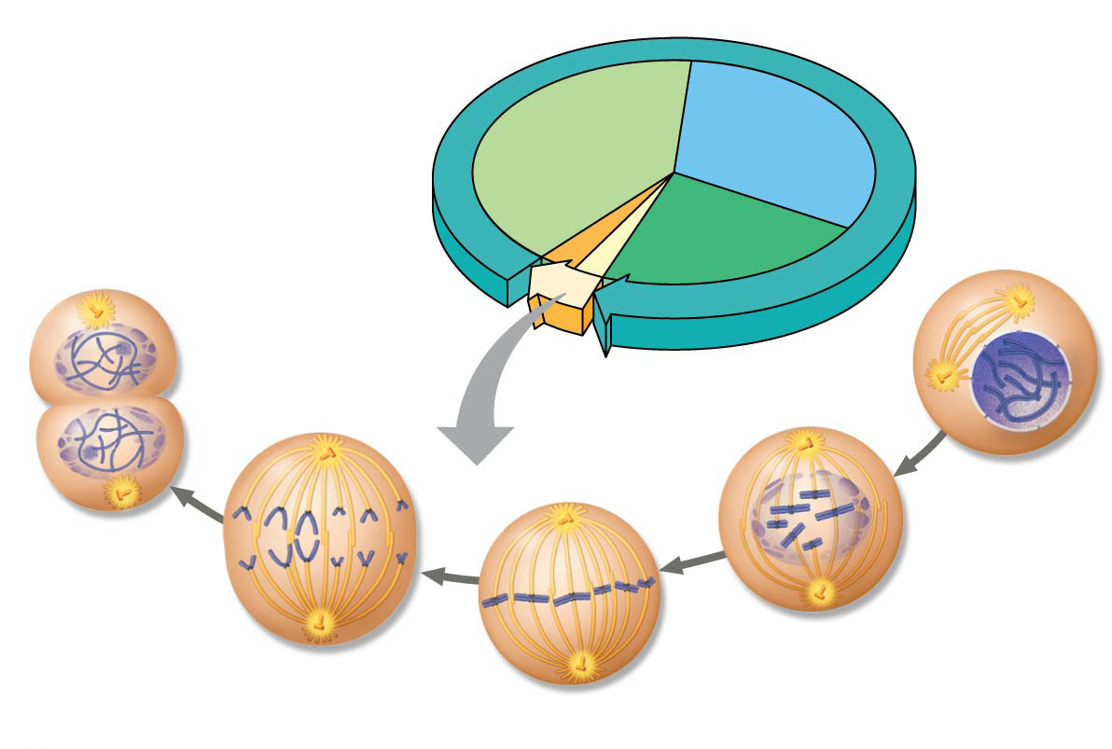
Figure 12.UN02
G₁
S
Cytokinesis
Mitosis
G₂
MITOTIC (M) PHASE
Prophase
Telophase and Cytokinesis
Prometaphase
Anaphase
Metaphase
Notes:
Figure 12.UN02 Summary of key concepts: mitotic (M) phase

Slide 25
The Mitotic Spindle: Intro
The mitotic spindle is a structure made of microtubules that controls chromosome movement during mitosis. It is made up of…
Centrosomes
Spindle microtubules
Asters

Slide 26
The Mitotic Spindle: Intro
In animal cells, assembly of spindle microtubules begins in the centrosome, the microtubule organizing center
The centrosome replicates during interphase, forming two centrosomes that migrate to opposite ends of the cell during prophase and prometaphase
An aster (a radial array of short microtubules) extends from each centrosome

Slide 27
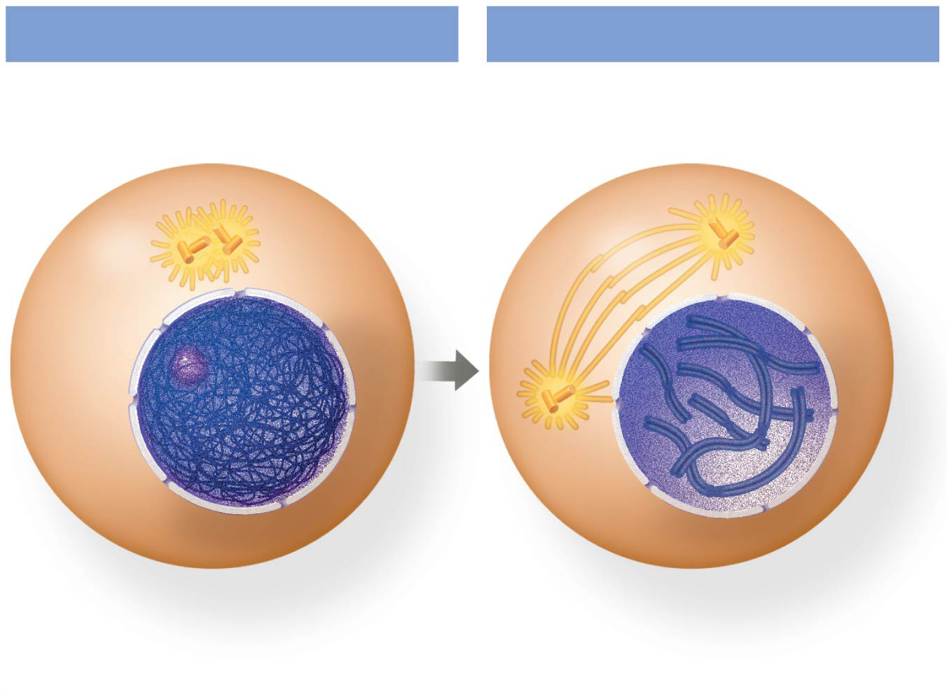
Figure 12.7c
G₂ of Interphase
Prophase
Centrosomes (with centriole pairs)
Chromatin (duplicated, uncondensed)
Early mitotic spindle
Aster
Centromere
Plasma membrane
Nucleolus
Two sister chromatids of one chromosome
Nuclear envelope
Notes:
Figure 12.7c Exploring mitosis in an animal cell (part 3: G₂ of interphase and prophase)

Slide 28
Figure 12.UN02
G₁
S
Cytokinesis
X
Mitosis
G₂
X
MITOTIC (M) PHASE
Prophase
Telophase and Cytokinesis
Prometaphase
Anaphase
Metaphase
Notes:
Figure 12.UN02 Summary of key concepts: mitotic (M) phase

Slide 29
The Mitotic Spindle: Prometaphase & Metaphase
During prometaphase, some spindle microtubules attach to the kinetochores of chromosomes and begin to move the chromosomes
Kinetochores are protein complexes associated with centromeres
At metaphase, the chromosomes are all lined up at the metaphase plate, a plane midway between the spindle’s two poles

Slide 30
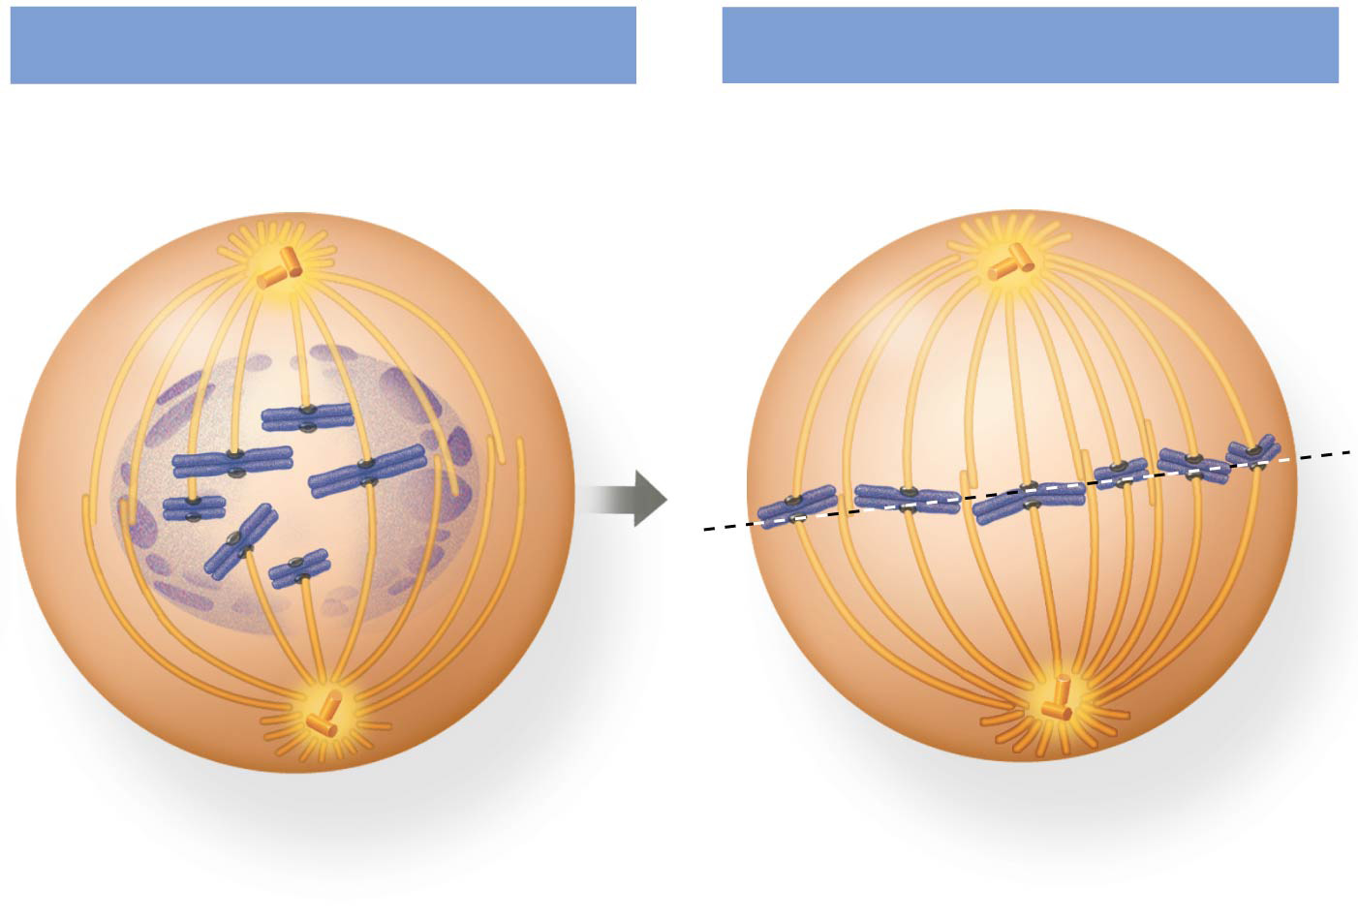
Figure 12.7d
Prometaphase
Metaphase
Fragments of nuclear envelope
Nonkinetochore microtubules
Metaphase plate
Kinetochore
Kinetochore microtubule
Spindle
Centrosome at one spindle pole
Notes:
Figure 12.7d Exploring mitosis in an animal cell (part 4: prometaphase and metaphase)

Slide 31
Figure 12.UN02
G₁
S
Cytokinesis
X
Mitosis
G₂
X
MITOTIC (M) PHASE
X
X
Prophase
Telophase and Cytokinesis
Prometaphase
Anaphase
Metaphase
Notes:
Figure 12.UN02 Summary of key concepts: mitotic (M) phase

Slide 32
The Mitotic Spindle: Anaphase
In anaphase the cohesins are cleaved by an enzyme called separase
Sister chromatids separate and move along the kinetochore microtubules toward opposite ends of the cell
The microtubules shorten by depolymerizing at their kinetochore ends

Slide 33
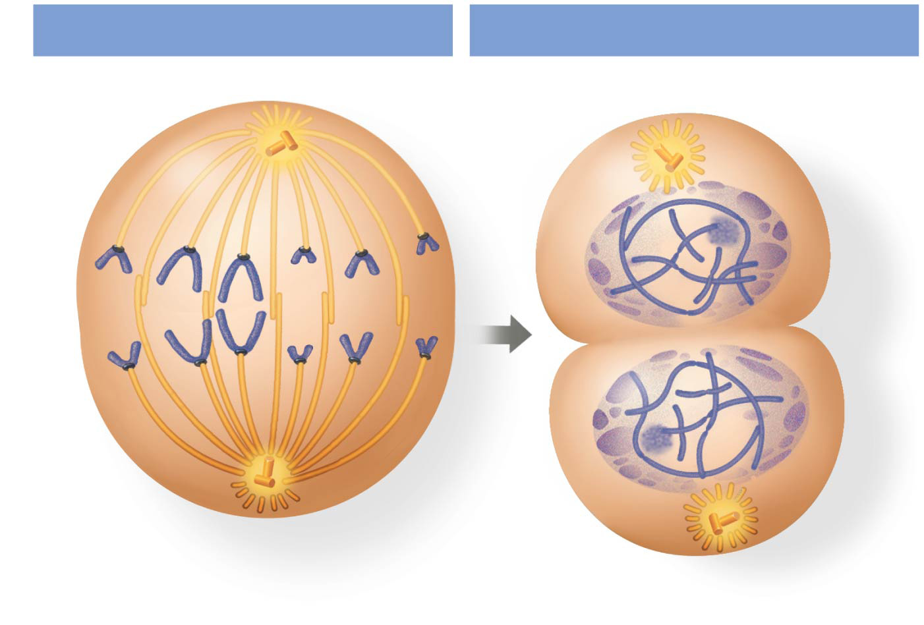
Figure 12.7e
Anaphase
Telophase and Cytokinesis
Cleavage furrow
Nucleolus forming
Daughter chromosomes
Nuclear envelope forming
Notes:
Figure 12.7e Exploring mitosis in an animal cell (part 5: anaphase, telophase and cytokinesis)

Slide 34
The Mitotic Spindle: Telophase & Cytokinesis
Nonkinetochore microtubules from opposite poles overlap and push against each other, elongating the cell
In telophase, genetically identical daughter nuclei form at opposite ends of the cell
Cytokinesis begins during anaphase or telophase and the spindle eventually disassembles

Slide 35
Figure 12.7e
Anaphase
Telophase and Cytokinesis
Cleavage furrow
Nucleolus forming
Daughter chromosomes
Nuclear envelope forming
Notes:
Figure 12.7e Exploring mitosis in an animal cell (part 5: anaphase, telophase and cytokinesis)

Slide 36
Cytokinesis: A Closer Look
In animal cells, cytokinesis occurs by a process known as cleavage, forming a cleavage furrow.

Slide 37
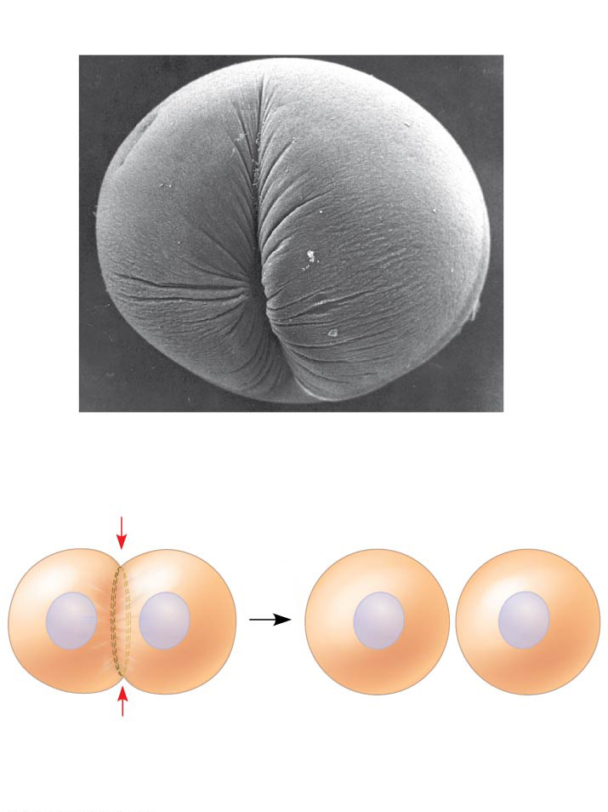
Figure 12.10a
(a) Cleavage of an animal cell (SEM)
Cleavage furrow
100 µm
Contractile ring of microfilaments
Daughter cells
Notes:
Figure 12.10a Cytokinesis in animal and plant cells (part 1: cleavage of animal cell)

Slide 38
Cytokinesis: A Closer Look
In plant cells, a cell plate forms during cytokinesis

Slide 39
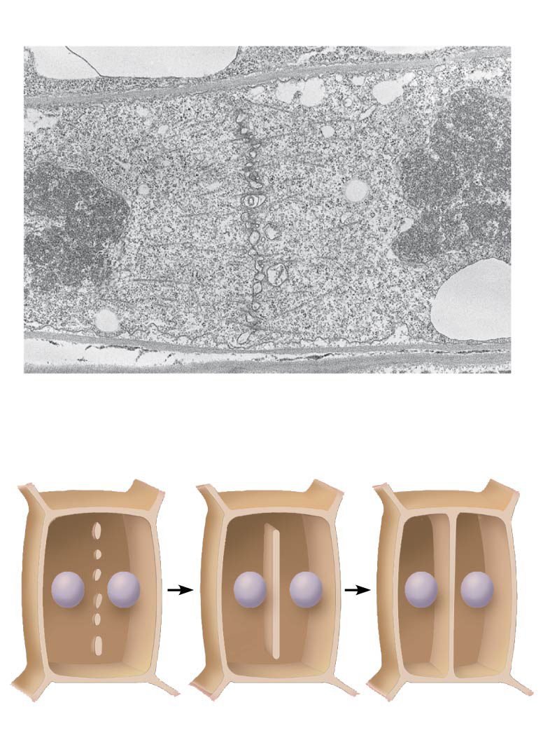
Figure 12.10b
(b) Cell plate formation in a plant cell (TEM)
Vesicles forming cell plate
Wall of parent cell
1 µm
Cell plate
New cell wall
Daughter cells
Notes:
Figure 12.10b Cytokinesis in animal and plant cells (part 2: cell plate formation in plant cell)

Slide 40
Figure 12.UN02
G₁
S
Cytokinesis
X
Mitosis
G₂
X
X
MITOTIC (M) PHASE
X
X
X
Prophase
Telophase and Cytokinesis
Prometaphase
Anaphase
Metaphase
Notes:
Figure 12.UN02 Summary of key concepts: mitotic (M) phase

Slide 41
BioFlix: Mitosis

Slide 42
Binary Fission in Bacteria
Prokaryotes (bacteria and archaea) reproduce by a type of cell division called binary fission
In binary fission, the chromosome replicates (beginning at the origin of replication), and the two daughter chromosomes actively move apart
The plasma membrane pinches inward, dividing the cell into two

Slide 43
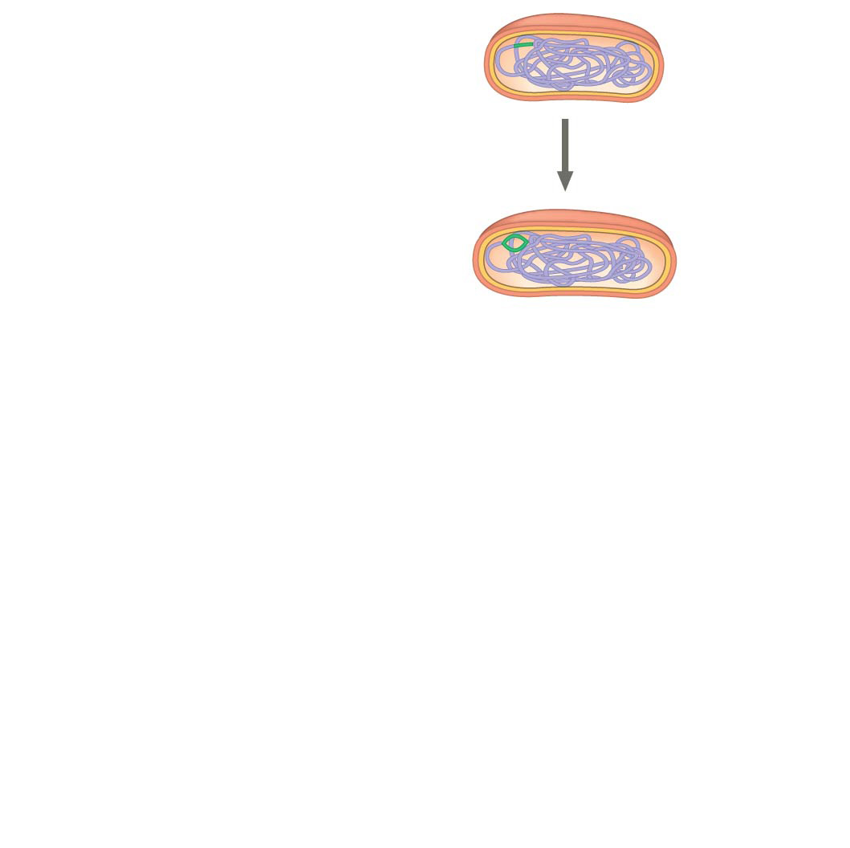
Figure 12.12-1
Cell wall
Origin of replication
Plasma membrane
E. coli cell
Bacterial chromosome
1
Chromosome replication begins.
Two copies of origin
Notes:
Figure 12.12-1 Bacterial cell division by binary fission (step 1)

Slide 44
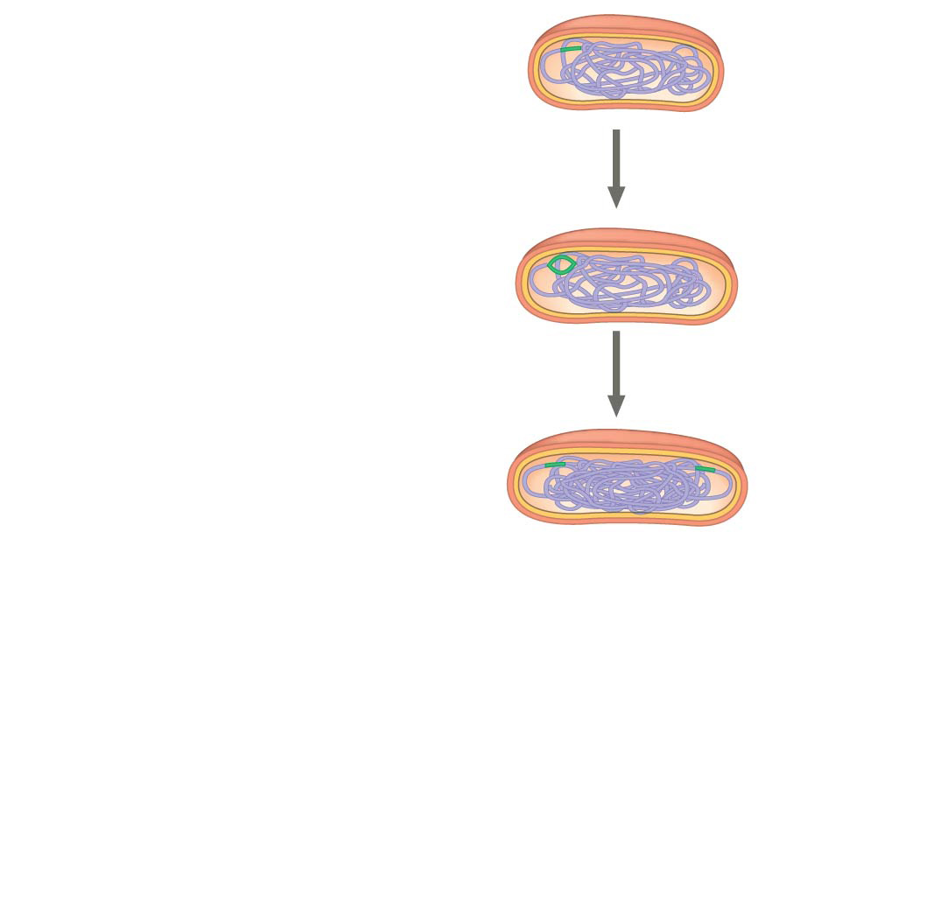
Figure 12.12-2
Cell wall
Origin of replication
Plasma membrane
E. coli cell
Bacterial chromosome
1
Chromosome replication begins.
Two copies of origin
2
One copy of the origin is now at each end of the cell.
Origin
Origin
Notes:
Figure 12.12-2 Bacterial cell division by binary fission (step 2)

Slide 45
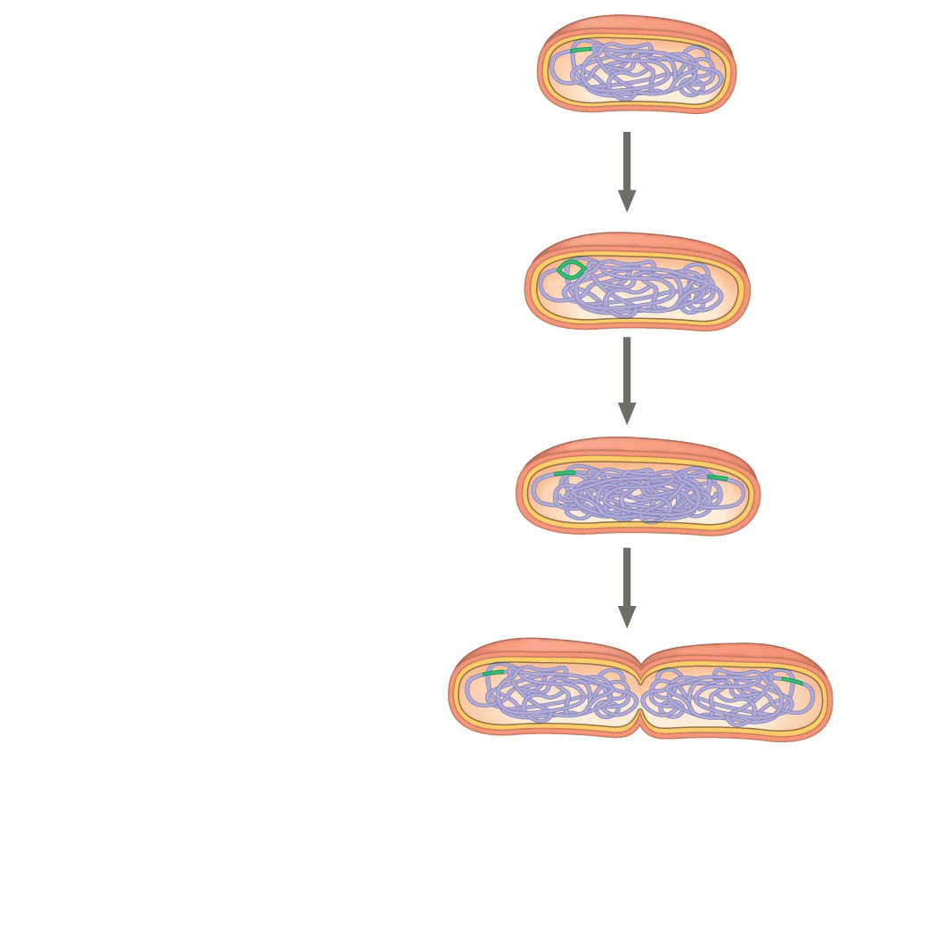
Figure 12.12-3
Cell wall
Origin of replication
Plasma membrane
E. coli cell
Bacterial chromosome
1
Chromosome replication begins.
Two copies of origin
2
One copy of the origin is now at each end of the cell.
Origin
Origin
3
Replication finishes.
Notes:
Figure 12.12-3 Bacterial cell division by binary fission (step 3)

Slide 46
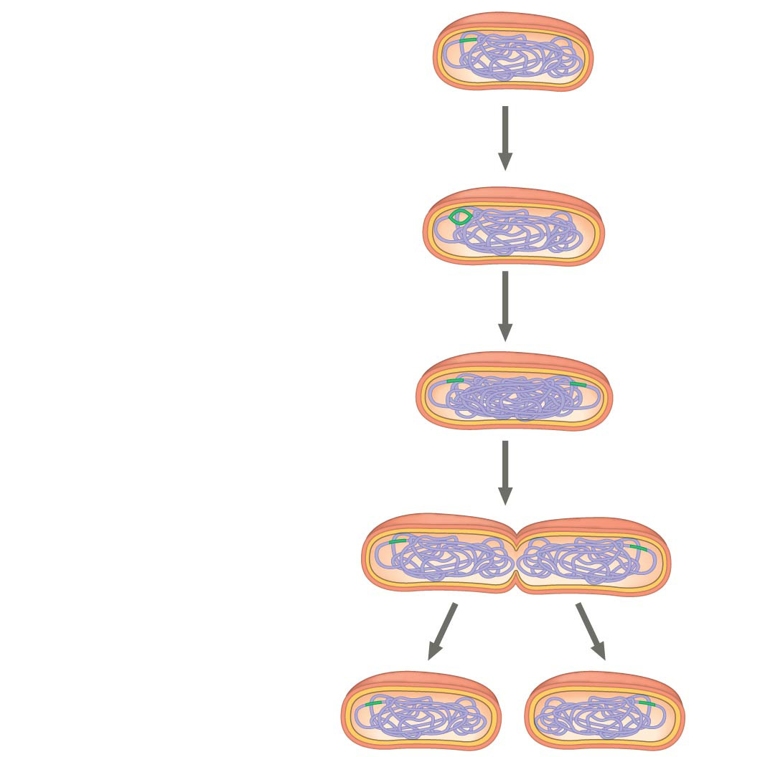
Figure 12.12-4
Cell wall
Origin of replication
Plasma membrane
E. coli cell
Bacterial chromosome
1
Chromosome replication begins.
Two copies of origin
2
One copy of the origin is now at each end of the cell.
Origin
Origin
3
Replication finishes.
4
Two daughter cells result.
Notes:
Figure 12.12-4 Bacterial cell division by binary fission (step 4)

Slide 47
Notes:
During mitosis in animal cells, at which phase do centrioles begin to move apart?
https://www.polleverywhere.com/multiple_choice_polls/nOtdJjC7jKAPqXV

Slide 48
Notes:
If there are 20 centromeres in a cell at anaphase of mitosis, how many chromosomes are there in each daughter cell following cytokinesis?
https://www.polleverywhere.com/multiple_choice_polls/nLjhaUvCDaADfze

Slide 49
Notes:
Movement of the chromosomes during anaphase would be most affected by a drug that prevents
https://www.polleverywhere.com/multiple_choice_polls/WpKp0gqKkConcNP

Slide 50
Notes:
Measurements of the amount of DNA per nucleus were taken on a large number of cells from a growing fungus. The measured DNA levels ranged from 3 to 6 picograms per nucleus. In which stage of the cell cycle would the nucleus contain 6 picograms of DNA?
https://www.polleverywhere.com/multiple_choice_polls/wrx24hckHCIdFvR

Slide 51
Notes:
A group of cells is assayed for DNA content immediately before beginning mitosis and is found to have an average of 16 picograms of DNA per nucleus. How many picograms would be in a cell nucleus following completion of mitosis and cytokinesis?
https://www.polleverywhere.com/multiple_choice_polls/qtebxln5CGqAJDK

Slide 52
Notes:
Where do the microtubules of the spindle originate during mitosis in animal cells?
https://www.polleverywhere.com/multiple_choice_polls/CQPY2hpZR9VjrMc

Slide 53
Overview
Concept 12.1: Most cell division results in genetically identical daughter cells
Concept 12.2: The mitotic phase alternates with interphase in the cell cycle
Concept 12.3: The eukaryotic cell cycle is regulated by a molecular control system

Slide 54
Concept 12.3: The eukaryotic cell cycle is regulated by a molecular control system
The frequency of cell division VARIES with the type of cell
These differences result from REGULATION at the molecular level
The cell cycle appears to be driven by SPECIFIC CHEMICAL SIGNALS present in the cytoplasm
Cancer cells manage to escape the usual controls on the cell cycle

Slide 55
The Cell Cycle Control System
The sequential events of the cell cycle are directed by a distinct cell cycle control system, which is similar to a clock
The cell cycle control system is regulated by both internal and external controls
The clock has specific checkpoints where the cell cycle stops until a go-ahead signal is received

Slide 56
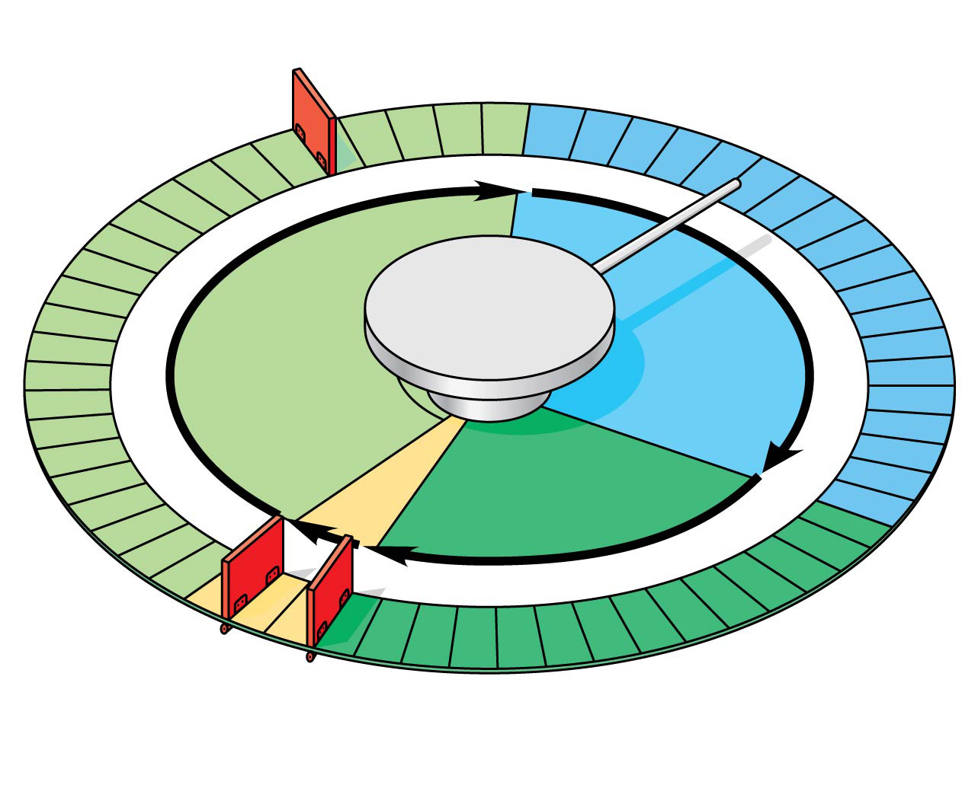
Figure 12.15
G₁ checkpoint
Control system
S
G₁
M
G₂
M checkpoint
G₂ checkpoint
Notes:
Figure 12.15 Mechanical analogy for the cell cycle control system

Slide 57
The Cell Cycle Clock: Cyclins and Cyclin-Dependent Kinases
Two types of regulatory proteins are involved in cell cycle control: cyclins and cyclin-dependent kinases (Cdks)
The activity of a Cdk rises and falls with changes in concentration of its cyclin partner
MPF (maturation-promoting factor) is a cyclin-Cdk complex that triggers a cell’s passage past the G₂ checkpoint into the M phase

Slide 58
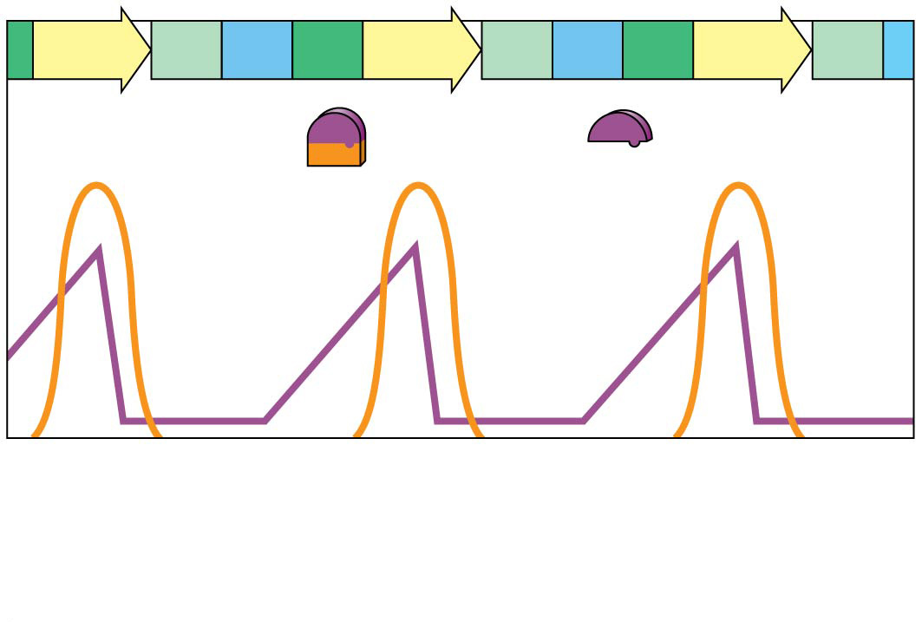
Figure 12.16a
M
G₁
S
G₂
M
G₁
S
G₂
M
G₁
MPF activity
Cyclin concentration
Time
(a) Fluctuation of MPF activity and cyclin concentration during the cell cycle
Notes:
Figure 12.16a Molecular control of the cell cycle at the G₂ checkpoint (part 1: MPF activity)

Slide 59
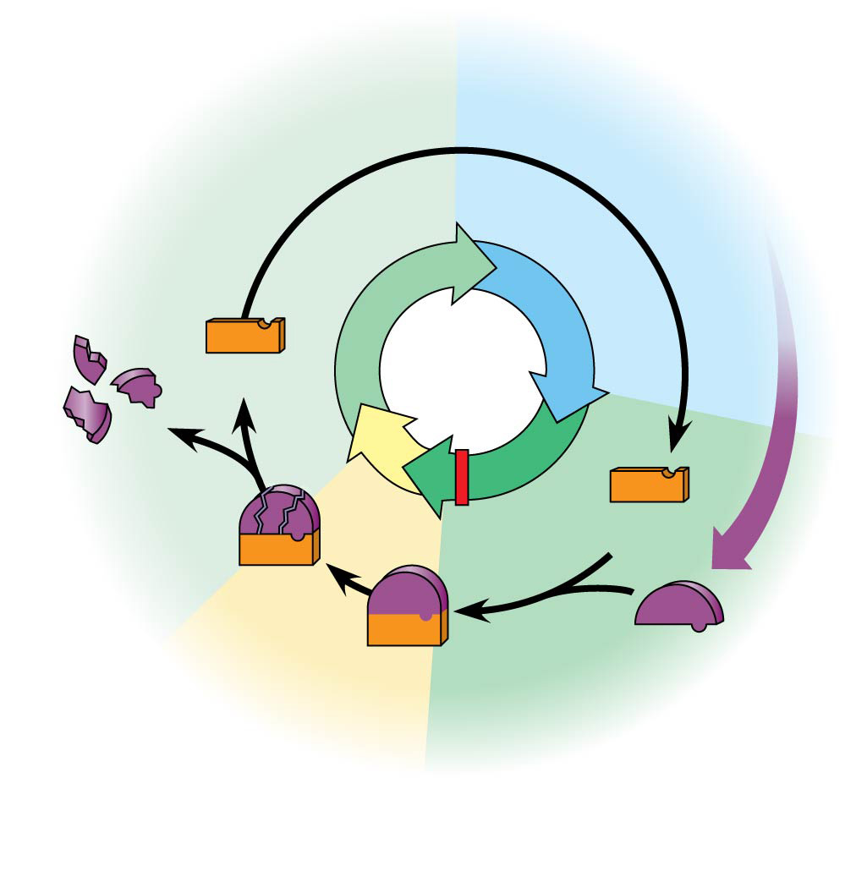
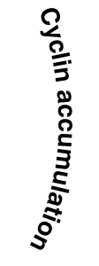
Figure 12.16b
G₁
S
Cdk
M
Degraded cyclin
G₂
Cdk
Cyclin is degraded
MPF
Cyclin
G₂ checkpoint
(b) Molecular mechanisms that help regulate the cell cycle
Notes:
Figure 12.16b Molecular control of the cell cycle at the G₂ checkpoint (part 2: molecular mechanisms)

Slide 60
Stop and Go Signs: Internal and External Signals as the Checkpoints
Many signals registered at CHECKPOINTS come from cellular surveillance mechanisms WITHIN the cell
Three important checkpoints are those in G₁, G₂, and M phases

Slide 61
Stop and Go Signs: Internal G₁ checkpoint
For many cells, the G₁ checkpoint seems to be the MOST IMPORTANT
If a cell receives a go-ahead signal at the G₁ checkpoint, it will usually complete the S, G₂, and M phases and divide
If the cell does not receive the go-ahead signal, it will EXIT THE CYCLE, switching into a NONDIVIDING state called the G₀ phase

Slide 62
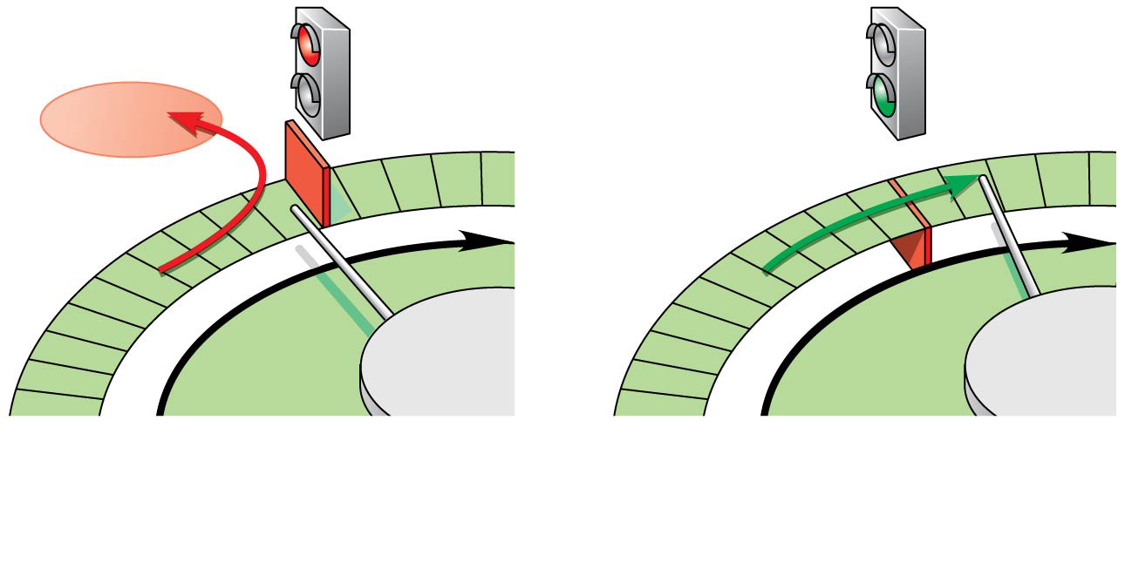
Figure 12.17a
G₁ checkpoint
G₀
G₁
G₁
Without go-ahead signal, cell enters G₀.
With go-ahead signal, cell continues cell cycle.
(a) G₁ checkpoint
Notes:
Figure 12.17a Two important checkpoints (part 1: G₁ checkpoint)

Slide 63
Stop and Go Signs:
Stop and Go Signs: Internal M Phase checkpoint
An example of an internal signal is that cells will not begin anaphase until all chromosomes are properly attached to the spindle at the metaphase plate
This mechanism assures that daughter cells have the correct number of chromosomes

Slide 64
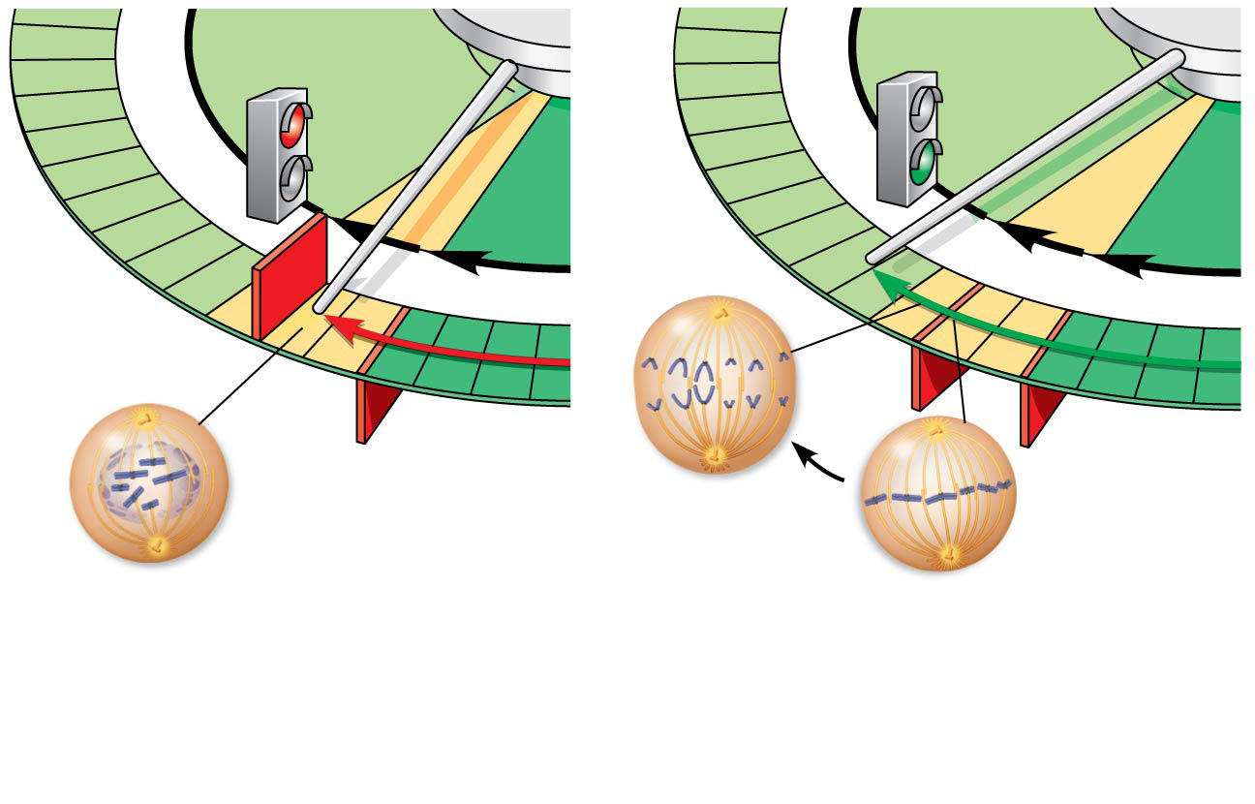
Figure 12.17b
G₁
G₁
M
G₂
M
G₂
M checkpoint
G₂ checkpoint
Anaphase
Prometaphase
Metaphase
Without full chromosome attachment, stop signal is received.
With full chromosome attachment, go-ahead signal is received.
(b) M checkpoint
Notes:
Figure 12.17b Two important checkpoints (part 2: M checkpoint)

Slide 65
Loss of Cell Cycle Controls in Cancer Cells
Cancer cells DO NOT respond normally to the body’s control mechanisms
They may have an ABNORMAL cell cycle control system
A normal cell is converted to a cancerous cell by a process called transformation
Cancer cells that are not eliminated by the immune system form TUMORS, masses of ABNORMAL CELLS within otherwise normal tissue

Slide 66
Loss of Cell Cycle Controls in Cancer Cells
If abnormal cells remain ONLY at the original site, the lump is called a benign tumor
Malignant tumors invade SURROUNDING tissues
Metastasis: exporting of cancer cells to other parts of the body, where they may form ADDITIONAL tumors

Slide 67
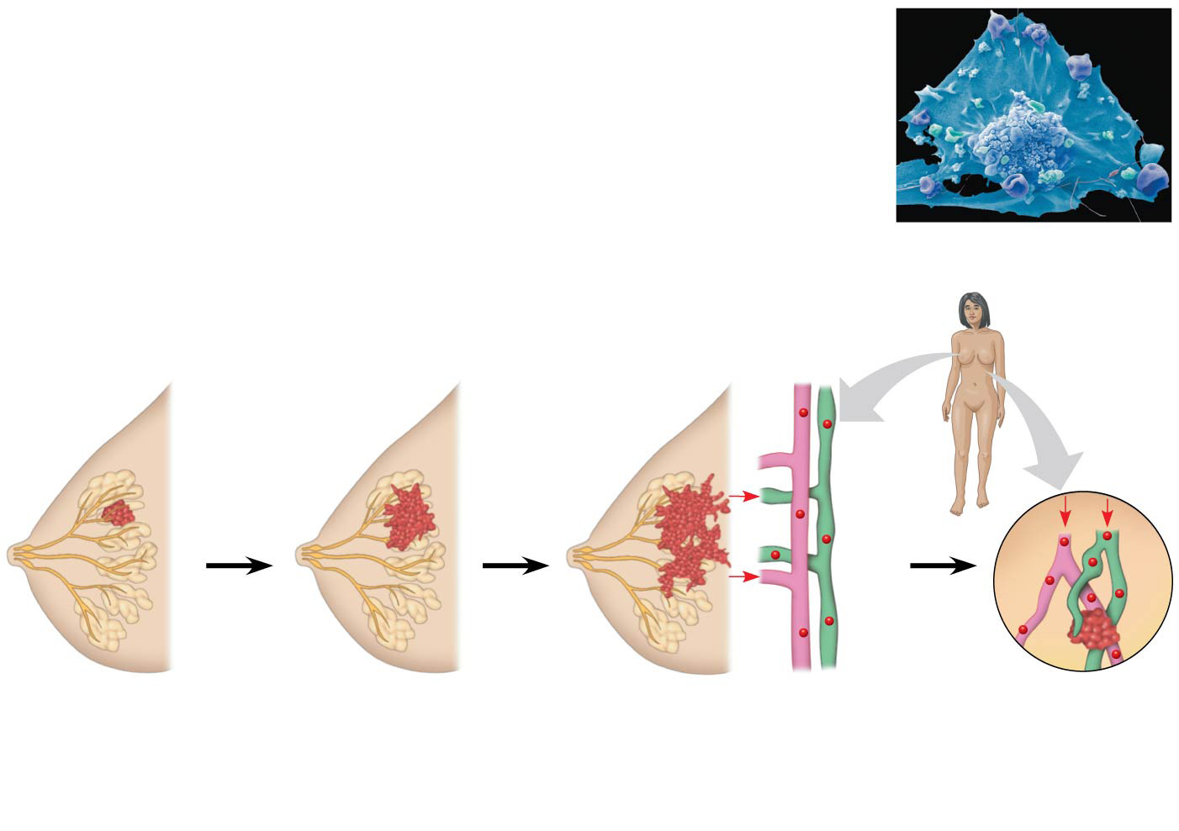
Figure 12.20
5 µm
Breast cancer cell (colorized SEM)
Metastatic tumor
Lymph vessel
Tumor
Blood vessel
Glandular tissue
Cancer cell
1
A tumor grows from a single cancer cell.
2
Cancer cells invade neighboring tissue.
3
Cancer cells spread through lymph and blood vessels to other parts of the body.
4
A small percentage of cancer cells may metastasize to another part of the body.
Notes:
Figure 12.20 The growth and metastasis of a malignant breast tumor

Slide 68
Notes:
Which is the first checkpoint in the cell cycle where a cell will be caused to exit the cycle if this point is not passed?
https://www.polleverywhere.com/multiple_choice_polls/53Wl5F7wCpOCWlE

Slide 69
Notes:
Why do neurons and some other specialized cells divide infrequently?
https://www.polleverywhere.com/multiple_choice_polls/N1hd11b2MG4V8zY

Slide 70
Notes:
MPF is a dimer consisting of _____.
https://www.polleverywhere.com/multiple_choice_polls/4sX0eM0QnswC7KI

Slide 71
Notes:
What happens if MPF (mitosis-promoting factor) is introduced into immature frog oocytes that are arrested in G2?
https://www.polleverywhere.com/multiple_choice_polls/0eDMl4qMB48IOdB

Slide 72
Notes:
Besides the ability of some cancer cells to overproliferate, what else could logically result in a tumor?
https://www.polleverywhere.com/multiple_choice_polls/kn6AAsnt1nIcFEv

Slide 73
Overview
Concept 12.1: Most cell division results in genetically identical daughter cells
Concept 12.2: The mitotic phase alternates with interphase in the cell cycle
Concept 12.3: The eukaryotic cell cycle is regulated by a molecular control system

Slide 74
Summary
The cell cycle is a complex set of stages that is HIGHLY REGULATED with checkpoints, which determine the ultimate fate of the cell
Mitosis alternates with interphase in the cell cycle
Interphase (PREP PHASE) consists of 3 phases;
G1 Phase (growth/prep), S Phase (growth/prep + DNA synthesis), and G2 Phase (more growth/prep)
When a cell SPECIALIZES, it often enters into a stage where it NO LONGER DIVIDES.
Nondividing cells may EXIT the cell cycle completely or REMAIN at a particular stage in the cycle

Slide 75
Summary
Mitosis passes down a COMPLETE GENOME from parent cell to daughter cellS
It plays a role in growth, repair, and asexual reproduction
It occurs AFTER the DNA/genome has been replicated
It is a CONTNIOUS process with characteristic and observable structural changes along its steps including replication, alignment, and separation.
It is followed by cytokinesis, which produces TWO genetically IDENTICAL daughter cellS

Slide 76
Summary
The cell cycle is DIRECTED by internal controls and checkpoints
Internal signals provide stop-and-go signs at the checkpoints. These include:
MPF, cyclin, and CDKs
Cancer results from DISRUPTIONS in cell cycle controls

