Slide 1
AP Biology – Ch. 16+17+18 – DNA + Gene Expression + Gene Regulation
AP Exam Questions

Slide 2
Do Now
Draw a model of the operon in your notes.
True/False: Our genes are arranged as operons

Slide 3
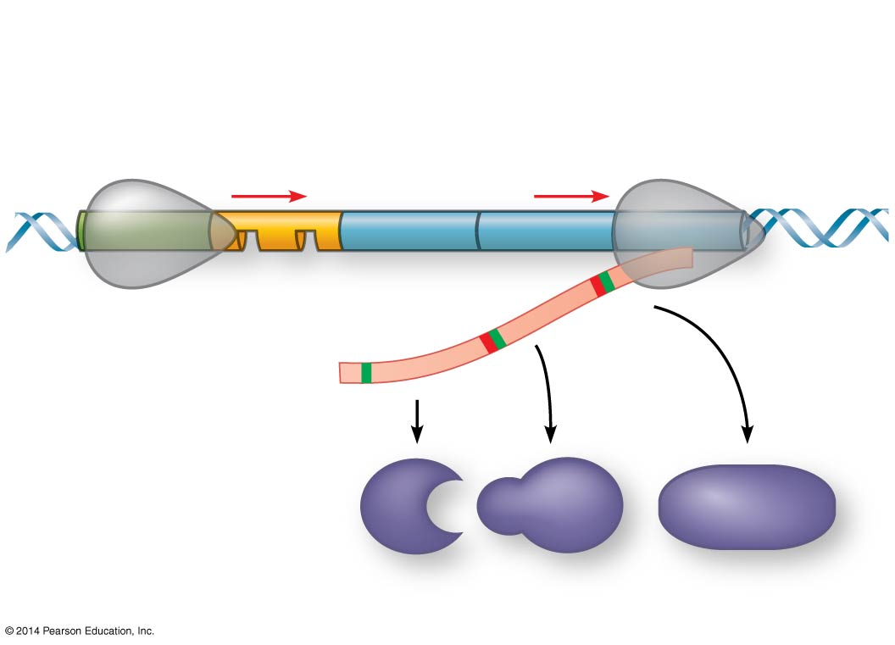
Figure 18.UN06
Operon
Promoter
Genes
A B C
Operator
RNA polymerase
A B C
Polypeptides
True/False: Our genes are arranged as operons
Notes:
Figure 18.UN06 Summary of key concepts: operon, general

Slide 4
Overview
Today, we’ll be answering and analyzing real AP biology multiple choice exam questions on DNA (Ch. 16.1-16.3), Gene Expression (Ch. 17.1-17.4), and Gene Regulation (Ch. 18.1-18.4).
I will walk us through questions 1-3.
We will complete questions 4-8 as a class in groups.
You will complete questions 9-20 independently using the strategies learned today.

Slide 5
Bloom’s taxonomy
Levels of Questions
Level 1: Knowledge/comprehension
Level 2: Application/analysis
Level 3: Synthesis/evaluation

Slide 6
Question 1
In his transformation experiments, what did Griffith observe?
A) Mixing a heat-killed pathogenic strain of bacteria with a living nonpathogenic strain can convert some of the living cells into the pathogenic form.
B) Mixing a heat-killed nonpathogenic strain of bacteria with a living pathogenic strain makes the pathogenic strain nonpathogenic.
C) Infecting mice with nonpathogenic strains of bacteria makes them resistant to pathogenic strains.
D) Mice infected with a pathogenic strain of bacteria can spread the infection to other mice.
Bloom's Taxonomy: Knowledge/Comprehension
Section: 16.1

Slide 7
Question 1
In his transformation experiments, what did Griffith observe?
A) Mixing a heat-killed pathogenic strain of bacteria with a living nonpathogenic strain can convert some of the living cells into the pathogenic form.
B) Mixing a heat-killed nonpathogenic strain of bacteria with a living pathogenic strain makes the pathogenic strain nonpathogenic.
C) Infecting mice with nonpathogenic strains of bacteria makes them resistant to pathogenic strains.
D) Mice infected with a pathogenic strain of bacteria can spread the infection to other mice.
Bloom's Taxonomy: Knowledge/Comprehension
Section: 16.1

Slide 8
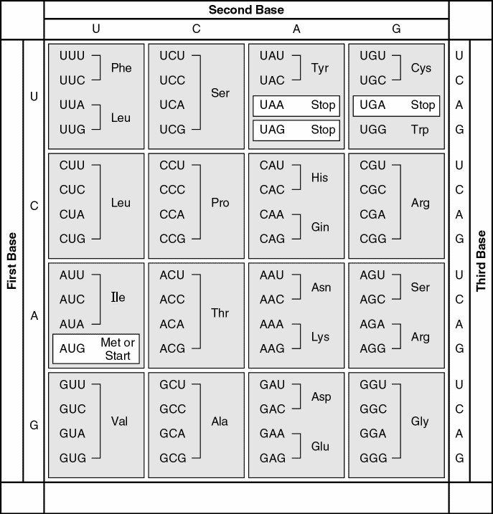
Question 2
A possible sequence of nucleotides in the template strand of DNA that would code for the polypeptide sequence phe-leu-ile-val would be _____.
A) 5’—TTG-CTA-CAG-TAG—3’
B) 5’—AUG-CTG-CAG-TAT—3’
C) 3’—AAA-AAT-ATA-ACA—5’
D) 3’—AAA-GAA-TAA-CAA —5’
Bloom's Taxonomy: Application/Analysis
Section: 17.1

Slide 9
Question 2
A possible sequence of nucleotides in the template strand of DNA that would code for the polypeptide sequence phe-leu-ile-val would be _____.
A) 5’—TTG-CTA-CAG-TAG—3’
B) 5’—AUG-CTG-CAG-TAT—3’
C) 3’—AAA-AAT-ATA-ACA—5’
D) 3’—AAA-GAA-TAA-CAA —5’
Bloom's Taxonomy: Application/Analysis
Section: 17.1

Slide 10
Question 3
There is a mutation in the repressor that results in a molecule known as a super-repressor because it represses the lac operon permanently. Which of these would characterize such a mutant?
A) It cannot bind to the operator.
B) It cannot make a functional repressor.
C) It cannot bind to the inducer.
D) It makes a repressor that binds CAP.
Bloom's Taxonomy: Application/Analysis
Section: 18.1

Slide 11
Question 3
There is a mutation in the repressor that results in a molecule known as a super-repressor because it represses the lac operon permanently. Which of these would characterize such a mutant?
A) It cannot bind to the operator.
B) It cannot make a functional repressor.
C) It cannot bind to the inducer.
D) It makes a repressor that binds CAP.
Bloom's Taxonomy: Application/Analysis
Section: 18.1

Slide 12
For the next 5 questions…
Work in your groups to come up with ONE consensus answer
Be prepared to explain your reasoning! (one “volunteer”)

Slide 13
Question 4
In E. coli, there is a mutation in a gene called dnaB that alters the helicase that normally acts at the origin. Which of the following would you expect as a result of this mutation?
A) Additional proofreading will occur.
B) No replication fork will be formed.
C) Replication will occur via RNA polymerase alone.
D) Replication will require a DNA template from another source.
Bloom's Taxonomy: Application/Analysis
Section: 16.2

Slide 14
Question 4
In E. coli, there is a mutation in a gene called dnaB that alters the helicase that normally acts at the origin. Which of the following would you expect as a result of this mutation?
A) Additional proofreading will occur.
B) No replication fork will be formed.
C) Replication will occur via RNA polymerase alone.
D) Replication will require a DNA template from another source.
Bloom's Taxonomy: Application/Analysis
Section: 16.2

Slide 15
Question 5
What amino acid sequence will be generated, based on the following mRNA codon sequence?
5' AUG-UCU-UCG-UUA-UCC-UUG 3’
A) met-arg-glu-arg-glu-arg
B) met-glu-arg-arg-glu-leu
C) met-ser-leu-ser-leu-ser
D) met-ser-ser-leu-ser-leu
Bloom's Taxonomy: Application/Analysis
Section: 17.1

Slide 16
Question 5
What amino acid sequence will be generated, based on the following mRNA codon sequence?
5' AUG-UCU-UCG-UUA-UCC-UUG 3’
A) met-arg-glu-arg-glu-arg
B) met-glu-arg-arg-glu-leu
C) met-ser-leu-ser-leu-ser
D) met-ser-ser-leu-ser-leu
Bloom's Taxonomy: Application/Analysis
Section: 17.1

Slide 17
Question 6
A primary transcript in the nucleus of a eukaryotic cell is _____ the functional mRNA, while a primary transcript in a prokaryotic cell is _____ the functional mRNA.
A) the same size as; smaller than
B) larger than; the same size as
C) larger than; smaller than
D) the same size as; larger than
Bloom's Taxonomy: Application/Analysis
Section: 17.3

Slide 18
Question 6
A primary transcript in the nucleus of a eukaryotic cell is _____ the functional mRNA, while a primary transcript in a prokaryotic cell is _____ the functional mRNA.
A) the same size as; smaller than
B) larger than; the same size as
C) larger than; smaller than
D) the same size as; larger than
Bloom's Taxonomy: Application/Analysis
Section: 17.3

Slide 19
Question 7
Suppose an experimenter becomes proficient with a technique that allows her to move DNA sequences within a prokaryotic genome.
If she moves the operator to the far end of the operon, past the transacetylase (lacA) gene, which of the following would likely occur when the cell is exposed to lactose?
A) The inducer will no longer bind to the repressor.
B) The repressor will no longer bind to the operator.
C) The operon will never be transcribed.
D) The structural genes will be transcribed continuously.
Bloom's Taxonomy: Application/Analysis
Section: 18.1

Slide 20
Question 7
Suppose an experimenter becomes proficient with a technique that allows her to move DNA sequences within a prokaryotic genome.
If she moves the operator to the far end of the operon, past the transacetylase (lacA) gene, which of the following would likely occur when the cell is exposed to lactose?
A) The inducer will no longer bind to the repressor.
B) The repressor will no longer bind to the operator.
C) The operon will never be transcribed.
D) The structural genes will be transcribed continuously.
Bloom's Taxonomy: Application/Analysis
Section: 18.1

Slide 21
Question 8
A researcher found a method she could use to manipulate and quantify methylation in embryonic cells in culture.
One of her colleagues suggested she try increased methylation of C nucleotides in the DNA of promoters of a mammalian system. Which of the following results would she most likely see?
A) decreased chromatin condensation
B) activation of histone tails for enzymatic function
C) higher levels of transcription of certain genes
D) inactivation of the selected genes
Bloom's Taxonomy: Application/Analysis
Section: 18.2

Slide 22
Question 8
A researcher found a method she could use to manipulate and quantify methylation in embryonic cells in culture.
One of her colleagues suggested she try increased methylation of C nucleotides in the DNA of promoters of a mammalian system. Which of the following results would she most likely see?
A) decreased chromatin condensation
B) activation of histone tails for enzymatic function
C) higher levels of transcription of certain genes
D) inactivation of the selected genes
Bloom's Taxonomy: Application/Analysis
Section: 18.2

Slide 23
Questions 9-20
Independently complete these questions. Be sure to use the strategies we’ve discussed!

Slide 24
Questions 9-20 Answers
9. D
10. D
11. C
12. A
13. A
14. B
15. C
16. D
17. D
18. D
19. C
20. C

Slide 25
Exit Ticket
In groups, come up with your own multiple choice question/answer from any topic covered thus far.
Be sure to appropriately classify it using Bloom’s taxonomy.
Level 1: Knowledge/comprehension
Level 2: Application/analysis
Level 3: Synthesis/evaluation

