Slide 1
0
17
Gene Expression: From Gene to Protein

Slide 2
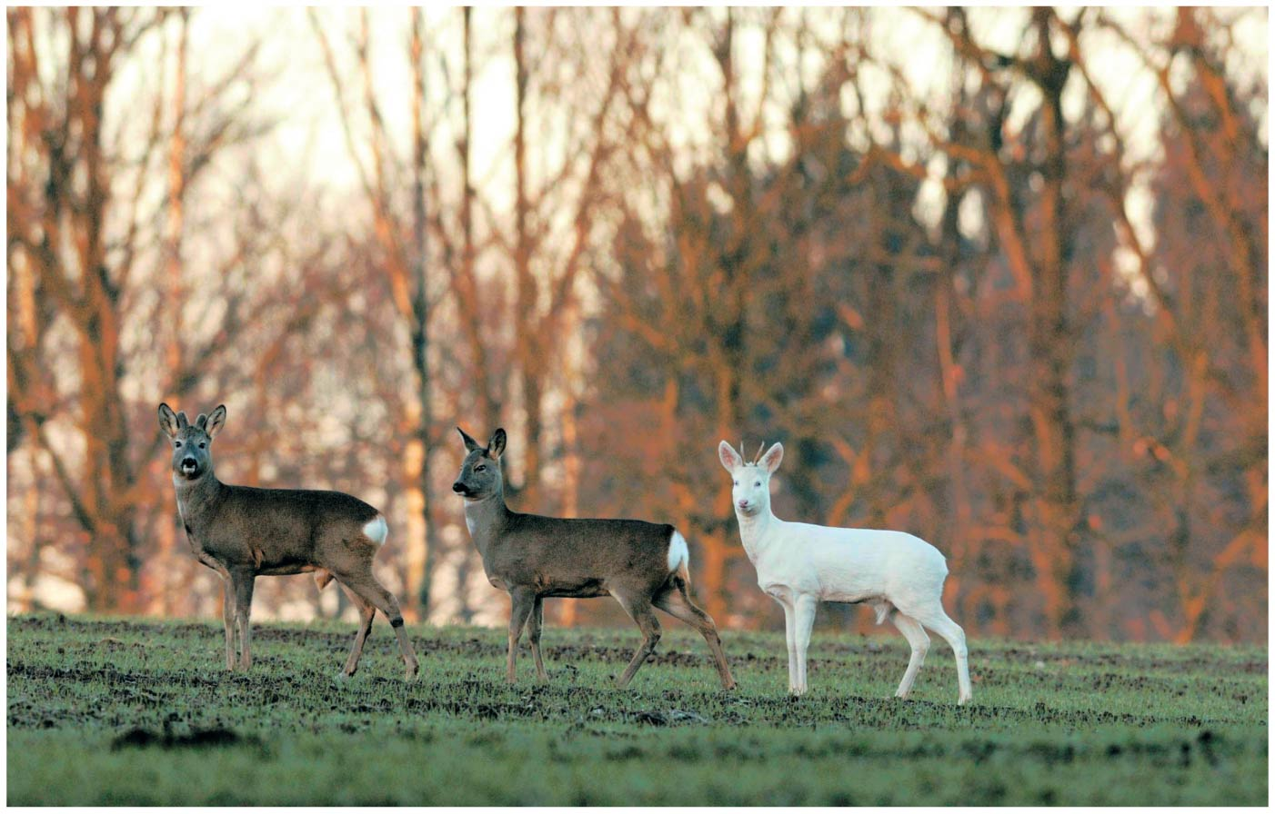
Figure 17.1
Notes:
Figure 17.1 How does a single faulty gene result in the dramatic appearance of an albino deer?

Slide 3
The Flow of Genetic Information
The information content of genes is in the specific sequences of nucleotides
The DNA inherited by an organism leads to specific traits by dictating the synthesis of proteins
Proteins are the links between genotype and phenotype
Gene expression, the process by which DNA directs protein synthesis, includes two stages: transcription (txn) and translation (tsn)

Slide 4
Overview
Concept 17.1: Genes specify proteins via transcription and translation
Concept 17.2: Transcription is the DNA-directed synthesis of RNA
Concept 17.3: Eukaryotic cells modify RNA after transcription
Concept 17.4: Translation is the RNA-directed synthesis of a polypeptide

Slide 5
Overview
Concept 17.1: Genes specify proteins via transcription and translation
Concept 17.2: Transcription is the DNA-directed synthesis of RNA
Concept 17.3: Eukaryotic cells modify RNA after transcription
Concept 17.4: Translation is the RNA-directed synthesis of a polypeptide

Slide 6
Concept 17.1: Genes specify proteins via transcription and translation
Basic Principles – Transcription & Translation
RNA is the bridge between genes and the proteins for which they code
Transcription is the synthesis of RNA using information in DNA
Transcription produces messenger RNA (mRNA)
Translation is the synthesis of a polypeptide, using information in the mRNA
Ribosomes are the sites of translation

Slide 7
Concept 17.1: Genes specify proteins via transcription and translation
Basic Principles – Prokaryotes vs. Eukaryotes
In prokaryotes:
Translation of mRNA can begin before transcription has finished (txn + tsn = simultaneous)
In a eukaryotes:
Nuclear envelope separates transcription from translation (txn + tsn NOT simultaneous)
Primary RNA transcripts (immature) are modified through RNA processing to yield the (mature) mRNA

Slide 8
Concept 17.1: Genes specify proteins via transcription and translation
Basic Principles – Crick’s Central Dogma (1958)
The central dogma is the concept that cells are governed by a cellular chain of command
Unidirectional flow of genetic information
TXN
TSN
DNA
RNA
Protein

Slide 9
Concept 17.1: Genes specify proteins via transcription and translation
Basic Principles – The Genetic Code
How are the instructions for assembling amino acids into proteins encoded into DNA?
How many nucleotides correspond to an amino acid?
There are 20 amino acids, but there are only four nucleotide bases in DNA…

Slide 10
Concept 17.1: Genes specify proteins via transcription and translation
Basic Principles – The Genetic Code – TXN
The flow of information from gene to protein is based on a triplet code: a series of nonoverlapping, three-nucleotide words
The words of a gene are TRANSCRIBED into complementary nonoverlapping three-nucleotide words of mRNA (codons)
During transcription, one of the two DNA strands, called the template strand, provides a template for ordering the sequence of complementary nucleotides in an RNA transcript

Slide 11
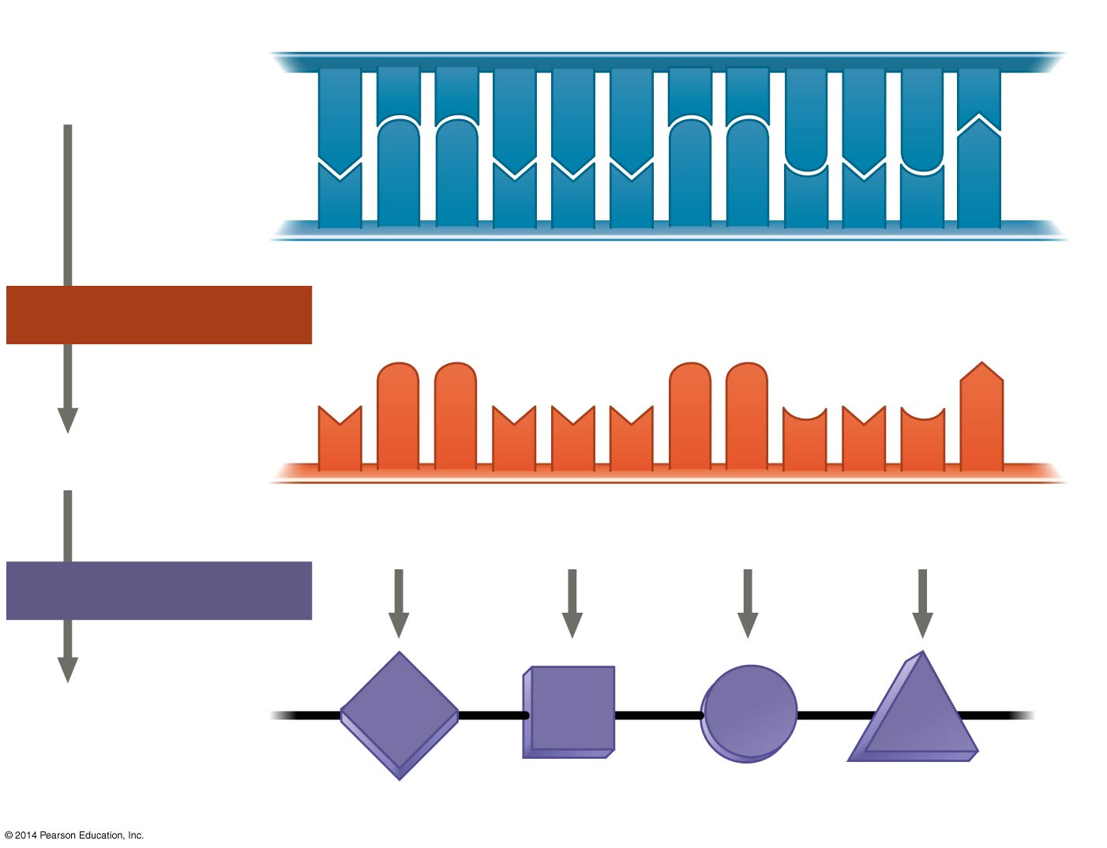
Figure 17.4
DNA
template
strand
3′
5′
A
C
C
A
A
A
C
C
G
A
G
T
T
G
G
T
T
T
G
G
C
T
C
A
5′
3′
TRANSCRIPTION
mRNA
U
G
G
U
U
U
G
G
C
U
C
A
5′
3′
Codon
TRANSLATION
Protein
Trp
Phe
Gly
Ser
Amino acid
Notes:
Figure 17.4 The triplet code

Slide 12
Concept 17.1: Genes specify proteins via transcription and translation
Basic Principles – The Genetic Code – TSN
These words are then TRANSLATED into a chain of amino acids, forming a polypeptide
During translation, the mRNA base triplets, called codons, are read in the 5′ → 3′ direction
Each codon specifies the amino acid (one of 20) to be placed at the corresponding position along a polypeptide

Slide 13
Figure 17.4
DNA
template
strand
3′
5′
A
C
C
A
A
A
C
C
G
A
G
T
T
G
G
T
T
T
G
G
C
T
C
A
5′
3′
TRANSCRIPTION
mRNA
U
G
G
U
U
U
G
G
C
U
C
A
5′
3′
Codon
TRANSLATION
Protein
Trp
Phe
Gly
Ser
Amino acid
Notes:
Figure 17.4 The triplet code

Slide 14
Concept 17.1: Genes specify proteins via transcription and translation
Basic Principles – Cracking the Code
The genetic code is:
Redundant/degenerate—more than one codon may specify a particular amino acid
Unambiguous—no codon specifies more than one amino acid

Slide 15
Concept 17.1: Genes specify proteins via transcription and translation
Basic Principles – Cracking the Code
Of the 64 triplets:
61 triplets code for amino acids
3 triplets code for “stop” signals to end translation
Codons must be read in the correct reading frame (correct groupings) in order for the correct polypeptide to be produced

Slide 16
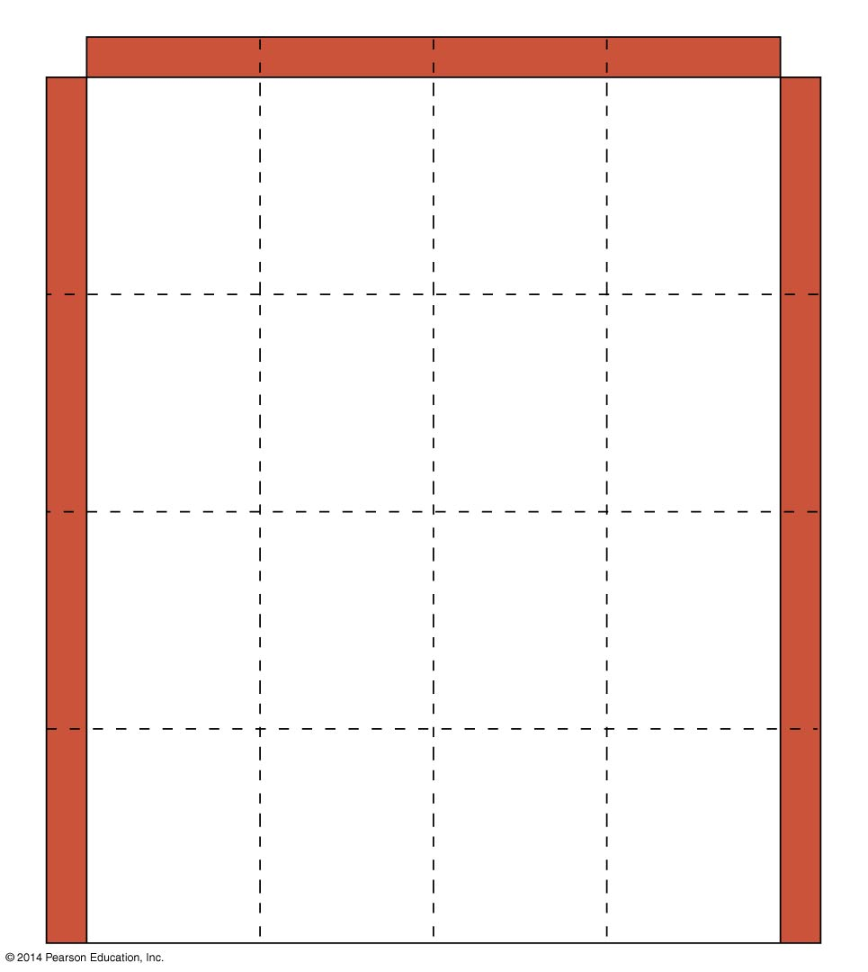
Figure 17.5
Second mRNA base
U
C
A
G
UUU
UCU
UAU
UGU
U
Phe
Tyr
Cys
U
UUC
UCC
UAC
UGC
C
Ser
UUA
UCA
UAA
Stop
UGA
Stop
A
Leu
UUG
UCG
UAG
Stop
UGG
Trp
G
CUU
CCU
CAU
CGU
U
His
C
CUC
CCC
CAC
CGC
C
Leu
Pro
Arg
CUA
CCA
CAA
CGA
A
Gln
CUG
CCG
CAG
CGG
G
First mRNA base (5′ end of codon)
Third mRNA base (3′ end of codon)
AUU
ACU
AAU
AGU
U
Asn
Ser
AUC
Ile
ACC
AAC
AGC
C
A
Thr
AUA
ACA
AAA
AGA
A
Lys
Arg
AUG
Met or
start
ACG
AAG
AGG
G
GUU
GCU
GAU
GGU
U
Asp
G
GUC
GCC
GAC
GGC
C
Val
Ala
Gly
GUA
GCA
GAA
GGA
A
Glu
GUG
GCG
GAG
GGG
G
Notes:
Figure 17.5 The codon table for mRNA

Slide 17
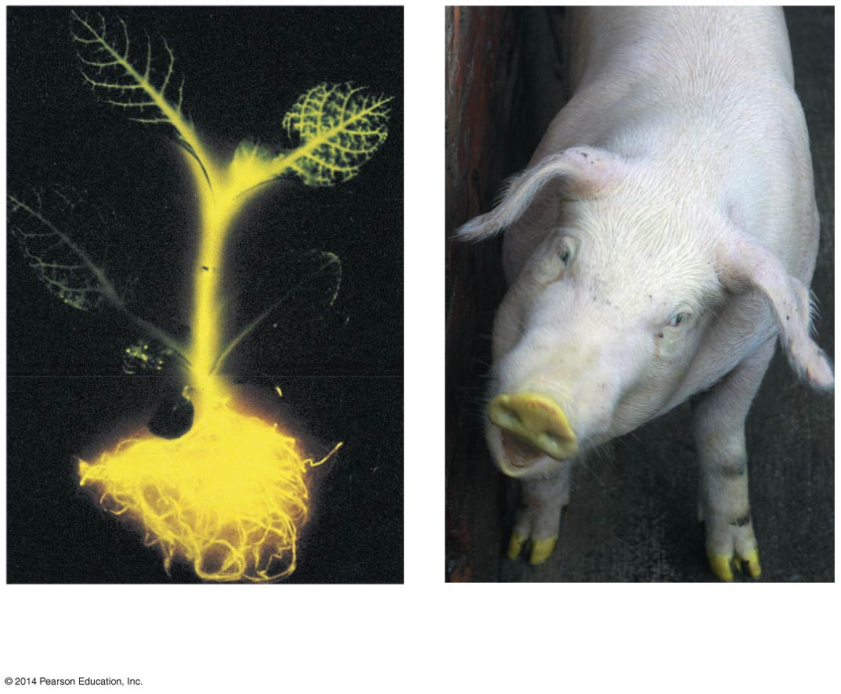
Concept 17.1: Genes specify proteins via transcription and translation
Basic Principles – Evolution of the Genetic Code
The genetic code is nearly universal, shared by the simplest bacteria to the most complex animals
Genes can be transcribed and translated after being transplanted from one species to another
Tobacco plant expressing
a firefly gene
Pig expressing a jellyfish gene

Slide 18
Notes:
In the process of transcription, _____.
https://www.polleverywhere.com/multiple_choice_polls/0hH9SKVBZdsQQ2I

Slide 19
Notes:
Codons are part of the molecular structure of _____.
https://www.polleverywhere.com/multiple_choice_polls/tqCF2qdS5WBT9Xu

Slide 20
Notes:
Which of the following occurs in prokaryotes but not in eukaryotes?
https://www.polleverywhere.com/multiple_choice_polls/fmoUb19unsOc4DE

Slide 21
Notes:
What does it mean when we say the genetic code is redundant?
https://www.polleverywhere.com/multiple_choice_polls/1klWjYBoEJOKCBL

Slide 22
Notes:
A particular triplet of bases in the template strand of DNA is 5' AGT 3'. The corresponding codon for the mRNA transcribed is _____.
https://www.polleverywhere.com/multiple_choice_polls/DMNyZlRcqzYg7yl

Slide 23
Notes:
The genetic code is essentially the same for all organisms. From this, one can logically assume which of the following?
https://www.polleverywhere.com/multiple_choice_polls/Li1KXG1wvGJ0MsA

Slide 24
Notes:
A possible sequence of nucleotides in the template strand of DNA that would code for the polypeptide sequence phe-leu-ile-val would be _____.
https://www.polleverywhere.com/multiple_choice_polls/FLhA7zgbfqgWoq9

Slide 25
Notes:
What amino acid sequence will be generated, based on the following mRNA codon sequence? 5' AUG-UCU-UCG-UUA-UCC-UUG 3'
https://www.polleverywhere.com/multiple_choice_polls/R0pX1FPD1ZXn2jc

Slide 26
Overview
Concept 17.1: Genes specify proteins via transcription and translation
Concept 17.2: Transcription is the DNA-directed synthesis of RNA
Concept 17.3: Eukaryotic cells modify RNA after transcription
Concept 17.4: Translation is the RNA-directed synthesis of a polypeptide

Slide 27
Overview
Concept 17.2: Transcription is the DNA-directed synthesis of RNA
TXN
TSN
DNA
RNA
Protein

Slide 28
Concept 17.2: Transcription is the DNA-directed synthesis of RNA
Molecular Components of Transcription
RNA synthesis is catalyzed by RNA polymerase, which pries the DNA strands apart and joins together the RNA nucleotides
The RNA is complementary to the DNA template strand
RNA polymerase does NOT need any primer!
RNA synthesis follows the same base-pairing rules as DNA, except that uracil substitutes for thymine (A—U) + (C—G)

Slide 29
Concept 17.2: Transcription is the DNA-directed synthesis of RNA
Molecular Components of Transcription
The DNA sequence where RNA polymerase attaches is called the promoter; in bacteria, the sequence signaling the end of transcription is called the terminator *Arnold Schwarzenegger voice*
The stretch of DNA that is transcribed is called a transcription unit

Slide 30
Concept 17.2: Transcription is the DNA-directed synthesis of RNA
Transcription is the first step of gene expression that synthesis an RNA transcript (mRNA) via 3 stages
Initiation
Elongation
Termination

Slide 31
Concept 17.2: Transcription is the DNA-directed synthesis of RNA – 1. Initiation
1a. Promoters signal the transcriptional start point
A promoter called a TATA box is crucial in forming the initiation complex in eukaryotes
1b. Transcription factors mediate the binding of RNA polymerase and the initiation of transcription
1c. The completed assembly of transcription factors and RNA polymerase bound to a promoter is called a transcription initiation complex

Slide 32
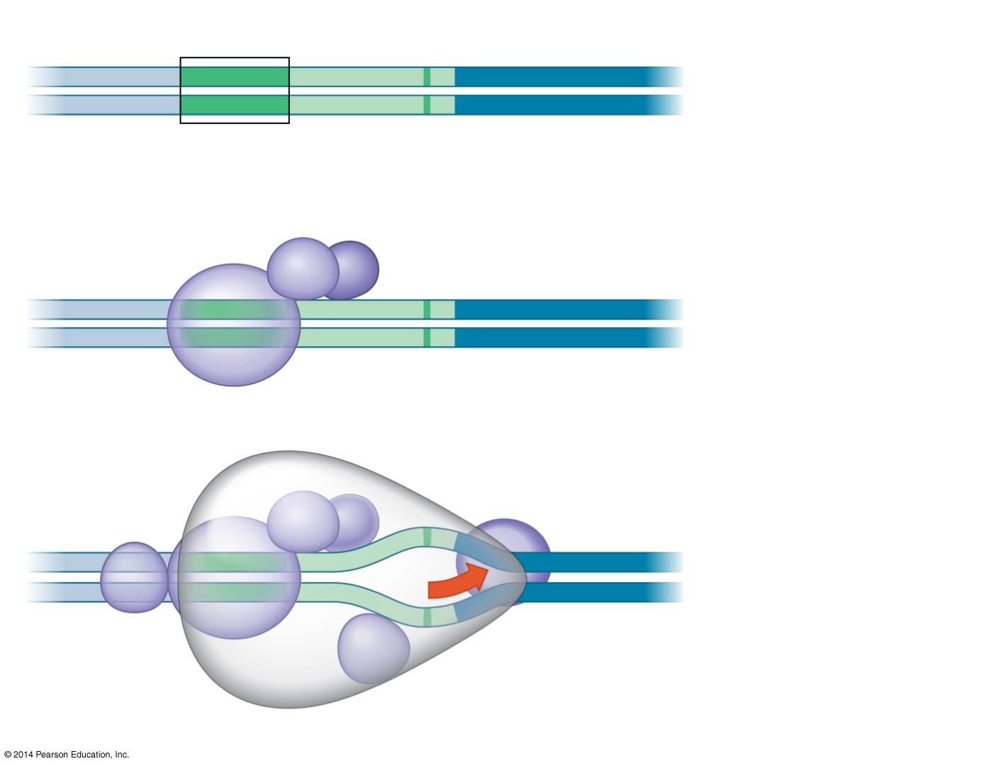
Figure 17.8
Promoter
Nontemplate strand
DNA
5′
T
A
T
A
A
A
A
3′
1
A eukaryotic
promoter
3′
A
T
A
T
T
T
T
5′
TATA box
Start point
Template
strand
Transcription
factors
5′
3′
2
Several
transcription
factors bind
to DNA.
3′
5′
RNA polymerase II
Transcription factors
5′
3′
3′
Transcription
initiation
complex
forms.
3′
5′
5′
3
RNA transcript
Transcription initiation complex
Notes:
Figure 17.8 The initiation of transcription at a eukaryotic promoter

Slide 33
Notes:
Which of the following best describes the significance of the TATA box in eukaryotic promoters?
https://www.polleverywhere.com/multiple_choice_polls/anjKjt1WrH1xzIJ

Slide 34
Notes:
Transcription in eukaryotes requires which of the following in addition to RNA polymerase?
https://www.polleverywhere.com/multiple_choice_polls/NfRZptpeXBdMKq7

Slide 35
Concept 17.2: Transcription is the DNA-directed synthesis of RNA – 2. Elongation
As RNA polymerase moves along the DNA, it untwists the double helix (no helicase needed!)
RNA polymerase READS the template DNA strand in the 3’ → 5’ direction
RNA polymerase SYNTHESIZES (elongates) a new RNA strand in the 5’ → 3’ direction
Nucleotides are added to the 3′ end of the growing RNA molecule

Slide 36
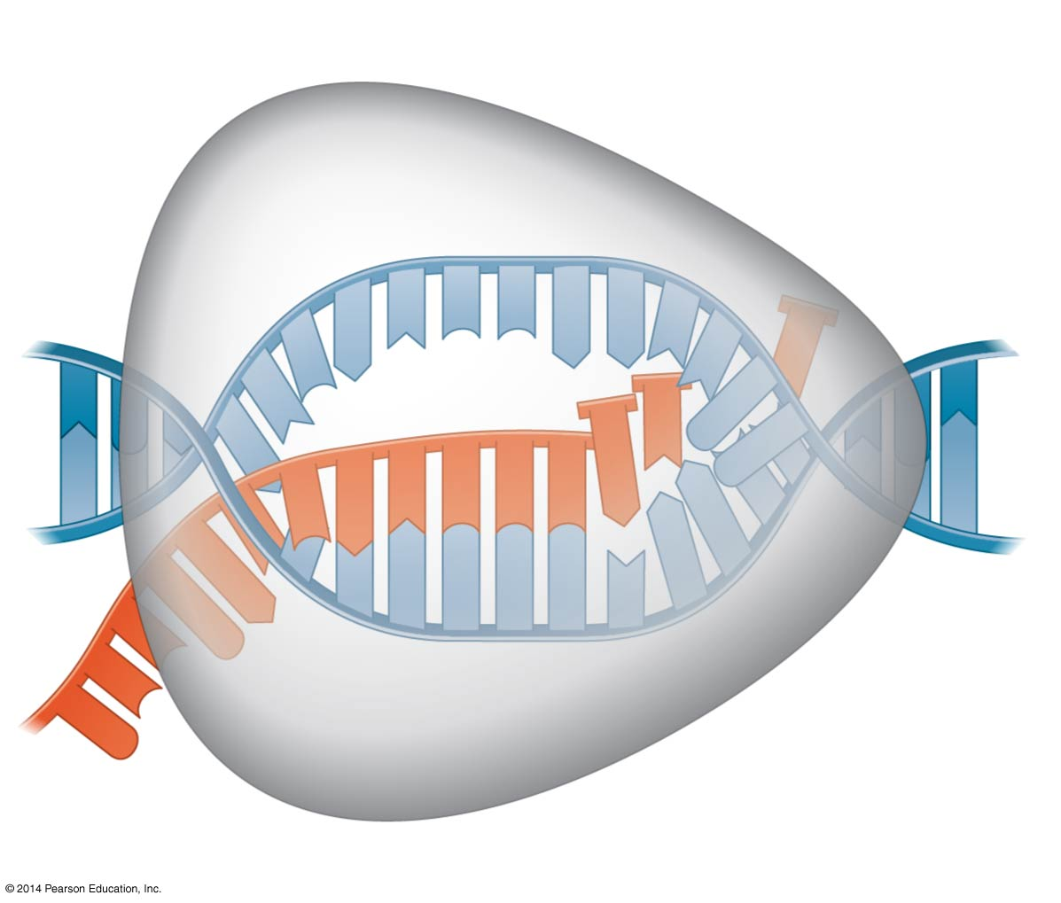
Figure 17.9
Nontemplate
strand of DNA
RNA nucleotides
RNA
polymerase
A
T
C
C
A
A
T
3′
C
T
U
5′
T
3′ end
G
A
U
A
G
A
U
C
C
A
C
C
C
5′
A
3′
T
A
A
G
G
T
T
5′
Direction of transcription
Template
strand of DNA
Newly made
RNA
Notes:
Figure 17.9 Transcription elongation

Slide 37
Concept 17.2: Transcription is the DNA-directed synthesis of RNA – 3. Termination
The mechanisms of termination are different in bacteria and eukaryotes
In bacteria, the polymerase stops transcription at the end of the terminator and the mRNA can be immediately translated WITHOUT further modification
In eukaryotes, RNA polymerase transcribes the polyadenylation signal sequence and later falls off the template as pre-mRNA (immature)

Slide 38
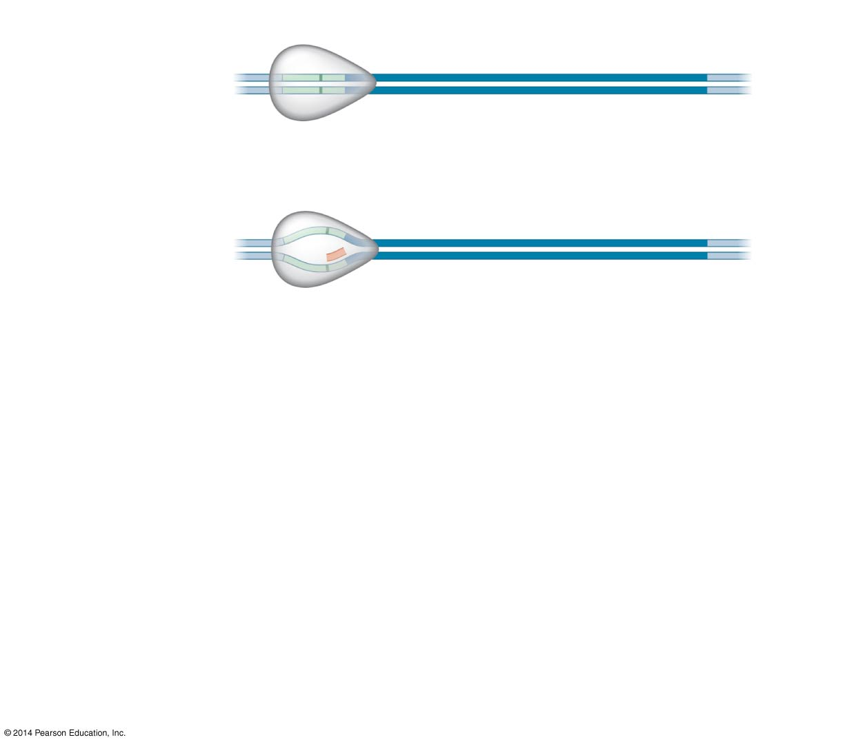
Figure 17.7-1
Promoter
Transcription unit
5′
3′
3′
5′
Start point
RNA polymerase
1
Initiation
5′
3′
3′
5′
Unwound
DNA
RNA
transcript
Template strand of DNA
Notes:
Figure 17.7-1 The stages of transcription: initiation, elongation, and termination (step 1)

Slide 39
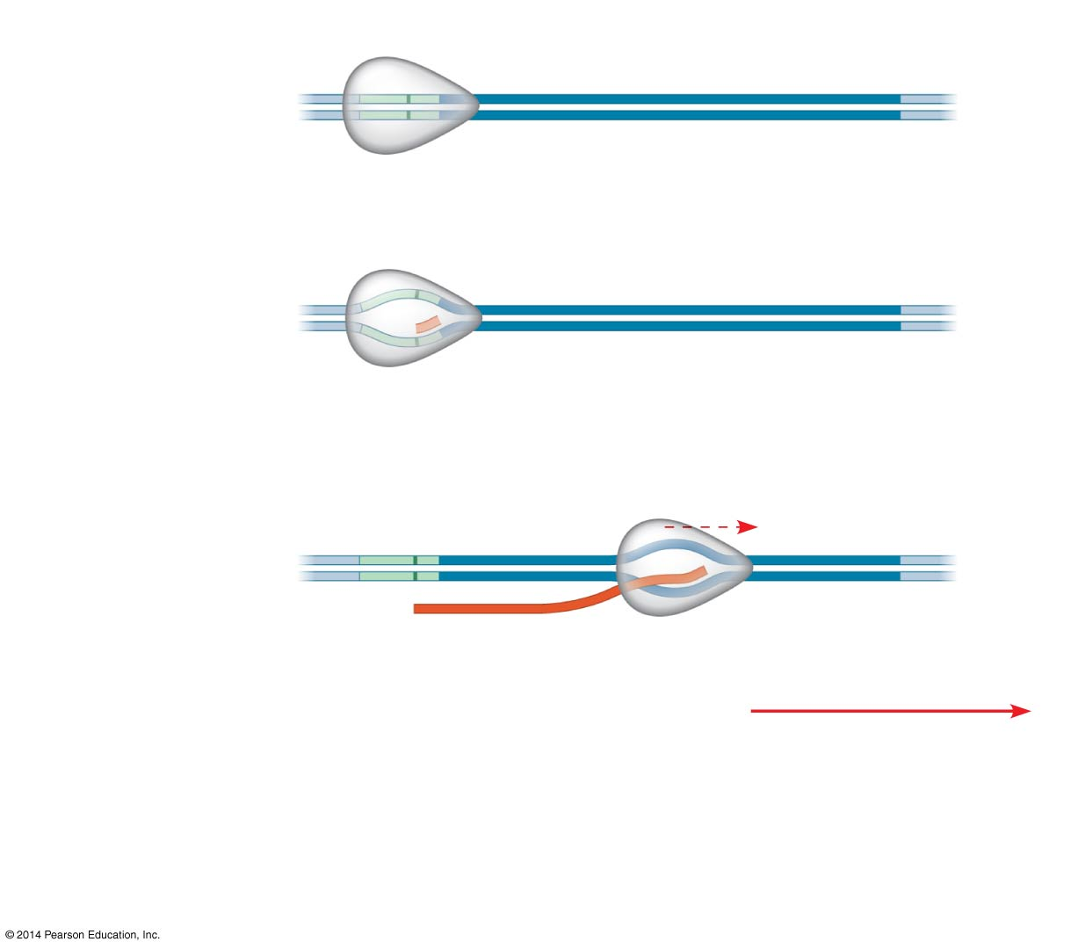
Figure 17.7-2
Promoter
Transcription unit
5′
3′
3′
5′
Start point
RNA polymerase
1
Initiation
5′
3′
3′
5′
Unwound
DNA
RNA
transcript
Template strand of DNA
2
Elongation
Rewound
DNA
5′
3′
3′
3′
5′
5′
Direction of
transcription
(“downstream”)
RNA
transcript
Notes:
Figure 17.7-2 The stages of transcription: initiation, elongation, and termination (step 2)

Slide 40
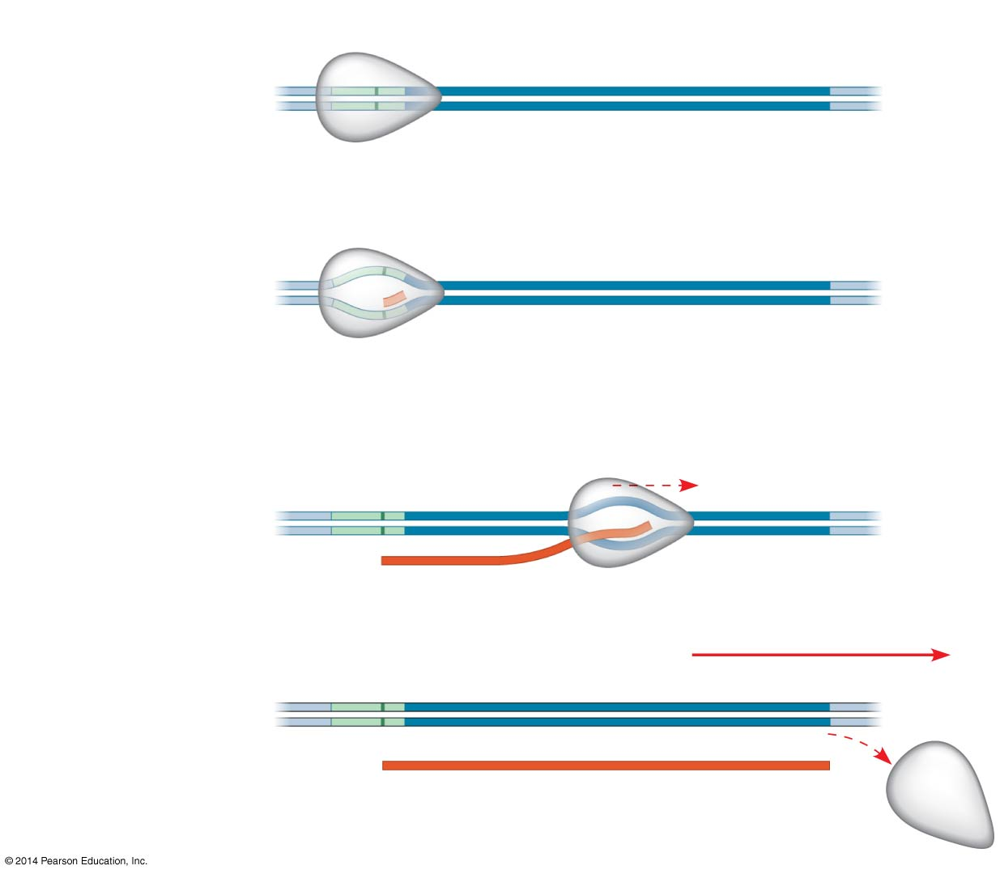
Figure 17.7-3
Promoter
Transcription unit
5′
3′
3′
5′
Start point
RNA polymerase
1
Initiation
5′
3′
3′
5′
Unwound
DNA
RNA
transcript
Template strand of DNA
2
Elongation
Rewound
DNA
5′
3′
3′
3′
5′
5′
Direction of
transcription
(“downstream”)
RNA
transcript
3
Termination
5′
3′
3′
5′
5′
3′
Completed RNA transcript
Notes:
Figure 17.7-3 The stages of transcription: initiation, elongation, and termination (step 3)

Slide 41
Overview
Concept 17.1: Genes specify proteins via transcription and translation
Concept 17.2: Transcription is the DNA-directed synthesis of RNA
Concept 17.3: Eukaryotic cells modify RNA after transcription
Concept 17.4: Translation is the RNA-directed synthesis of a polypeptide

Slide 42
Concept 17.3: Eukaryotic cells modify RNA after transcription
Enzymes in the eukaryotic nucleus modify pre-mRNA (RNA processing) before the genetic messages are dispatched to the cytoplasm
Both ends (5’ + 3’) of the primary transcript are usually altered
Certain interior sections of the molecule are cut out (“excised”), and the remaining parts “spliced” together

Slide 43
Concept 17.3: Eukaryotic cells modify RNA after transcription
Alteration of mRNA Ends
Each end of a pre-mRNA molecule is modified
The 5′ end receives a modified nucleotide 5′ cap
The 3′ end gets a poly-A tail
These modifications share several functions
Facilitate the export of mRNA to the cytoplasm
Protect mRNA from hydrolytic enzymes
Help ribosomes attach to the 5′ end

Slide 44
Figure 17.10
A modified guanine
nucleotide added to
the 5′ end
50–250 adenine
nucleotides added
to the 3′ end
Region that includes
protein-coding segments
Polyadenylation
signal
5′
3′
G
P
P
P
AAUAAA
AAA
…
AAA
5′ Cap
5′ UTR
Start
codon
Stop
codon
3′ UTR
Poly-A tail
Notes:
Figure 17.10 RNA processing: Addition of the 5' cap and poly-A tail

Slide 45
Notes:
Which of the following does not occur in prokaryotic gene expression, but does occur in eukaryotic gene expression?
https://www.polleverywhere.com/multiple_choice_polls/gENZbZZUKQrgc2m

Slide 46
Notes:
In an experimental situation, a student researcher inserts an mRNA molecule into a eukaryotic cell after she has removed its 5' cap and poly-A tail. Which of the following would you expect her to find?
https://www.polleverywhere.com/multiple_choice_polls/boUY2d7tGLcrO2s

Slide 47
Concept 17.3: Eukaryotic cells modify RNA after transcription
Split Genes and RNA Splicing
Most EUKARYOTIC genes and their RNA transcripts have long noncoding stretches of nucleotides that lie between coding regions
Noncoding regions = intervening sequences = introns
Coding regions = expressed sequences = exons
Eventually translated into amino acid sequences of polypeptide

Slide 48
Concept 17.3: Eukaryotic cells modify RNA after transcription
Split Genes and RNA Splicing
RNA splicing…
REMOVES introns
JOINS exons
Creates an mRNA molecule with a continuous coding sequence
Only done in eukaryotes!!!

Slide 49
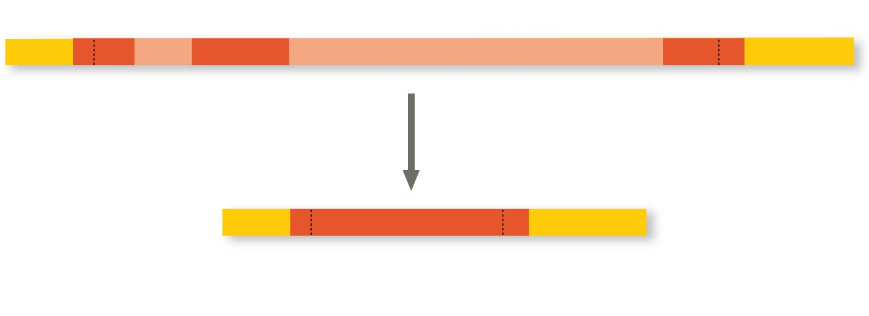
Figure 17.11
Pre-mRNA
Intron
Intron
5′ Cap
Poly-A tail
1–30
31–104
Introns cut out
and exons
spliced together
105–146
mRNA
5′ Cap
Poly-A tail
1–146
5′ UTR
3′ UTR
Coding
segment
Notes:
Figure 17.11 RNA processing: RNA splicing

Slide 50
Notes:
A primary transcript in the nucleus of a eukaryotic cell is _____ the functional mRNA, while a primary transcript in a prokaryotic cell is _____ the functional mRNA.
https://www.polleverywhere.com/multiple_choice_polls/fy3d1TXYtKITxMo

Slide 51
Overview
Concept 17.1: Genes specify proteins via transcription and translation
Concept 17.2: Transcription is the DNA-directed synthesis of RNA
Concept 17.3: Eukaryotic cells modify RNA after transcription
Concept 17.4: Translation is the RNA-directed synthesis of a polypeptide

Slide 52
Overview
Concept 17.4: Translation is the RNA-directed synthesis of a polypeptide
TXN
TSN
DNA
RNA
Protein

Slide 53
Concept 17.4: Translation is the RNA-directed synthesis of a polypeptide
Genetic information flows from mRNA to protein through the process of translation
Genetic information is translated from the language of nucleotides to the language of amino acids

Slide 54
Concept 17.4: Translation is the RNA-directed synthesis of a polypeptide
Molecular Components of Translation
A cell translates an mRNA message into protein with the help of transfer RNA (tRNA)
tRNAs transfer amino acids to the growing polypeptide in a ribosome

Slide 55
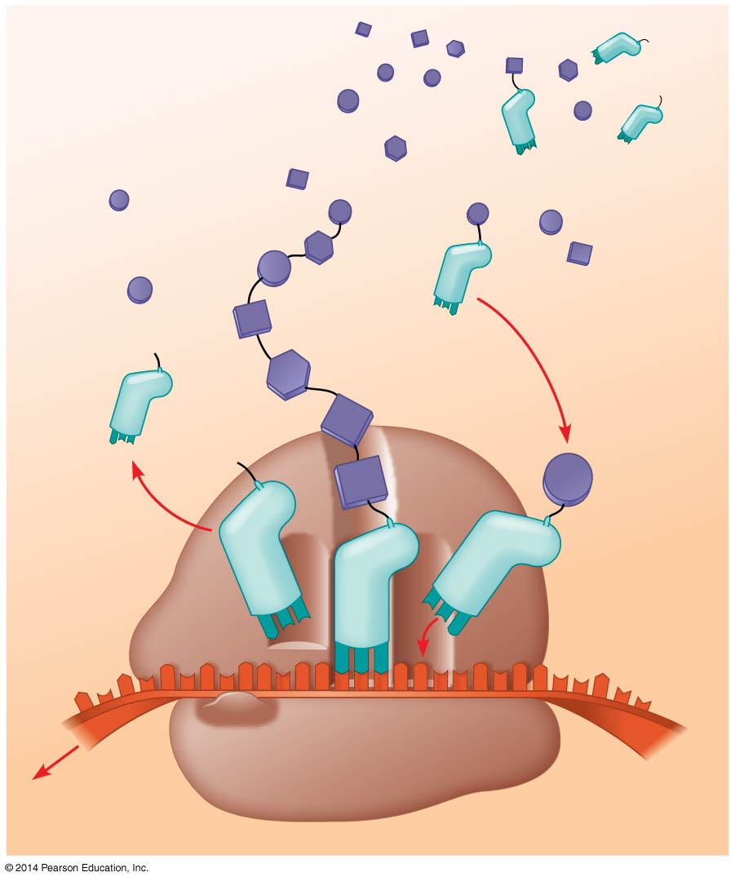
Figure 17.14
Amino
acids
Polypeptide
tRNA with
amino acid
attached
Ribosome
Trp
Phe
Gly
tRNA
C
C
C
Anticodon
A
C
G
A
A
A
U
G
G
U
U
U
G
G
C
5′
Codons
3′
mRNA
Notes:
Figure 17.14 Translation: the basic concept

Slide 56
Concept 17.4: Translation is the RNA-directed synthesis of a polypeptide
The Structure and Function of Transfer RNA
A tRNA molecule consists of a single RNA strand
Individual molecules of tRNA are NOT identical
Each carries a specific amino acid on one end
Each has a specific anticodon on the other end; the anticodon base-pairs with a complementary codon on mRNA

Slide 57
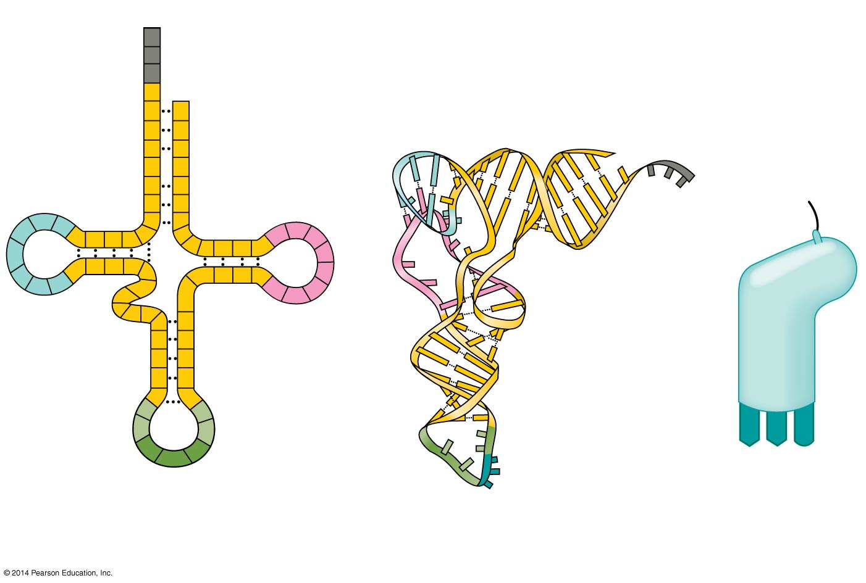
Figure 17.15
3′
Amino acid
attachment
site
A
C
C
5′
A
Amino acid
attachment site
C
G
G
C
C
G
5′
U
G
U
A
3′
A
U
*
U
C
G
A
U
G
C
A
C
A
U
A
C
A
*
G
*
C
U
*
C
G
U
G
U
*
C
G
A
G
G
Hydrogen
bonds
*
*
U
C
*
A
G
G
*
G
A
G
C
G
C
Hydrogen
bonds
U
A
*
G
A
*
A
C
A
A
G
*
U
A
A
G
3′
5′
Anticodon
Anticodon
Anticodon
(a) Two-dimensional structure
(b)
Three-dimensional
structure
(c)
Symbol used
in this book
Notes:
Figure 17.15 The structure of transfer RNA (tRNA) (Holley at Cornell, NP in 1968)

Slide 58
Notes:
A particular triplet of bases in the coding sequence of DNA is AAA. The anticodon on the tRNA that binds the mRNA codon is _____.
https://www.polleverywhere.com/multiple_choice_polls/xmfsB2NOZjRFGuG

Slide 59
Concept 17.4: Translation is the RNA-directed synthesis of a polypeptide
Accurate translation requires two steps
Correct match between a tRNA and an amino acid, done by the enzyme aminoacyl-tRNA synthetase
tRNA + AA = correct
Correct match between the tRNA anticodon and an mRNA codon
anticodon + codon = correct

Slide 60
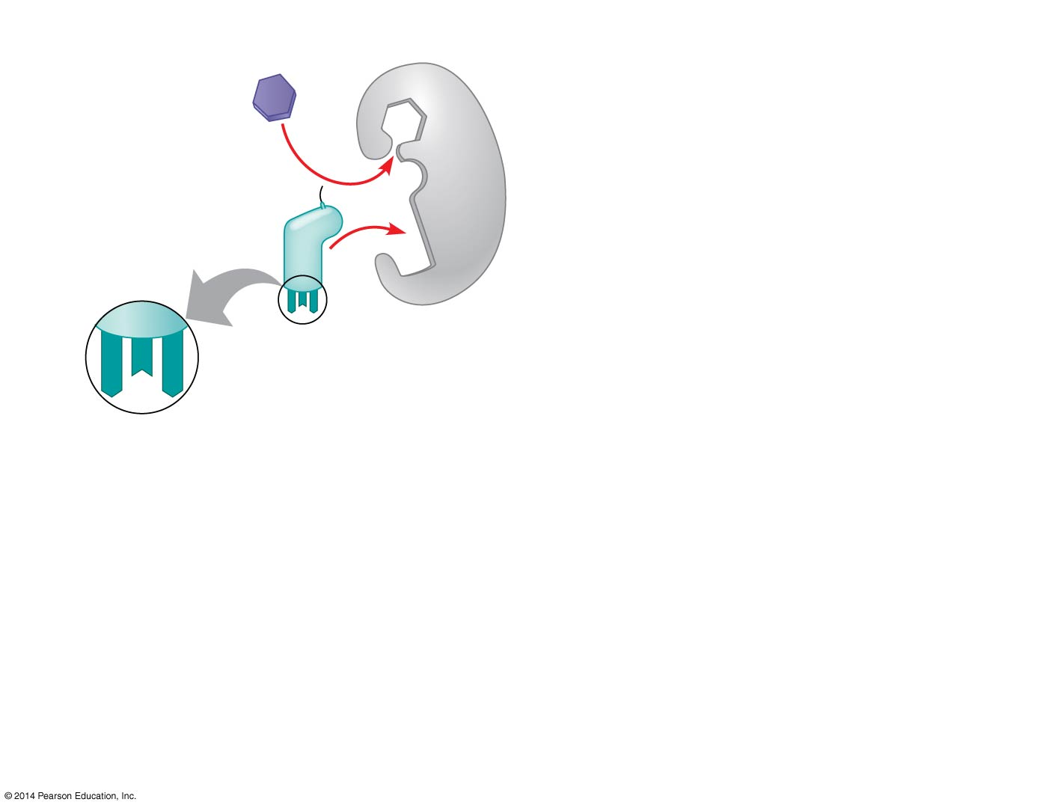
Figure 17.16-1
1
Amino acid
and tRNA
enter active
site.
Tyrosine (Tyr)
(amino acid)
Tyrosyl-tRNA
synthetase
Tyr-tRNA
A
U
A
Complementary
tRNA anticodon
Notes:
Figure 17.16-1 Aminoacyl-tRNA synthetases provide specificity in joining amino acids to their tRNAs (step 1)

Slide 61
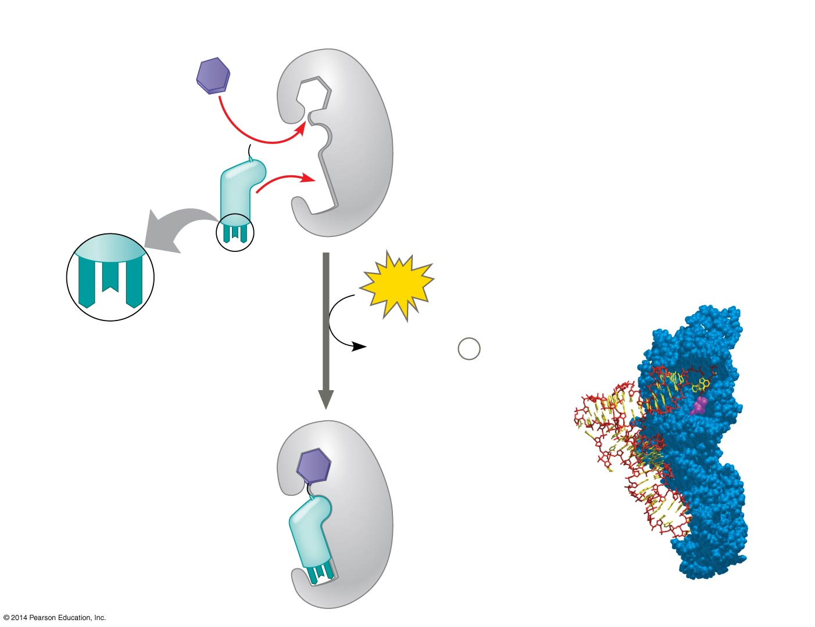
Figure 17.16-2
1
Amino acid
and tRNA
enter active
site.
Tyrosine (Tyr)
(amino acid)
Tyrosyl-tRNA
synthetase
Tyr-tRNA
Aminoacyl-tRNA
synthetase
A
U
A
ATP
Complementary
tRNA anticodon
AMP + 2
P
i
tRNA
2
Using ATP,
synthetase
catalyzes
covalent
bonding.
Amino
acid
Computer model
Notes:
Figure 17.16-2 Aminoacyl-tRNA synthetases provide specificity in joining amino acids to their tRNAs (step 2)

Slide 62
Figure 17.16-3
1
Amino acid
and tRNA
enter active
site.
Tyrosine (Tyr)
(amino acid)
Tyrosyl-tRNA
synthetase
Tyr-tRNA
Aminoacyl-tRNA
synthetase
A
U
A
ATP
Complementary
tRNA anticodon
AMP + 2
P
i
tRNA
3
Aminoacyl
tRNA
released.
2
Using ATP,
synthetase
catalyzes
covalent
bonding.
Amino
acid
Computer model
Notes:
Figure 17.16-3 Aminoacyl-tRNA synthetases provide specificity in joining amino acids to their tRNAs (step 3)

Slide 63
Notes:
Accuracy in the translation of mRNA into the primary structure of a polypeptide depends on specificity in the _____.
https://www.polleverywhere.com/multiple_choice_polls/d8D1R9UD9ROCP2f

Slide 64
Concept 17.4: Translation is the RNA-directed synthesis of a polypeptide
Ribosomes
Ribosomes facilitate specific coupling of tRNA anticodons with mRNA codons in protein synthesis
The two ribosomal subunits (large and small) are made of proteins and ribosomal RNA (rRNA)
Bacterial and eukaryotic ribosomes are somewhat similar but have significant differences
Some antibiotic drugs specifically target bacterial ribosomes without harming eukaryotic ribosomes

Slide 65
Figure 17.17b
P site (Peptidyl-tRNA binding site)
Exit tunnel
A site (Aminoacyl-
tRNA binding site)
E site
(Exit site)
E
P
A
Large
subunit
mRNA
binding site
Small
subunit
(b) Schematic model showing binding sites
Notes:
Figure 17.17b The anatomy of a functioning ribosome (part 2: binding sites)

Slide 66
Concept 17.4: Translation is the RNA-directed synthesis of a polypeptide
A ribosome has three binding sites for tRNA
The E site is the exit site, where discharged tRNAs leave the ribosome
The P site holds the tRNA that carries the growing polypeptide chain
The A site holds the tRNA that carries the next amino acid to be added to the chain

Slide 67
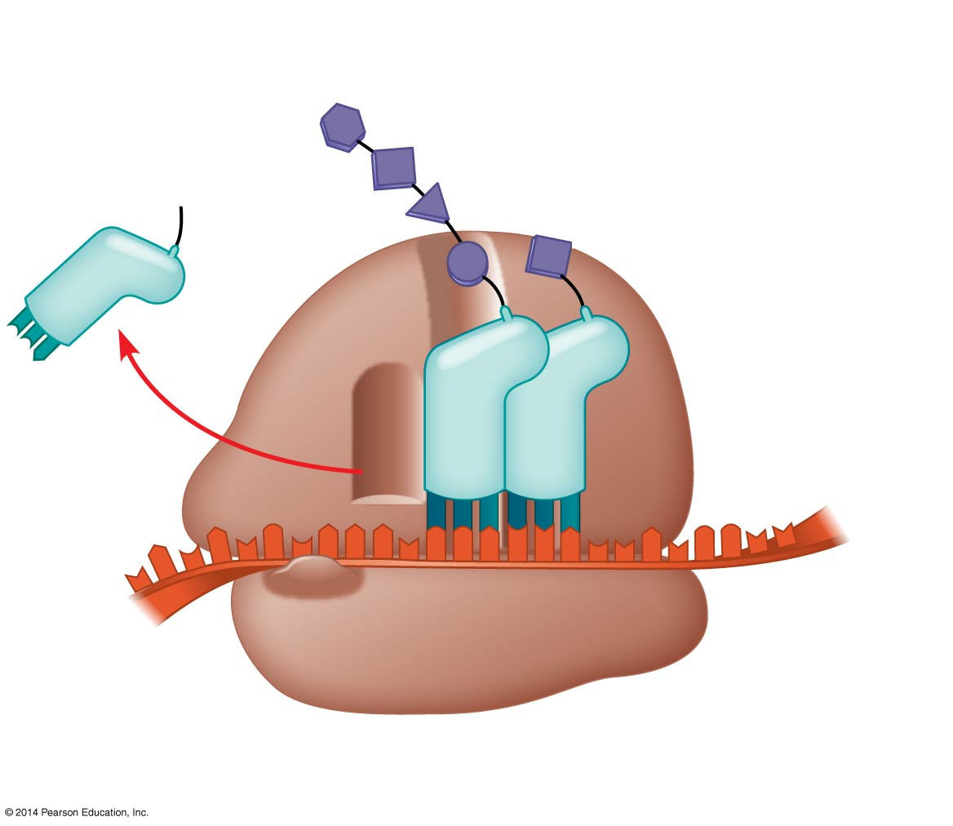
Figure 17.17c
Growing
polypeptide
Amino end
Next amino
acid to be
added to
polypeptide
chain
E
tRNA
mRNA
3′
Codons
5′
(c) Schematic model with mRNA and tRNA
Notes:
Figure 17.17c The anatomy of a functioning ribosome (part 3: mRNA and tRNA)

Slide 68
Concept 17.4: Translation is the RNA-directed synthesis of a polypeptide
Building a Polypeptide – Three Stages of Translation
Initiation
Elongation
Termination
All three stages require protein “factors” that aid in the translation process
Energy, in the form of GTP, is required for some steps
Translation proceeds along the mRNA in a 5′ → 3′ direction (mRNA is “read” 5’ → 3’ by ribosome)

Slide 69
Concept 17.4: Translation is the RNA-directed synthesis of a polypeptide – 1. Initiation
Initiation brings together mRNA, a tRNA with the first amino acid, and the two ribosomal subunits
1a. Small ribosomal subunit binds with mRNA and a special initiator tRNA
1b. Small subunit moves along the mRNA until it reaches the start codon (AUG)
1c. Proteins called initiation factors bring in the large subunit that completes the translation initiation complex

Slide 70
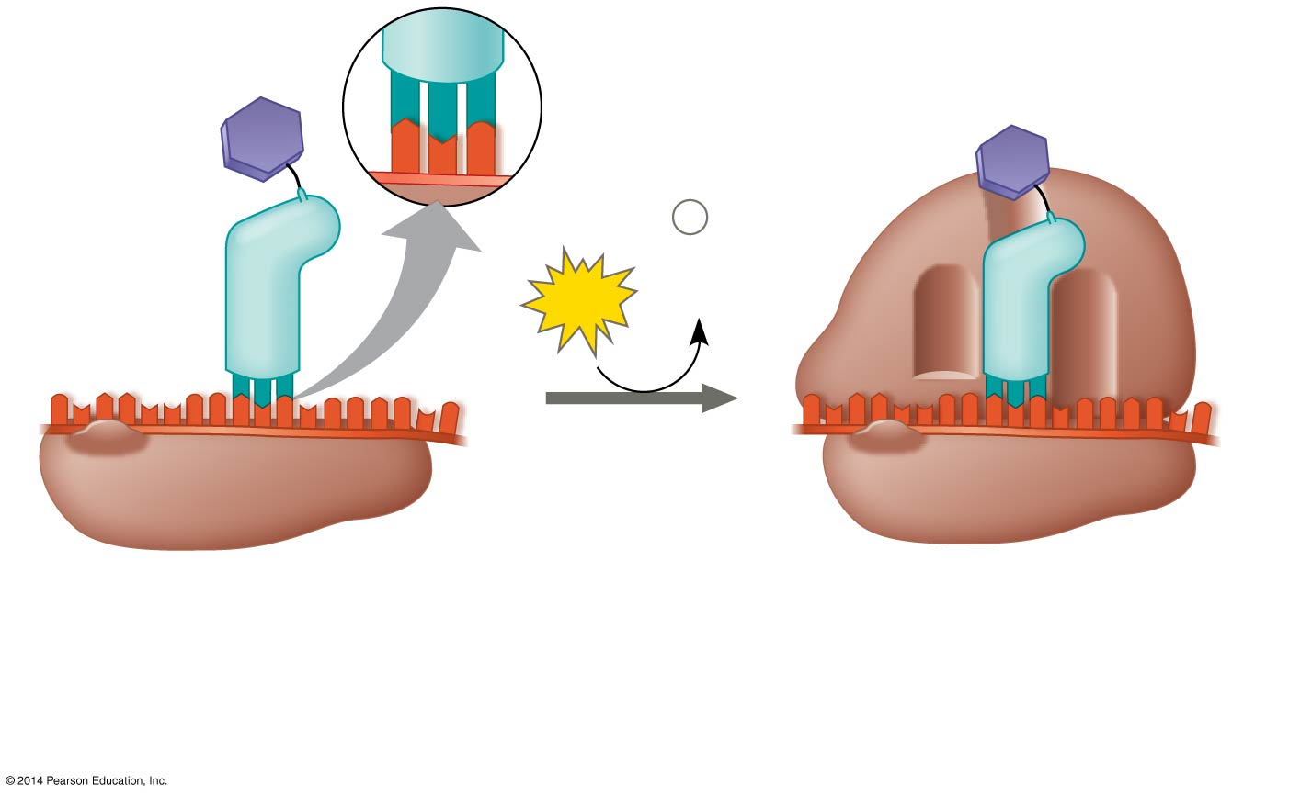
Figure 17.18
Large
ribosomal
subunit
3′
U
A
C
5′
P site
Met
5′
A
U
G
3′
Met
P
i
Initiator
tRNA
+
GTP
GDP
E
A
mRNA
5′
3′
5′
3′
Start codon
Small
ribosomal
subunit
mRNA binding site
Translation initiation complex
1
Small ribosomal subunit binds to mRNA.
2
Large ribosomal subunit
completes the initiation
complex.
Notes:
Figure 17.18 The initiation of translation

Slide 71
Notes:
Which of the following is the first event to take place in translation in eukaryotes?
https://www.polleverywhere.com/multiple_choice_polls/y2ED1L5KQcCiw6l

Slide 72
Concept 17.4: Translation is the RNA-directed synthesis of a polypeptide – 2. Elongation
During elongation, amino acids are added one by one to the C-terminus of the growing chain
Each addition involves proteins called elongation factors and occurs in three steps:
Codon recognition (requires GTP E)
Peptide bond formation
Translocation (requires GTP E)

Slide 73
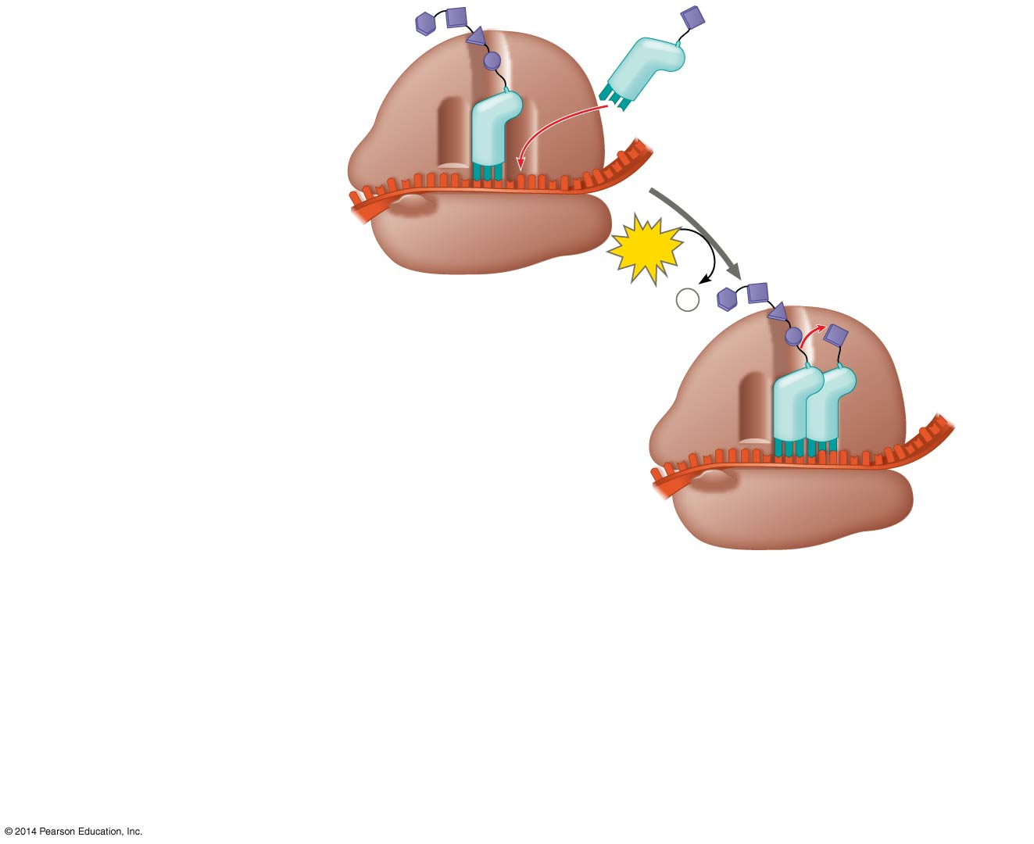
Figure 17.19-1
Amino end
of polypeptide
1
Codon
recognition
E
3′
mRNA
P
A
5′
site
site
GTP
GDP +
P
i
E
P
A
Notes:
Figure 17.19-1 The elongation cycle of translation (step 1)

Slide 74
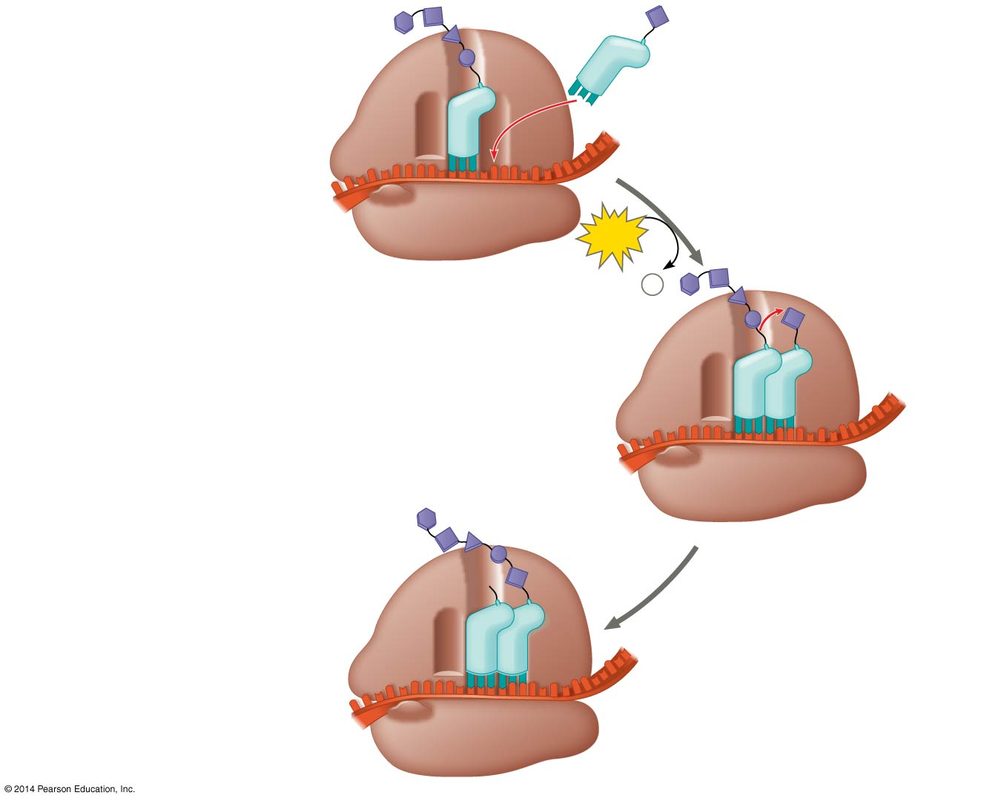
Figure 17.19-2
Amino end
of polypeptide
1
Codon
recognition
E
3′
mRNA
P
A
5′
site
site
GTP
GDP +
P
i
E
P
A
2
Peptide bond
formation
E
P
A
Notes:
Figure 17.19-2 The elongation cycle of translation (step 2)

Slide 75
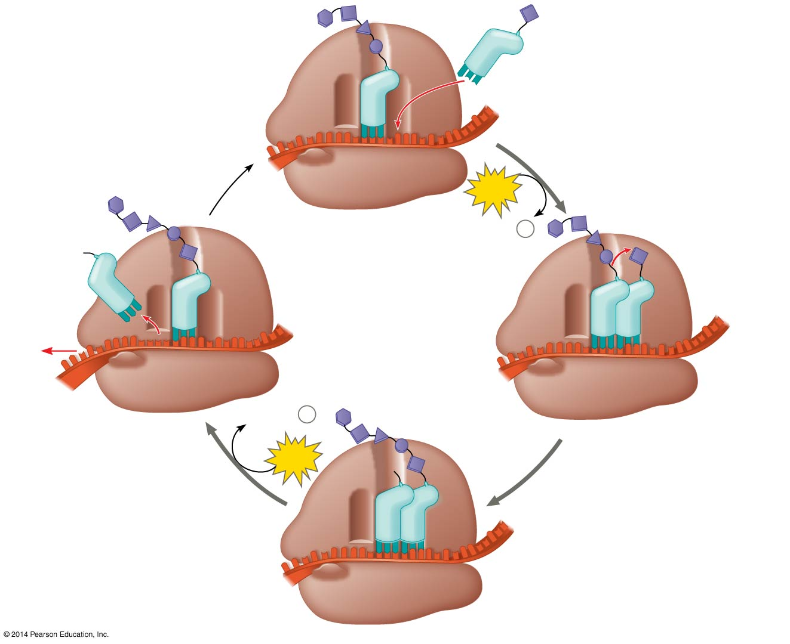
Figure 17.19-3
Amino end
of polypeptide
1
Codon
recognition
E
3′
mRNA
Ribosome ready for
next aminoacyl tRNA
P
A
5′
site
site
GTP
GDP +
P
i
E
E
P
A
P
A
GDP +
P
i
3
Translocation
2
Peptide bond
formation
GTP
E
P
A
Notes:
Figure 17.19-3 The elongation cycle of translation (step 3)

Slide 76
Concept 17.4: Translation is the RNA-directed synthesis of a polypeptide – 3. Termination
Termination occurs when a stop codon in the mRNA reaches the A site of the ribosome
The A site accepts a protein called a release factor
The release factor causes the addition of a water molecule…NOT an amino acid!
This (hydrolysis) reaction RELEASES the polypeptide, and the translation assembly subsequently comes apart

Slide 77
Figure 17.20-1
Release
factor
3′
5′
Stop codon
(UAG, UAA, or UGA)
1
Ribosome reaches a
stop codon on mRNA.
Notes:
Figure 17.20-1 The termination of translation (step 1)

Slide 78
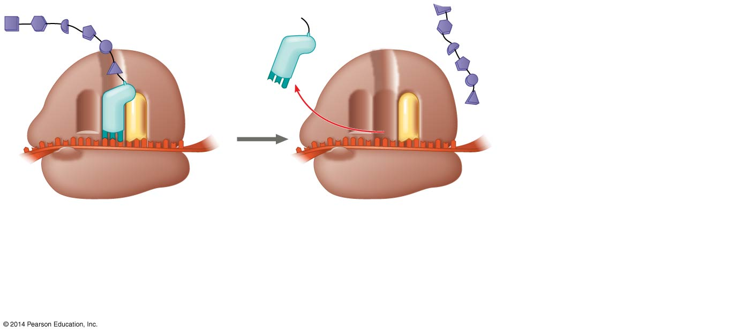
Figure 17.20-2
Release
factor
Free
polypeptide
3′
3′
5′
5′
Stop codon
(UAG, UAA, or UGA)
1
Ribosome reaches a
stop codon on mRNA.
2
Release factor
promotes hydrolysis.
Notes:
Figure 17.20-2 The termination of translation (step 2)

Slide 79
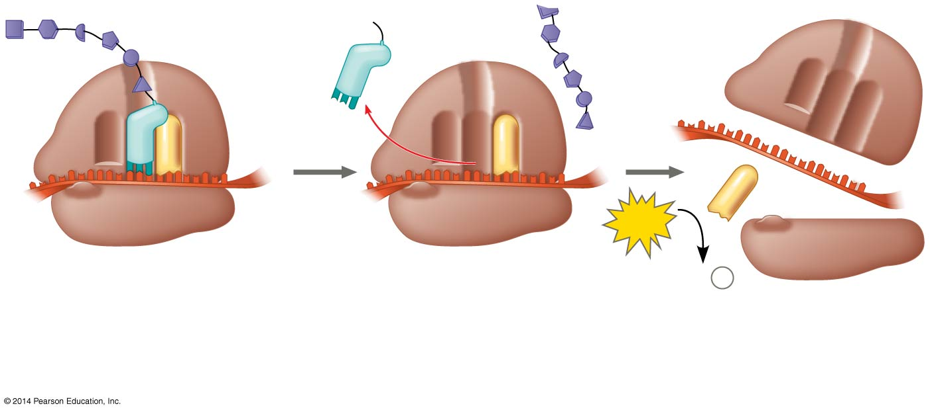
Figure 17.20-3
Release
factor
Free
polypeptide
5′
3′
3′
5′
5′
3′
2
GTP
Stop codon
(UAG, UAA, or UGA)
2 GDP
+
2
P
i
1
Ribosome reaches a
stop codon on mRNA.
2
Release factor
promotes hydrolysis.
3
Ribosomal subunits
and other components
dissociate.
Notes:
Figure 17.20-3 The termination of translation (step 3)

Slide 80
Notes:
The release factor (RF) _____.
https://www.polleverywhere.com/multiple_choice_polls/IzZnKGdkZCCyaBn

Slide 81
Concept 17.4: Translation is the RNA-directed synthesis of a polypeptide – Post-translation
Translation alone is often not sufficient to make a functional protein…only get a primary structure
Post-translational modifications may be required
Polypeptide chains are modified AFTER translation or targeted to specific sites in the cell
During its synthesis, a polypeptide chain begins to…
Coil and fold spontaneously to form a protein with a SPECIFIC shape—a three-dimensional molecule with secondary and tertiary structure (functional!)

Slide 82
Overview
Concept 17.1: Genes specify proteins via transcription and translation
Concept 17.2: Transcription is the DNA-directed synthesis of RNA
Concept 17.3: Eukaryotic cells modify RNA after transcription
Concept 17.4: Translation is the RNA-directed synthesis of a polypeptide

Slide 83
What Is a Gene? Revisiting the Question
The idea of the gene has evolved through the history of genetics
A discrete unit of inheritance
A region of specific nucleotide sequence in a chromosome
A DNA sequence that codes for a specific polypeptide chain
A gene can now be defined as a region of DNA that can be expressed to produce a final functional product that is either a polypeptide or an RNA molecule

Slide 84
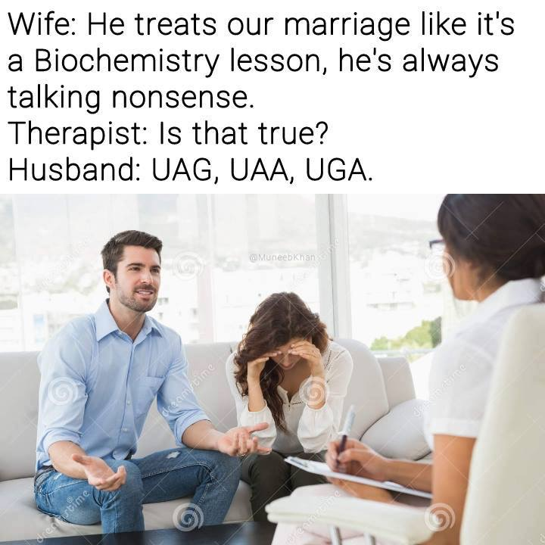

Slide 85
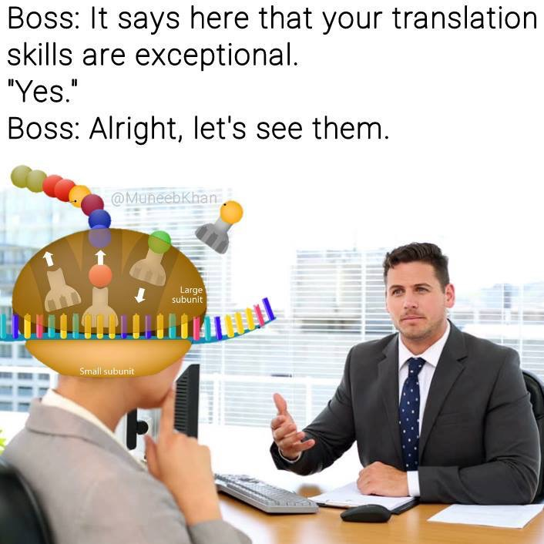

Slide 86
BioFlix: Protein Synthesis

Slide 87
WATCH
https://www.youtube.com/watch?v=2BwWavExcFI
https://www.youtube.com/watch?v=h_1QLdtF8d0
https://www.youtube.com/watch?v=itsb2SqR-R0
https://www.youtube.com/watch?v=h3b9ArupXZg
https://www.youtube.com/watch?v=yqESR7E4b_8&t=204s

Slide 88
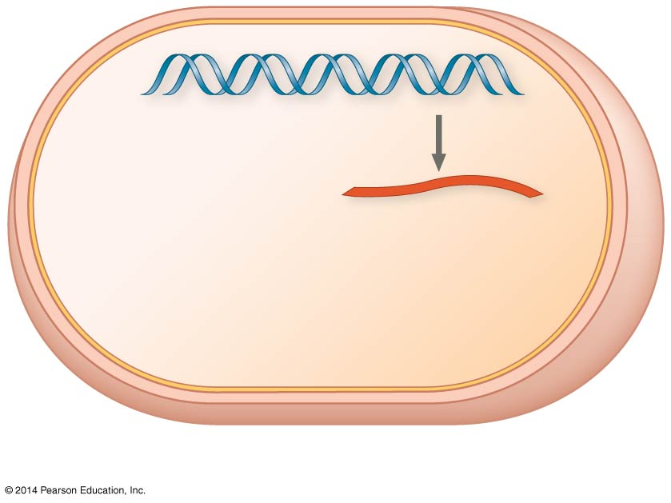
Figure 17.3a-1
DNA
TRANSCRIPTION
CYTOPLASM
mRNA
(a) Bacterial cell
Notes:
Figure 17.3a-1 Overview: the roles of transcription and translation in the flow of genetic information (part 1, step 1)

Slide 89
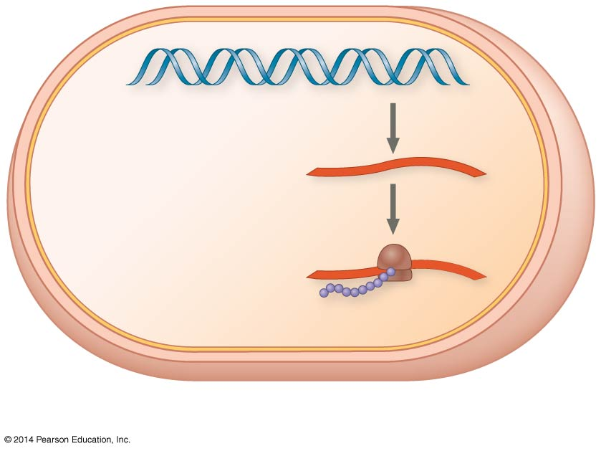
Figure 17.3a-2
DNA
TRANSCRIPTION
CYTOPLASM
mRNA
Ribosome
TRANSLATION
Polypeptide
(a) Bacterial cell
Notes:
Figure 17.3a-2 Overview: the roles of transcription and translation in the flow of genetic information (part 1, step 2)

Slide 90
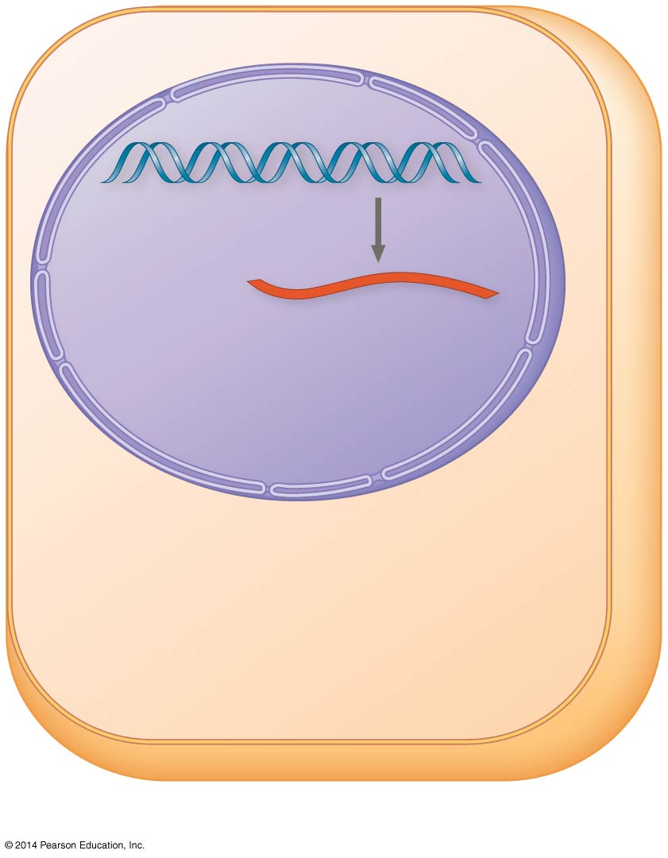
Figure 17.3b-1
Nuclear
envelope
TRANSCRIPTION
DNA
Pre-mRNA
NUCLEUS
CYTOPLASM
(b) Eukaryotic cell
Notes:
Figure 17.3b-1 Overview: the roles of transcription and translation in the flow of genetic information (part 2, step 1)

Slide 91
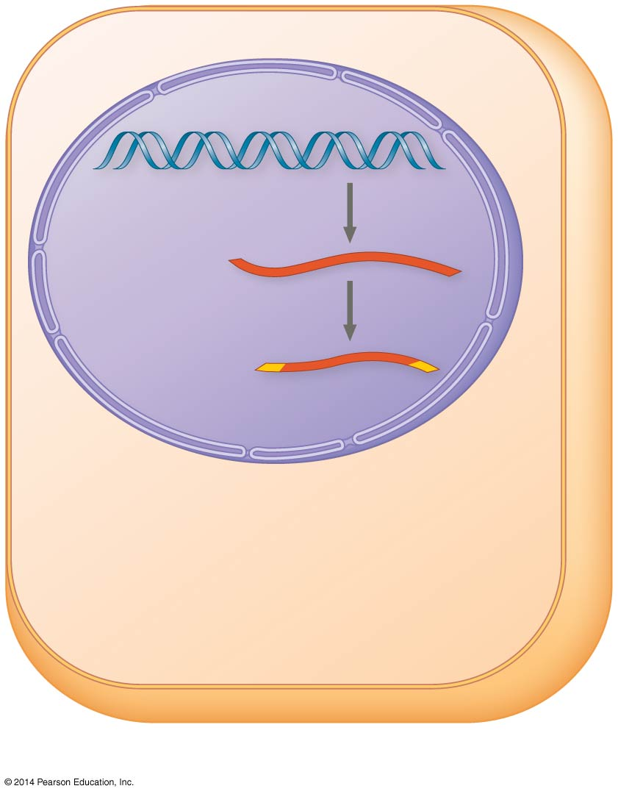
Figure 17.3b-2
Nuclear
envelope
TRANSCRIPTION
DNA
Pre-mRNA
RNA PROCESSING
NUCLEUS
mRNA
CYTOPLASM
(b) Eukaryotic cell
Notes:
Figure 17.3b-2 Overview: the roles of transcription and translation in the flow of genetic information (part 2, step 2)

Slide 92
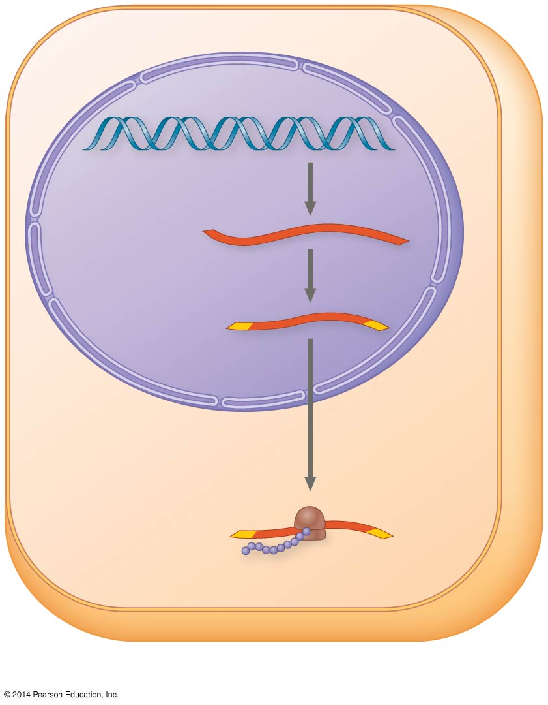
Figure 17.3b-3
Nuclear
envelope
TRANSCRIPTION
DNA
Pre-mRNA
RNA PROCESSING
NUCLEUS
mRNA
CYTOPLASM
TRANSLATION
Ribosome
Polypeptide
(b) Eukaryotic cell
Notes:
Figure 17.3b-3 Overview: the roles of transcription and translation in the flow of genetic information (part 2, step 3)

Slide 93
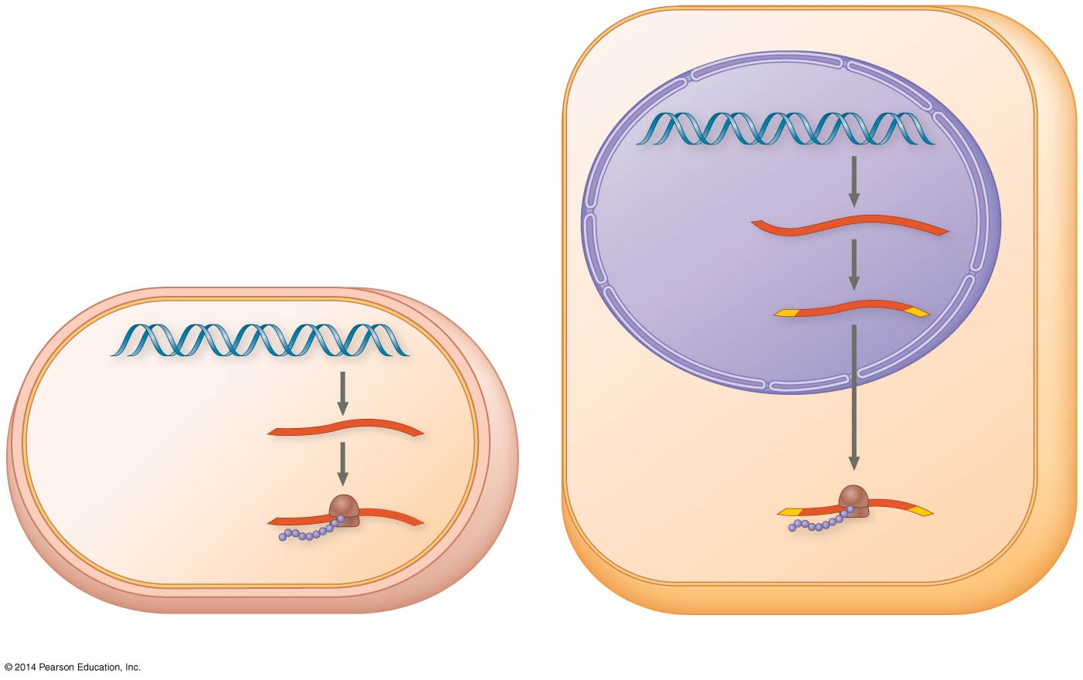
Figure 17.3
Nuclear
envelope
TRANSCRIPTION
DNA
Pre-mRNA
RNA PROCESSING
NUCLEUS
mRNA
TRANSCRIPTION
DNA
CYTOPLASM
CYTOPLASM
mRNA
Ribosome
TRANSLATION
Ribosome
TRANSLATION
Polypeptide
Polypeptide
(a) Bacterial cell
(b) Eukaryotic cell
Notes:
Figure 17.3 Overview: the roles of transcription and translation in the flow of genetic information

Slide 94
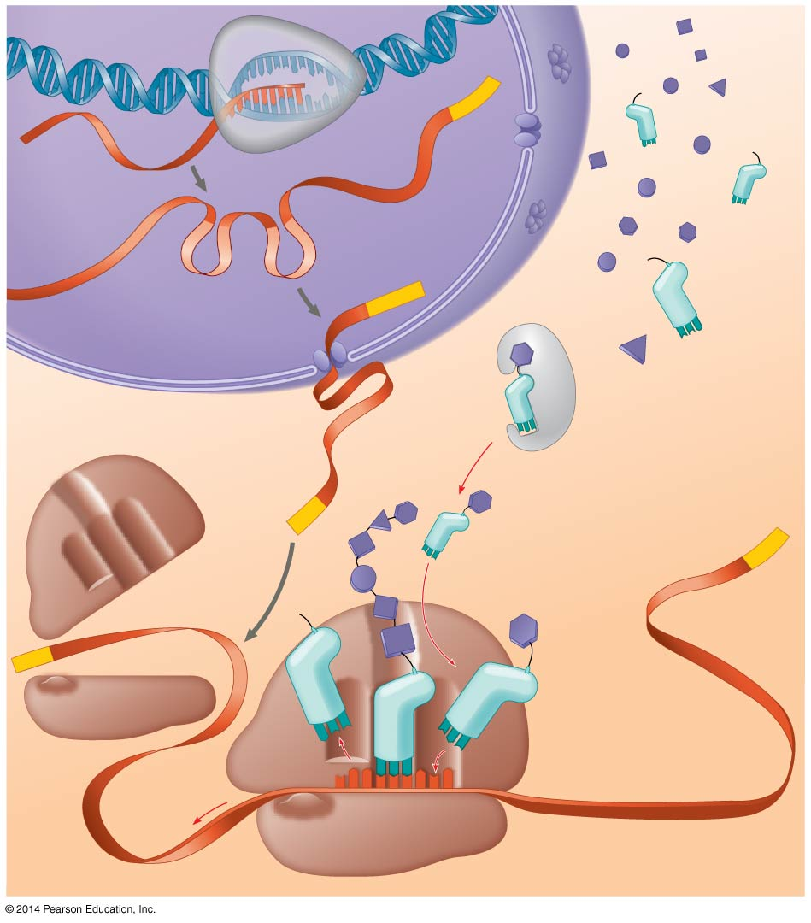
Figure 17.24
DNA
TRANSCRIPTION
3′
Poly-A
5′
RNA
polymerase
RNA
transcript
Exon
RNA PROCESSING
RNA transcript
(pre-mRNA)
Intron
Poly-A
Aminoacyl-tRNA
synthetase
NUCLEUS
Amino
acid
CYTOPLASM
AMINO ACID ACTIVATION
tRNA
mRNA
5′ Cap
3′
P
A
Aminoacyl
(charged)
tRNA
Poly-A
E
Ribosomal
subunits
5′ Cap
C
C
U
TRANSLATION
A
E
A
A
C
A
A
A
A
Anticodon
U
G
G
U
U
U
U
G
Codon
Ribosome
Notes:
Figure 17.24 A summary of transcription and translation in a eukaryotic cell

