Slide 1
40
Basic Principles of Animal Form and Function

Slide 2
Diverse Forms, Common Challenges
Anatomy = biological FORM of an organism
Physiology = biological FUNCTION(S) an organism performs
The comparative study of organisms reveals that form and function are CLOSELY CORRELATED

Slide 3
Overview
Concept 40.1: Animal form and function are correlated at all levels of organization
Concept 40.2: Feedback control maintains the internal environment in many animals
Concept 40.3: Homeostatic processes for thermoregulation involve form, function, and behavior
Concept 40.4: Energy requirements are related to animal size, activity, and environment

Slide 4
Overview
Concept 40.1: Animal form and function are correlated at all levels of organization
Concept 40.2: Feedback control maintains the internal environment in many animals
Concept 40.3: Homeostatic processes for thermoregulation involve form, function, and behavior
Concept 40.4: Energy requirements are related to animal size, activity, and environment

Slide 5
Concept 40.1: Animal form and function are correlated at all levels of organization
Size and shape affect the way an animal INTERACTS with its environment
The body plan of an animal is programmed by the genome, itself the product of MILLIONS of years of evolution

Slide 6
Concept 40.1: Animal form and function are correlated at all levels of organization
Exchange with the Environment
Materials such as nutrients, waste products, and gases must be EXCHANGED across the cell membranes of animal cells
Rate of exchange is proportional to a cell’s surface area while amount of exchange material is proportional to a cell’s volume
Major key of ALL A&P = maximize SA:Vol

Slide 7
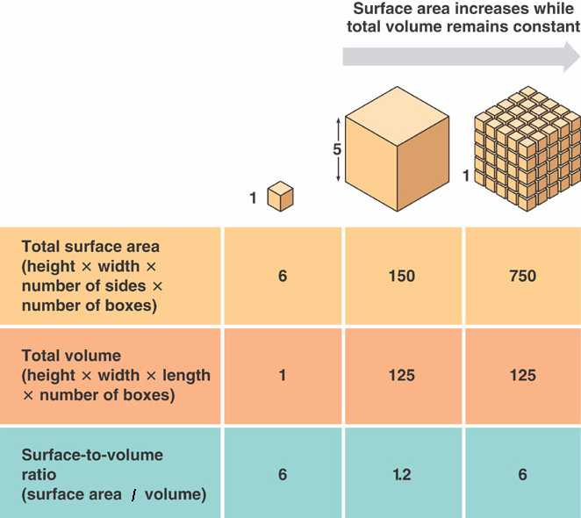
SA:VOL

Slide 8
Notes:
All animals, whether large or small, have _____.
https://www.polleverywhere.com/multiple_choice_polls/poOkpT0kQtDjDzT

Slide 9
Concept 40.1: Animal form and function are correlated at all levels of organization
A single-celled organism living in water has sufficient surface area to carry out all necessary exchange
In flat animals such as tapeworms, most cells are in DIRECT CONTACT with its environment
More complex organisms are composed of compact masses of cells with COMPLEX internal organization
Evolutionary adaptations such as specialized, extensively branched or folded structures, enable sufficient exchange with the environment (aka maximize SA:vol!)

Slide 10
Notes:
As the size of some animals has evolved to greater sizes, the effectiveness of their adaptations that promote exchanges with the environment have also increased. For example, in many larger organisms, evolution has favored lungs and a digestive tract with _____.
https://www.polleverywhere.com/multiple_choice_polls/nO8CjjfYpqH6b2M

Slide 11
Concept 40.1: Animal form and function are correlated at all levels of organization
Hierarchical Organization of Body Plans
Most animals are composed of specialized cells organized into tissues that have different functions
Tissues make up organs, which together make up organ systems
Cells → tissues → organs → organ systems → organism (never forget this hierarchy!)

Slide 12
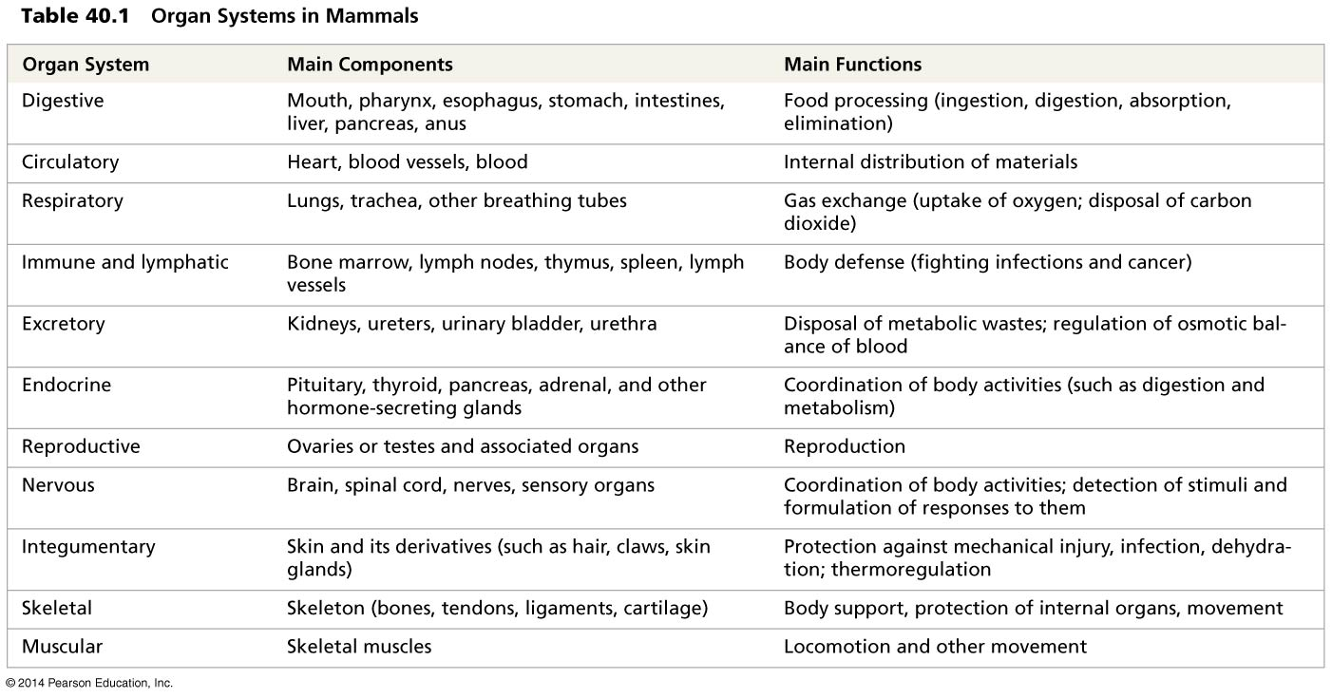
Table 40.1
Notes:
Table 40.1 Organ systems in mammals

Slide 13
Concept 40.1: Animal form and function are correlated at all levels of organization
Control and coordination within a body depend on the endocrine system and the nervous system
The endocrine system transmits chemical signals called hormones to receptive cells throughout the body via blood (recall “blood highway”)
A hormone may affect one or more regions throughout the body
Hormones are relatively SLOW acting, but can have LONG-LASTING effects

Slide 14
Concept 40.1: Animal form and function are correlated at all levels of organization
Control and coordination within a body depend on the endocrine system and the nervous system
The nervous system transmits information between specific locations
The information conveyed depends on a signal’s pathway, not the type of signal
Nerve signal transmission is very FAST, but TRANSIENT

Slide 15
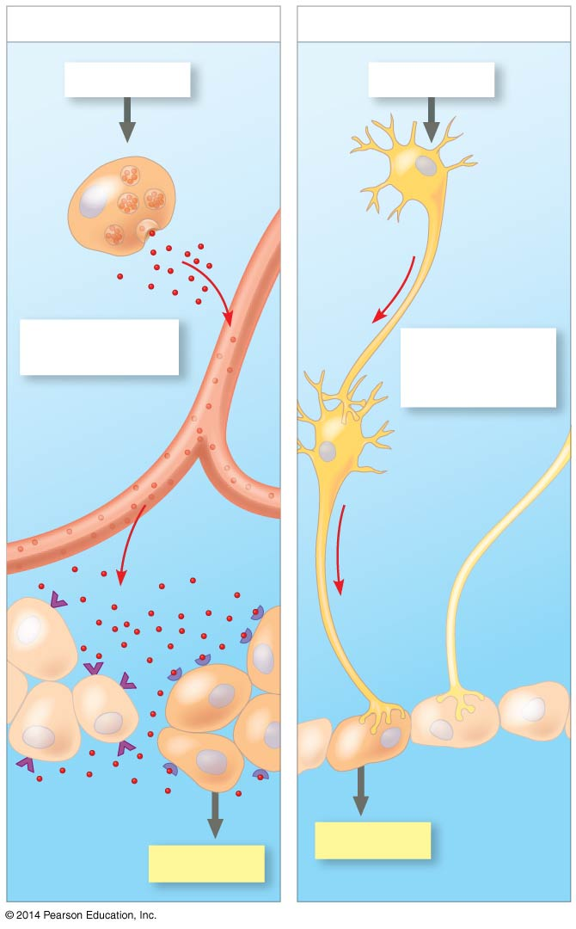
Figure 40.6
(a) Signaling by hormones
(b) Signaling by neurons
STIMULUS
STIMULUS
Endocrine
cell
Cell body
of neuron
Nerve
impulse
Axon
Hormone
Signal travels
everywhere.
Signal travels
to a specific
location.
Blood
vessel
Nerve
impulse
Axons
Response
Response
Notes:
Figure 40.6 Signaling in the endocrine and nervous systems

Slide 16
Notes:
Much of the coordination of vertebrate body functions via chemical signals is accomplished by the _____.
https://www.polleverywhere.com/multiple_choice_polls/QBXT7z4AVOI5HHx

Slide 17
Notes:
Most types of communication between cells utilize _____.
https://www.polleverywhere.com/multiple_choice_polls/DXmktXbozipfBmm

Slide 18
Overview
Concept 40.1: Animal form and function are correlated at all levels of organization
Concept 40.2: Feedback control maintains the internal environment in many animals
Concept 40.3: Homeostatic processes for thermoregulation involve form, function, and behavior
Concept 40.4: Energy requirements are related to animal size, activity, and environment

Slide 19
Concept 40.2: Feedback control maintains the internal environment in many animals
Faced with environmental fluctuations, animals manage their internal environment by either regulating or conforming
A regulator uses internal control mechanisms to control internal change in the face of external fluctuation
A conformer allows its internal condition to vary with certain external changes
Animals may regulate some environmental variables while conforming to others

Slide 20
Concept 40.2: Feedback control maintains the internal environment in many animals
Homeostasis
Organisms use homeostasis to MAINTAIN a “steady state” or internal balance regardless of external environment
Ex: In humans, body temperature, blood pH, and glucose concentration are each maintained at a CONSTANT, “steady state” level

Slide 21
Concept 40.2: Feedback control maintains the internal environment in many animals
Mechanisms of Homeostasis
Mechanisms of homeostasis MODERATE changes in the internal environment
For a given variable, fluctuations above or below a set point serve as a stimulus; these are detected by a sensor and trigger a response
The response returns the variable to the set point

Slide 22
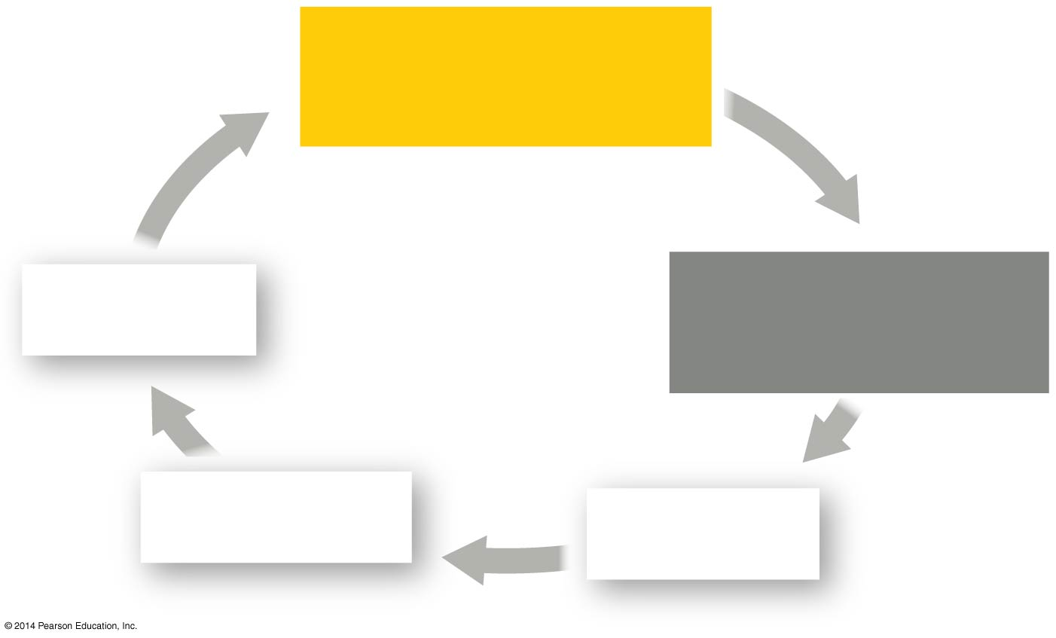
Figure 40.UN03
NORMAL RANGE
for internal variable
Response
Stimulus: change in
internal variable
Control center
Sensor
Notes:
Figure 40.UN03 Summary of key concepts: feedback control

Slide 23
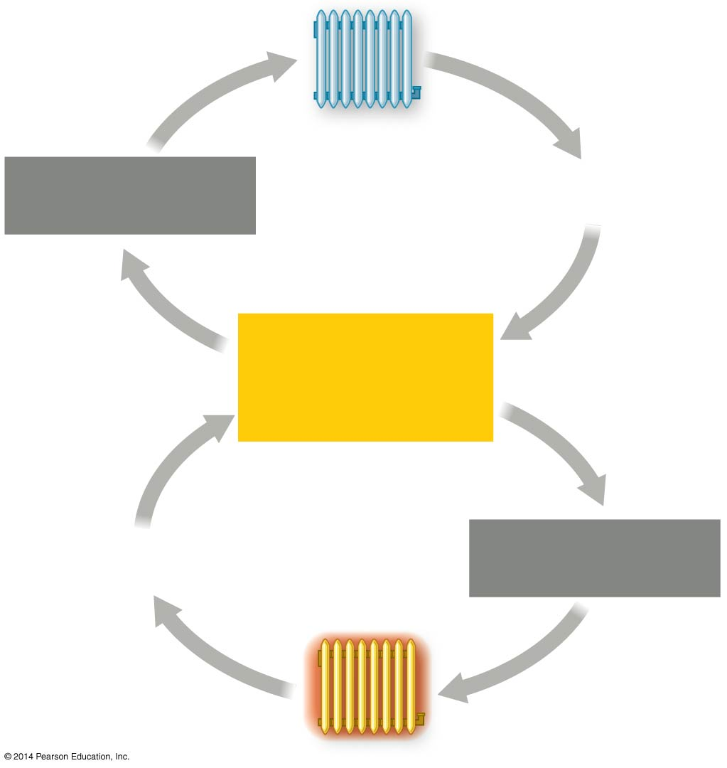
Figure 40.8
Thermostat turns
heater off.
Room temperature
increases.
Room temperature
decreases.
ROOM
TEMPERATURE
AT 20°C (set point)
Room temperature
increases.
Room temperature
decreases.
Thermostat
turns heater on.
Notes:
Figure 40.8 A nonliving example of temperature regulation: control of room temperature

Slide 24
Concept 40.2: Feedback control maintains the internal environment in many animals
Feedback Control in Homeostasis
Homeostasis in animals relies largely on negative feedback, which helps to RETURN a variable to a normal range
Ex: Blood glucose level after meal
Positive feedback AMPLIFIES a stimulus and does not usually contribute to homeostasis in animals
Ex: Childbirth
Very special occasion!

Slide 25
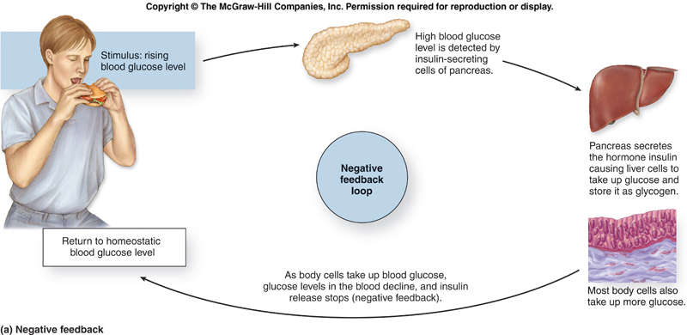

Slide 26
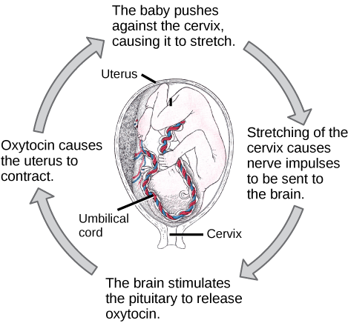
Positive feedback

Slide 27
Concept 40.2: Feedback control maintains the internal environment in many animals
Alterations in Homeostasis
Set points and normal ranges can CHANGE with age or show cyclic variation
In animals and plants, a circadian rhythm governs physiological changes that occur roughly every 24 hours
Homeostasis can ADJUST to changes in external environment, a process called acclimatization

Slide 28
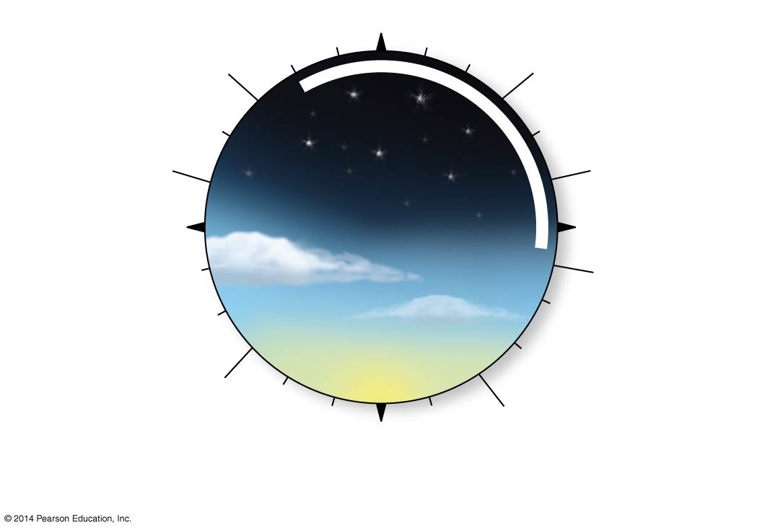
https://www.nobelprize.org/nobel_prizes/medicine/laureates/2017/
Start of
melatonin secretion
Midnight
Lowest
heart rate
When to fight someone
Greatest
muscle
strength
Lowest body
temperature
6 PM
6 AM
Most rapid
rise in blood
pressure
When to play sports/video games
Fastest
reaction time
Highest risk
of cardiac arrest
Noon
(b) The human circadian clock
Kinda when school/work starts right?!
Notes:
Figure 40.9b Human circadian rhythm (part 2: clock)

Slide 29
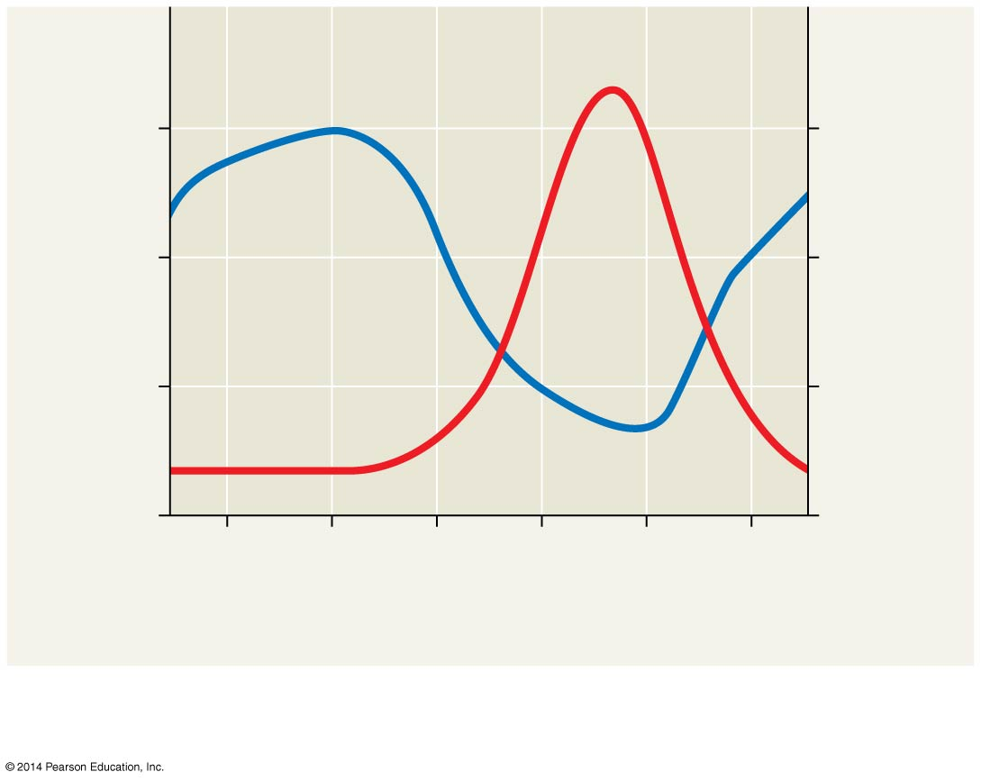
Figure 40.9a
Body
temperature
Melatonin
concentration
37.1
60
Melatonin concentration
in blood (pg/mL)
36.9
Core body temperature (°C)
40
36.7
20
36.5
0
2
PM
6
PM
10
PM
2
AM
6
AM
10
AM
Time of day
Variation in core body temperature and melatonin
concentration in blood
(a)
Notes:
Figure 40.9a Human circadian rhythm (part 1: graph)

Slide 30
Notes:
Once labor begins in childbirth, contractions increase in intensity and frequency, causing more contractions to occur until delivery. The increasing labor contractions of childbirth are an example of which type of regulation?
https://www.polleverywhere.com/multiple_choice_polls/9eQjeL1q7OCczDm

Slide 31
Notes:
When the body's blood glucose level rises, the pancreas secretes insulin and, as a result, the blood glucose level declines. When the blood glucose level is low, the pancreas secretes glucagon and, as a result, the blood glucose level rises. Such regulation of the blood glucose level is the result of _____.
https://www.polleverywhere.com/multiple_choice_polls/tYchY3MjxNaEwuG

Slide 32
Overview
Concept 40.1: Animal form and function are correlated at all levels of organization
Concept 40.2: Feedback control maintains the internal environment in many animals
Concept 40.3: Homeostatic processes for thermoregulation involve form, function, and behavior
Concept 40.4: Energy requirements are related to animal size, activity, and environment

Slide 33
Concept 40.3: Homeostatic processes for thermoregulation involve form, function, and behavior
Thermoregulation is the process by which animals maintain an internal temperature within a tolerable range
Endothermic animals generate heat by metabolism
Ex: birbs and mammals
Ectothermic animals gain heat from EXTERNAL sources
Ex: most invertebrates, fishes, amphibians, and non-avian reptiles

Slide 34
Concept 40.3: Homeostatic processes for thermoregulation involve form, function, and behavior
Endotherms can MAINTAIN a stable body temperature even in the face of large fluctuations in environmental temperature (regulators)
In general, ectotherms tolerate greater variation in internal temperature (conformers)
Endothermy is MORE energetically expensive than ectothermy

Slide 35
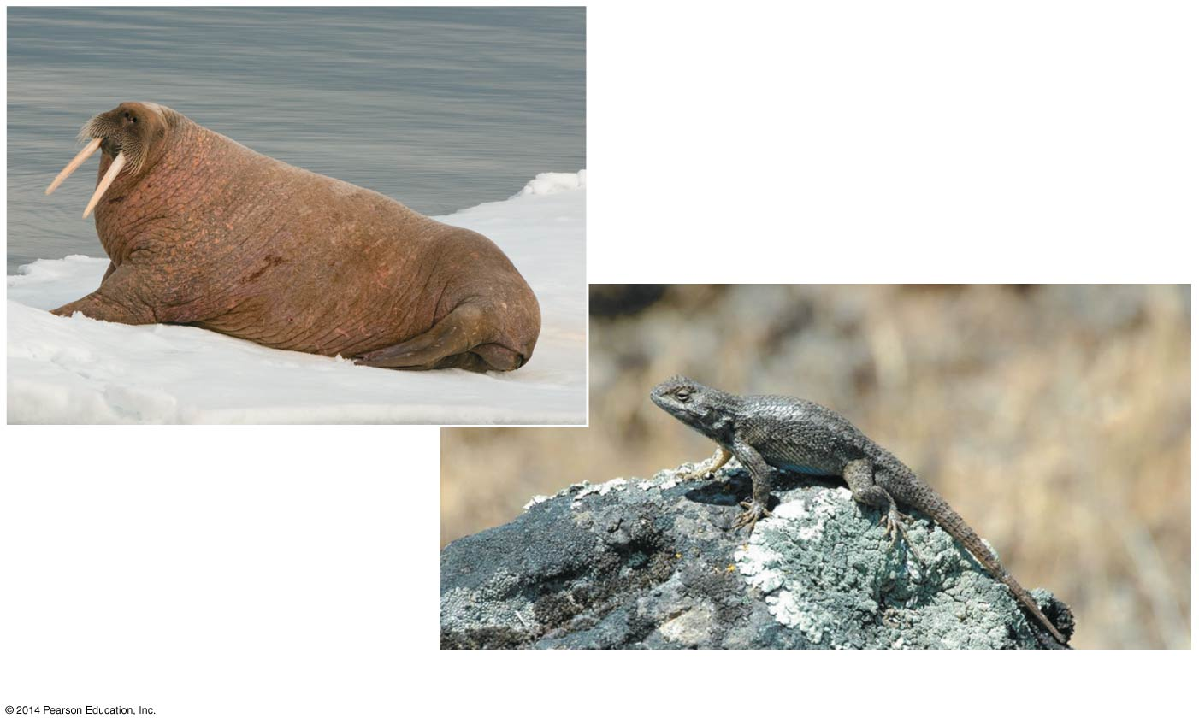
Figure 40.11
(a) A walrus, an endotherm
(b) A lizard, an ectotherm
Notes:
Figure 40.11 Thermoregulation by internal or external sources of heat

Slide 36
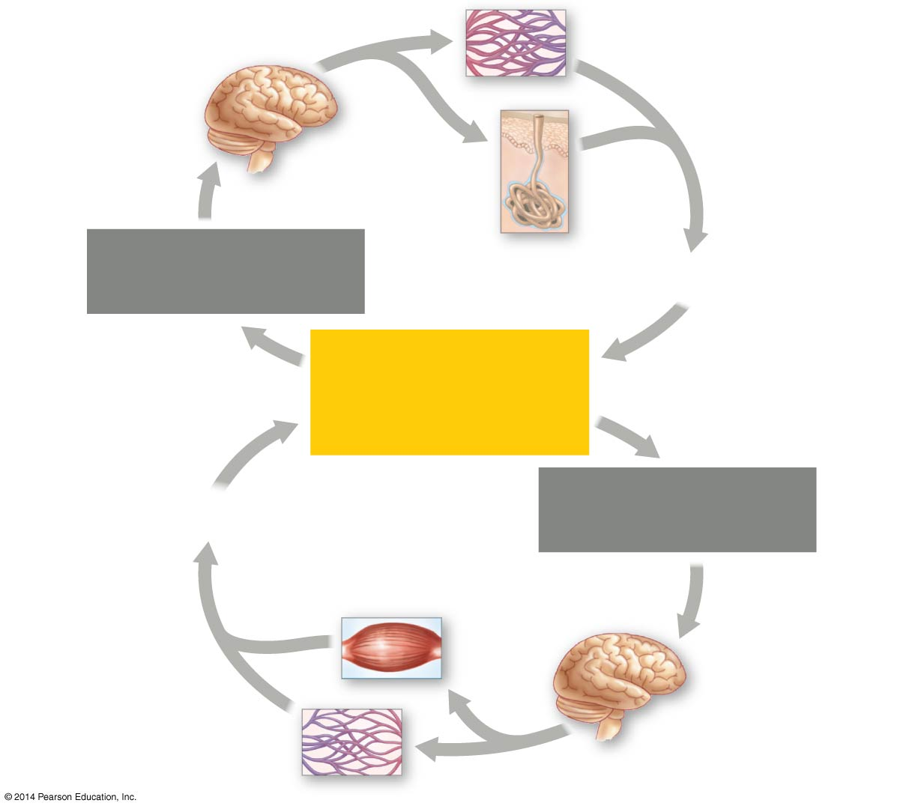
Figure 40.17
Thermostat in
hypothalamus
activates cooling
mechanisms.
Response: Blood
vessels in skin dilate.
Response:
Sweat
Body temperature
increases.
Body temperature
decreases.
NORMAL BODY
TEMPERATURE
(approximately
36–38°C)
Body temperature
increases.
Body temperature
decreases.
Response: Shivering
Response: Blood
vessels in skin
constrict.
Thermostat in
hypothalamus
activates warming
mechanisms.
Notes:
Figure 40.17 The thermostatic function of the hypothalamus in human thermoregulation

Slide 37
Notes:
A moth preparing for flight on a cold morning may warm its flight muscles via _____.
https://www.polleverywhere.com/multiple_choice_polls/h875Hdh8VwvKKCl

Slide 38
Notes:
You are studying a large tropical reptile that has a high and relatively stable body temperature. How would you determine whether this animal is an endotherm or an ectotherm?
https://www.polleverywhere.com/multiple_choice_polls/2NzzuwTiNOa8URo

Slide 39
Notes:
Organisms maintain dynamic homeostasis (internal balance) through behavioral and physiological mechanisms. Which of the following statements is an accurate explanation of a negative feedback mechanism used by animals to regulate body temperature?
https://www.polleverywhere.com/multiple_choice_polls/ChtEEKHvBV2x2DQ

Slide 40
Overview
Concept 40.1: Animal form and function are correlated at all levels of organization
Concept 40.2: Feedback control maintains the internal environment in many animals
Concept 40.3: Homeostatic processes for thermoregulation involve form, function, and behavior
Concept 40.4: Energy requirements are related to animal size, activity, and environment

Slide 41
Concept 40.4: Energy requirements are related to animal size, activity, and environment
Bioenergetics is the overall flow and transformation of energy in an animal
Determines how much food an animal needs + relates to an animal’s size, activity, and environment
Organisms can be classified by how they obtain chemical energy
Autotrophs, such as plants, harness light energy to BUILD energy-rich molecules
Heterotrophs, such as animals, harvest (BREAK DOWN) food for its chemical energy

Slide 42
Concept 40.4: Energy requirements are related to animal size, activity, and environment
Energy-containing molecules from food are usually used to make ATP (via…?), which powers cellular work
After the needs of staying alive are met, remaining food molecules can be used in biosynthesis
Ex: body growth, repair, synthesis of storage material (e.g. fat), and production of gametes
Happening in you RIGHT NOW!

Slide 43
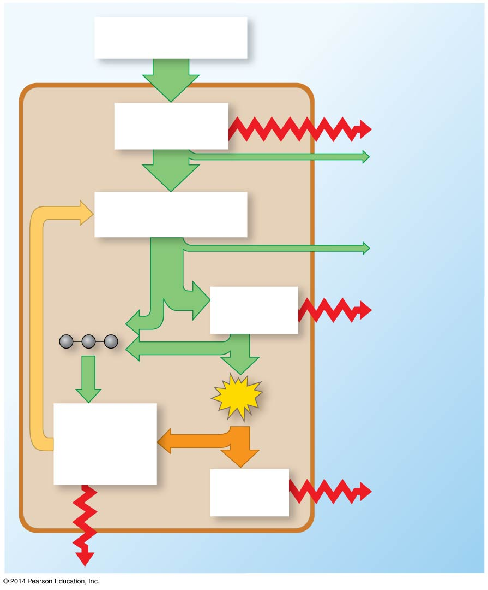
Figure 40.18
Organic molecules
in food
External
environment
Animal
body
Digestion and
absorption
Heat
Energy lost
in feces
Nutrient molecules
in body cells
Energy lost in
nitrogenous
waste
Carbon
skeletons
Cellular
respiration
Heat
ATP
Bio-
synthesis
Cellular
work
Heat
Heat
Notes:
Figure 40.18 Bioenergetics of an animal: an overview

Slide 44
Concept 40.4: Energy requirements are related to animal size, activity, and environment
Torpor is a physiological state in which activity is low and metabolism decreases
Hibernation is long-term torpor that is an adaptation to winter cold and food scarcity
Torpor enables animals to save energy while avoiding difficult and dangerous conditions

Slide 45
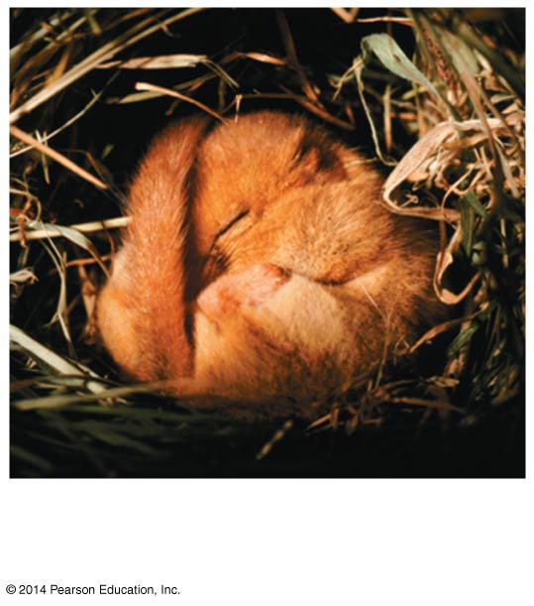
Figure 40.UN02
Hibernating dormouse
(Muscardinus avellanarius)
Notes:
Figure 40.UN02 In-text figure, hibernation, p. 887

Slide 46
Notes:
Hummingbirds are small birds that require a regular food supply. When hummingbirds are faced with a situation that decreases their food supply, such as a storm, which of the following adaptations would be most useful for the bird to survive such an unpredictable and short-term absence of food resources?
https://www.polleverywhere.com/multiple_choice_polls/JFgyJHXo8bB3YzH

Slide 47
Overview
Concept 40.1: Animal form and function are correlated at all levels of organization
Concept 40.2: Feedback control maintains the internal environment in many animals
Concept 40.3: Homeostatic processes for thermoregulation involve form, function, and behavior
Concept 40.4: Energy requirements are related to animal size, activity, and environment

