Slide 1
Lecture 20 - Standard potentials, free energy, equilibrium constant

Slide 2
Standard potentials
Can think of electrode in each half-cell as having its own potential
Standard electrode potential
Electrons flow from electrode with greater potential energy to electrode with less potential energy
More negative to more positive
High to low
Ecell = Ecathode - Eanode
More negative potential: repel electrons
More positive potential: attract electrons

Slide 3
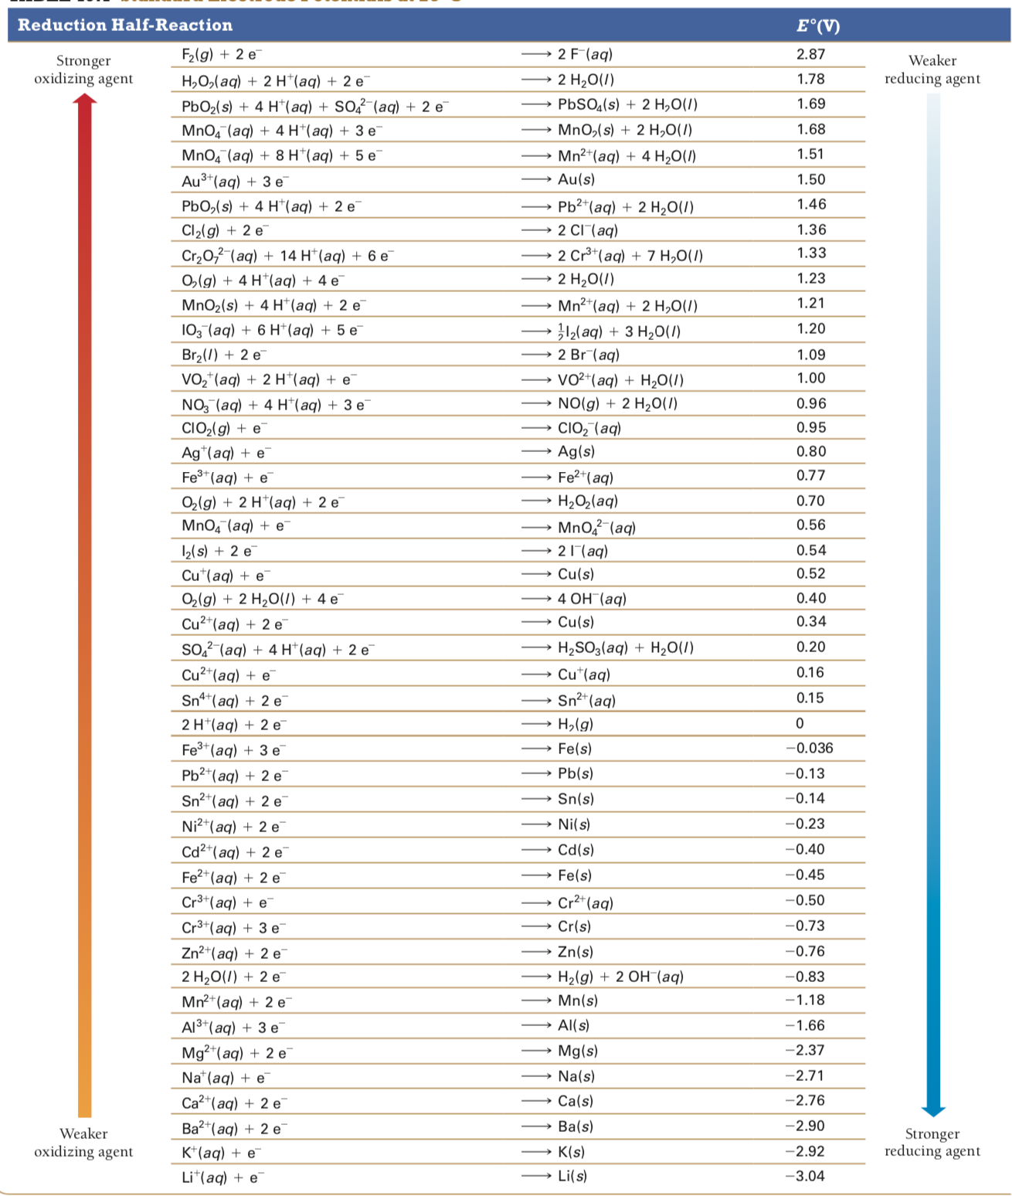

Slide 4
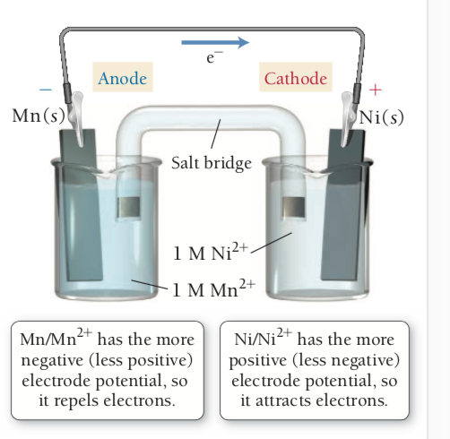
Standard potentials
Predicting Spontaneous Direction of Redox reaction
Look at reduction potentials
More negative is more easily oxidized
More positive is more easily reduced
Ex. Ni2+ + 2 e- -> Ni (s) and Mn2+ + 2 e- -> Mn (s)
Ni2+
E = -0.23 V
Mn2+
E = -1.18 V
Oxidation: Mn (s) -> Mn2+ (aq) +2e-
Reduction: Ni2+ (aq) + 2 e- -> Ni (s)
E cell = Ecat-Ean = -0.23 - (-1.18) = 0.95 V
Cell potential is positive which indicates a spontaneous reaction
Any reduction half-reaction is spontaneous when paired with the reverse of a half-reaction that is below it on the table
Can use to see whether metals will dissolve in acid
Any metal half-reaction which is below the H+ half reaction will dissolve and metals above will not

Slide 5
Cell potential, free energy, and the equilibrium constant
Ecell and ΔG are related
ΔG and K are related
E cell and K must also be related
Spontaneous redox reaction
ΔG is negative
Ecell is positive
K > 1
Nonspontaneous reaction
ΔG is positive
E cell is negative
K < 1

Slide 6
Cell potential, free energy, and the equilibrium constant
Relationship between ΔG and Ecell
E = potential energy difference (J)/charge (C)
PE is maximum work done by system
W = -qE
Negative because work done by system on surroundings is negative
Q can be quantified using faraday’s constant
F = 96485 C/mol e-
Q = nF
W = -nFE
W = ΔG
Free
ΔG is the maximum amount of work that can be done by the reaction
ΔG = -nFE

Slide 7
Cell potential, free energy, and the equilibrium constant
Relationship between Ecell and K
ΔG = -RTlnK
-nFE = -RTlnK
E = (RT/nF)lnK
R = 8.314 J/(mol*k)
T = 298.15K
F = 96485 C/mol e-
lnK = 2.303*logK
E = (0.0592V/n)logK

