Slide 1
0
5
The Structure and Function of Large Biological Molecules

Slide 2
Notes:
Carbs are bad.
https://www.polleverywhere.com/multiple_choice_polls/M0Jq4SWGLPm9oBW

Slide 3
The Molecules of Life
All living things are made up of four classes of large biological molecules: carbohydrates, lipids, proteins, and nucleic acids
Macromolecules are large, complex molecules
Large biological molecules have unique properties that arise from the orderly arrangement of their atoms

Slide 4
Overview
Concept 5.1: Macromolecules are polymers, built from monomers
Concept 5.2: Carbohydrates serve as fuel and building material
Concept 5.3: Lipids are a diverse group of hydrophobic molecules
Concept 5.4: Proteins include a diversity of structures, resulting in a wide range of functions
Concept 5.5: Nucleic acids store, transmit, and help express hereditary information

Slide 5
Overview
Concept 5.1: Macromolecules are polymers, built from monomers
Concept 5.2: Carbohydrates serve as fuel and building material
Concept 5.3: Lipids are a diverse group of hydrophobic molecules
Concept 5.4: Proteins include a diversity of structures, resulting in a wide range of functions
Concept 5.5: Nucleic acids store, transmit, and help express hereditary information

Slide 6
Concept 5.1: Macromolecules are polymers, built from monomers
A polymer is a long molecule consisting of many similar building blocks
The repeating units that serve as building blocks are called monomers
Three of the four classes of life’s organic molecules are polymers
Carbohydrates
Proteins
Nucleic acids

Slide 7
Concept 5.1: Macromolecules are polymers, built from monomers
The Synthesis and Breakdown of Polymers
Enzymes are specialized macromolecules that speed up chemical reactions such as those that make or break down polymers
A dehydration reaction occurs when two monomers bond together through the loss of a water molecule
Polymers are disassembled to monomers by hydrolysis, a reaction that is essentially the reverse of the dehydration reaction

Slide 8
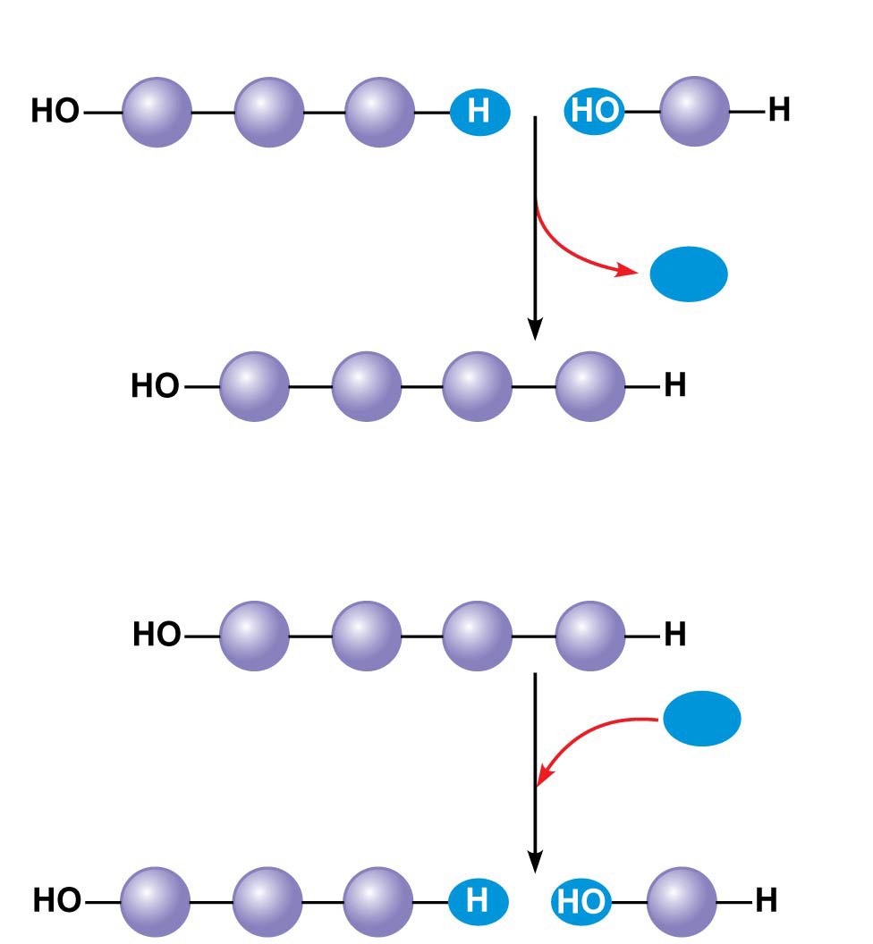
Figure 5.2
(a) Dehydration reaction: synthesizing a polymer
1
2
3
Short polymer
Unlinked monomer
Dehydration removes a water
molecule, forming a new bond.
H₂O
1
2
3
4
Longer polymer
(b) Hydrolysis: breaking down a polymer
1
2
3
4
Hydrolysis adds a water
molecule, breaking a bond.
H₂O
1
2
3
Notes:
Figure 5.2 The synthesis and breakdown of polymers

Slide 9
Animation: Polymers

Slide 10
Notes:
Which of the following best summarizes the relationship between dehydration reactions and hydrolysis?
https://www.polleverywhere.com/multiple_choice_polls/RLeGEgpj6pHCQj9

Slide 11
Notes:
Which of these classes of biological molecules does NOT include polymers?
https://www.polleverywhere.com/multiple_choice_polls/C5pX2BO3wJbaur6

Slide 12
Overview
Concept 5.1: Macromolecules are polymers, built from monomers
Concept 5.2: Carbohydrates serve as fuel and building material
Concept 5.3: Lipids are a diverse group of hydrophobic molecules
Concept 5.4: Proteins include a diversity of structures, resulting in a wide range of functions
Concept 5.5: Nucleic acids store, transmit, and help express hereditary information

Slide 13
Concept 5.2: Carbohydrates serve as fuel and building material
Carbohydrates include sugars and the polymers of sugars
The simplest carbohydrates are monosaccharides, or simple sugars
Carbohydrate macromolecules are polysaccharides, polymers composed of many sugar building blocks

Slide 14
Concept 5.2: Carbohydrates serve as fuel and building material
Sugars
Monosaccharides have molecular formulas that are usually multiples of CH₂O
Glucose (C₆H₁₂O₆) is the most common monosaccharide
Monosaccharides are classified by
The location of the carbonyl group (as aldose or ketose)
The number of carbons in the carbon skeleton

Slide 15
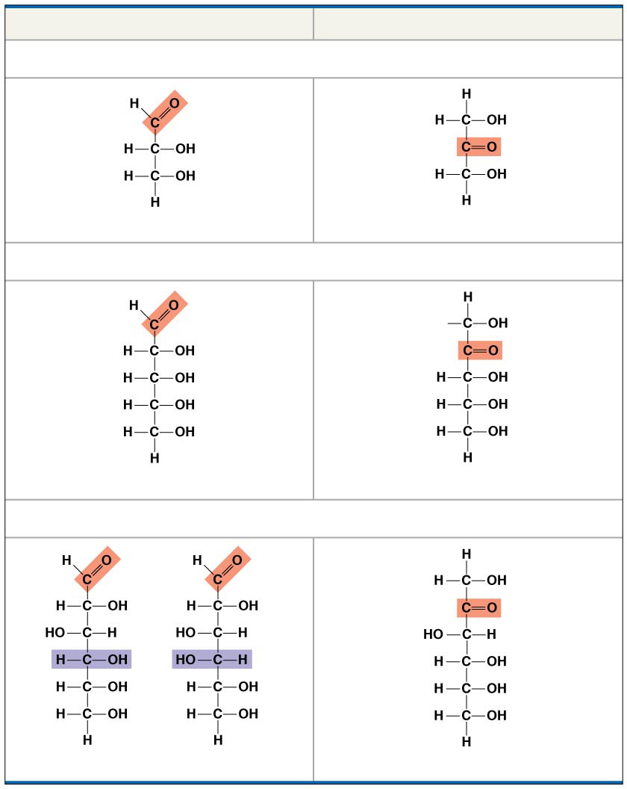
Figure 5.3
Aldoses (Aldehyde Sugars)
Ketoses (Ketone Sugars)
Trioses: 3-carbon sugars (C₃H₆O₃)
Glyceraldehyde
Dihydroxyacetone
Pentoses: 5-carbon sugars (C₅H₁₀O₅)
Ribose
Ribulose
Hexoses: 6-carbon sugars (C₆H₁₂O₆)
Glucose
Galactose
Fructose
Notes:
Figure 5.3 The structure and classification of some monosaccharides

Slide 16
Concept 5.2: Carbohydrates serve as fuel and building material
Though often drawn as linear skeletons, in aqueous solutions many sugars form rings
Monosaccharides serve as a major fuel for cells and as raw material for building molecules

Slide 17
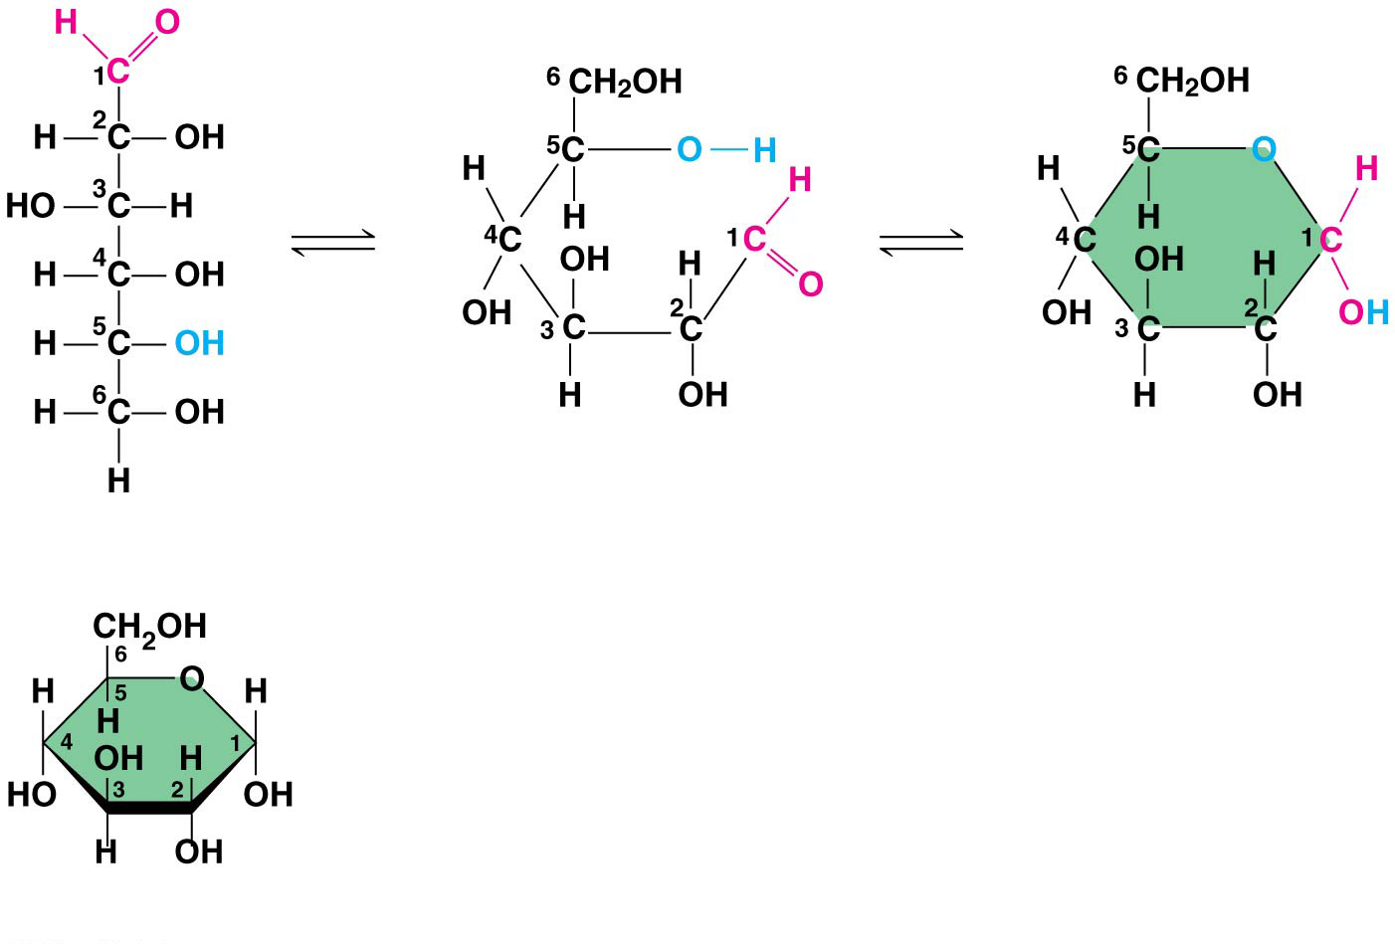
Figure 5.4
(a) Linear and ring forms
(b) Abbreviated ring structure
Notes:
Figure 5.4 Linear and ring forms of glucose

Slide 18
Concept 5.2: Carbohydrates serve as fuel and building material
A disaccharide is formed when a dehydration reaction joins two monosaccharides
This covalent bond is called a glycosidic linkage

Slide 19
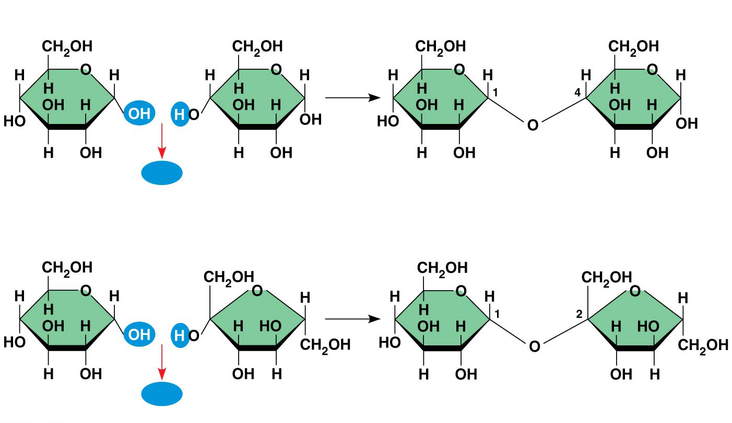
Figure 5.5
(a) Dehydration reaction in the synthesis of maltose
1−4
glycosidic
linkage
H₂O
Glucose
Glucose
Maltose
(b) Dehydration reaction in the synthesis of sucrose
1−2
glycosidic
linkage
H₂O
Glucose
Fructose
Sucrose
Notes:
Figure 5.5 Examples of disaccharide synthesis

Slide 20
Animation: Disaccharides

Slide 21
Concept 5.2: Carbohydrates serve as fuel and building material
Polysaccharides, the polymers of sugars, have storage and structural roles
The architecture and function of a polysaccharide are determined by its sugar monomers and the positions of its glycosidic linkages

Slide 22
Concept 5.2: Carbohydrates serve as fuel and building material
Storage Polysaccharides
Starch, a storage polysaccharide of plants, consists entirely of glucose monomers
Plants store surplus starch as granules within chloroplasts and other plastids
The simplest form of starch is amylose

Slide 23
Concept 5.2: Carbohydrates serve as fuel and building material
Storage Polysaccharides
Glycogen is a storage polysaccharide in animals
Glycogen is stored mainly in liver and muscle cells
Hydrolysis of glycogen in these cells releases glucose when the demand for sugar increases

Slide 24
Concept 5.2: Carbohydrates serve as fuel and building material
Structural Polysaccharides
The polysaccharide cellulose is a major component of the tough wall of plant cells
Like starch, cellulose is a polymer of glucose, but the glycosidic linkages differ
The difference is based on two ring forms for glucose: alpha (α) and beta (β)

Slide 25
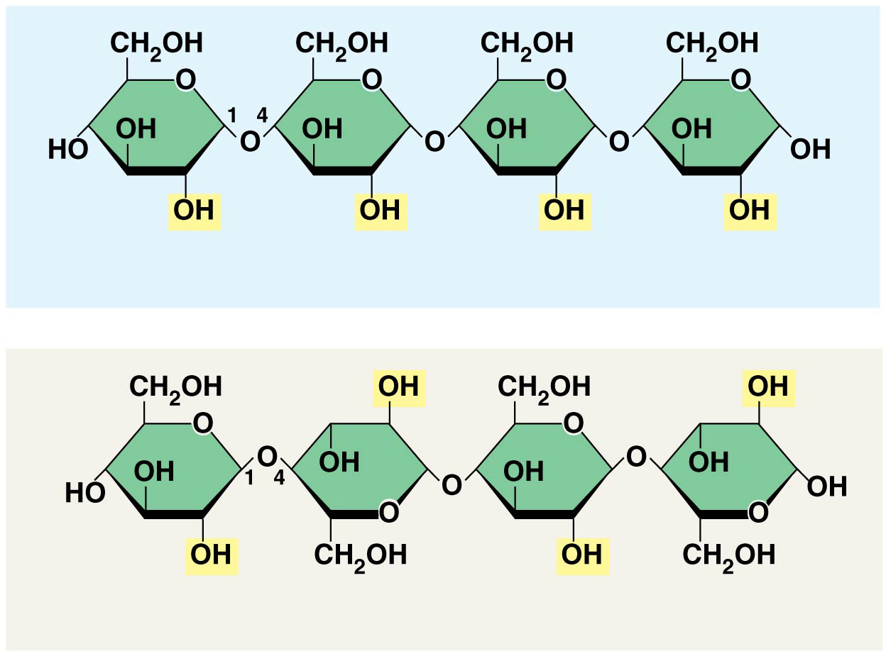
Figure 5.7b
(b) Starch: 1–4 linkage of 𝛂 glucose monomer
(c) Cellulose: 1–4 linkage of 𝛃 glucose monomers
Notes:
Figure 5.7b Starch and cellulose structures (part 2: linkages)

Slide 26
Concept 5.2: Carbohydrates serve as fuel and building material
Enzymes that digest starch by hydrolyzing α linkages can’t hydrolyze β linkages in cellulose
The cellulose in human food passes through the digestive tract as “insoluble fiber”
Some microbes use enzymes to digest cellulose
Many herbivores, from cows to termites, have symbiotic relationships with these microbes

Slide 27
Concept 5.2: Carbohydrates serve as fuel and building material
Chitin, another structural polysaccharide, is found in the exoskeleton of arthropods
Chitin also provides structural support for the cell walls of many fungi

Slide 28
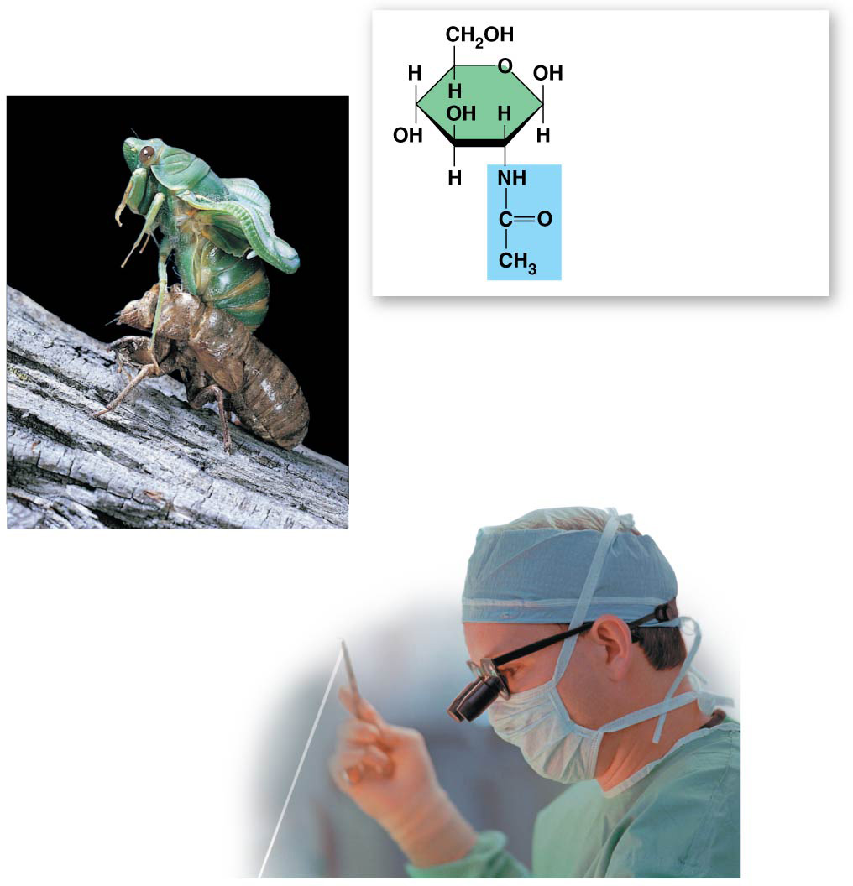
Figure 5.8
►
The structure
of the chitin
monomer
►
Chitin, embedded in proteins,
forms the exoskeleton of
arthropods.
►
Chitin is used to
make a strong
and flexible
surgical
thread.
Notes:
Figure 5.8 Chitin, a structural polysaccharide

Slide 29
Summary of key concepts: carbohydrates
Notes:
Figure 5.UN03 Summary of key concepts: carbohydrates

Slide 30
Notes:
What does the term "insoluble fiber" refer to on food packages?
https://www.polleverywhere.com/multiple_choice_polls/weeHT6SGn74ENwI

Slide 31
Notes:
Humans can digest starch but not cellulose because _____.
https://www.polleverywhere.com/multiple_choice_polls/XbZXKX46KAfl1kX

Slide 32
Overview
Concept 5.1: Macromolecules are polymers, built from monomers
Concept 5.2: Carbohydrates serve as fuel and building material
Concept 5.3: Lipids are a diverse group of hydrophobic molecules
Concept 5.4: Proteins include a diversity of structures, resulting in a wide range of functions
Concept 5.5: Nucleic acids store, transmit, and help express hereditary information

Slide 33
Concept 5.3: Lipids are a diverse group of hydrophobic molecules
Lipids are the one class of large biological molecules that does not include true polymers
The unifying feature of lipids is that they mix poorly, if at all, with water
Lipids are hydrophobic because they consist mostly of hydrocarbons, which form nonpolar covalent bonds
The most biologically important lipids are fats, phospholipids, and steroids

Slide 34
Concept 5.3: Lipids are a diverse group of hydrophobic molecules
Fats
Fats are constructed from two types of smaller molecules: glycerol and fatty acids
Glycerol is a three-carbon alcohol with a hydroxyl group attached to each carbon
A fatty acid consists of a carboxyl group attached to a long carbon skeleton

Slide 35
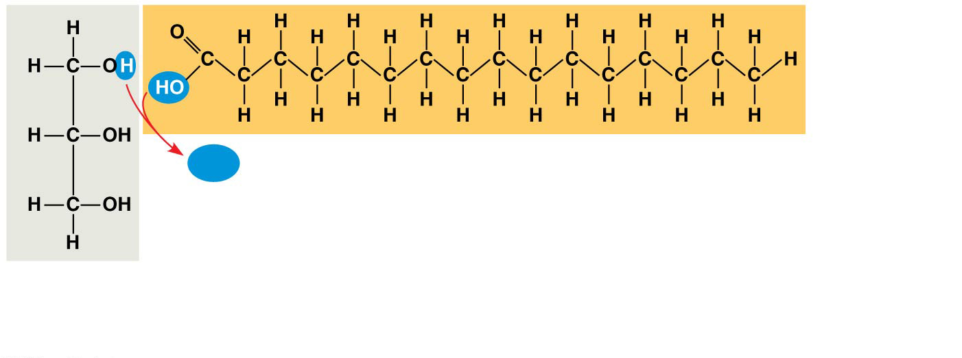
Figure 5.9a
H₂O
Fatty acid
(in this case, palmitic acid)
Glycerol
(a) One of three dehydration reactions in the synthesis of a fat
Notes:
Figure 5.9a The synthesis and structure of a fat, or triacylglycerol (part 1: dehydration reaction)

Slide 36
Concept 5.3: Lipids are a diverse group of hydrophobic molecules
Fats separate from water because water molecules hydrogen-bond to each other and exclude the fats
In a fat, three fatty acids are joined to glycerol by an ester linkage, creating a triacylglycerol, or triglyceride
The fatty acids in a fat can be all the same or of two or three different kinds

Slide 37
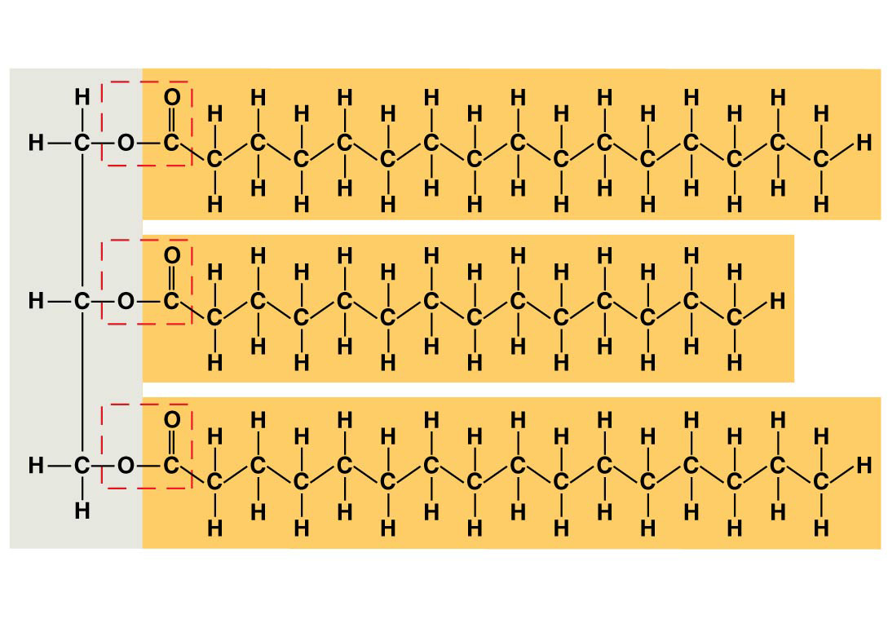
Figure 5.9b
Ester linkage
(b) Fat molecule (triacylglycerol)
Notes:
Figure 5.9b The synthesis and structure of a fat, or triacylglycerol (part 2: triacylglycerol)

Slide 38
Concept 5.3: Lipids are a diverse group of hydrophobic molecules
Fatty acids vary in length (number of carbons) and in the number and locations of double bonds
Saturated fatty acids have the maximum number of hydrogen atoms possible and no double bonds
Unsaturated fatty acids have one or more double bonds

Slide 39
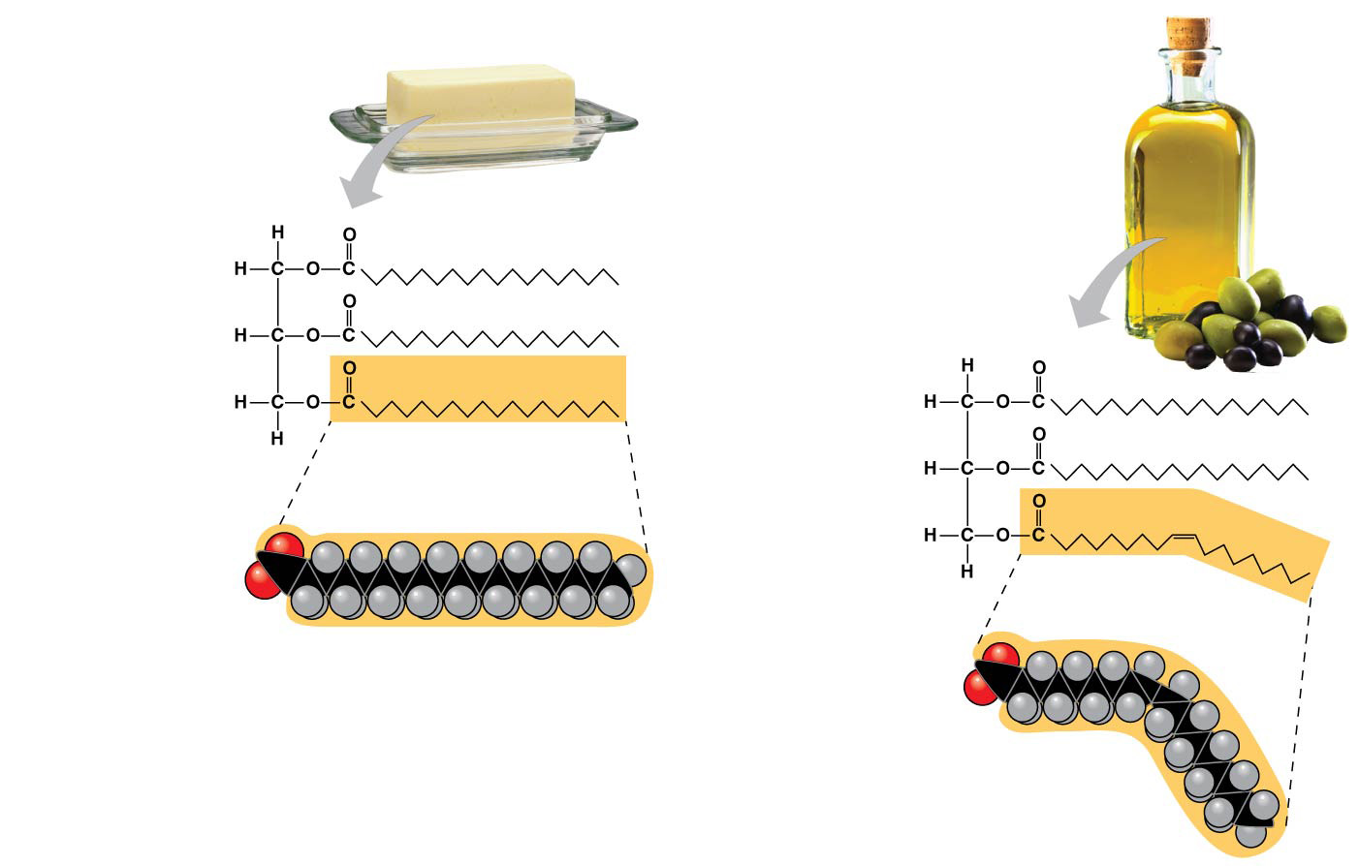
Figure 5.10
(a) Saturated fat
(b) Unsaturated fat
Structural
formula
of a saturated
fat molecule
Structural
formula of an
unsaturated
fat molecule
Space-filling
model of
stearic acid,
a saturated
fatty acid
Space-filling
model of oleic
acid, an
unsaturated
fatty acid
Cis double
bond causes
bending.
Notes:
Figure 5.10 Saturated and unsaturated fats and fatty acids

Slide 40
Concept 5.3: Lipids are a diverse group of hydrophobic molecules
Fats made from saturated fatty acids are called saturated fats and are solid at room temperature
Most animal fats are saturated
Fats made from unsaturated fatty acids are called unsaturated fats or oils and are liquid at room temperature
Plant fats and fish fats are usually unsaturated

Slide 41
Concept 5.3: Lipids are a diverse group of hydrophobic molecules
A diet rich in saturated fats may contribute to cardiovascular disease through plaque deposits
Hydrogenation is the process of converting unsaturated fats to saturated fats by adding hydrogen
Hydrogenating vegetable oils also creates unsaturated fats with trans double bonds
These trans fats may contribute more than saturated fats to cardiovascular disease

Slide 42
Concept 5.3: Lipids are a diverse group of hydrophobic molecules
The major function of fats is energy storage
Humans and other mammals store their long-term food reserves in adipose cells
Adipose tissue also cushions vital organs and insulates the body

Slide 43
Concept 5.3: Lipids are a diverse group of hydrophobic molecules
Phospholipids
In a phospholipid, two fatty acids and a phosphate group are attached to glycerol
The two fatty acid tails are hydrophobic, but the phosphate group and its attachments form a hydrophilic head

Slide 44
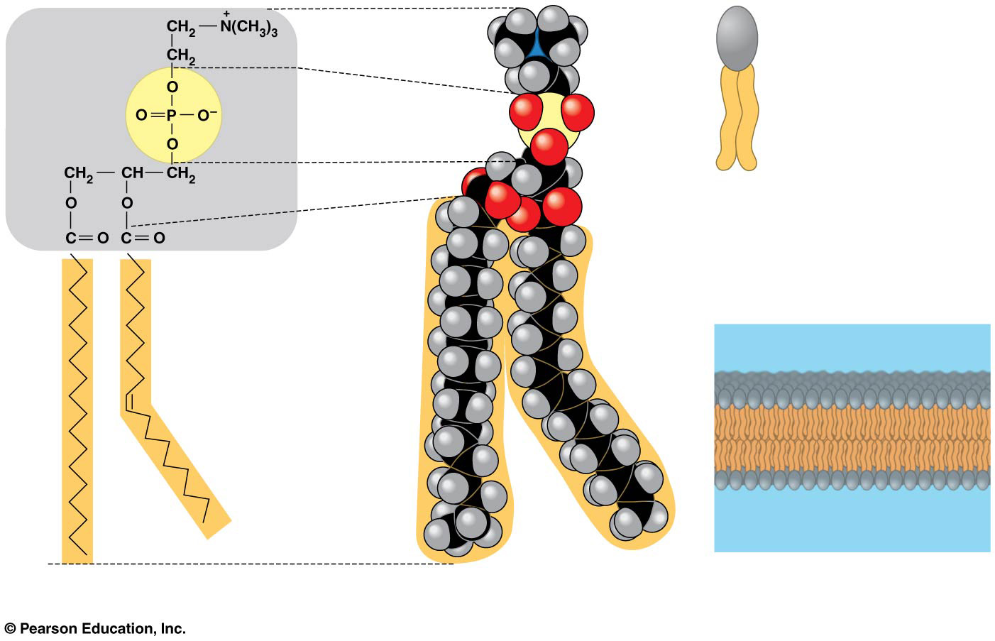
Figure 5.11
Choline
Hydrophilic
head
Hydrophilic head
Phosphate
Hydrophobic
tails
Glycerol
(c) Phospholipid symbol
Fatty acids
Hydrophobic tails
Kink due to cis
double bond
(a) Structural formula
(b) Space-filling model
(d) Phospholipid bilayer
Notes:
Figure 5.11 The structure of a phospholipid

Slide 45
Concept 5.3: Lipids are a diverse group of hydrophobic molecules
Steroids
Steroids are lipids characterized by a carbon skeleton consisting of four fused rings
Cholesterol, a type of steroid, is a component in animal cell membranes and a precursor from which other steroids are synthesized
A high level of cholesterol in the blood may contribute to cardiovascular disease

Slide 46
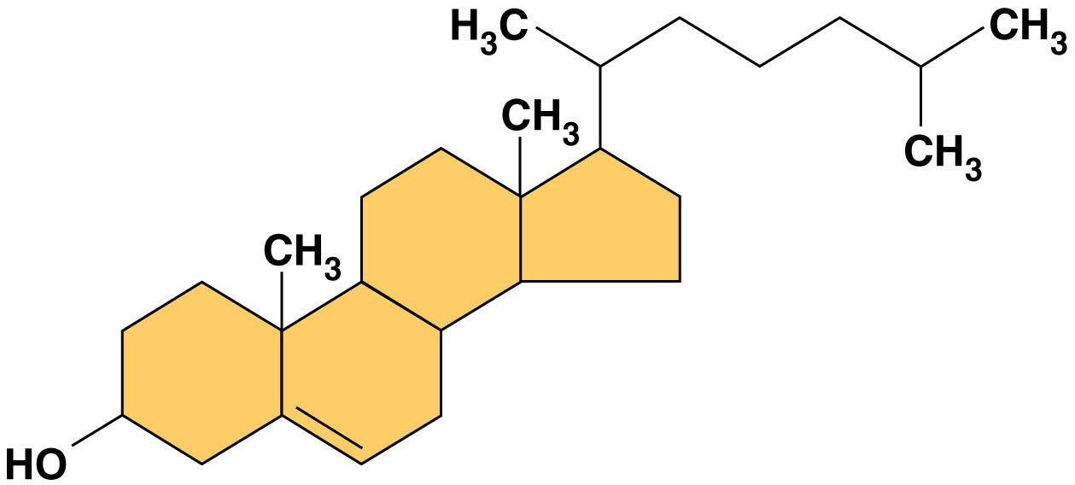
Figure 5.12
Notes:
Figure 5.12 Cholesterol, a steroid

Slide 47
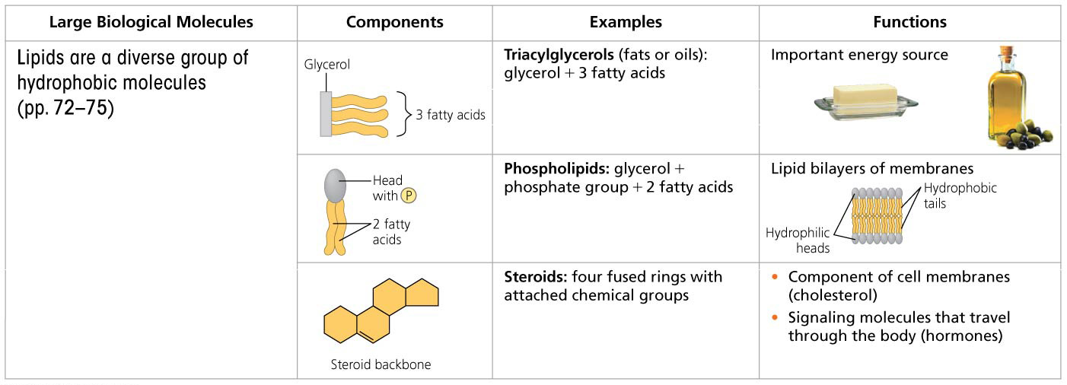
Summary of key concepts: lipids
Notes:
Figure 5.UN04 Summary of key concepts: lipids

Slide 48
Notes:
How do phospholipids interact with water molecules?
https://www.polleverywhere.com/multiple_choice_polls/1r224vPw8jxoh8U

Slide 49
Notes:
The label on a container of margarine lists "hydrogenated vegetable oil" as the major ingredient. Hydrogenated vegetable oil _____.
https://www.polleverywhere.com/multiple_choice_polls/xErqxK13PADAgd9

Slide 50
Overview
Concept 5.1: Macromolecules are polymers, built from monomers
Concept 5.2: Carbohydrates serve as fuel and building material
Concept 5.3: Lipids are a diverse group of hydrophobic molecules
Concept 5.4: Proteins include a diversity of structures, resulting in a wide range of functions
Concept 5.5: Nucleic acids store, transmit, and help express hereditary information

Slide 51
Concept 5.4: Proteins include a diversity of structures, resulting in a wide range of functions
Proteins account for more than 50% of the dry mass of most cells
Some proteins speed up chemical reactions
Other protein functions include defense, storage, transport, cellular communication, movement, or structural support

Slide 52
Concept 5.4: Proteins include a diversity of structures, resulting in a wide range of functions
Proteins are all constructed from the same set of 20 amino acids
Polypeptides are unbranched polymers built from these amino acids
A protein is a biologically functional molecule that consists of one or more polypeptides

Slide 53
Concept 5.4: Proteins include a diversity of structures, resulting in a wide range of functions
Amino Acid Monomers
Amino acids are organic molecules with amino and carboxyl groups
Amino acids differ in their properties due to differing side chains, called R groups

Slide 54
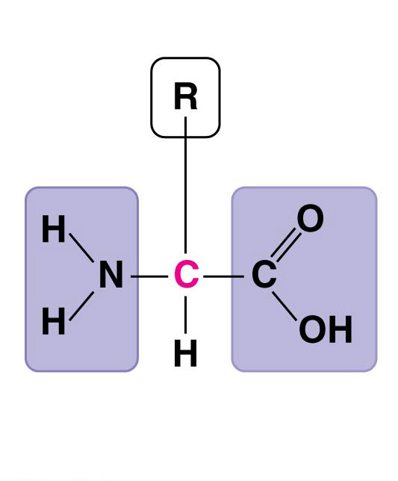
Figure 5.UN01
Side chain (R group)
𝛂 carbon
Amino
group
Carboxyl
group
Notes:
Figure 5.UN01 In-text figure, amino acid monomer, p. 75

Slide 55
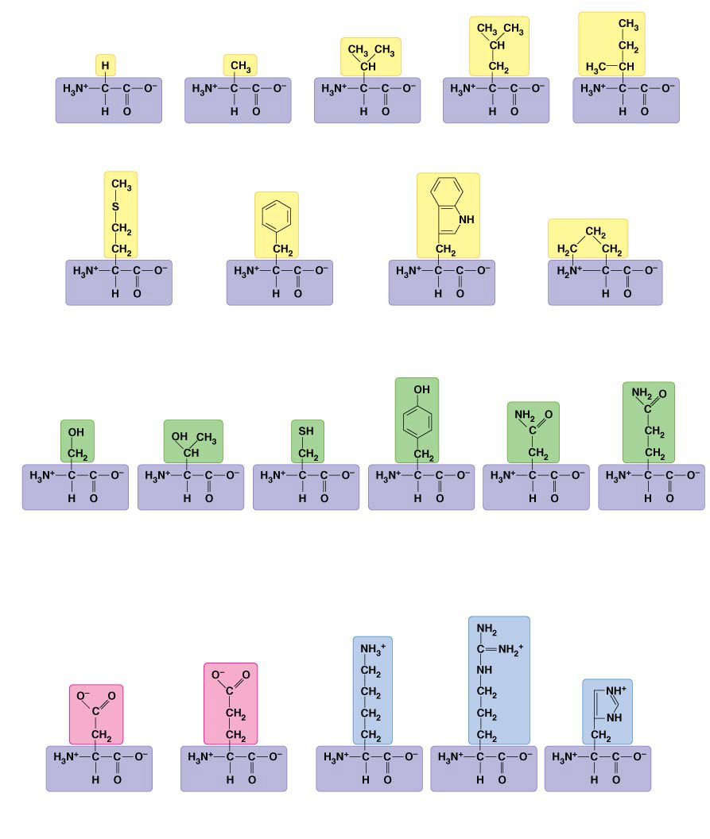
Figure 5.14
Nonpolar side chains; hydrophobic
Side chain (R group)
Glycine
(Gly or G)
Alanine
(Ala or A)
Valine
(Val or V)
Leucine
(Leu or L)
Isoleucine
(Ile or I)
Methionine
(Met or M)
Phenylalanine
(Phe or F)
Tryptophan
(Trp or W)
Proline
(Pro or P)
Polar side chains; hydrophilic
Serine
(Ser or S)
Threonine
(Thr or T)
Cysteine
(Cys or C)
Tyrosine
(Tyr or Y)
Asparagine
(Asn or N)
Glutamine
(Gln or Q)
Electrically charged side chains; hydrophilic
Basic (positively charged)
Acidic (negatively charged)
Aspartic acid
(Asp or D)
Glutamic acid
(Glu or E)
Lysine
(Lys or K)
Arginine
(Arg or R)
Histidine
(His or H)
Notes:
Figure 5.14 The 20 amino acids of proteins

Slide 56
Concept 5.4: Proteins include a diversity of structures, resulting in a wide range of functions
Polypeptides
Amino acids are linked by covalent bonds called peptide bonds
A polypeptide is a polymer of amino acids
Polypeptides range in length from a few to more than a thousand monomers
Each polypeptide has a unique linear sequence of amino acids, with a carboxyl end (C-terminus) and an amino end (N-terminus)

Slide 57
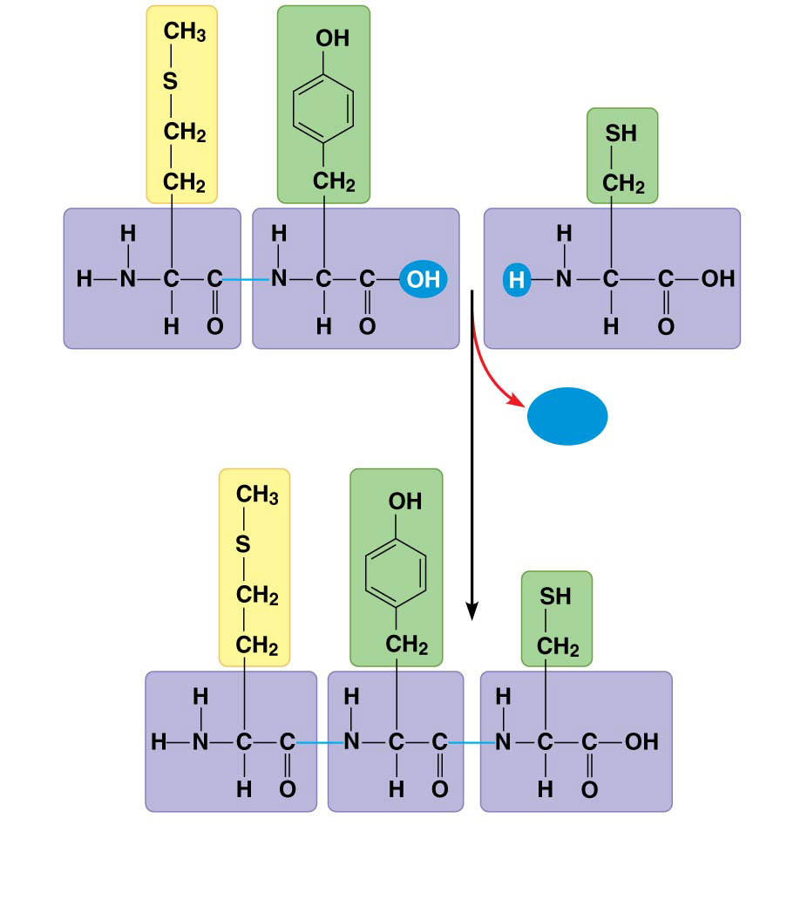
Figure 5.15
Peptide bond
H₂O
New peptide
bond forming
Side
chains
Back-
bone
Amino end
(N-terminus)
Peptide
bond
Carboxyl end
(C-terminus)
Notes:
Figure 5.15 Making a polypeptide chain

Slide 58
Concept 5.4: Proteins include a diversity of structures, resulting in a wide range of functions
Protein Structure and Function
The specific activities of proteins result from their intricate three-dimensional architecture
A functional protein consists of one or more polypeptides precisely twisted, folded, and coiled into a unique shape

Slide 59
Concept 5.4: Proteins include a diversity of structures, resulting in a wide range of functions
4 Levels of Protein Structure
The primary structure of a protein is its unique sequence of amino acids
Secondary structure, found in most proteins, consists of coils and folds in the polypeptide chain
Tertiary structure is determined by interactions among various side chains (R groups)
Quaternary structure results when a protein consists of multiple polypeptide chains

Slide 60
Concept 5.4: Proteins include a diversity of structures, resulting in a wide range of functions
The primary structure of a protein is its sequence of amino acids
Primary structure is like the order of letters in a long word
Primary structure is determined by inherited genetic information

Slide 61
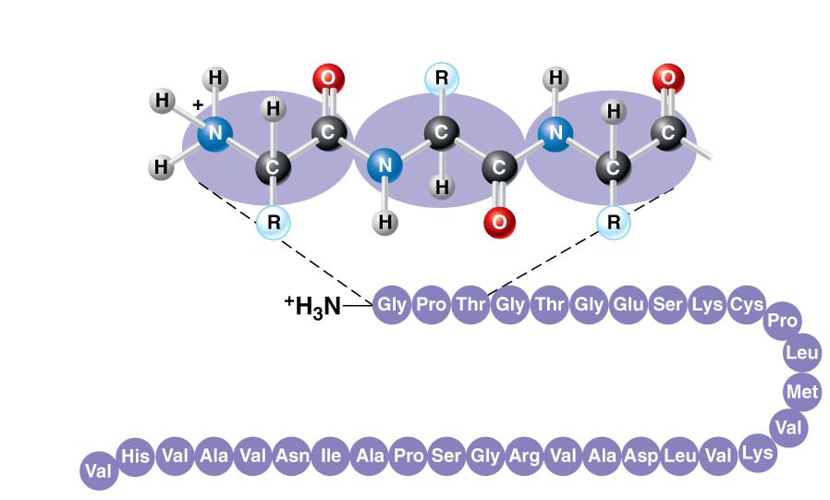
Figure 5.18aa
Primary Structure
Amino
acids
1
5
10
Amino end
30
25
20
15
Notes:
Figure 5.18aa Exploring levels of protein structure (part 1a: primary, detail)

Slide 62
Concept 5.4: Proteins include a diversity of structures, resulting in a wide range of functions
The coils and folds of secondary structure result from hydrogen bonds between repeating constituents of the polypeptide backbone
Typical secondary structures are a coil called an α helix and a folded structure called a β pleated sheet

Slide 63
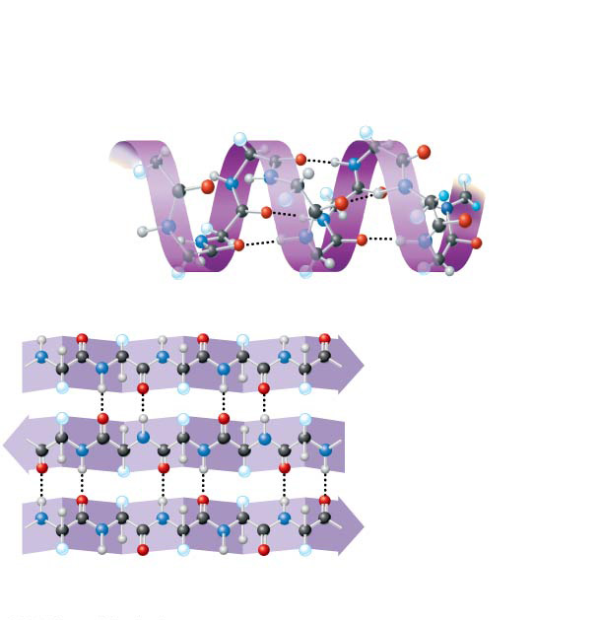
Figure 5.18ba
Secondary
Structure
𝛂 helix
Hydrogen bond
𝛃 strand
Hydrogen
bond
𝛃 pleated sheet
Notes:
Figure 5.18ba Exploring levels of protein structure (part 2a: secondary)

Slide 64
Concept 5.4: Proteins include a diversity of structures, resulting in a wide range of functions
Tertiary structure, the overall shape of a polypeptide, results from interactions between R groups, rather than interactions between backbone constituents
These interactions include hydrogen bonds, ionic bonds, hydrophobic interactions, and van der Waals interactions
Strong covalent bonds called disulfide bridges may reinforce the protein’s structure

Slide 65
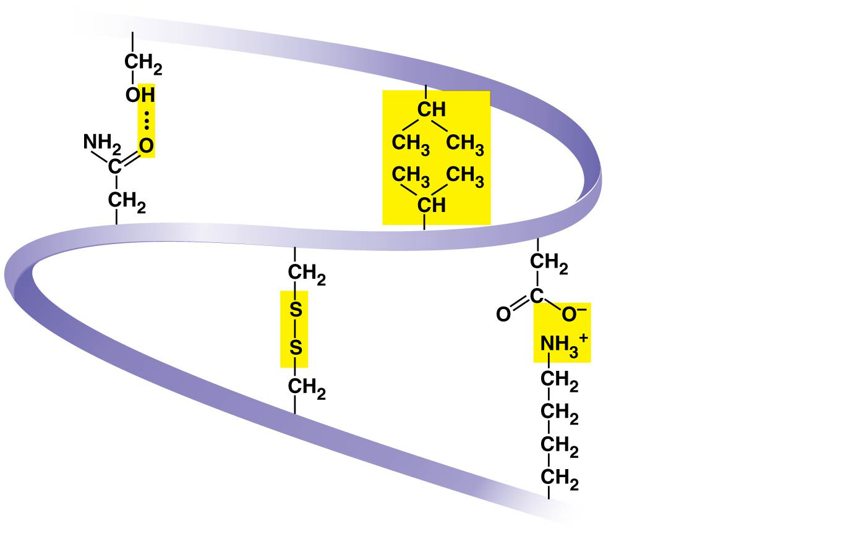
Figure 5.18d
Hydrogen
bond
Hydrophobic
interactions and
Van der Waals
interactions
Disulfide
bridge
Ionic bond
Polypeptide
backbone
Notes:
Figure 5.18d Exploring levels of protein structure (part 4: tertiary stabilization)

Slide 66
Concept 5.4: Proteins include a diversity of structures, resulting in a wide range of functions
Quaternary structure results when two or more polypeptide chains form one macromolecule
Collagen is a fibrous protein consisting of three polypeptides coiled like a rope
Hemoglobin is a globular protein consisting of four polypeptides: two alpha and two beta chains

Slide 67
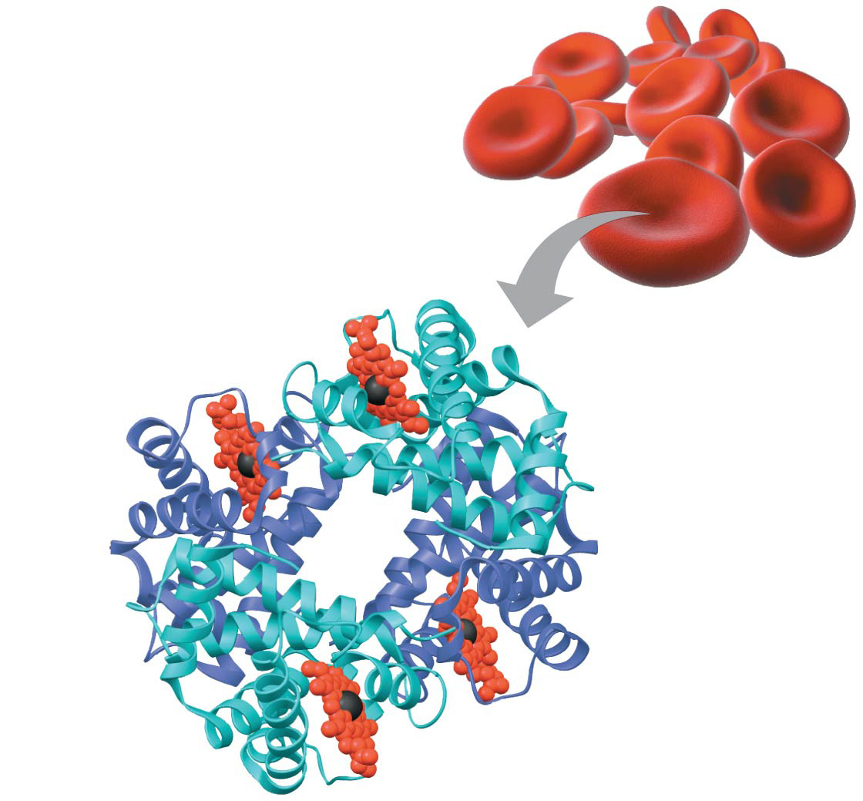
Figure 5.18f
Heme
Iron
𝛃 subunit
𝛂 subunit
𝛂 subunit
𝛃 subunit
Hemoglobin
Notes:
Figure 5.18f Exploring levels of protein structure (part 6: hemoglobin)

Slide 68
Concept 5.4: Proteins include a diversity of structures, resulting in a wide range of functions
What determines protein stricture?
In addition to primary structure, physical and chemical conditions can affect structure
Alterations in pH, salt concentration, temperature, or other environmental factors can cause a protein to unravel
This loss of a protein’s native structure is called denaturation
A denatured protein is biologically inactive

Slide 69
Figure 5.20-1
Normal protein
Notes:
Figure 5.20-1 Denaturation and renaturation of a protein (step 1)

Slide 70
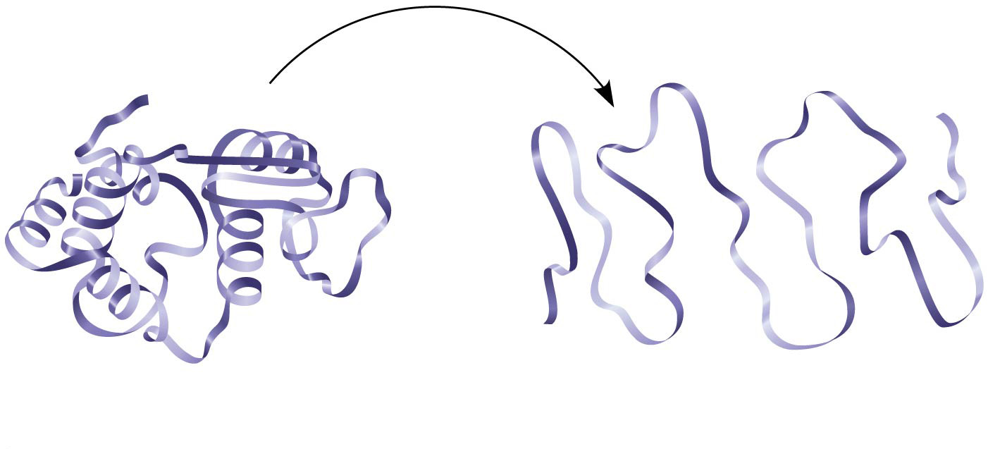
Figure 5.20-2
Normal protein
Denatured protein
Notes:
Figure 5.20-2 Denaturation and renaturation of a protein (step 2)

Slide 71
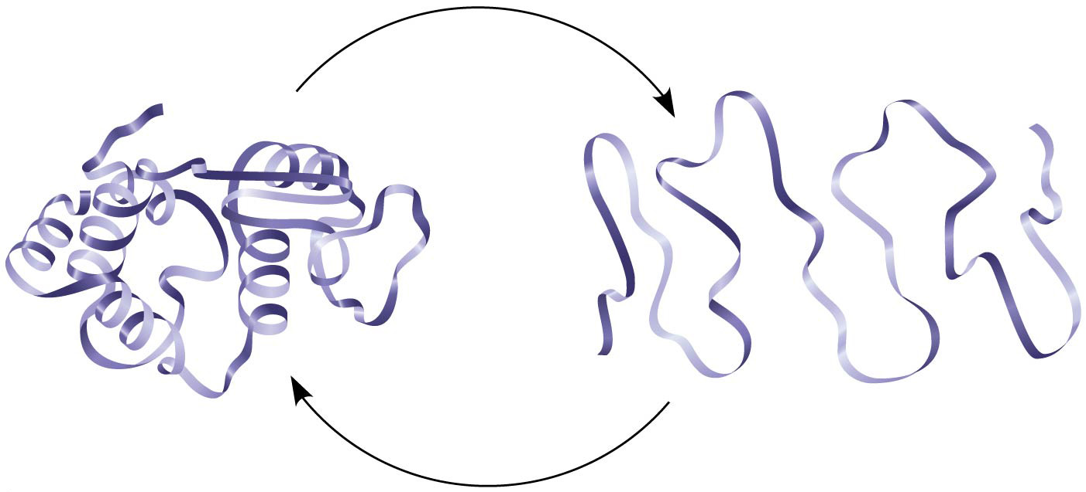
Figure 5.20-3
Normal protein
Denatured protein
Notes:
Figure 5.20-3 Denaturation and renaturation of a protein (step 3)

Slide 72
Summary of key concepts: proteins
Notes:
Figure 5.UN05 Summary of key concepts: proteins

Slide 73
Notes:
A glycosidic linkage is analogous to which of the following in proteins?
https://www.polleverywhere.com/multiple_choice_polls/TGtinRurcc6eWvv

Slide 74
Notes:
The tertiary structure of a protein is the _____.
https://www.polleverywhere.com/multiple_choice_polls/d44A86u08LBOMtX

Slide 75
Do Now
For EACH macromolecule we’ve covered, write down or type out:
The macromolecule itself
Polymer or not polymer
Name of monomer or structural subunit(s)
Name of bond that links subunits
Name of process that builds complex molecules
Name of process that breaks down complex molecules

Slide 76
Overview
Concept 5.1: Macromolecules are polymers, built from monomers
Concept 5.2: Carbohydrates serve as fuel and building material
Concept 5.3: Lipids are a diverse group of hydrophobic molecules
Concept 5.4: Proteins include a diversity of structures, resulting in a wide range of functions
Concept 5.5: Nucleic acids store, transmit, and help express hereditary information

Slide 77
Concept 5.5: Nucleic acids store, transmit, and help express hereditary information
The amino acid sequence of a polypeptide is programmed by a unit of inheritance called a gene
Genes consist of DNA, a nucleic acid made of monomers called nucleotides

Slide 78
Concept 5.5: Nucleic acids store, transmit, and help express hereditary information
Roles of Nucleic Acids
There are two types of nucleic acids
Deoxyribonucleic acid (DNA)
Ribonucleic acid (RNA)
DNA provides directions for its own replication
DNA directs synthesis of messenger RNA (mRNA) and, through mRNA, controls protein synthesis
This process is called gene expression

Slide 79
Concept 5.5: Nucleic acids store, transmit, and help express hereditary information
Components of Nucleic Acids
Nucleic acids are polymers called polynucleotides
Each polynucleotide is made of monomers called nucleotides
Each nucleotide consists of a nitrogenous base, a pentose sugar, and one or more phosphate groups
The portion of a nucleotide without the phosphate group is called a nucleoside

Slide 80
Summary of key concepts: nucleic acids
Notes:
Figure 5.UN06 Summary of key concepts: nucleic acids

Slide 81
Notes:
Nucleic acids are polymers made up of which of the following monomers?
https://www.polleverywhere.com/multiple_choice_polls/SzVQ9ZV0Jiv0uzv

Slide 82
Notes:
What is your favorite macromolecule and why?
https://www.polleverywhere.com/free_text_polls/Ws02qrFOorZrVvw

Slide 83
Overview
Concept 5.1: Macromolecules are polymers, built from monomers
Concept 5.2: Carbohydrates serve as fuel and building material
Concept 5.3: Lipids are a diverse group of hydrophobic molecules
Concept 5.4: Proteins include a diversity of structures, resulting in a wide range of functions
Concept 5.5: Nucleic acids store, transmit, and help express hereditary information

Slide 84
Macromolecules Activity
SWBAT:
Assess a variety of unknown food labels in relation to the presence of biological macromolecules by analyzing their nutritional information and ingredients.
Driving question:
How do the macromolecules of life show up in our everyday lives, specifically, in what we eat?

Slide 85
Macromolecules Activity
Your Task
In your groups, look at the unknown food labels provided to you.
Write down which macromolecules are present and at what quantity (in grams/milligrams).
Look at the ingredients…figure out which ingredient most probably contributes to which macromolecule…explain!
Take a guess at what the food item may be.
Present your finding to the class.
Eat the food items.

Slide 86
Exit Ticket
Write down which macromolecule would be the primary ingredient in this:

