Slide 1
0
6
A Tour of the Cell

Slide 2
Notes:
What is a cell?
https://www.polleverywhere.com/multiple_choice_polls/jTYkWzE1a0YOjNR

Slide 3
The Fundamental Units of Life
All organisms are made of cells
The cell is the simplest collection of matter that can be alive
All cells are related by their descent from earlier cells
Cells can differ substantially from one another but share common features

Slide 4
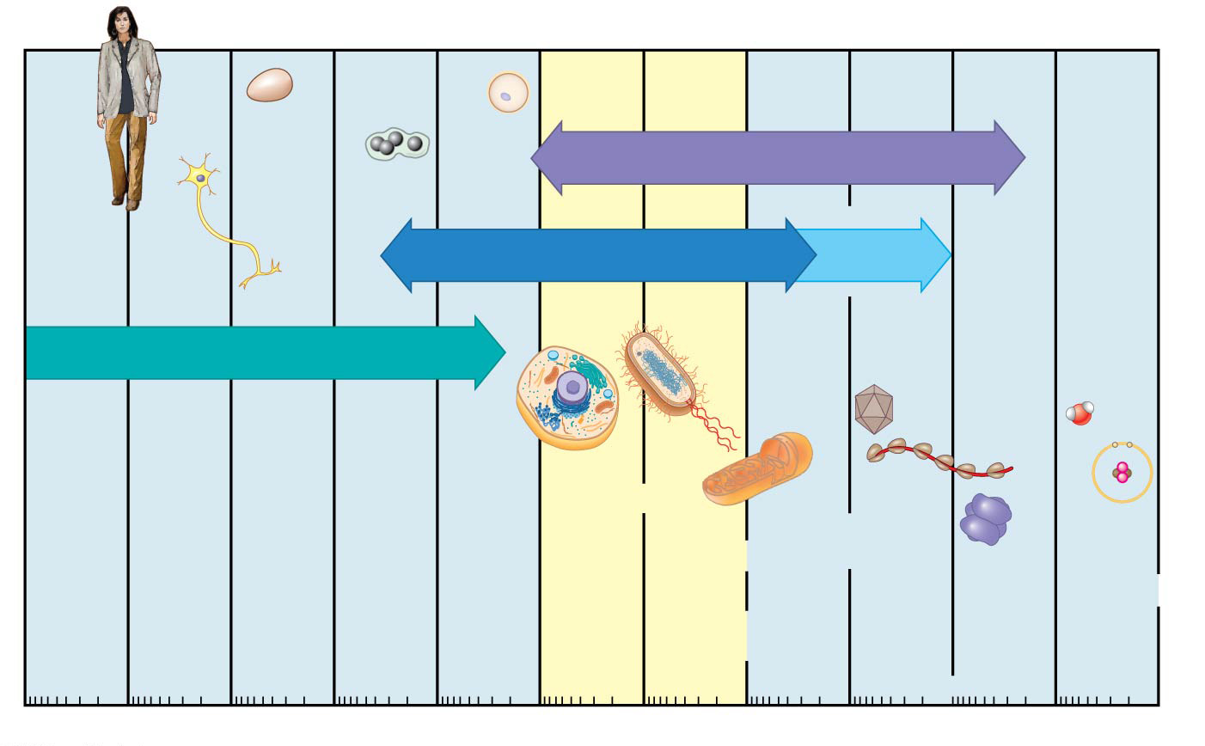
Figure 6.2c
Electron microscopy
Super-
resolution
microscopy
Light microscopy
Unaided eye
Nucleus
Length
of some
nerve
and
muscle
cells
Most
bacteria
Smallest
bacteria
Most
plant
and
animal
cells
Small
molecules
Viruses
Proteins
Human
height
Chicken
egg
Frog
egg
Human
egg
Mito-
chondrion
Ribo-
somes
Lipids
Atoms
10 m
1 m
0.1 m
1 cm
1 mm
100 µm
10 µm
1 µm
100 µm
10 nm
1 nm
0.1 nm
Notes:
Figure 6.2c The size range of cells (part 3: horizontal version)

Slide 5
Overview
Concept 6.1: Biologists use microscopes and the tools of biochemistry to study cells
Concept 6.2: Eukaryotic cells have internal membranes that compartmentalize their functions
Concept 6.3: The eukaryotic cell’s genetic instructions are housed in the nucleus and carried out by the ribosomes
Concept 6.4: The endomembrane system regulates protein traffic and performs metabolic functions in the cell
Concept 6.5: Mitochondria and chloroplasts change energy from one form to another
Concept 6.6: The cytoskeleton is a network of fibers that organizes structures and activities in the cell
Concept 6.7: Extracellular components and connections between cells help coordinate cellular activities

Slide 6
Overview
Concept 6.1: Biologists use microscopes and the tools of biochemistry to study cells
Concept 6.2: Eukaryotic cells have internal membranes that compartmentalize their functions
Concept 6.3: The eukaryotic cell’s genetic instructions are housed in the nucleus and carried out by the ribosomes
Concept 6.4: The endomembrane system regulates protein traffic and performs metabolic functions in the cell
Concept 6.5: Mitochondria and chloroplasts change energy from one form to another
Concept 6.6: The cytoskeleton is a network of fibers that organizes structures and activities in the cell
Concept 6.7: Extracellular components and connections between cells help coordinate cellular activities

Slide 7
Overview
Concept 6.2: Eukaryotic cells have internal membranes that compartmentalize their functions
Concept 6.3: The eukaryotic cell’s genetic instructions are housed in the nucleus and carried out by the ribosomes
Concept 6.4: The endomembrane system regulates protein traffic and performs metabolic functions in the cell
Concept 6.5: Mitochondria and chloroplasts change energy from one form to another
Concept 6.6: The cytoskeleton is a network of fibers that organizes structures and activities in the cell

Slide 8
Overview
Concept 6.2: Eukaryotic cells have internal membranes that compartmentalize their functions
Concept 6.3: The eukaryotic cell’s genetic instructions are housed in the nucleus and carried out by the ribosomes
Concept 6.4: The endomembrane system regulates protein traffic and performs metabolic functions in the cell
Concept 6.5: Mitochondria and chloroplasts change energy from one form to another
Concept 6.6: The cytoskeleton is a network of fibers that organizes structures and activities in the cell

Slide 9
Concept 6.2: Eukaryotic cells have internal membranes that compartmentalize their functions
The basic structural and functional unit of every organism is one of two types of cells: prokaryotic or eukaryotic
Only organisms of the domains Bacteria and Archaea consist of prokaryotic cells
Protists, fungi, animals, and plants all consist of eukaryotic cells

Slide 10
Comparing Prokaryotic and Eukaryotic Cells
Basic features of all cells
Plasma membrane
Semifluid substance called cytosol
Chromosomes (carry genes)
Ribosomes (make proteins)

Slide 11
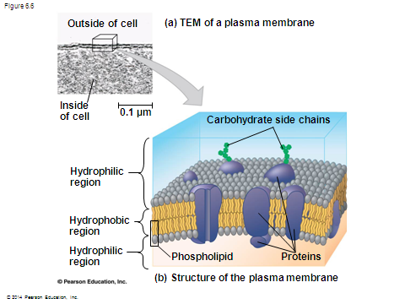
The plasma membrane is a selective barrier that allows sufficient passage of oxygen, nutrients, and waste to service the volume of EVERY CELL

Slide 12
Comparing Prokaryotic and Eukaryotic Cells
Prokaryotic cells are characterized by having
No nucleus
DNA in an unbound region called the nucleoid
No membrane-bound organelles
Cytoplasm bound by the plasma membrane

Slide 13
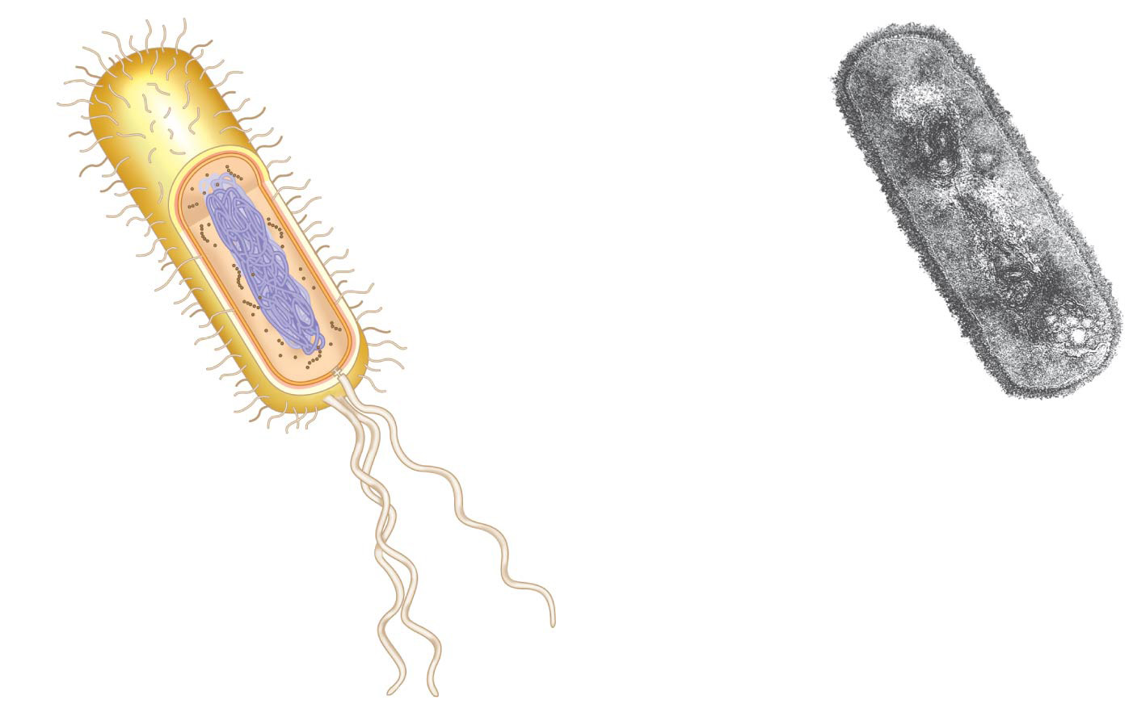
Figure 6.5
Fimbriae
Nucleoid
Ribosomes
Plasma membrane
Cell wall
Bacterial
chromosome
Capsule
0.5 µm
Flagella
(a)
A typical
rod-shaped
bacterium
(b)
A thin section through
the bacterium Bacillus
coagulans (TEM)
Notes:
Figure 6.5 A prokaryotic cell

Slide 14
Comparing Prokaryotic and Eukaryotic Cells
Eukaryotic cells are characterized by having
DNA in a nucleus that is bounded by a membranous nuclear envelope
Membrane-bound organelles
Cytoplasm in the region between the plasma membrane and nucleus
Eukaryotic cells are generally much larger (more VOLUME) than prokaryotic cells

Slide 15
The Importance of Surface Area:Volume Ratio
Metabolic requirements set upper limits on the size of cells (cells MUST be small)
The surface area to volume ratio of a cell is critical
As cells increase in volume…
Surface area DECREASES
Demand for resources INCREASES (Problem)
Solution: Use lots of SUB-cellular structures (organelles) to adequately exchange resources with the environment

Slide 16
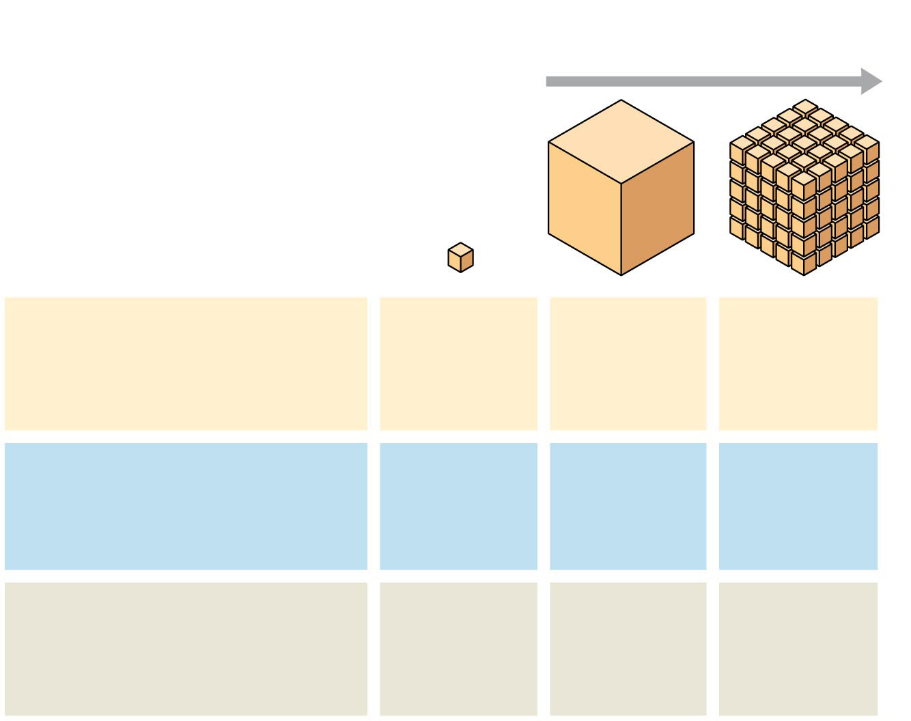
Figure 6.7
Surface area increases while
total volume remains constant
5
1
1
Total surface area
[sum of the surface areas
(height × width) of all box
sides × number of boxes]
6
150
750
Total volume
[height × width × length
× number of boxes]
1
125
125
Surface-to-volume
(S-to-V) ratio
[surface area ÷ volume]
6
1.2
6
Notes:
Figure 6.7 Geometric relationships between surface area and volume

Slide 17
A Panoramic View of the Eukaryotic Cell
A eukaryotic cell has internal membranes that partition the cell into organelles (↑SA:VOL)
Organelles are enclosed within a biological membrane that is a double layer of phospholipids and other lipids
Plant and animal cells have most of the same organelles

Slide 18
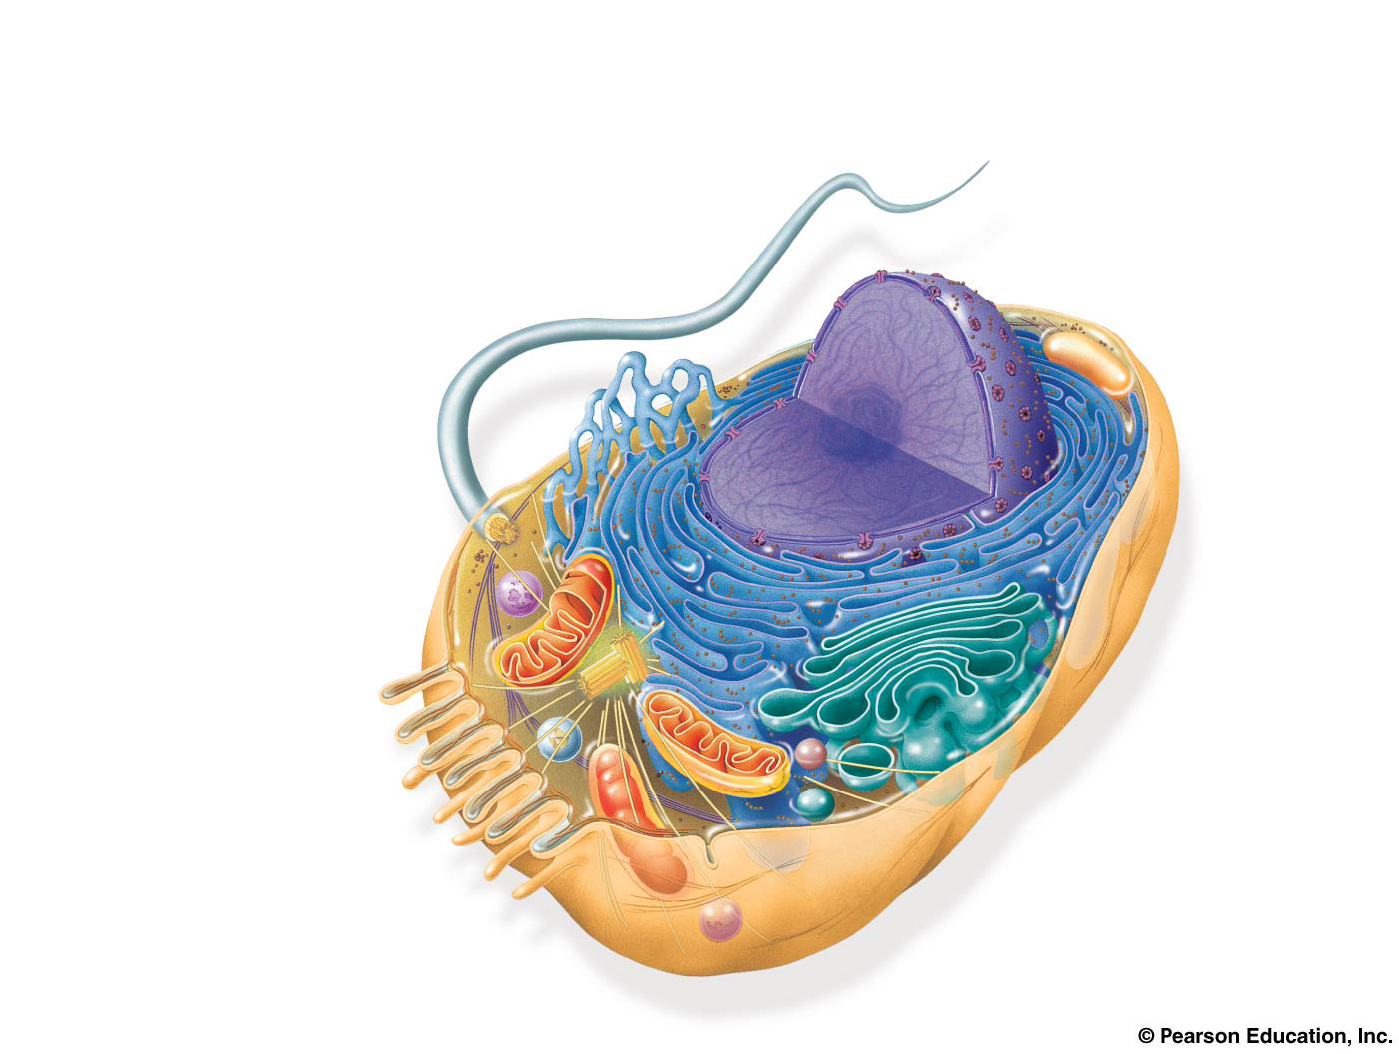
Figure 6.8a
ENDOPLASMIC
RETICULUM (ER)
Nuclear
envelope
Rough ER
Smooth ER
Nucleolus
NUCLEUS
Flagellum
Chromatin
Centrosome
Plasma
membrane
CYTOSKELETON:
Microfilaments
Intermediate filaments
Microtubules
Ribosomes
Microvilli
Golgi apparatus
Peroxisome
Lysosome
Mitochondrion
Notes:
Figure 6.8a Exploring eukaryotic cells (part 1: animal cell cutaway)

Slide 19
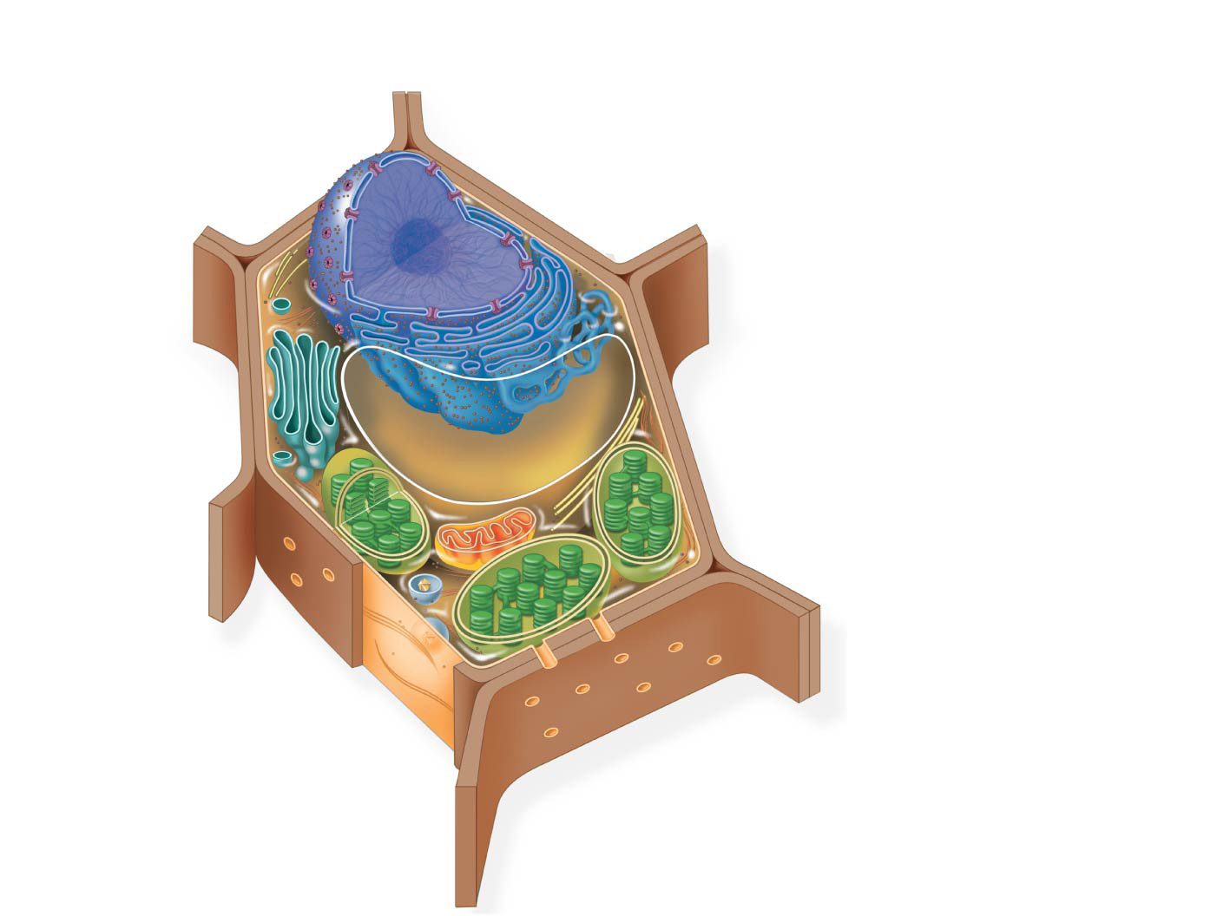
Figure 6.8b
Nuclear
envelope
NUCLEUS
Nucleolus
Chromatin
Rough ER
Smooth ER
Ribosomes
Golgi
apparatus
Central vacuole
Microfilaments
CYTOSKELETON
Microtubules
Mitochondrion
Peroxisome
Plasma
membrane
Chloroplast
Cell wall
Plasmodesmata
Wall of adjacent cell
Notes:
Figure 6.8b Exploring eukaryotic cells (part 2: plant cell cutaway)

Slide 20
Notes:
Which of the following may be found in eukaryotic cells, but not in bacteria?
https://www.polleverywhere.com/multiple_choice_polls/j9dI7kzL4Zxpoo6

Slide 21
Notes:
Which of the following statements concerning cells of bacteria and archaea is correct?
https://www.polleverywhere.com/multiple_choice_polls/DtitAjGtZr01hhS

Slide 22
Overview
Concept 6.2: Eukaryotic cells have internal membranes that compartmentalize their functions
Concept 6.3: The eukaryotic cell’s genetic instructions are housed in the nucleus and carried out by the ribosomes
Concept 6.4: The endomembrane system regulates protein traffic and performs metabolic functions in the cell
Concept 6.5: Mitochondria and chloroplasts change energy from one form to another
Concept 6.6: The cytoskeleton is a network of fibers that organizes structures and activities in the cell

Slide 23
Concept 6.3: The eukaryotic cell’s genetic instructions are housed in the nucleus and carried out by the ribosomes
The nucleus contains most of the DNA in a eukaryotic cell
Ribosomes use the information from the DNA to make proteins

Slide 24
The Nucleus: Information Central
The nucleus contains most of the cell’s genes and is usually the most conspicuous organelle
The nuclear envelope encloses the nucleus, separating it from the cytoplasm
The nuclear membrane is a double membrane; each membrane consists of a lipid bilayer

Slide 25
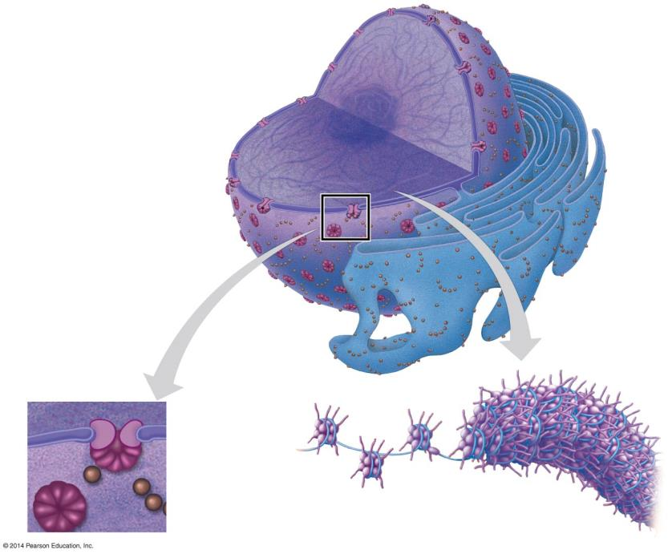
Figure 6.9a
Nucleus
Nucleolus
Chromatin
Nuclear envelope:
Inner membrane
Outer membrane
Nuclear pore
Rough
ER
Pore
complex
Ribosome
Close-up
of nuclear
envelope
Chromatin
Notes:
Figure 6.9a The nucleus and its envelope (part 1: detail of art)

Slide 26
The Nucleus: Information Central
Pores regulate the entry and exit of molecules from the nucleus
The nuclear size of the envelop is lined by the nuclear lamina, which is composed of proteins and maintains the shape of the nucleus

Slide 27
The Nucleus: Information Central
In the nucleus, DNA is organized into discrete units called chromosomes
Each chromosome is composed of a SINGLE DNA MOLECULE associated with proteins
The DNA and proteins of chromosomes are together called chromatin
Chromatin condenses to form discrete chromosomes as a cell prepares to divide
The nucleolus is located within the nucleus and is the site of ribosomal RNA (rRNA) synthesis

Slide 28
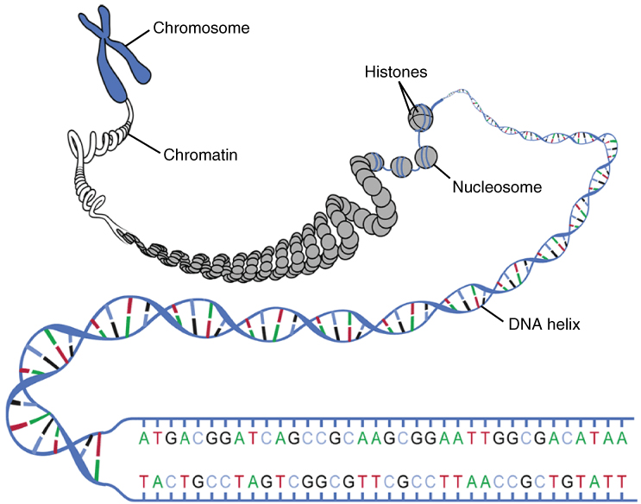
The Nucleus: Information Central

Slide 29
Ribosomes: Protein Factories
Ribosomes are complexes made of ribosomal RNA and protein
Ribosomes carry out protein synthesis in two locations
In the cytosol (free ribosomes)
On the outside of the endoplasmic reticulum or the nuclear envelope (bound ribosomes)

Slide 30
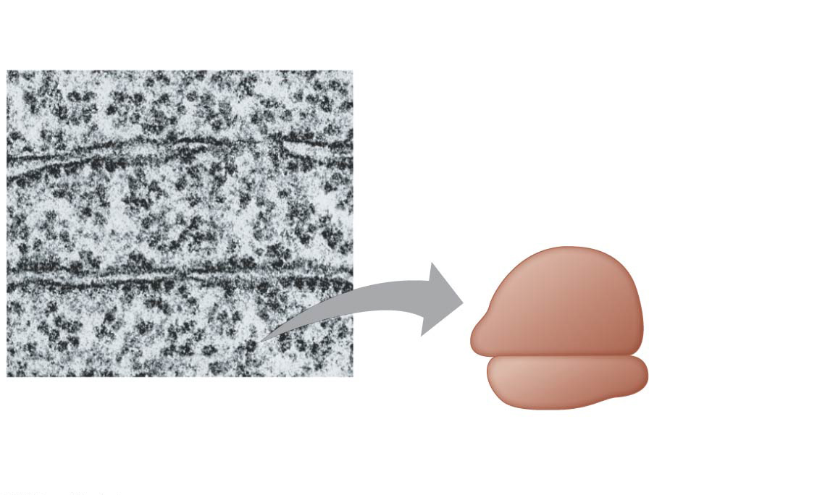
Figure 6.10a
0.25 μm
Free ribosomes in cytosol
Endoplasmic
reticulum (ER)
Ribosomes bound to ER
Large
subunit
Small
subunit
TEM showing ER
and ribosomes
Diagram of a
ribosome
Notes:
Figure 6.10a Ribosomes (part 1: detail of art)

Slide 31
Summary of key concepts: nucleus and ribosomes
Notes:
Figure 6.UN03 Summary of key concepts: nucleus and ribosomes

Slide 32
Notes:
Large numbers of ribosomes are present in cells that specialize in producing which of the following molecules?
https://www.polleverywhere.com/multiple_choice_polls/kypBUh23ZK2CaFY

Slide 33
Notes:
A cell with an abundance of free ribosomes is most likely
https://www.polleverywhere.com/multiple_choice_polls/HtOozi8thp1Spak

Slide 34
Overview
Concept 6.2: Eukaryotic cells have internal membranes that compartmentalize their functions
Concept 6.3: The eukaryotic cell’s genetic instructions are housed in the nucleus and carried out by the ribosomes
Concept 6.4: The endomembrane system regulates protein traffic and performs metabolic functions in the cell
Concept 6.5: Mitochondria and chloroplasts change energy from one form to another
Concept 6.6: The cytoskeleton is a network of fibers that organizes structures and activities in the cell

Slide 35
Concept 6.4: The endomembrane system regulates protein traffic and performs metabolic functions in the cell
The endomembrane system consists of
Nuclear envelope
Endoplasmic reticulum
Golgi apparatus
Lysosomes
Vacuoles
Plasma membrane
These components are either continuous or connected via transfer by vesicles

Slide 36
The Endoplasmic Reticulum: Biosynthetic Factory
The endoplasmic reticulum (ER) accounts for more than half of the total membrane in many eukaryotic cells
The ER membrane is continuous with the nuclear envelope
There are two distinct regions of ER
Smooth ER, which lacks ribosomes
Rough ER, whose surface is studded with ribosomes

Slide 37
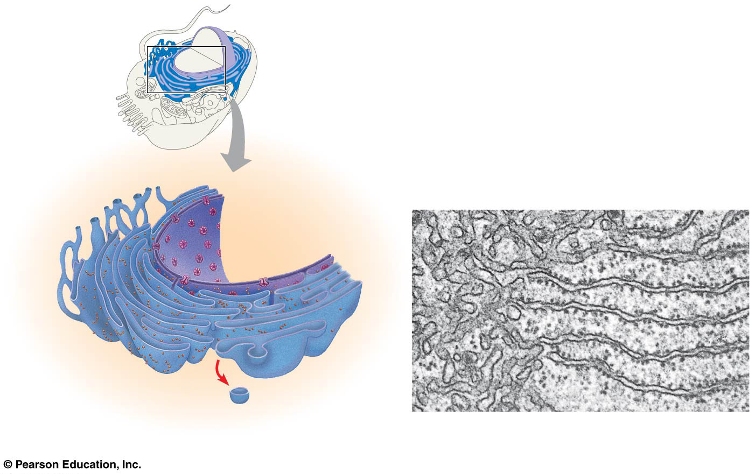
Figure 6.11
Smooth ER
Rough ER
Nuclear
envelope
Smooth ER
Rough ER
ER lumen
Cisternae
Ribosomes
Transitional
ER
Transport vesicle
0.20 μm
Notes:
Figure 6.11 Endoplasmic reticulum (ER)

Slide 38
Functions of Smooth ER
The smooth ER
SYNTHESIZES LIPIDS
Metabolizes carbohydrates
Detoxifies drugs and poisons
Stores calcium ions

Slide 39
Functions of Rough ER
The rough ER
Has bound ribosomes, which secrete glycoproteins (proteins covalently bonded to carbohydrates)
Distributes transport vesicles, secretory proteins surrounded by membranes
Is a membrane factory for the cell

Slide 40
The Golgi Apparatus: Shipping and Receiving Center
The Golgi apparatus consists of flattened membranous sacs called cisternae
Functions of the Golgi apparatus
Modifies products of the ER
Manufactures certain macromolecules
Sorts and packages materials into transport vesicles

Slide 41
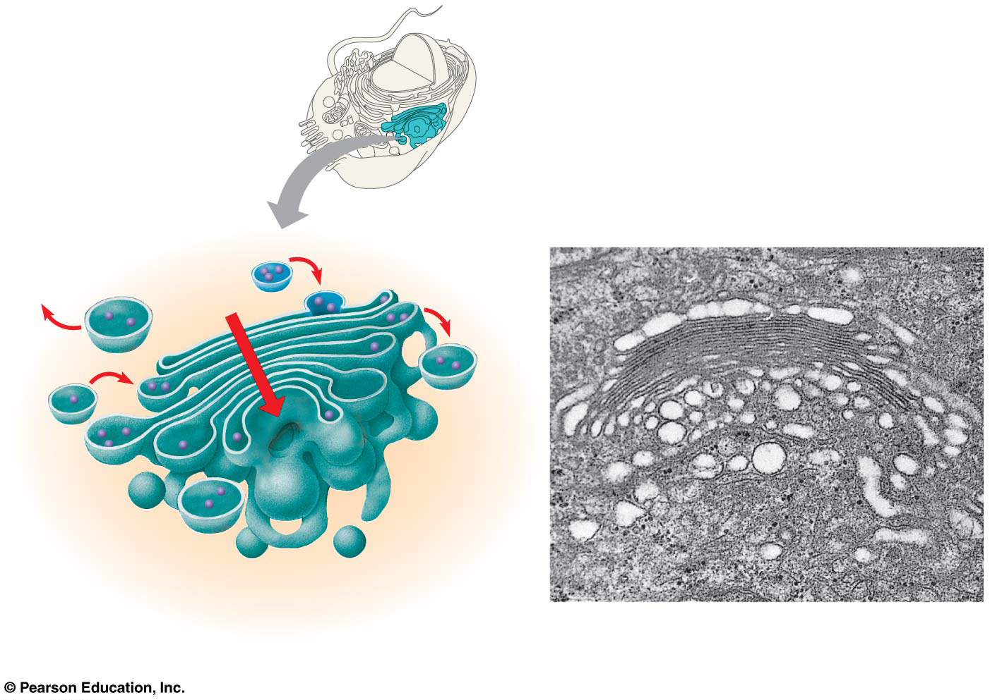
Figure 6.12
Golgi
apparatus
cis face
(“receiving” side of
Golgi apparatus)
0.1 μm
Cisternae
trans face
(“shipping” side of
Golgi apparatus)
TEM of Golgi apparatus
Notes:
Figure 6.12 The Golgi apparatus

Slide 42
Lysosomes: Digestive Compartments
A lysosome is a membranous sac of hydrolytic enzymes that can digest macromolecules
Lysosomal enzymes work best in the acidic environment inside the lysosome
Hydrolytic enzymes and lysosomal membranes are made by rough ER and then transferred to the Golgi apparatus for further processing

Slide 43
Vacuoles: Diverse Maintenance Compartments
Vacuoles are large, membrane-bound vesicles derived from the ER and Golgi apparatus
Vacuoles perform a variety of functions in different kinds of cells
Food vacuoles are formed by phagocytosis
Contractile vacuoles, found in many freshwater protists, pump excess water out of cells
Central vacuoles, found in many mature plant cells, hold organic compounds and water (↑SA:VOL)

Slide 44
The Endomembrane System: A Review
The endomembrane system is a complex and dynamic player in the cell’s COMPARTMENTAL ORGANIZATION that helps the cell maximize its SA:VOL ratio

Slide 45
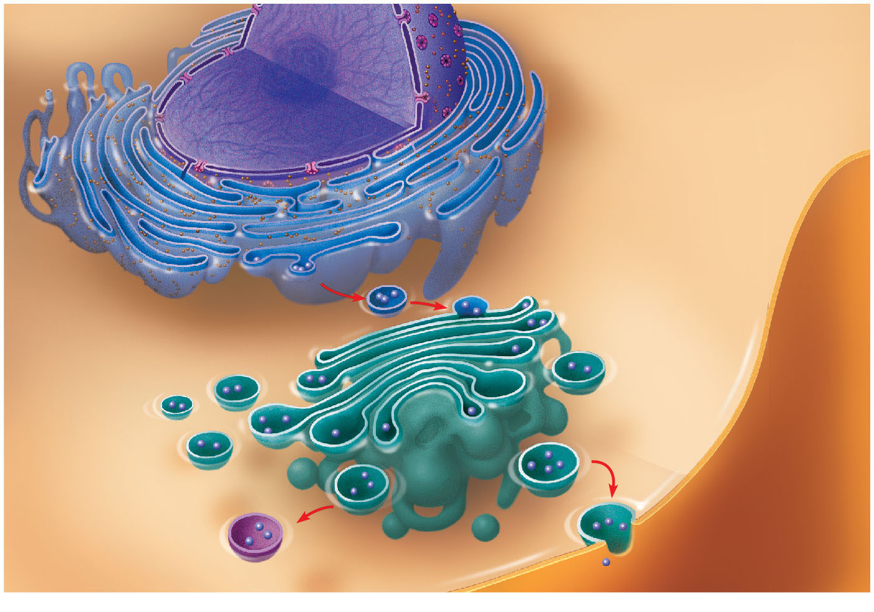
Review: relationships among organelles of the endomembrane system
Nucleus
Rough ER
Smooth ER
cis Golgi
Plasma
membrane
trans Golgi
© 2016 Pearson Education, Inc.
Notes:
Figure 4.15 Review: relationships among organelles of the endomembrane system

Slide 46
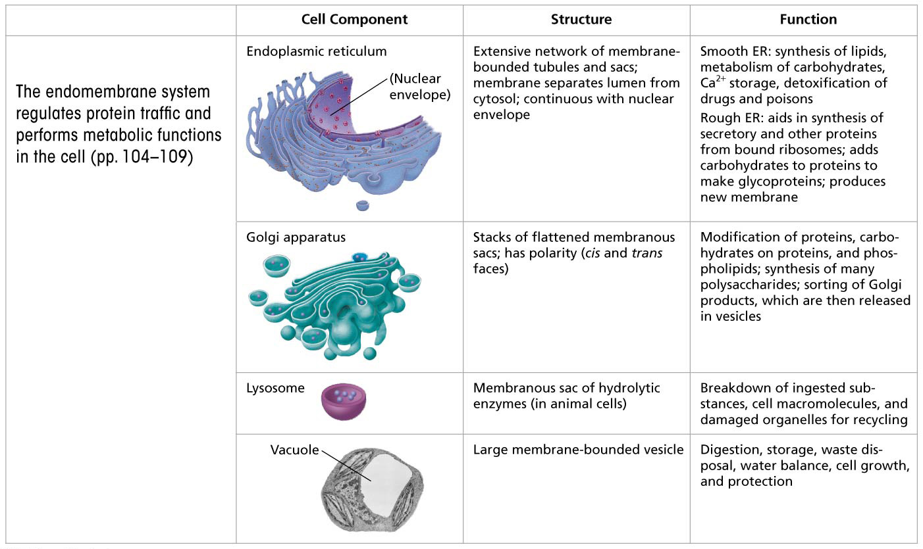
Summary of key concepts: endomembrane system
Notes:
Figure 6.UN04 Summary of key concepts: endomembrane system

Slide 47
Notes:
Which structure is the site of the synthesis of proteins destined for export from the cell?
https://www.polleverywhere.com/multiple_choice_polls/28z5KJNiu2PiTII

Slide 48
Notes:
The liver is involved in detoxification of many poisons and drugs. Which of the following structures is primarily involved in this process and therefore abundant in liver cells?
https://www.polleverywhere.com/multiple_choice_polls/9fxMFyb4yiMbbJj

Slide 49
Notes:
Which of the following statements correctly describes a function of the Golgi apparatus?
https://www.polleverywhere.com/multiple_choice_polls/mCgHsUuSnrEHg9C

Slide 50
Notes:
Tay-Sachs disease is a human genetic abnormality that results in cells accumulating very large, complex, undigested lipids. Which cellular organelle must be defective in this condition?
https://www.polleverywhere.com/multiple_choice_polls/NFBM6jqqR9W7i0Z

Slide 51
Notes:
Which organelle often takes up much of the volume of a plant cell?
https://www.polleverywhere.com/multiple_choice_polls/FHRzOL33YGO0Dlg

Slide 52
Notes:
What is the most likely pathway taken by a newly synthesized protein that will be secreted by a cell?
https://www.polleverywhere.com/multiple_choice_polls/k16QqEKpnMql4t9

Slide 53
Overview
Concept 6.2: Eukaryotic cells have internal membranes that compartmentalize their functions
Concept 6.3: The eukaryotic cell’s genetic instructions are housed in the nucleus and carried out by the ribosomes
Concept 6.4: The endomembrane system regulates protein traffic and performs metabolic functions in the cell
Concept 6.5: Mitochondria and chloroplasts change energy from one form to another
Concept 6.6: The cytoskeleton is a network of fibers that organizes structures and activities in the cell

Slide 54
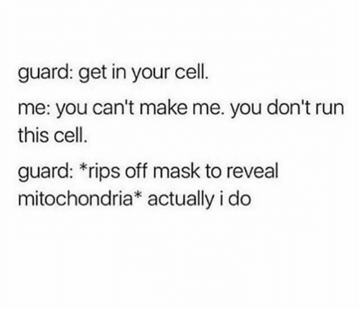
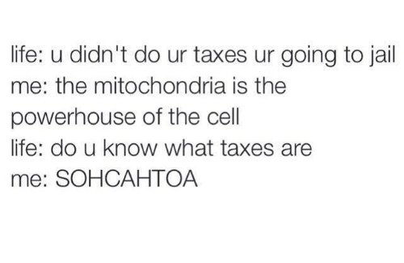

Slide 55
Concept 6.5: Mitochondria and chloroplasts change energy from one form to another
Mitochondria are the sites of cellular respiration, a metabolic process that uses oxygen to generate ATP
Chloroplasts, found in plants and algae, are the sites of photosynthesis

Slide 56
The Evolutionary Origins of Mitochondria and Chloroplasts
Mitochondria and chloroplasts have similarities with bacteria
Enveloped by a double membrane
Contain free ribosomes and circular DNA molecules
Grow and reproduce somewhat independently in cells

Slide 57
Mitochondria: Chemical Energy Conversion
Mitochondria are in nearly all eukaryotic cells
They have a smooth outer membrane and an inner membrane folded into cristae
Cristae present a LARGE SURFACE AREA for enzymes that synthesize ATP
The inner membrane creates two compartments: intermembrane space and mitochondrial matrix
Some metabolic steps of cellular respiration are catalyzed in the mitochondrial matrix

Slide 58
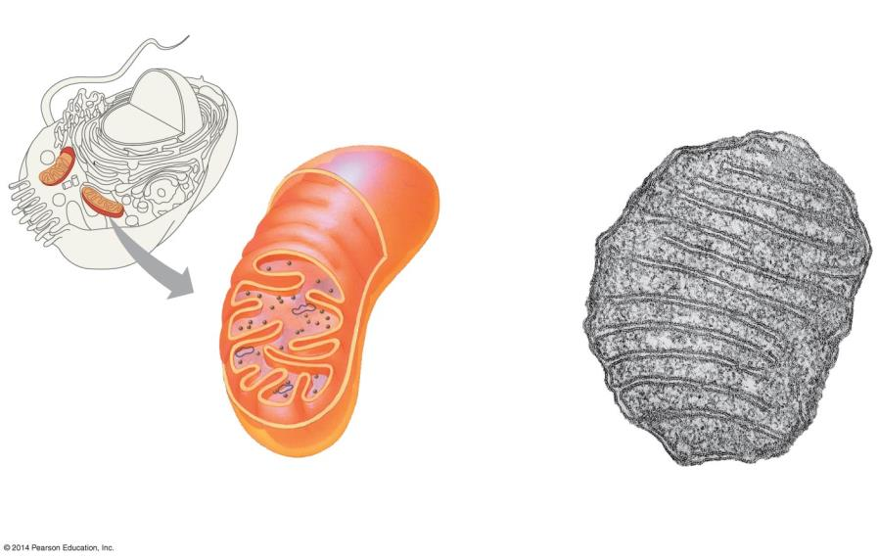
Figure 6.17a
Mitochondrion
Intermembrane
space
Outer
membrane
DNA
Free
ribosomes
in the
mitochondrial
matrix
Inner
membrane
Cristae
Matrix
0.1 μm
(a)
Diagram and TEM of mitochondrion
Notes:
Figure 6.17a The mitochondrion, site of cellular respiration (part 1: detail of art)

Slide 59
Chloroplasts: Capture of Light Energy
Chloroplasts contain the green pigment chlorophyll, as well as enzymes and other molecules that function in photosynthesis
Chloroplasts are found in leaves and other green organs of plants and in algae

Slide 60
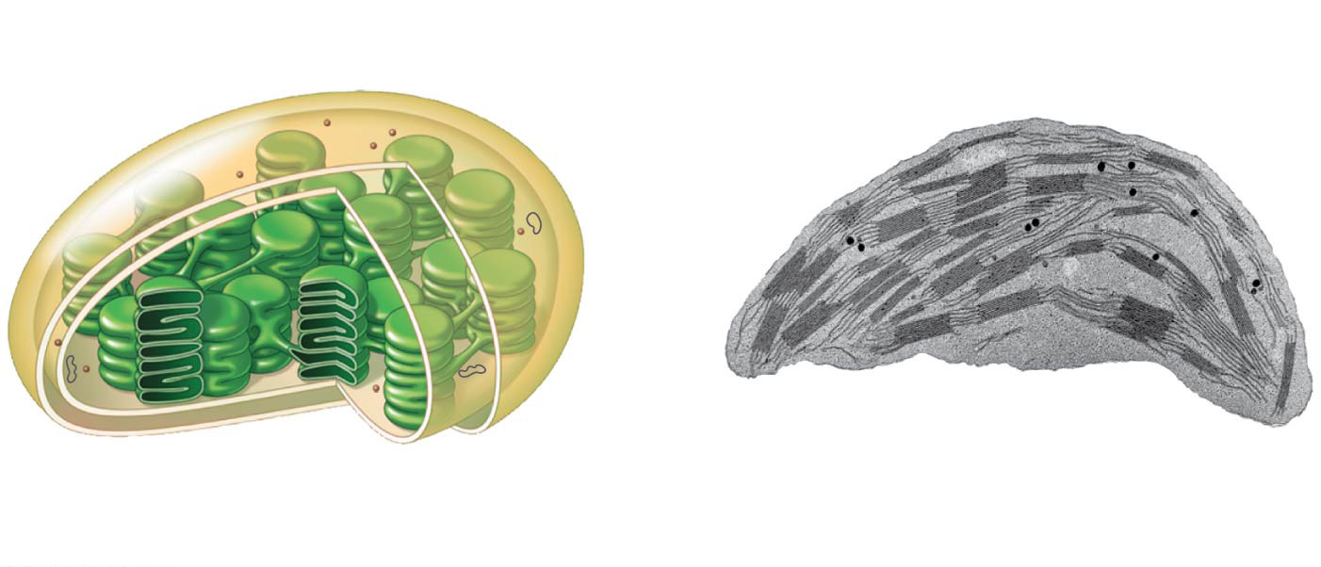
Figure 6.18a
Ribosomes
Stroma
Inner
and outer
membranes
Granum
DNA
Thylakoid
Intermembrane space
1 μm
(a)
Diagram and TEM of chloroplast
Notes:
Figure 6.18a The chloroplast, site of photosynthesis (part 1: detail of art)

Slide 61
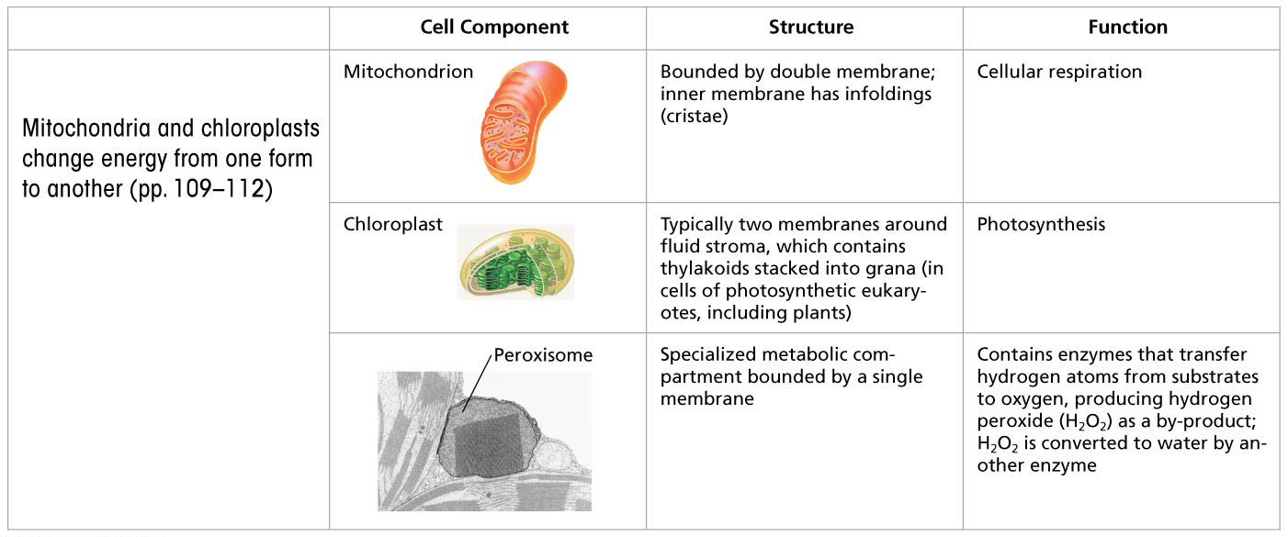
Summary of key concepts: mitochondria and chloroplasts
Notes:
Figure 6.UN05 Summary of key concepts: mitochondria, chloroplasts and peroxisomes

Slide 62
Notes:
Which of the following is NOT true? Both chloroplasts and mitochondria _____.
https://www.polleverywhere.com/multiple_choice_polls/zjbWiofmSwsVWRc

Slide 63
Overview
Concept 6.2: Eukaryotic cells have internal membranes that compartmentalize their functions
Concept 6.3: The eukaryotic cell’s genetic instructions are housed in the nucleus and carried out by the ribosomes
Concept 6.4: The endomembrane system regulates protein traffic and performs metabolic functions in the cell
Concept 6.5: Mitochondria and chloroplasts change energy from one form to another
Concept 6.6: The cytoskeleton is a network of fibers that organizes structures and activities in the cell

Slide 64
Concept 6.6: The cytoskeleton is a network of fibers that organizes structures and activities in the cell
The cytoskeleton is a network of fibers extending throughout the cytoplasm
It organizes the cell’s structures and activities, anchoring many organelles
It is composed of three types of molecular structures
Microtubules
Microfilaments
Intermediate filaments

Slide 65
Components of the Cytoskeleton
Three main types of fibers make up the cytoskeleton
Microtubules are the thickest of the three components of the cytoskeleton
Microfilaments, also called actin filaments, are the thinnest components
Intermediate filaments are fibers with diameters in a middle range

Slide 66
Roles of the Cytoskeleton: Support and Motility
The cytoskeleton helps to support the cell and maintain its shape
It interacts with motor proteins to produce motility
Inside the cell, vesicles can travel along tracks provided by the cytoskeleton

Slide 67
Cell Walls = EXTRAcellular Structure
The cell wall is an extracellular structure that distinguishes plant cells from animal cells
Prokaryotes, fungi, and some unicellular eukaryotes also have cell walls
The cell wall protects the plant cell, maintains its shape, and prevents excessive uptake of water
Plant cell walls are made of CELLULOSE FIBERS embedded in other polysaccharides and protein

Slide 68
Overview
Concept 6.2: Eukaryotic cells have internal membranes that compartmentalize their functions
Concept 6.3: The eukaryotic cell’s genetic instructions are housed in the nucleus and carried out by the ribosomes
Concept 6.4: The endomembrane system regulates protein traffic and performs metabolic functions in the cell
Concept 6.5: Mitochondria and chloroplasts change energy from one form to another
Concept 6.6: The cytoskeleton is a network of fibers that organizes structures and activities in the cell

Slide 69
Notes:
Which structure-function pair is mismatched?
https://www.polleverywhere.com/multiple_choice_polls/4maNk0DrPtMbGKQ

Slide 70
Notes:
Some key innovations in the evolution of eukaryotes from a prokaryotic ancestor are membrane-bound organelles. Which of the following organelles or features is likely to be a common component shared by both eukaryotic cells and their prokaryotic ancestors?
https://www.polleverywhere.com/multiple_choice_polls/sPXAe8jRhIsKLWy

Slide 71
Notes:
Suppose a cell has the following molecules and structures: enzymes, DNA, ribosomes, plasma membrane, and mitochondria. It could be a cell from _____.
https://www.polleverywhere.com/multiple_choice_polls/WEBDiose2o3HdAk

Slide 72
The Cell: A Living Unit Greater Than the Sum of Its Parts
Cells rely on the INTEGRATION of structures and organelles in order to function
For example, a macrophage’s ability to destroy bacteria involves the whole cell, coordinating components such as the cytoskeleton, lysosomes, and plasma membrane

