Slide 1
Draw Them Chromosomes!
Ch. 13 – Meiosis and Sexual Life Cycles

Slide 2
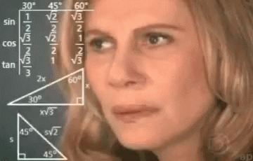
Tricky Terminology
Chromosome
Chromatid
Chromatin
Haploid
Diploid
n
2n
Homologous chromosomes
Homologous pairs
Tetrad
Sister chromatids
Centromere
Mitosis
Meiosis
Gamete
Somatic
Zygote
Fertilization

Slide 3
The Big Picture
When studying meiosis, never lose sight of WHY we focus on chromosomes so much…
Chromosomes carry genes (DNA)
Genes are units of heredity
Heredity passes on traits from one generation to the next
Variations lead to differences amongst heritable traits
WE ARE ALL DIFFERENT DUE TO GENETICS!
Notes:
Please don’t forget this!!!!!!!!!!!!!!!!!!!!!!!!!!!

Slide 4
Homologous pair (unduplicated)

Slide 5
2n = 4 (unduplicated)

Slide 6
2n = 4 (duplicated)

Slide 7
2n = 4 (duplicated) at Prophase I

Slide 8
2n = 4 at Metaphase I

Slide 9
2n = 4 at Anaphase I

Slide 10
After Meiosis I Completion

Slide 11
Both cells at Anaphase II

Slide 12
After Meiosis II Completion

