Slide 1
0
20
DNA Tools and Biotechnology

Slide 2
#Relevant
Biotechnology is the manipulation of organisms or their components to make useful products
The applications of DNA technology affect everything from agriculture, to criminal law, to medical research

Slide 3
Overview
Concept 20.1: DNA sequencing and DNA cloning are valuable tools for genetic engineering and biological inquiry
Concept 20.2: Biologists use DNA technology to study gene expression and function
Concept 20.3: Cloned organisms and stem cells are useful for basic research and other applications
Concept 20.4: The practical applications of DNA-based biotechnology affect our lives in many ways

Slide 4
Overview
Concept 20.1: DNA cloning is a valuable tool for genetic engineering and biological inquiry
Concept 20.4: The practical applications of DNA-based biotechnology affect our lives in many ways

Slide 5
Concept 20.1: DNA cloning is a valuable tool for genetic engineering and biological inquiry
The complementarity of the two DNA strands is the basis for nucleic acid hybridization
Base pairing of one strand of nucleic acid to the complementary sequence on another strand
Genetic engineering is the direct manipulation of genes for PRACTICAL purposes
Ex: Gene cloning is useful for amplifying genes to produce a protein product for research, medical, or other purposes

Slide 6
Concept 20.1: DNA cloning is a valuable tool for genetic engineering and biological inquiry
To work directly with specific genes, scientists prepare well-defined DNA segments in multiple identical copies by a process called DNA cloning
How? …use bacterial plasmids
Plasmids are small circular DNA molecules that replicate separately from the bacterial chromosome
Why plasmids? …they are readily obtained, easily manipulated, easily introduced into bacterial cells, and once in the bacteria they multiply rapidly

Slide 7
Concept 20.1: DNA cloning is a valuable tool for genetic engineering and biological inquiry
Researchers can INSERT DNA into plasmids to produce recombinant DNA, a molecule with DNA from TWO DIFFERENT SOURCES
Reproduction of a recombinant plasmid in a bacterial cell results in cloning of the plasmid including the foreign DNA (that was the goal!)
This results in the production of multiple copies of a single gene = gene cloning

Slide 8
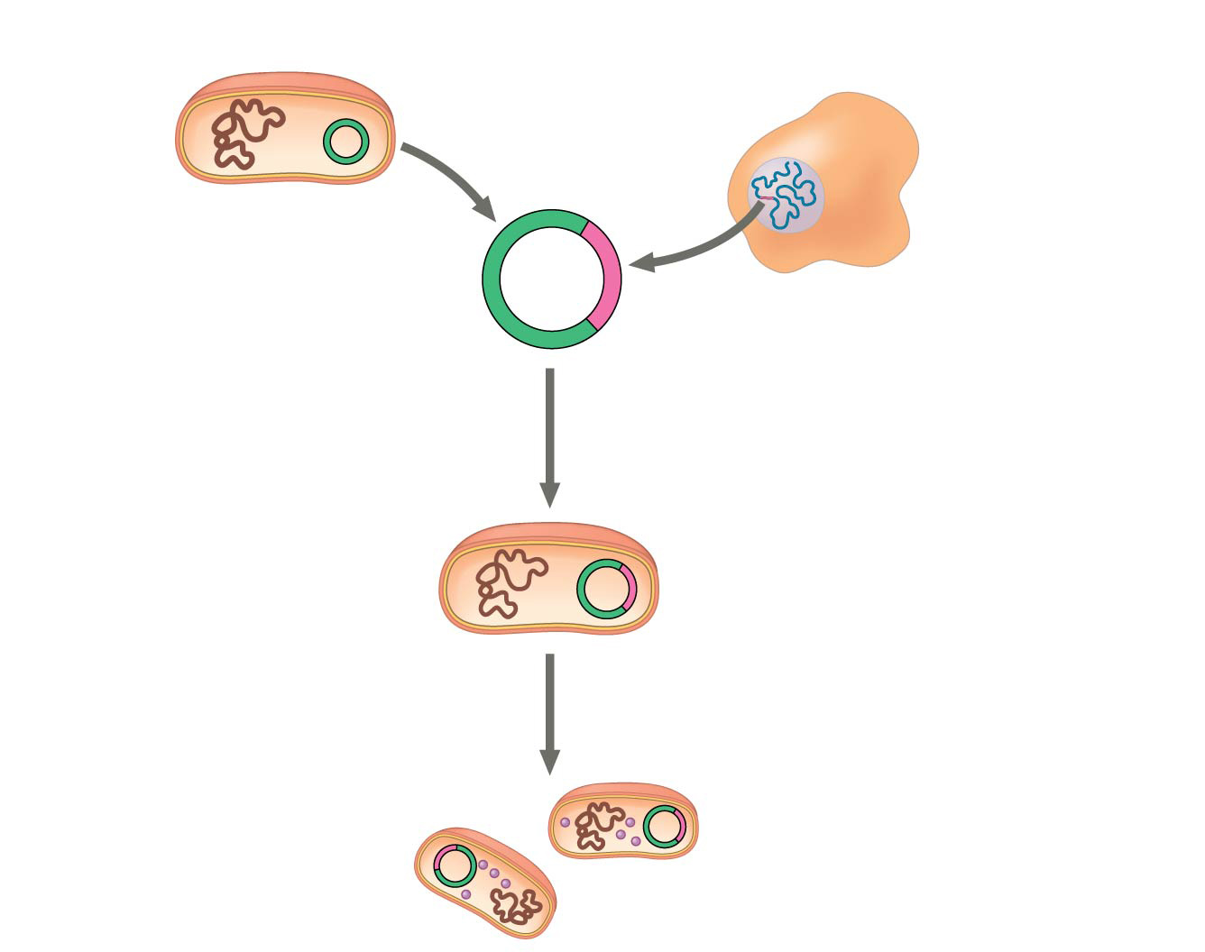
Figure 20.5a
Bacterium
Cell containing gene of interest
1
Gene inserted into plasmid
Bacterial chromosome
Plasmid
DNA of chromosome (“foreign” DNA)
Recombinant DNA (plasmid)
Gene of interest
2
Plasmid put into bacterial cell
Recombinant bacterium
3
Host cell grown in culture to form a clone of cells containing the “cloned” gene of interest
Gene of interest
Gene of interest
Protein expressed from gene of interest
Notes:
Figure 20.5a Gene cloning and some uses of cloned genes (part 1: steps)

Slide 9
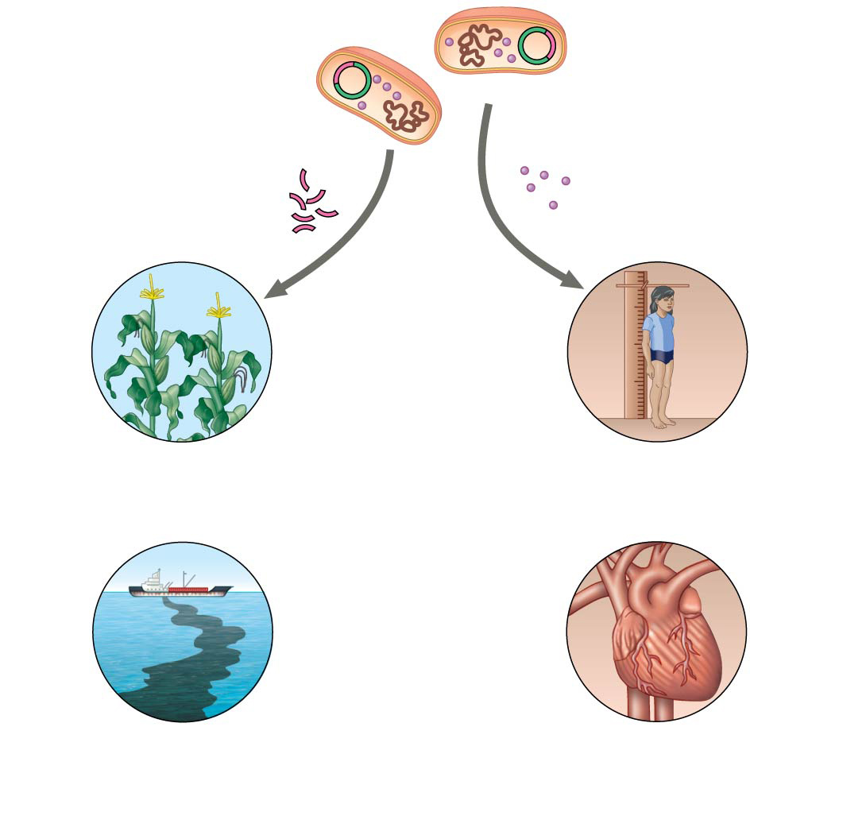
Figure 20.5b
Gene of interest
Protein expressed from gene of interest
Copies of gene
Protein harvested
4
Basic research and various applications
Gene for pest resistance inserted into plants
Human growth hormone treats stunted growth
Gene used to alter bacteria for cleaning up toxic waste
Protein dissolves blood clots in heart attack therapy
Notes:
Figure 20.5b Gene cloning and some uses of cloned genes (part 2: applications)

Slide 10
Notes:
Many identical copies of genes cloned in bacteria are produced as a result of _____.
https://www.polleverywhere.com/multiple_choice_polls/2nbdrUEfefZfIOk

Slide 11
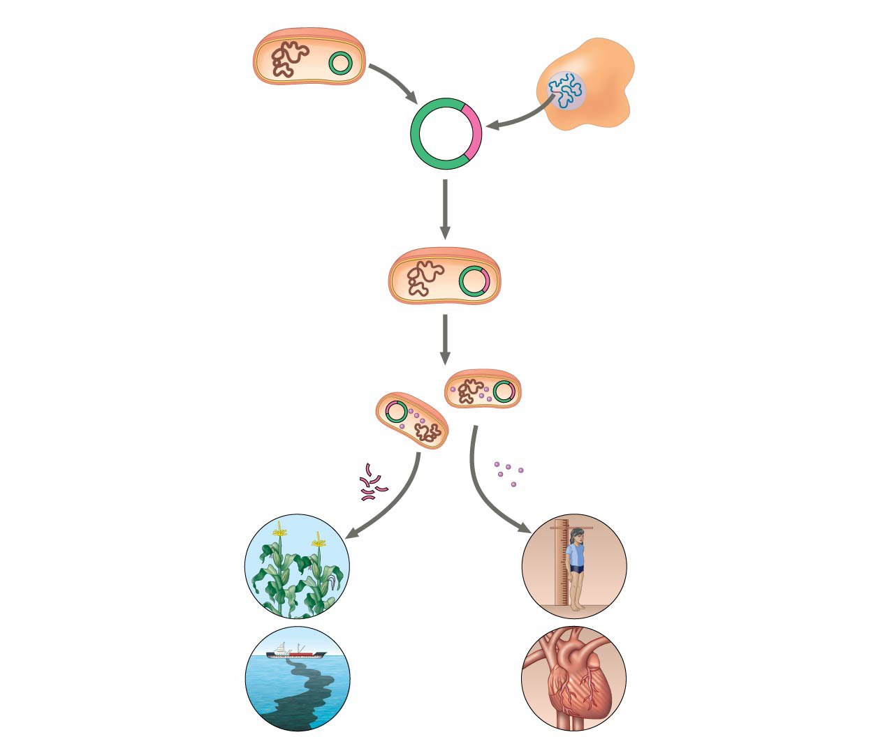
Figure 20.5
Bacterium
Cell containing gene of interest
How?
1
Gene inserted into plasmid
Bacterial chromosome
Plasmid
DNA of chromosome (“foreign” DNA)
Recombinant DNA (plasmid)
Gene of interest
2
Plasmid put into bacterial cell
Recombinant bacterium
3
Host cell grown in culture to form a clone of cells containing the “cloned” gene of interest
Gene of interest
Protein expressed from gene of interest
Copies of gene
Protein harvested
Gene for pest resistance inserted into plants
4
Basic research and various applications
Human growth hormone treats stunted growth
Gene used to alter bacteria for cleaning up toxic waste
Protein dissolves blood clots in heart attack therapy
Notes:
Figure 20.5 Gene cloning and some uses of cloned genes

Slide 12
Concept 20.1: DNA cloning is a valuable tool for genetic engineering and biological inquiry
Using Restriction Enzymes to Make a Recombinant DNA Plasmid
Bacterial restriction enzymes cut DNA molecules at specific DNA sequences called restriction sites
A restriction enzyme usually makes many cuts, yielding restriction fragments

Slide 13
Concept 20.1: DNA cloning is a valuable tool for genetic engineering and biological inquiry
Using Restriction Enzymes to Make a Recombinant DNA Plasmid
The most useful restriction enzymes cut DNA in a staggered way, producing fragments with “sticky ends”
Sticky ends can bond with complementary sticky ends of other fragments
DNA ligase is an enzyme that seals the bonds between restriction fragments

Slide 14
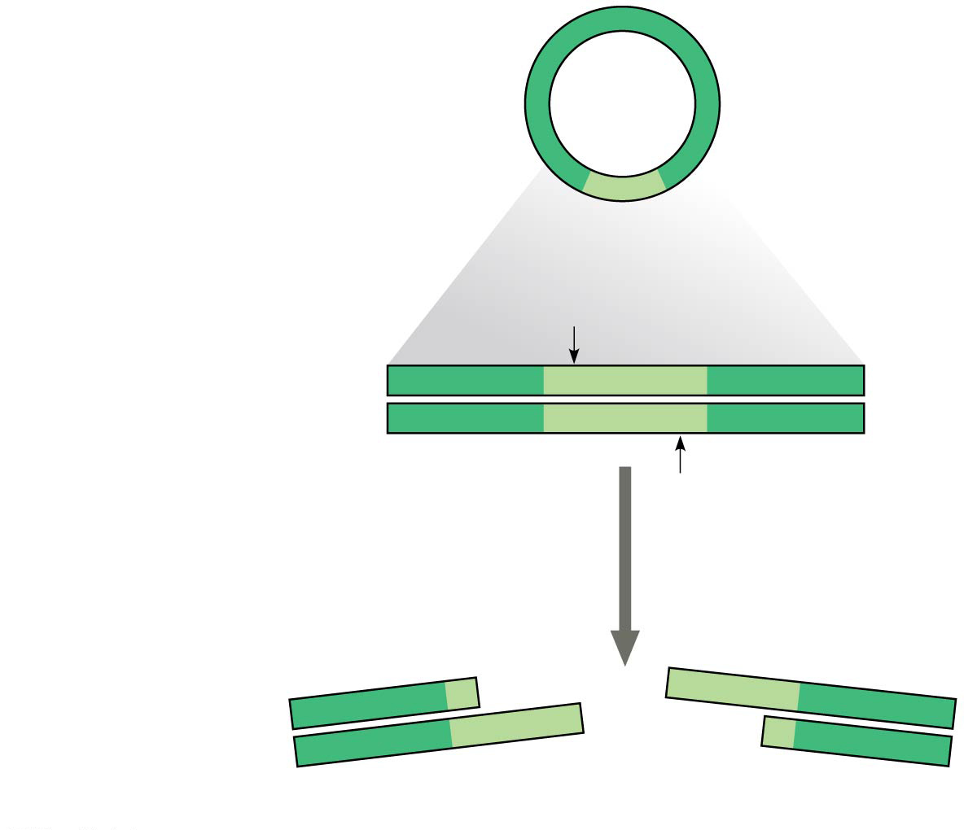
Figure 20.6a
Bacterial plasmid
Restriction site
5′
3′
DNA
GAATTC
CTTAAG
3′
5′
1
Restriction enzyme cuts the sugar-phosphate backbones at each arrow.
3′
5′
5′
AATTC
3′
G
CTTAA
G
5′
3′
3′
Sticky end
5′
Notes:
Figure 20.6a Using a restriction enzyme DNA ligase to make a recombinant DNA plasmid (part 1)

Slide 15
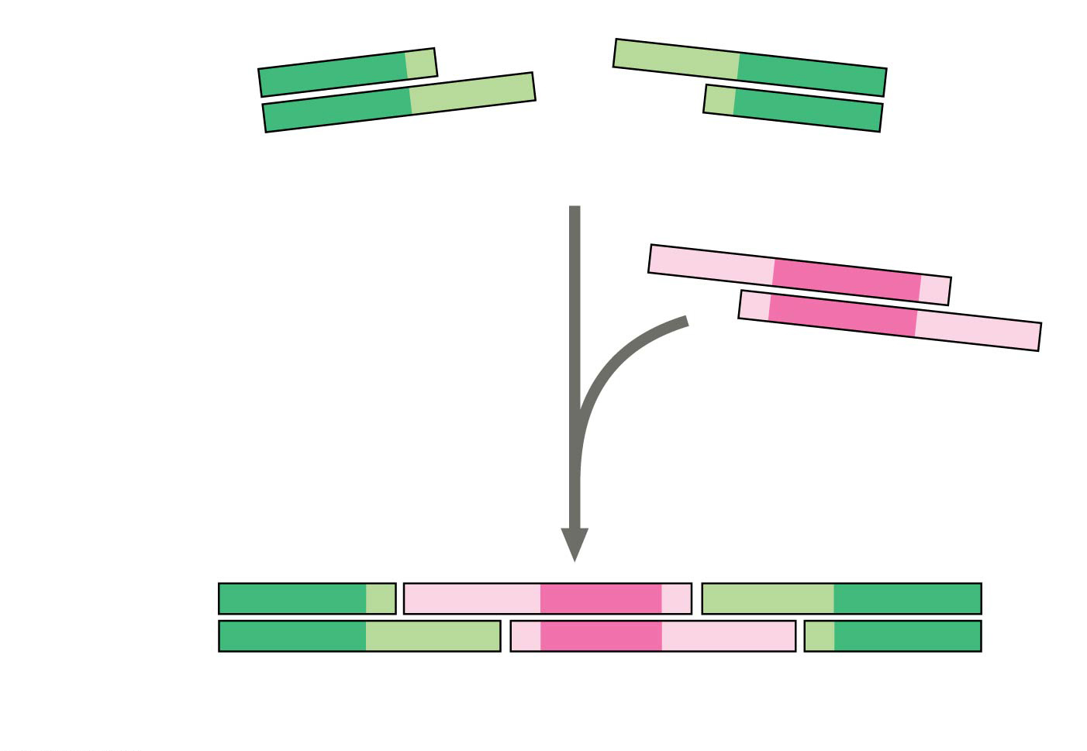
Figure 20.6b
3′
5′
5′
G
AATTC
3′
CTTAA
G
5′
3′
3′
Sticky end
5′
5′
AATTC
3′
2
Base pairing of sticky ends produces various combinations.
G
G
3′
CTTAA
5′
Fragment from different DNA molecule cut by the same restriction enzyme
5′
3′
5′
3′
5′
3′
G
AATT
C
G
AATT
C
C
TTAA
G
C
TTAA
G
3′
5′
3′
5′
3′
5′
One possible combination
Notes:
Figure 20.6b Using a restriction enzyme DNA ligase to make a recombinant DNA plasmid (part 2)

Slide 16
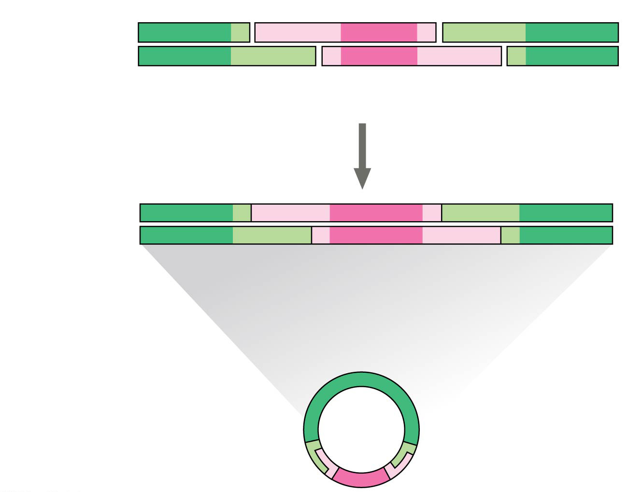
Figure 20.6c
5′
3′
5′
3′
5′
3′
G
AATT
C
G
AATT
C
C
TTAA
G
C
TTAA
G
3′
5′
3′
5′
3′
5′
One possible combination
3
DNA ligase seals the strands
5′
3′
3′
Recombinant DNA molecule
5′
Recombinant plasmid
Notes:
Figure 20.6c Using a restriction enzyme DNA ligase to make a recombinant DNA plasmid (part 3)

Slide 17
Notes:
A principal problem with inserting an unmodified mammalian gene into a plasmid and then getting that gene expressed in bacteria is that _____.
https://www.polleverywhere.com/multiple_choice_polls/yExZJKp0E9IcEwY

Slide 18
Notes:
Which enzyme was used to produce the molecule in the figure above?
https://www.polleverywhere.com/multiple_choice_polls/hQmHVe0R9n4K6Yp

Slide 19
Notes:
Which of the following sequences is most likely to be cut by a restriction enzyme?
https://www.polleverywhere.com/multiple_choice_polls/05a6xYVOZ98MzYy

Slide 20
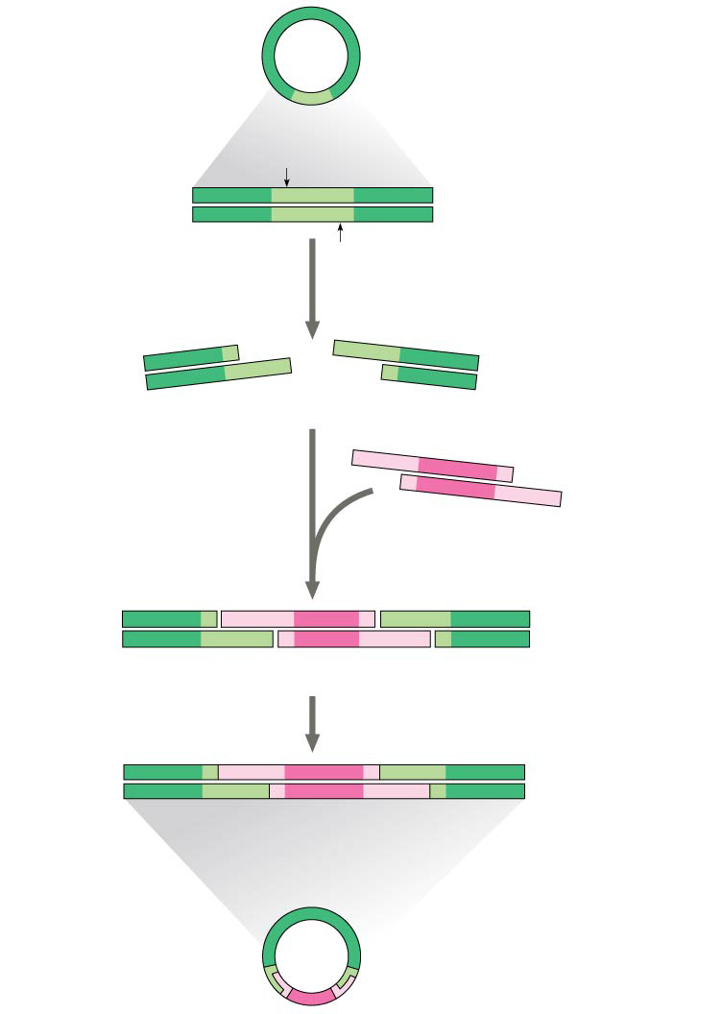
Figure 20.6
Bacterial plasmid
Restriction site
5′
GAATTC
3′
DNA
CTTAAG
3′
5′
1
Restriction enzyme cuts the sugar-phosphate backbones at each arrow.
5′
3′
5′
3′
G
AATTC
CTTAA
G
3′
5′
3′
5′
Sticky end
5′
3′
2
Base pairing of sticky ends produces various combinations.
AATTC
G
G
CTTAA
3′
5′
Fragment from different DNA molecule cut by the same restriction enzyme
5′
3′
5′
3′
5′
T
3′
How do we check if it worked?
G
A
A
T
T
C
G
A
A
T
C
C
T
T
A
A
G
C
T
T
A
A
G
3′
5′
3′
5′
3′
5′
3
DNA ligase seals the strands.
One possible combination
5′
3′
3′
Recombinant DNA molecule
5′
Recombinant plasmid
Notes:
Figure 20.6 Using a restriction enzyme DNA ligase to make a recombinant DNA plasmid

Slide 21
Concept 20.1: DNA cloning is a valuable tool for genetic engineering and biological inquiry
Gel Electrophoresis
To check the recombinant plasmid, researchers might cut the products again using the same restriction enzyme
To separate and visualize the fragments produced, gel electrophoresis would be carried out
This technique uses a gel made of a polymer to separate a mixture of nucleic acids or proteins based on size, charge, or other physical properties

Slide 22
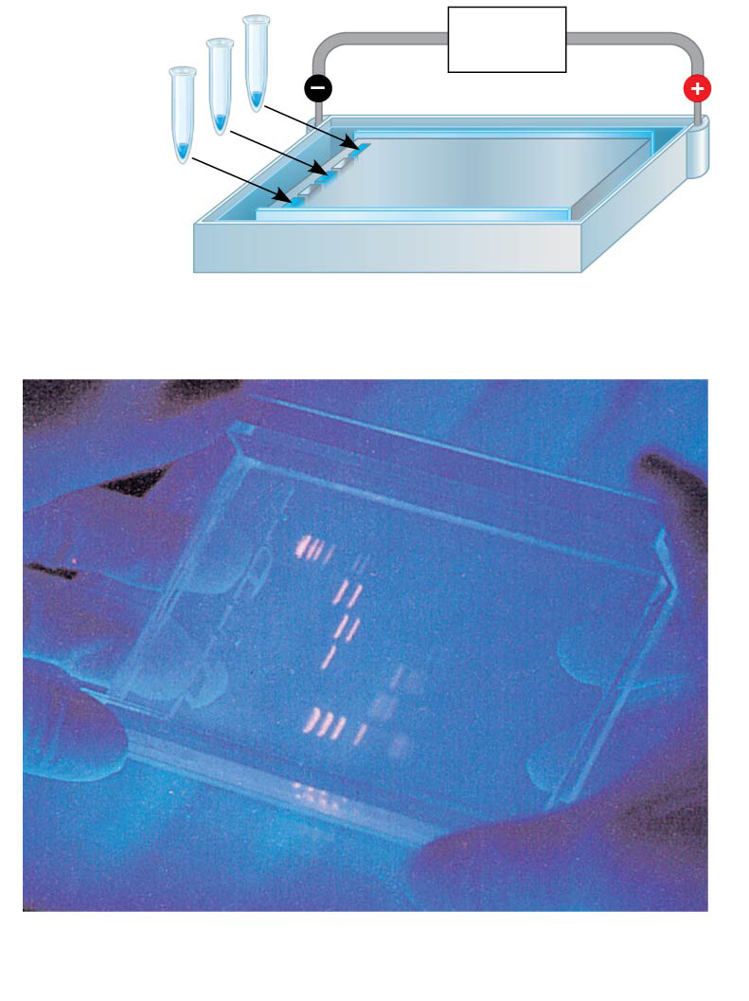
Figure 20.7
Mixture of DNA mol- ecules of different sizes
Power source
Cathode
Anode
Wells
Gel
(a) Negatively charged DNA molecules move toward the positive electrode.
Restriction fragments (size standards)
(b) Shorter molecules are slowed down less than longer ones, so they move faster through the gel.
Notes:
Figure 20.7 Gel electrophoresis

Slide 23
Concept 20.1: DNA cloning is a valuable tool for genetic engineering and biological inquiry
Amplifying DNA
The polymerase chain reaction, PCR, can exponentially produce MANY identical copies of a specific target segment of DNA
A three-step cycle—heating, cooling, and replication—brings about a chain reaction that produces an EXPONENTIALLY growing population of identical DNA molecules
The key to PCR is an unusual, heat-stable DNA polymerase called Taq polymerase (Pfu better tho)
PCR also needs a pair of primers specific for the sequence to be amplified

Slide 24
Figure 20.8a
Technique
5′
3′
Target sequence
Genomic DNA
3′
5′
Notes:
Figure 20.8a Research method: the polymerase chain reaction (PCR) (part 1)

Slide 25
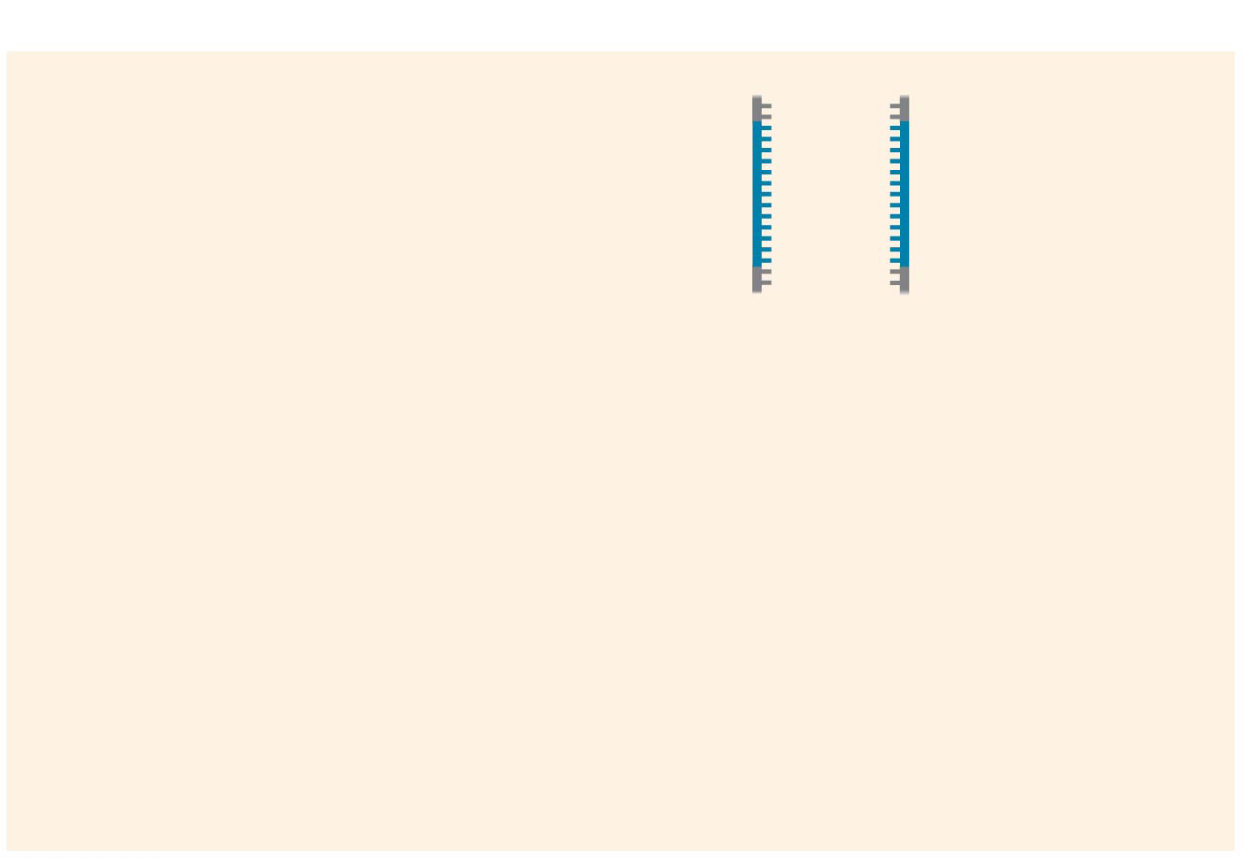
Figure 20.8b-1
Technique
1
Denaturation
5′
3′
3′
5′
Cycle 1 yields 2 molecules
Notes:
Figure 20.8b-1 Research method: the polymerase chain reaction (PCR) (part 2, step 1)

Slide 26
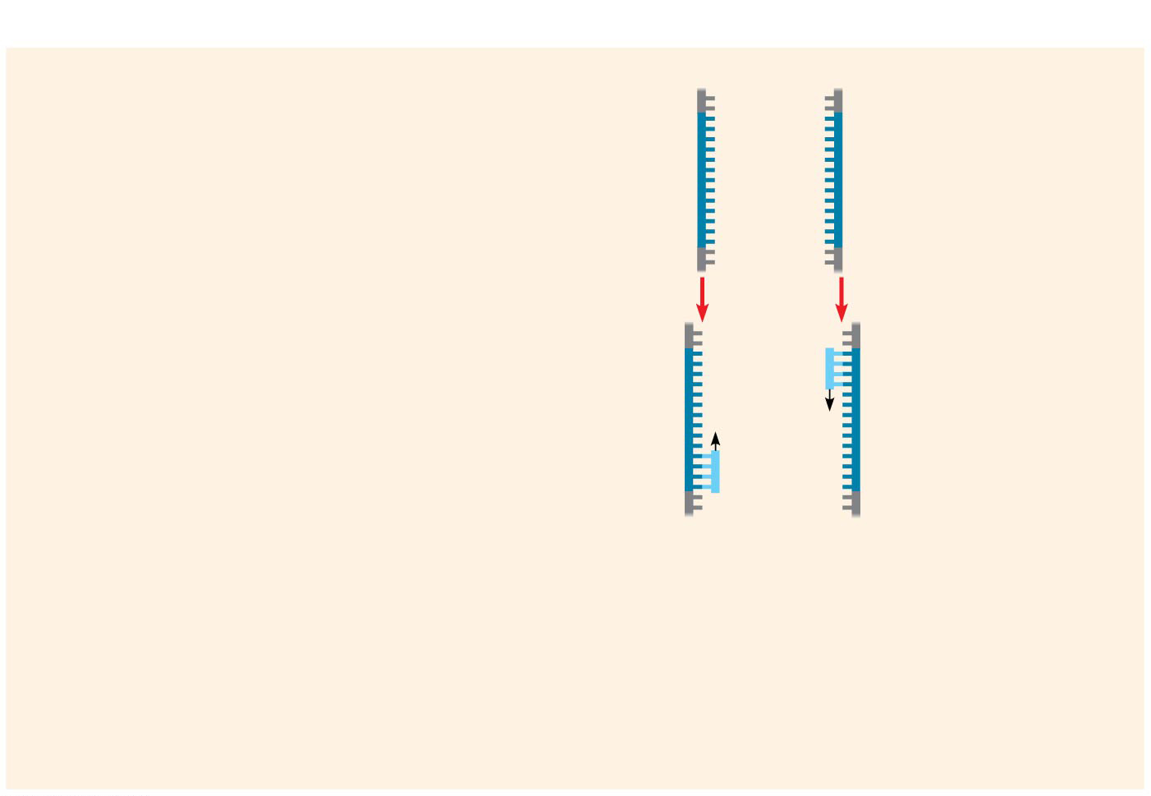
Figure 20.8b-2
Technique
1
Denaturation
5′
3′
3′
5′
2
Annealing
Cycle 1 yields 2 molecules
Primers
Notes:
Figure 20.8b-2 Research method: the polymerase chain reaction (PCR) (part 2, step 2)

Slide 27
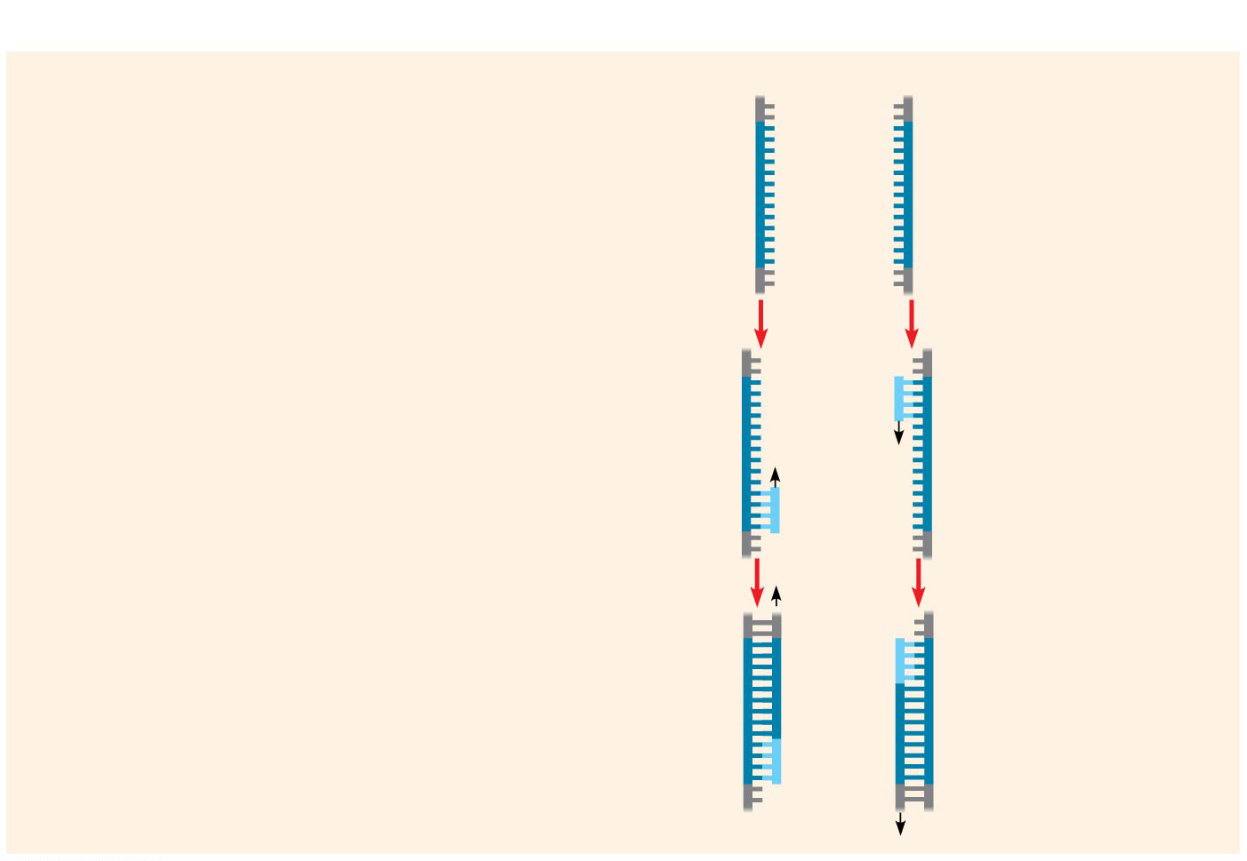
Figure 20.8b-3
Technique
1
Denaturation
5′
3′
3′
5′
2
Annealing
Cycle 1 yields 2 molecules
Primers
3
Extension
New nucleotides
Notes:
Figure 20.8b-3 Research method: the polymerase chain reaction (PCR) (part 2, step 3)

Slide 28
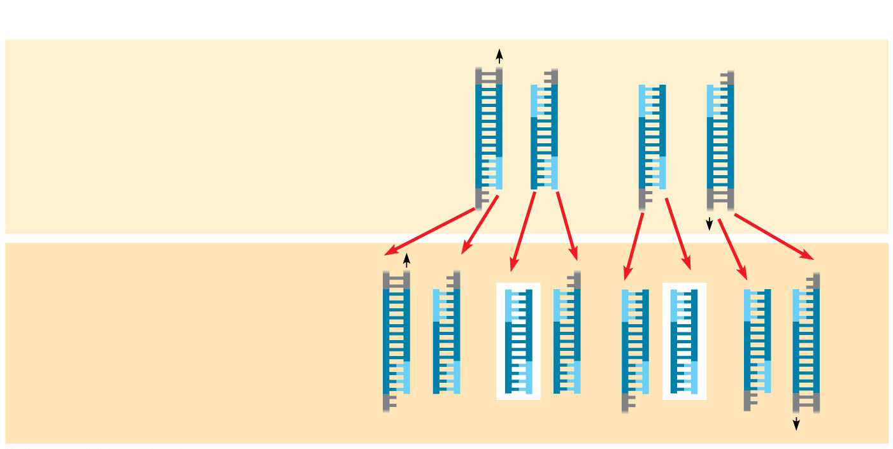
Figure 20.8c
Technique
Cycle 2 yields 4 molecules
Cycle 3 yields 8 molecules; 2 molecules (in white boxes) match target sequence
Results After 30 more cycles, over 1 billion (10⁹) molecules match the target sequence.
Notes:
Figure 20.8c Research method: the polymerase chain reaction (PCR) (part 3)

Slide 29
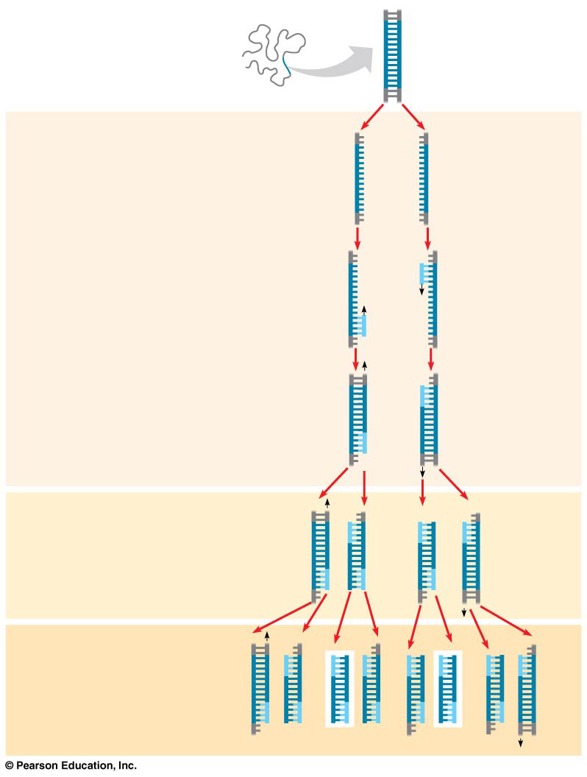
Figure 20.8
Technique
5′
3′
Target sequence
Genomic DNA
3′
5′
1
Denaturation
5′
3′
3′
5′
2
Annealing
Cycle 1 yields 2 molecules
Primers
3
Extension
New
nucleotides
Cycle 2 yields 4 molecules
Cycle 3 yields 8 molecules; 2 molecules (in white boxes) match target sequence
Notes:
Figure 20.8 Research method: the polymerase chain reaction (PCR)

Slide 30
Notes:
Why is it so important to be able to amplify DNA fragments when studying genes?
https://www.polleverywhere.com/multiple_choice_polls/t1w5D7KRl1Rvv2p

Slide 31
Notes:
The reason for using Taq polymerase for PCR is that _____.
https://www.polleverywhere.com/multiple_choice_polls/oyXnzKr1bFXnQEu

Slide 32
Notes:
Which of the following is in the correct order for one cycle of polymerase chain reaction (PCR)?
https://www.polleverywhere.com/multiple_choice_polls/lvN1qXhaYw5ialM

Slide 33
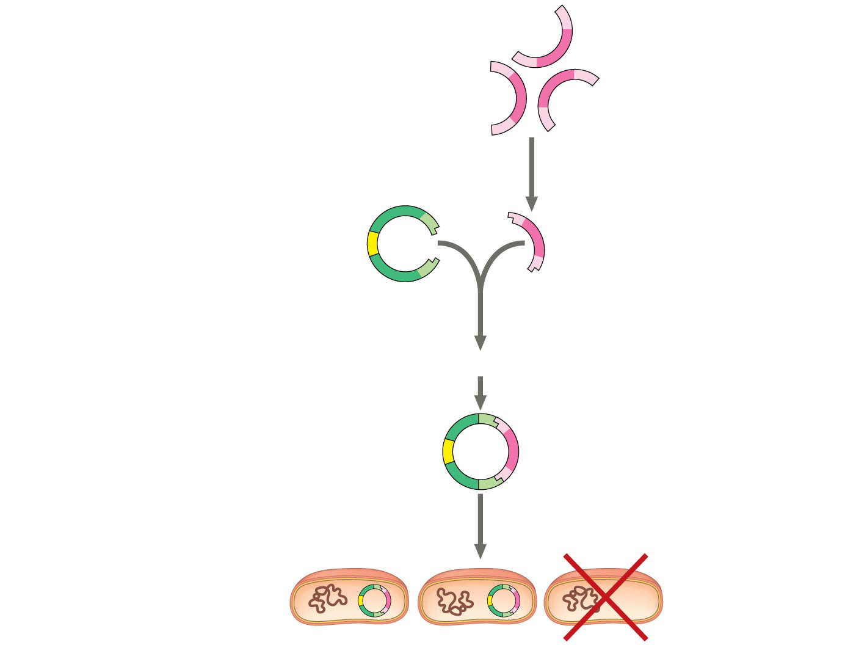
Figure 20.9
DNA fragments obtained by PCR with restriction sites matching those in the cloning vector
Cut with same restriction enzyme used on cloning vector
A gene that makes bacterial cells resistant to an antibiotic is present on the plasmid.
Cloning vector (bacterial plasmid)
Mix and ligate
Recombinant DNA plasmid
Only cells that take up a plasmid will survive
Notes:
Figure 20.9 Use of restriction enzyme and PCR in gene cloning

Slide 34
Animation: Cloning a Gene

Slide 35
Overview
Concept 20.1: DNA cloning are valuable tools for genetic engineering and biological inquiry
Concept 20.4: The practical applications of DNA-based biotechnology affect our lives in many ways

Slide 36
Concept 20.4: The practical applications of DNA-based biotechnology affect our lives in many ways
Many fields benefit from DNA technology and genetic engineering
Medical Applications
Pharmaceutical Products
Forensic Evidence and Genetic Profiles
Environmental Cleanup
Agricultural Applications
Potential benefits of genetic engineering must be weighed against potential hazards of creating harmful products or procedures

Slide 37
Overview
Concept 20.1: DNA cloning are valuable tools for genetic engineering and biological inquiry
Concept 20.4: The practical applications of DNA-based biotechnology affect our lives in many ways

Slide 38
WATCH
https://www.youtube.com/watch?v=ZDZUAleWX78
https://www.youtube.com/watch?v=2KoLnIwoZKU
https://www.youtube.com/watch?v=nfC689ElUVk
https://www.youtube.com/watch?v=yYIZgS-L5Sc

