Slide 1
24
The Origin of Species

Slide 2
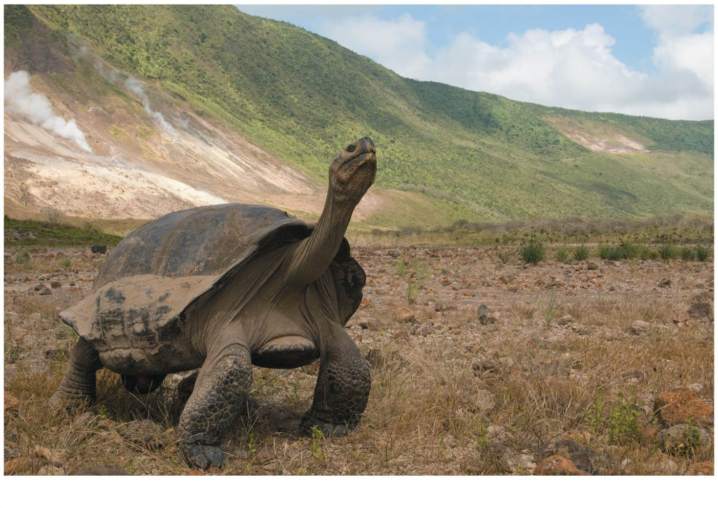
Figure 24.1a
How do you get to THIS?!
Notes:
Figure 24.1a How did this flightless bird come to live on the isolated Galápagos Islands? (part 1: Galápagos giant tortoise)

Slide 3
“Mystery of Mysteries” –Chuck Darwin
In the Galápagos Islands, Darwin discovered plants and animals found NOWHERE else on Earth (endemic species)
He stated that the origin of these unbelievably unique species was the “mystery of mysteries”
To this day, biologists struggle to establish what it means to be a “species”
However, many agree on several “species concepts” based on macroevolution

Slide 4
Species 101
Speciation = the origin of new species, the focal point of evolutionary theory
Evolutionary theory must explain…
How populations evolve → MICROevolution → changes in allele frequency in a population over time (population = basic “unit” of evolution)
How NEW species originate → MACROevolution → BROAD patterns of evolutionary change ABOVE the species level (today’s focus)

Slide 5
Overview
Concept 24.1: The biological species concept emphasizes reproductive isolation
Concept 24.2: Speciation can take place with or without geographic separation
Concept 24.3: Hybrid zones reveal factors that cause reproductive isolation
Concept 24.4: Speciation can occur rapidly or slowly and can result from changes in few or many genes

Slide 6
Overview
Concept 24.1: The biological species concept emphasizes reproductive isolation
Concept 24.2: Speciation can take place with or without geographic separation
Concept 24.3: Hybrid zones reveal factors that cause reproductive isolation
Concept 24.4: Speciation can occur rapidly or slowly and can result from changes in few or many genes

Slide 7
Concept 24.1: The biological species concept emphasizes reproductive isolation
Species is a Latin word meaning “kind” or “appearance”
Biological species concept (BSC): a species is a group of populations whose members have the potential to interbreed in nature to produce viable, fertile offspring
A biological species does NOT interbreed successfully with members of other populations
The biological species concept is based on the potential to interbreed, NOT on physical similarity!

Slide 8
The biological species concept is based on the potential to interbreed, not on physical similarity
(a) Similarity between different species
(b) Diversity within a species
Notes:
Figure 24.2 The biological species concept is based on the potential to interbreed, not on physical similarity

Slide 9
Concept 24.1: The biological species concept emphasizes reproductive isolation
Reproductive isolation: existence of biological factors (barriers) that impede two species from producing viable, fertile offspring
Reproductive isolation can be classified by whether impeding factors act BEFORE or AFTER fertilization
Before fertilization → Prezygotic reproductive isolation barriers
After fertilization → Postzygotic reproductive isolation barriers

Slide 10
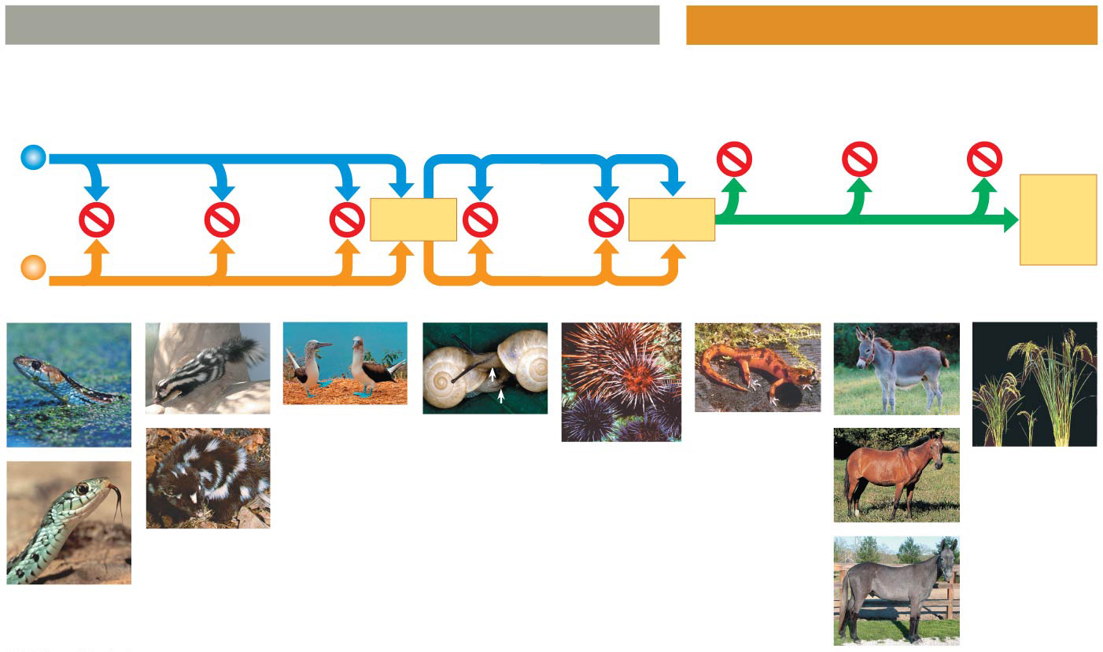
Figure 24.3
Prezygotic barriers
Postzygotic barriers
Habitat
isolation
Temporal
isolation
Behavioral
isolation
Mechanical
isolation
Gametic
isolation
Reduced
hybrid
viability
Reduced
hybrid
fertility
Hybrid
breakdown
Indivi-
duals of
different
species
VIABLE,
FERTILE
OFF-
SPRING
MATING ATTEMPT
FERTILI- ZATION
(a)
(c)
(e)
(f)
(g)
(h)
(i)
(l)
(d)
(j)
(b)
(k)
Notes:
Figure 24.3 Exploring reproductive barriers

Slide 11
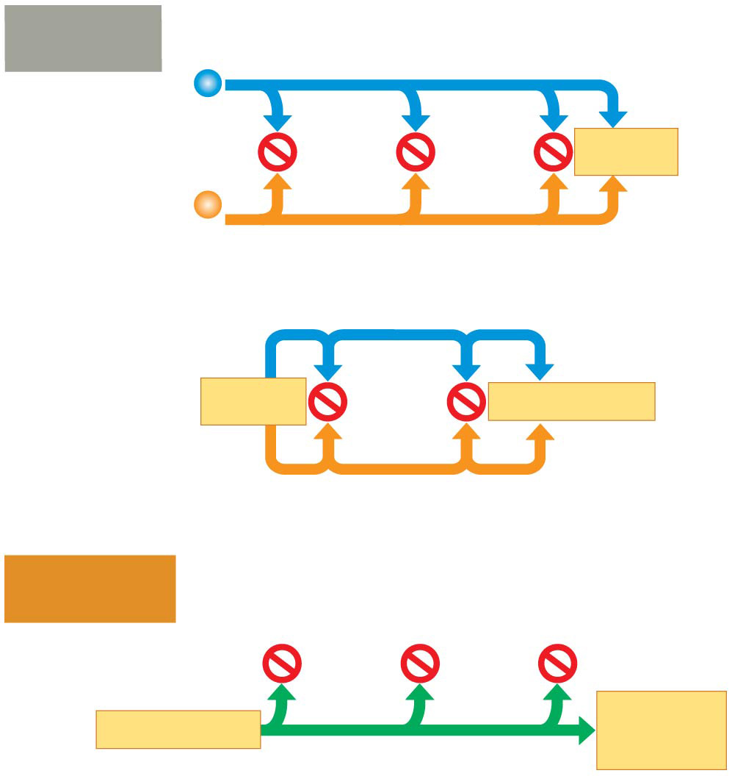
Figure 24.3d
Prezygotic
barriers
Habitat
isolation
Temporal
isolation
Behavioral
isolation
Individuals
of
different
species
MATING ATTEMPT
Mechanical
isolation
Gametic
isolation
MATING ATTEMPT
FERTILIZATION
Postzygotic
barriers
Reduced
hybrid
viability
Reduced
hybrid
fertility
Hybrid
breakdown
VIABLE,
FERTILE
OFFSPRING
FERTILIZATION
Notes:
Figure 24.3d Exploring reproductive barriers (part 4: art summary)

Slide 12
Concept 24.1: The biological species concept emphasizes reproductive isolation – Prezygotic
Prezygotic barriers BLOCK fertilization from occurring by…
Impeding different species from attempting to mate
Preventing the successful completion of mating
Hindering fertilization if mating is successful

Slide 13
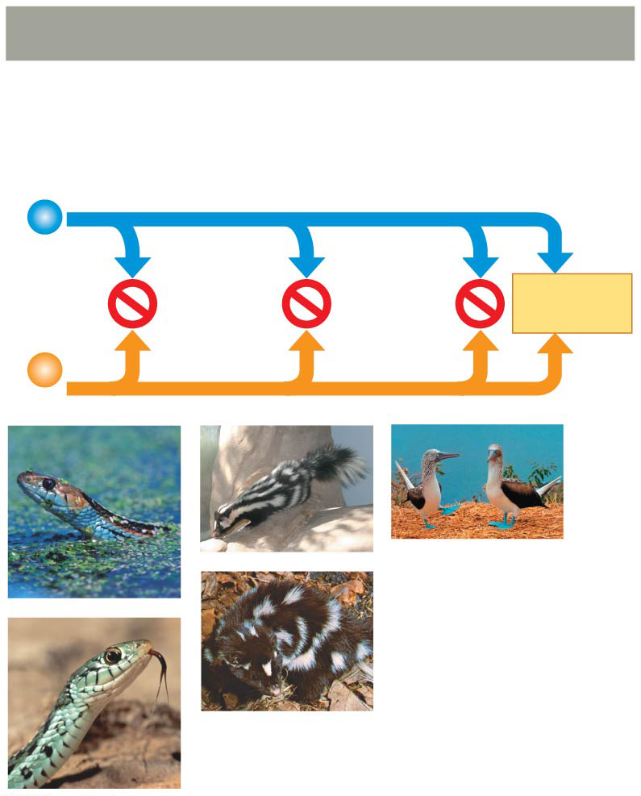
Figure 24.3a
Prezygotic barriers
Habitat
isolation
Temporal
isolation
Behavioral
isolation
Indivi-
duals of
different
species
MATING ATTEMPT
(a)
(c)
(e)
(d)
(b)
Notes:
Figure 24.3a Exploring reproductive barriers (part 1: prezygotic barriers)

Slide 14
Concept 24.1: The biological species concept emphasizes reproductive isolation – Prezygotic
Habitat isolation: Two species encounter each other rarely, or not at all, because they occupy DIFFERENT habitats
Example (just for demonstrative purposes, don’t need to remember any of the upcoming examples):
Aquatic snek species
Terrestrial snek species

Slide 15
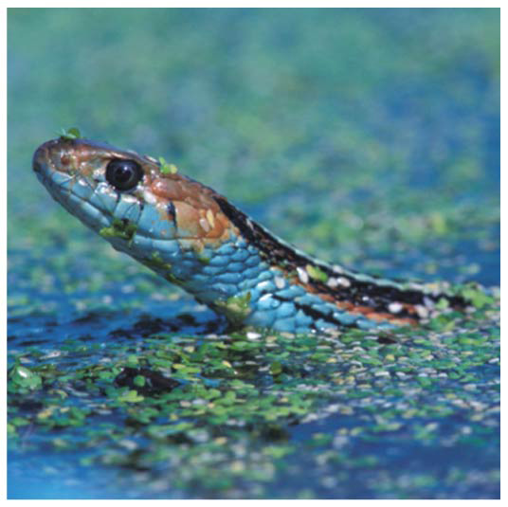
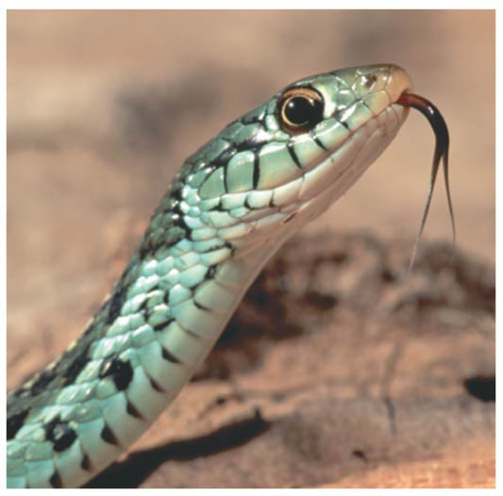
Figure 24.3aa
(a)
(b)
Aquatic ropey boi
Terrestrial ropey gal
Notes:
Figure 24.3aa Exploring reproductive barriers (part 1a: habitat isolation, water)

Slide 16
Concept 24.1: The biological species concept emphasizes reproductive isolation – Prezygotic
Temporal isolation: Species that breed at DIFFERENT times of the day, DIFFERENT seasons, or DIFFERENT years CANNOT mix their gametes
Example:
Winter-breeding fart squirrel
Summer-breeding fart squirrel

Slide 17
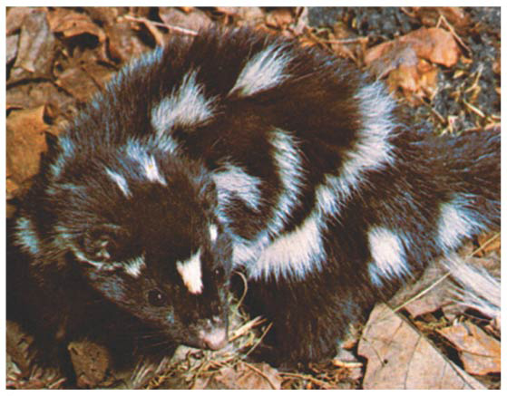
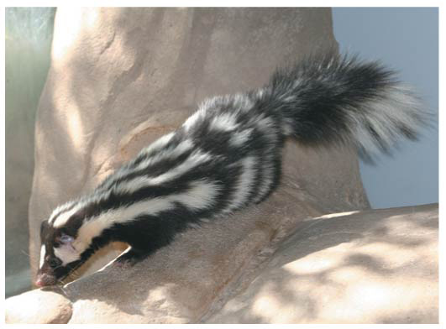
Figure 24.3ac
(d)
(c)
Winter fart squirrel
Summer fart squirrel
Notes:
Figure 24.3ac Exploring reproductive barriers (part 1c: temporal isolation, winter)

Slide 18
Concept 24.1: The biological species concept emphasizes reproductive isolation – Prezygotic
Behavioral isolation: Courtship rituals (colloquially referred to as “spitting game”) and other behaviors unique to a species are effective barriers to mating
Example:
Blue-footed boobies → males need to dance [correctly] to show off their blue feet for the female
YouTube search “animal courtship rituals” for tons of other hilarious ones!

Slide 19
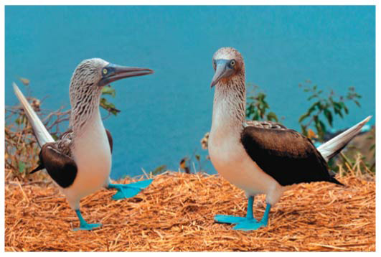
Figure 24.3ae
Clearly NOT impressed
(e)
Left him on “read”
Video
Notes:
Figure 24.3ae Exploring reproductive barriers (part 1e: behavioral isolation)

Slide 20
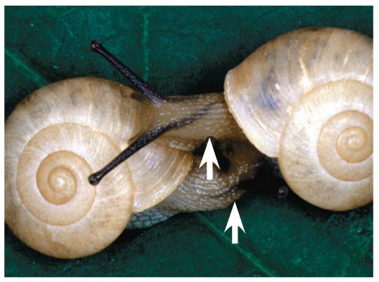
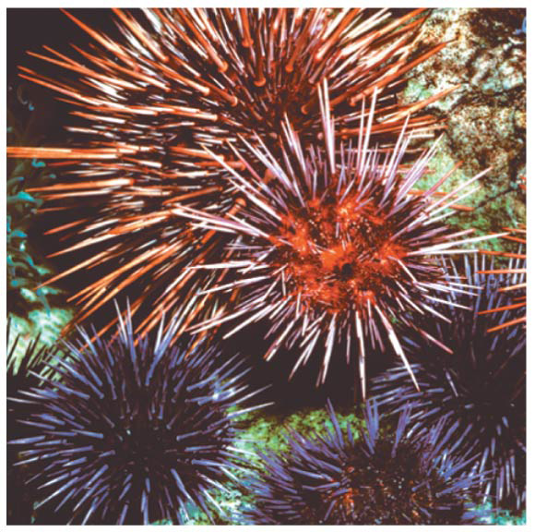
Concept 24.1: The biological species concept emphasizes reproductive isolation – Prezygotic
Mechanical isolation: Morphological differences can prevent successful completion of mating
Ex: Slimy shell boi/gal “chirality” (clockwise vs. counter-clockwise)
Gametic Isolation: Sperm of one species may NOT be able to fertilize eggs of another species
Ex: Spikey sea dood
(f)
NSFW
(g)
NSFW

Slide 21
Notes:
Three populations of crickets look very similar, but the males have courtship songs that sound different. What function would this difference in song likely serve if the populations came in contact?
https://www.polleverywhere.com/multiple_choice_polls/l2gkjoW2Z40qeHT

Slide 22
Notes:
What does the biological species concept use as the primary criterion for determining species boundaries?
https://www.polleverywhere.com/multiple_choice_polls/ruzCflUvhItH9KY

Slide 23
Notes:
Macroevolution is _____.
https://www.polleverywhere.com/multiple_choice_polls/BYmMj20n3HbJnnN

Slide 24
Notes:
Dog breeders maintain the purity of breeds by keeping dogs of different breeds apart when they are fertile. This kind of isolation is most similar to which of the following reproductive isolating mechanisms?
https://www.polleverywhere.com/multiple_choice_polls/0Vbhf6inP6VS67Y

Slide 25
Notes:
Rank the following in order from most general to most specific: 1. gametic isolation 2. reproductive isolating mechanism 3. sperm-egg incompatibility in sea urchins 4. prezygotic isolating mechanism
https://www.polleverywhere.com/multiple_choice_polls/f1GSKg1uEugjfbp

Slide 26
Concept 24.1: The biological species concept emphasizes reproductive isolation– Postzygotic
So what if the prezygotic barriers are overcome?
You get HYBRIDS → offspring of crosses between DIFFERENT species → subject to NEW barriers
Postzygotic barriers PREVENT the hybrid zygote from developing into a viable, fertile adult via:
Reduced hybrid viability
Reduced hybrid fertility
Hybrid breakdown

Slide 27
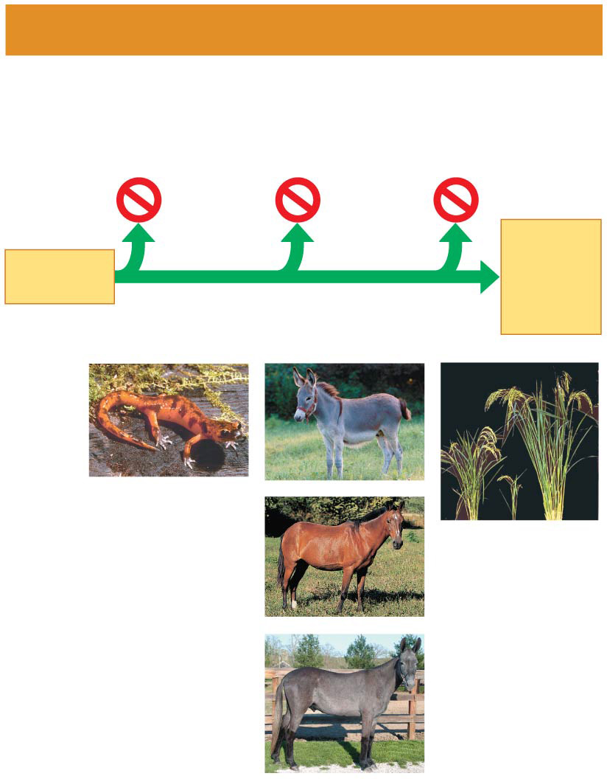
Figure 24.3c
Postzygotic barriers
Reduced
hybrid
viability
Reduced
hybrid
fertility
Hybrid
breakdown
VIABLE,
FERTILE
OFF-
SPRING
FERTILI- ZATION
(h)
(i)
(l)
(j)
(k)
Notes:
Figure 24.3c Exploring reproductive barriers (part 3: postzygotic barriers)

Slide 28
Concept 24.1: The biological species concept emphasizes reproductive isolation– Postzygotic
Reduced hybrid viability: Genes of the different parent species may interact and IMPAIR the hybrid’s development or survival in its environment
Reduced hybrid fertility: Even if hybrids are vigorous, they may be STERILE
Ex: female horse + male donkey = [sterile] MULE!
Hybrid breakdown: Some first-generation hybrids are fertile, but when they mate with each other or with either parent species, offspring of the next generation are feeble or sterile

Slide 29
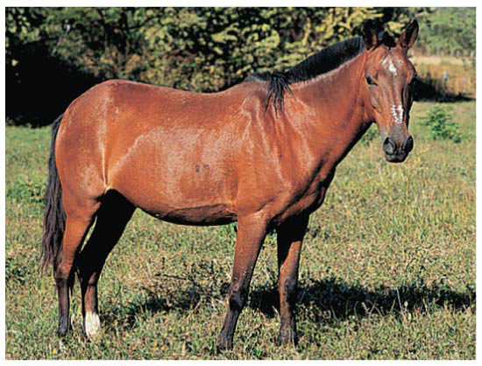
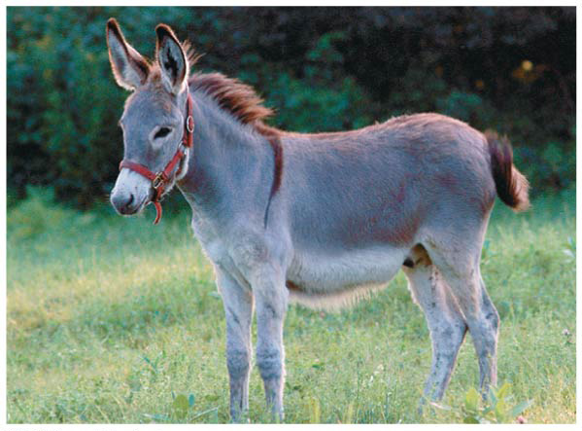
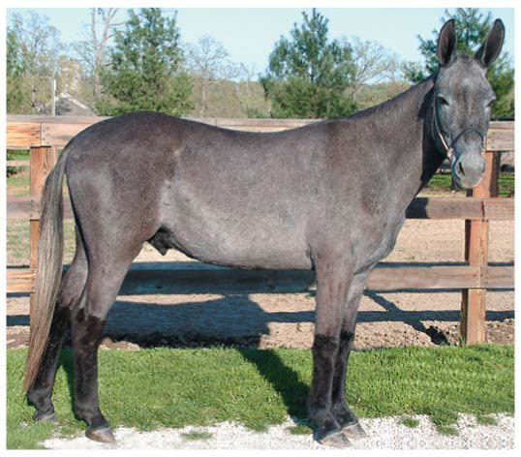
Figure 24.3cb
(j)
(i)
Quicc maffs
(k)
Notes:
Figure 24.3cb Exploring reproductive barriers (part 3b: reduced hybrid fertility, donkey)

Slide 30
Concept 24.1: The biological species concept emphasizes reproductive isolation – Limitations
The biological species concept cannot be applied to fossils or asexual organisms
Ex: ALL prokaryotes (aka the MAJORITY of living organisms on earth)
The biological species concept emphasizes absence of gene flow…however, gene flow can still occur between distinct species
Ex: Mate grizzly bears + polar bears → “grolar bears” …only happens because humans purposefully mate them, not seen in nature

Slide 31
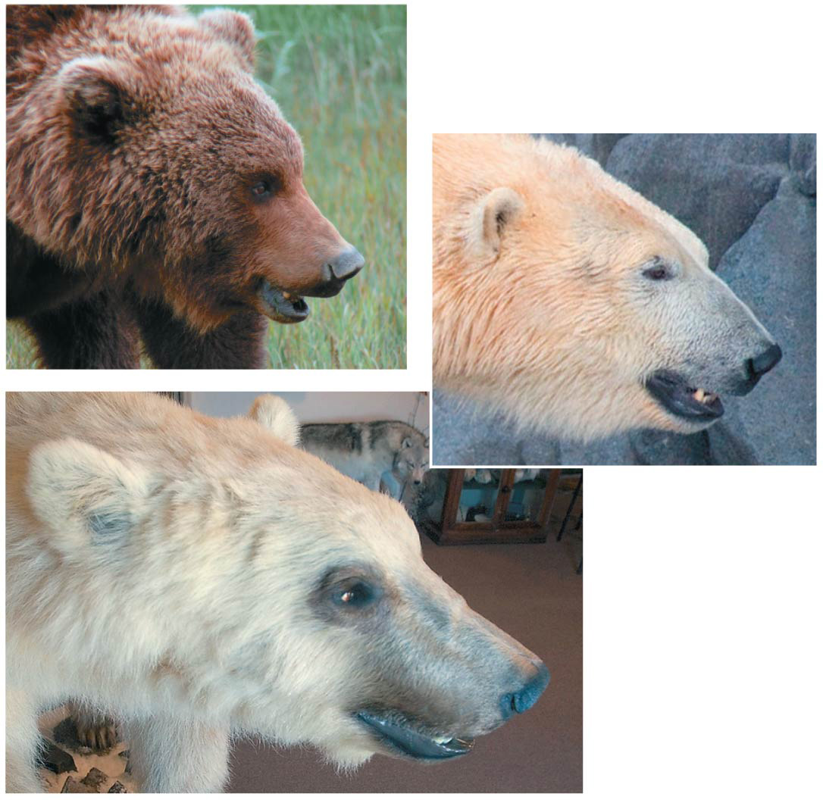
Figure 24.4
▶
Grizlord (U. arctos)
▶
Pablo escobear (U. maritimus)
▶
Hybrid
“grolar bear”
Notes:
Figure 24.4 Hybridization between two species of bears in the genus Ursus

Slide 32
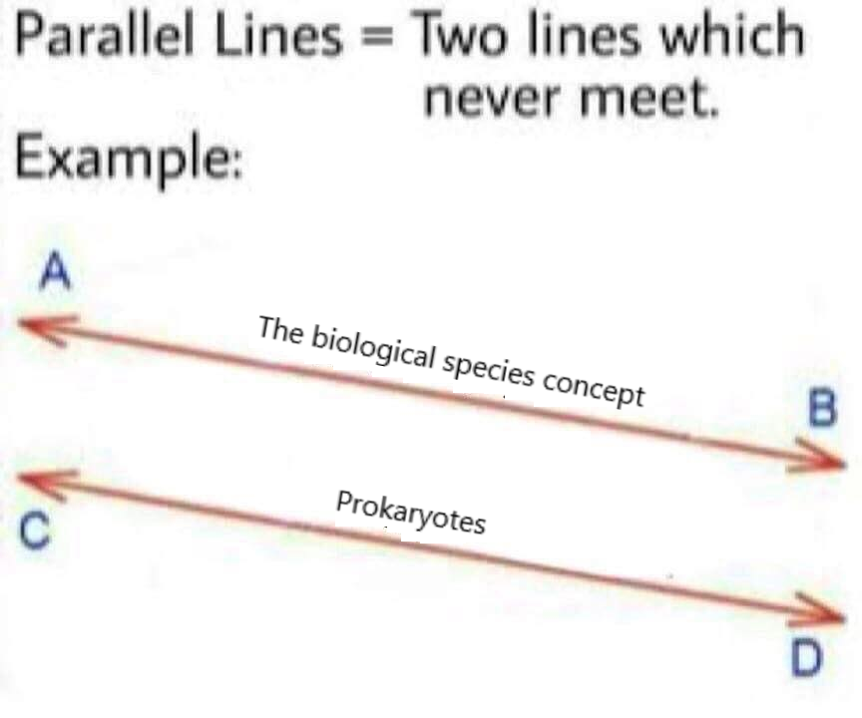

Slide 33
Notes:
Two species of frogs belonging to the same genus occasionally mate, but the embryos stop developing after a day and then die. These two frog species separate by _____.
https://www.polleverywhere.com/multiple_choice_polls/sLL6duZHEGAAWDJ

Slide 34
Notes:
The production of sterile mules by interbreeding between female horses (mares) and male donkeys (jacks) is an example of _____.
https://www.polleverywhere.com/multiple_choice_polls/ceJROB7gvBoHbI9

Slide 35
Overview
Concept 24.1: The biological species concept emphasizes reproductive isolation
Concept 24.2: Speciation can take place with or without geographic separation
Concept 24.3: Hybrid zones reveal factors that cause reproductive isolation
Concept 24.4: Speciation can occur rapidly or slowly and can result from changes in few or many genes

Slide 36
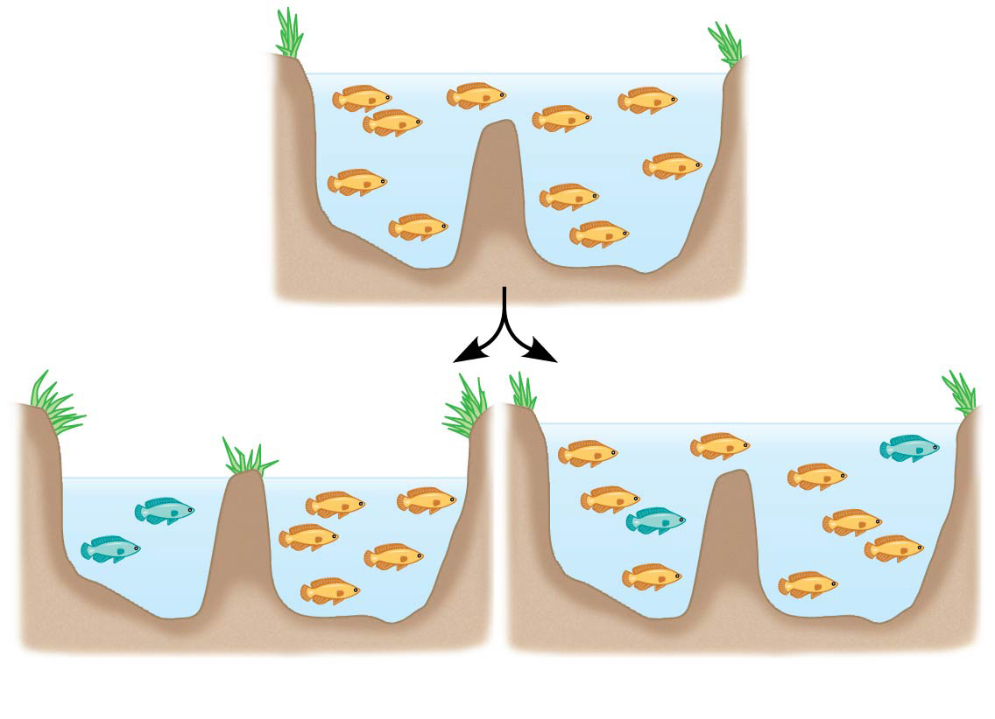
Concept 24.2: Speciation can take place with or without geographic separation
Speciation can occur in two ways:
Allopatric speciation = “other country” speciation
Sympatric speciation = “same country” speciation
(a) Allopatric speciation
(b) Sympatric speciation

Slide 37
Concept 24.2: Speciation can take place with or without geographic separation – Allopatric
Allopatric speciation: gene flow is INTERRUPTED or REDUCED when a population is divided into geographically ISOLATED subpopulations
Regions with many geographic barriers typically have MORE species than do regions with fewer barriers (more speciation!)
Reproductive isolation between populations generally INCREASES as the distance between them increases (exception? US!)

Slide 38
Concept 24.2: Speciation can take place with or without geographic separation – Sympatric
Sympatric speciation: speciation takes place in geographically OVERLAPPING populations
Sympatric speciation can occur if gene flow is reduced by factors including:
Polyploidy: presence of extra sets of chromosomes due to accidents during cell division, causes RAPID plant speciation
Sexual selection (will revisit during Animal Behavior)
Habitat differentiation (dw about this)

Slide 39
Concept 24.2: Speciation can take place with or without geographic separation – Review
Allopatric speciation
Geographic isolation RESTRICTS gene flow between populations
Reproductive isolation may then arise in the isolated populations
Even if contact is restored between populations, interbreeding is prevented
Sympatric speciation
A reproductive barrier isolates a subset of a population WITHOUT geographic separation from the parent species
Sympatric speciation can result from polyploidy, sexual selection, or habitat differentiation

Slide 40
Notes:
Which of the following describes the most likely order of events in allopatric speciation?
https://www.polleverywhere.com/multiple_choice_polls/iYHsAOLlblmWaET

Slide 41
Notes:
How are two different species most likely to evolve from one ancestral species?
https://www.polleverywhere.com/multiple_choice_polls/CwwGChOx3O4rltg

Slide 42
Notes:
Among known plant species, which of these have been the two most commonly occurring phenomena that have led to the origin of new species?
https://www.polleverywhere.com/multiple_choice_polls/4npyaplwxGsfcVg

Slide 43
Overview
Concept 24.1: The biological species concept emphasizes reproductive isolation
Concept 24.2: Speciation can take place with or without geographic separation
Concept 24.3: Hybrid zones reveal factors that cause reproductive isolation
Concept 24.4: Speciation can occur rapidly or slowly and can result from changes in few or many genes

Slide 44
Concept 24.3: Hybrid zones reveal factors that cause reproductive isolation
Hybrid zone: region in which members of different species mate and produce hybrids
Hybrids are the result of mating between species with INCOMPLETE reproductive barriers
Hybrids often have REDUCED fitness compared with parent species
Ex: Fire-bellied toad range overlaps with yellow-bellied toad range to produce hybrid zone

Slide 45
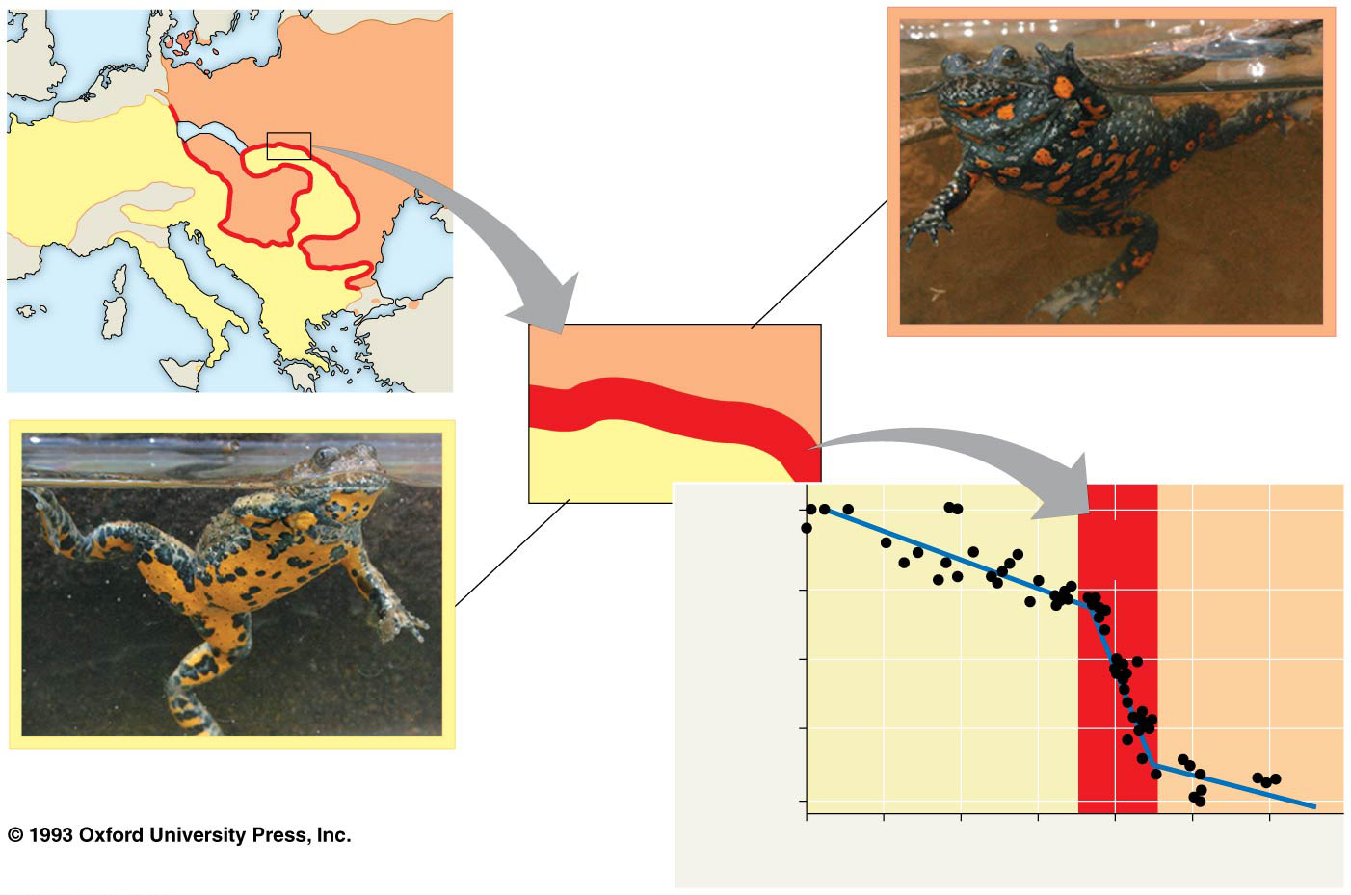
Fire-bellied
toad range
Fire-bellied toad, Bombina
bombina
Hybrid zone
Yellow-bellied
toad range
0.99
Hybrid
zone
0.9
Frequency of
B. variegata-specific allele
Yellow-bellied
toad range
Fire-bellied
toad range
0.5
0.1
Yellow-bellied toad, Bombina
variegata
0.01
40
30
20
10
0
10
20
Distance from hybrid zone center (km)
Notes:
Figure 24.12 A narrow hybrid zone for Bombina toads in Europe

Slide 46
Notes:
A hybrid zone is properly defined as _____.
https://www.polleverywhere.com/multiple_choice_polls/7uGrC5eGinepQWH

Slide 47
Notes:
A narrow hybrid zone separates the toad species Bombina bombina and Bombina variegata. What is true of those alleles that are unique to the parental species?
https://www.polleverywhere.com/multiple_choice_polls/aQLARieAUN5PDOO

Slide 48
Overview
Concept 24.1: The biological species concept emphasizes reproductive isolation
Concept 24.2: Speciation can take place with or without geographic separation
Concept 24.3: Hybrid zones reveal factors that cause reproductive isolation
Concept 24.4: Speciation can occur rapidly or slowly and can result from changes in few or many genes

Slide 49
Concept 24.4: Speciation can occur rapidly or slowly and can result from changes in few or many genes
Many questions remain concerning…
How long it takes for a new species to form?
How many genes need to differ between species?
Broad patterns in speciation can be studied using the fossil record, morphological data, or molecular data

Slide 50
Concept 24.4: Speciation can occur rapidly or slowly
The fossil record includes examples of species that appear suddenly, persist essentially unchanged for some time, and then apparently disappear
Niles Eldredge and Stephen Jay Gould coined the term “punctuated equilibria” to describe periods of apparent stasis punctuated by sudden change
The punctuated equilibrium model contrasts with a gradual model of change in a species over time

Slide 51
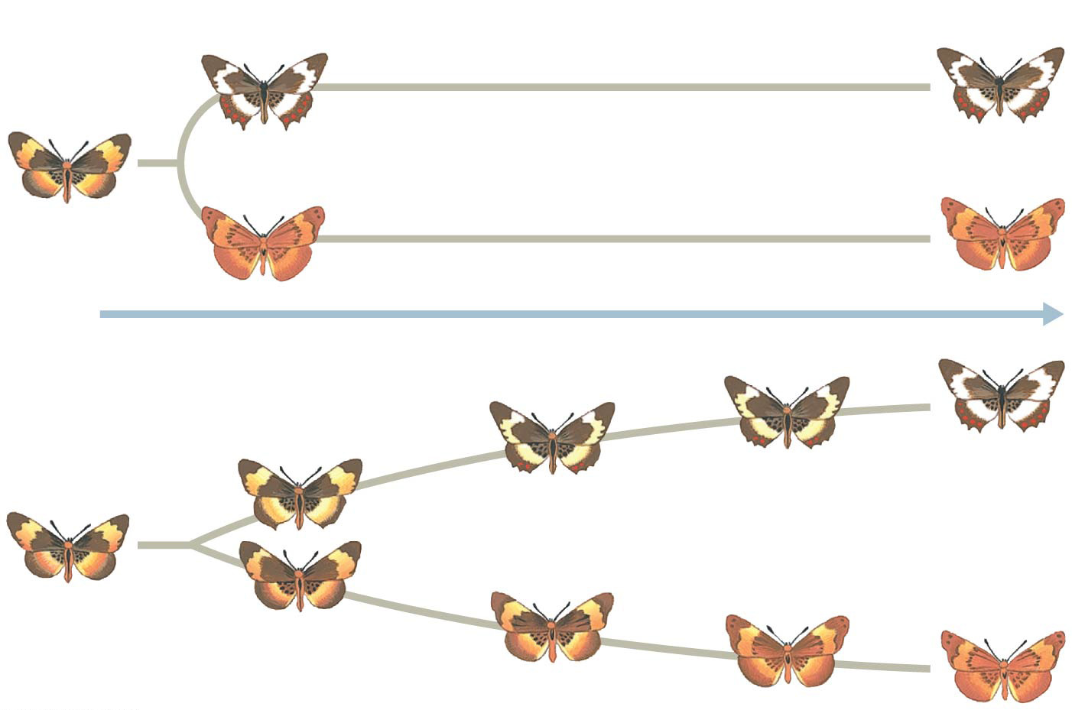
Figure 24.16
(a) Punctuated model
Time
(b) Gradual model
Notes:
Figure 24.16 Two models for the tempo of speciation

Slide 52
Concept 24.4: Speciation can occur rapidly or slowly
The punctuated pattern in the fossil record and evidence from lab studies suggest that speciation can be rapid
Ex: sympatric speciation in plants via polyploidy
The interval between speciation events can range from 4,000 years (some cichlids) to 40 million years (some beetles), with an average of 6.5 million years (remember, change OVER TIME)

Slide 53
Notes:
According to the concept of punctuated equilibrium, the "sudden" appearance of a new species in the fossil record means that _____.
https://www.polleverywhere.com/multiple_choice_polls/4h0O2AbONLSGVIf

Slide 54
Concept 24.4: Speciation can result from changes in few or many genes
A fundamental question of evolutionary biology persists: How many genes change when a new species forms?
Depending on the species in question, speciation might require change in a single gene or many genes
Ex: Japanese Euhadra snails (slide 20) → direction of shell spiral (chirality) affects mating and is controlled by a SINGLE gene
In other organisms, speciation can be influenced by larger numbers of genes and gene interactions

Slide 55
Notes:
Speciation _____.
https://www.polleverywhere.com/multiple_choice_polls/e0ZymvolDxvojf5

Slide 56
Revisiting the “Mystery of Mysteries”
Macroevolution is the cumulative effect of many speciation [and extinction] events leading to the unbelievable DIVERSITY and UNITY of life we see here on planet earth, as so eloquently stated by our friend, Chuck Darwin:
“Endless forms most beautiful”

Slide 57
Notes:
The largest unit within which gene flow can readily occur is _____.
https://www.polleverywhere.com/multiple_choice_polls/dtEHHUQfuISydT6

Slide 58
Overview
Concept 24.1: The biological species concept emphasizes reproductive isolation
Concept 24.2: Speciation can take place with or without geographic separation
Concept 24.3: Hybrid zones reveal factors that cause reproductive isolation
Concept 24.4: Speciation can occur rapidly or slowly and can result from changes in few or many genes

