Slide 1
25
The History of Life on Earth

Slide 2
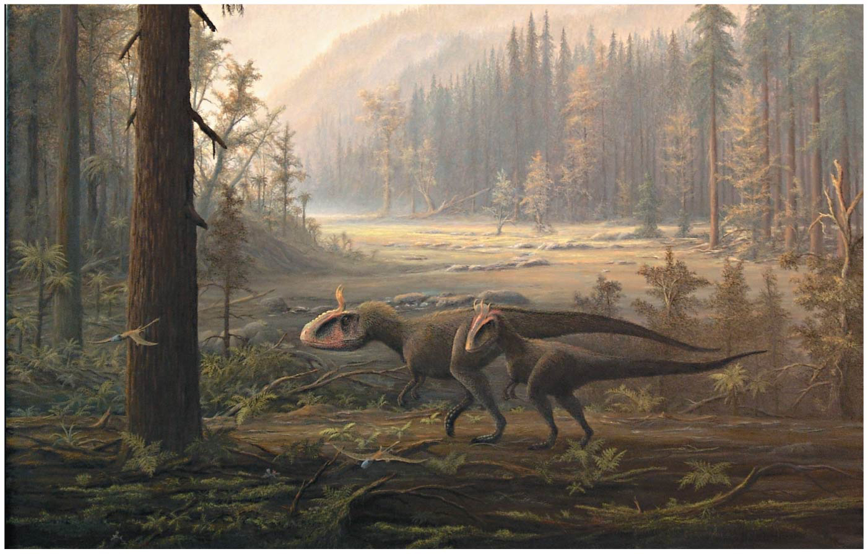
Where dey at?
Notes:
Figure 25.1 On what continent did these dinosaurs roam?

Slide 3
Lost Worlds
Past organisms were very different from those now alive
The fossil record shows macroevolutionary changes over large time scales, for example…
The emergence of terrestrial vertebrates
The impact of mass extinctions
The origin of flight in birds

Slide 4
Overview
Concept 25.1: Conditions on early Earth made the origin of life possible
Concept 25.2: The fossil record documents the history of life
Concept 25.3: Key events in life’s history include the origins of unicellular and multicellular organisms and the colonization of land
Concept 25.4: The rise and fall of groups of organisms reflect differences in speciation and extinction rates
Concepts 25.5 and 25.6 are not required for AP Bio

Slide 5
Overview
Concept 25.1: Conditions on early Earth made the origin of life possible
Concept 25.2: The fossil record documents the history of life
Concept 25.3: Key events in life’s history include the origins of unicellular and multicellular organisms and the colonization of land
Concept 25.4: The rise and fall of groups of organisms reflect differences in speciation and extinction rates

Slide 6
Concept 25.1: Conditions on early Earth made the origin of life possible
Chemical and physical processes on early Earth may have produced very simple, primitive cells through a sequence of stages:
ABIOTIC synthesis of small organic molecules
JOINING of these small molecules into macromolecules
PACKAGING of molecules into protocells
Origin of self-replicating molecules

Slide 7
Concept 25.1: Conditions on early Earth made the origin of life possible – 1. Organic Molecules
1. Synthesis of Organic Molecules on Early Earth
Earth formed about 4.6 billion years ago (along with the rest of our solar system)
Earth’s early atmosphere likely contained…
Lots of energy (thunderstorms, lightning, meteors)
Water vapor
Chemicals released by violent volcanic eruptions
Nitrogen, nitrogen oxides, carbon dioxide, methane, ammonia, hydrogen

Slide 8
Concept 25.1: Conditions on early Earth made the origin of life possible – 1. Organic Molecules
1. Synthesis of Organic Molecules on Early Earth
In the 1920s, Oparin and Haldane hypothesized that the early atmosphere was a REDUCING environment (as opposed to an oxidizing atmosphere)
In 1953, Miller and Urey conducted lab experiments that definitively showed that the ABIOTIC (“without life”) synthesis of organic molecules in a REDUCING atmosphere IS indeed possible!
The work by Miller-Urey and Oparin-Haldane helped develop the “organic soup” hypothesis

Slide 9
Notes:
How were conditions on the early Earth of more than three billion years ago different from those on today's Earth? Unlike Earth today, early Earth _____.
https://www.polleverywhere.com/multiple_choice_polls/vt42AFk1O8S1Of1

Slide 10
Concept 25.1: Conditions on early Earth made the origin of life possible – 2. Macromolecules
2. Abiotic Synthesis of Macromolecules
RNA monomers have been produced SPONTANEOUSLY from simple molecules suggesting a similar origination on early earth
Small organic molecules polymerize (fuse/bond together) when they are concentrated on hot sand, clay, or rock
This is most likely how MACROmolecules were first “built” or synthesized on early earth

Slide 11
Concept 25.1: Conditions on early Earth made the origin of life possible – 3. Protocells
3. Protocells
Replication and metabolism are key properties of life and may have appeared together in protocells
Protocells may have formed from fluid-filled vesicles with a membrane-like structure
In water, lipids and other organic molecules can SPONTANEOUSLY form vesicles with a lipid bilayer

Slide 12
Notes:
Which of the following is a defining characteristic that all protocells had in common?
https://www.polleverywhere.com/multiple_choice_polls/42rQYy3MkuChCWa

Slide 13
Concept 25.1: Conditions on early Earth made the origin of life possible – 4. RNA
4. The Origin of Self-Replicating RNA
The first genetic material was probably RNA, NOT DNA
RNA molecules called ribozymes have been found to catalyze (speed up, lower E_{A}) many different reactions
For example, ribozymes can make complementary copies of short stretches of RNA (aka they are self-replicating)

Slide 14
Concept 25.1: Conditions on early Earth made the origin of life possible – 4. RNA
4. The Origin of Self-Replicating RNA
RNA molecules that were more stable or replicated more quickly would have left the most descendant RNA molecules (quasi-evo?)
The early genetic material might have formed an “RNA world”
Vesicles containing RNA capable of replication would have been protocells
RNA could have provided the template for DNA, a more stable genetic material

Slide 15
Notes:
The first genetic material on Earth was probably _____.
https://www.polleverywhere.com/multiple_choice_polls/NK87YcUGGe4nbzb

Slide 16
Notes:
Which of the following is the correct sequence of events in the origin of life? I. formation of protobionts II. synthesis of organic monomers III. synthesis of organic polymers IV. formation of DNA-based genetic systems
https://www.polleverywhere.com/multiple_choice_polls/LDDsKgACkB7czNN

Slide 17
Overview
Concept 25.1: Conditions on early Earth made the origin of life possible
Concept 25.2: The fossil record documents the history of life
Concept 25.3: Key events in life’s history include the origins of unicellular and multicellular organisms and the colonization of land
Concept 25.4: The rise and fall of groups of organisms reflect differences in speciation and extinction rates

Slide 18
Concept 25.2: The fossil record documents the history of life
The fossil record reveals CHANGES in the history of life on Earth (this heavily supports Darwin’s theory of evolution)
Sedimentary rocks are deposited into layers called strata and are the richest source of fossils
The fossil record shows changes in kinds of organisms on Earth over time

Slide 19
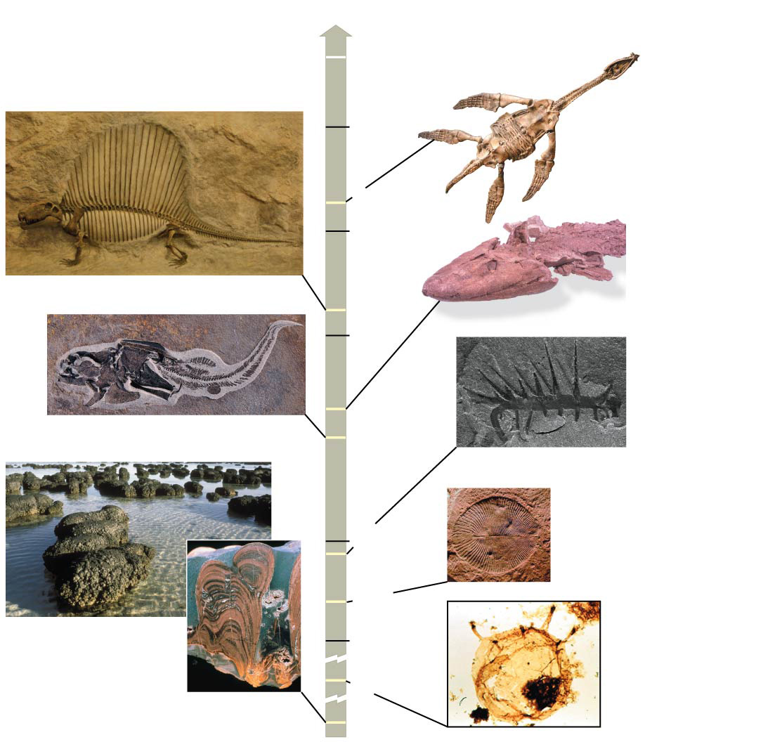
Figure 25.5
Present
1 m
100
mya
Rhomaleosaurus
victor
175
200
0.5 m
Dimetrodon
Tiktaalik
270
300
4.5 cm
375
Coccosteus cuspidatus
400
1 cm
Hallucigenia
500
Dickinsonia
costata
2.5 cm
510
560
Stromatolites
600
1,500
3,500
Tappania
Notes:
Figure 25.5 Documenting the history of life

Slide 20
Overview
Concept 25.1: Conditions on early Earth made the origin of life possible
Concept 25.2: The fossil record documents the history of life
Concept 25.3: Key events in life’s history include the origins of unicellular and multicellular organisms and the colonization of land
Concept 25.4: The rise and fall of groups of organisms reflect differences in speciation and extinction rates

Slide 21
Concept 25.3: Key events in life’s history include the origins of unicellular organisms
The First Single-Celled Organisms
The oldest known fossils are stromatolites, rocks formed by the accumulation of sedimentary layers on bacterial mats
Stromatolites date back 3.5 billion years ago (this is best estimate for the true origin of life)
Prokaryotes were Earth’s first and sole living inhabitants for more than 1.5 billion years

Slide 22
Concept 25.3: Key events in life’s history include the origins of unicellular organisms
Photosynthesis and the Oxygen Revolution
Most atmospheric oxygen (O₂) is of biological (living/biotic) origin
O₂ produced by oxygenic photosynthesis reacted with dissolved iron and precipitated out to form banded iron formations
By about 2.7 billion years ago, O₂ began accumulating in the atmosphere and rusting iron-rich terrestrial rocks

Slide 23
Concept 25.3: Key events in life’s history include the origins of unicellular organisms
Photosynthesis and the Oxygen Revolution
This all caused the “oxygen revolution” (great band name btw) from 2.7 to 2.3 billion years ago
Extinction of MANY prokaryotes that could NOT adapt to increased atmospheric O₂ levels (evolutionary Losers!)
Some groups survived, thrived and ADAPTED using cellular respiration to harvest energy (evolutionary winners!)
Many biologists consider this the biggest “moment” in the history of life!

Slide 24
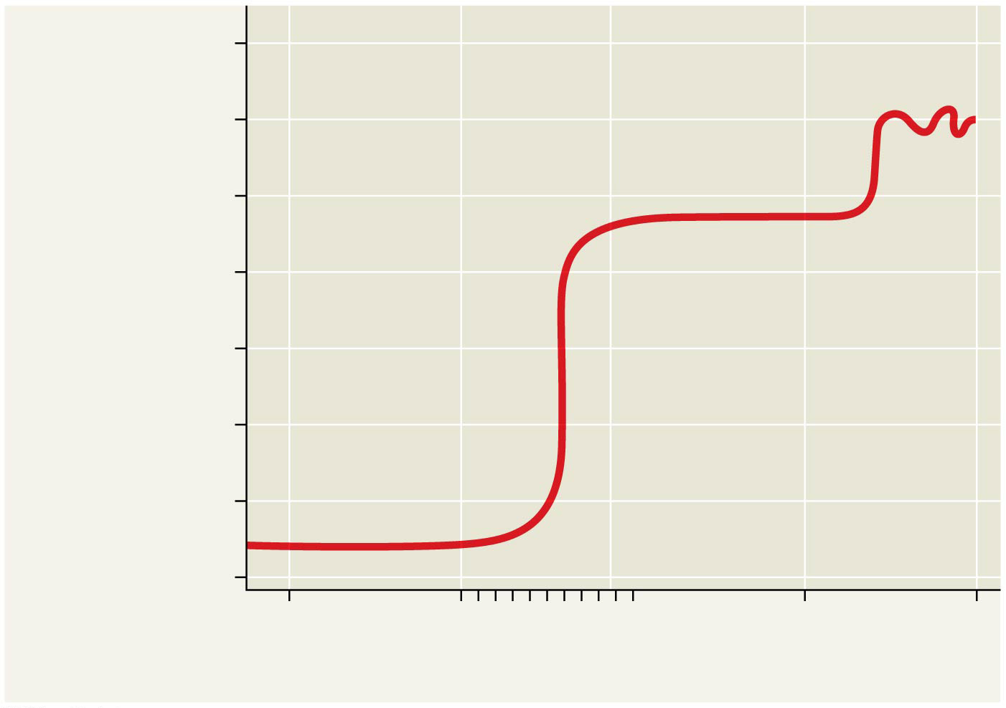
Figure 25.9
1,000
100
10
Atmospheric O₂
(percent of present-day levels;
log scale)
1
0.1
“Oxygen
revolution”
0.01
0.001
0.0001
4
3
2
1
0
Time (billions of years ago)
Notes:
Figure 25.9 The rise of atmospheric oxygen

Slide 25
Concept 25.3: Key events in life’s history include the origins of eukaryotes
The First Eukaryotes
The oldest fossils of eukaryotic cells date back 1.8 billion years
The endosymbiont theory proposes that mitochondria and plastids (chloroplasts and related organelles) were FORMERLY small prokaryotes living within larger host cells
An endosymbiont is a cell that lives WITHIN a host cell

Slide 26
Concept 25.3: Key events in life’s history include the origins of eukaryotes
The First Eukaryotes
The prokaryotic ancestors of mitochondria and plastids probably gained entry to the host cell as undigested prey or internal parasites
In the process of becoming more interdependent, the host and endosymbionts would have become a single organism

Slide 27
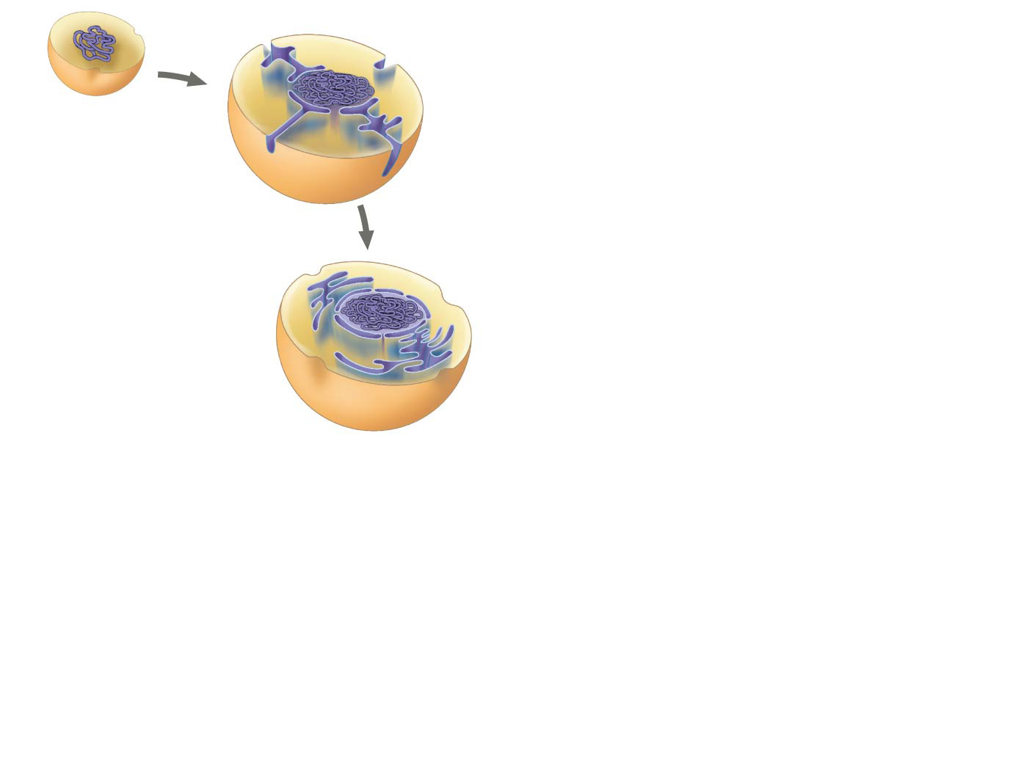
Figure 25.10-1
Cytoplasm
DNA
Ancestral
prokaryote
Plasma
membrane
Nucleus
Endoplasmic
reticulum
Nuclear
envelope
Notes:
Figure 25.10-1 A hypothesis for the origin of eukaryotes through serial endosymbiosis (step 1)

Slide 28
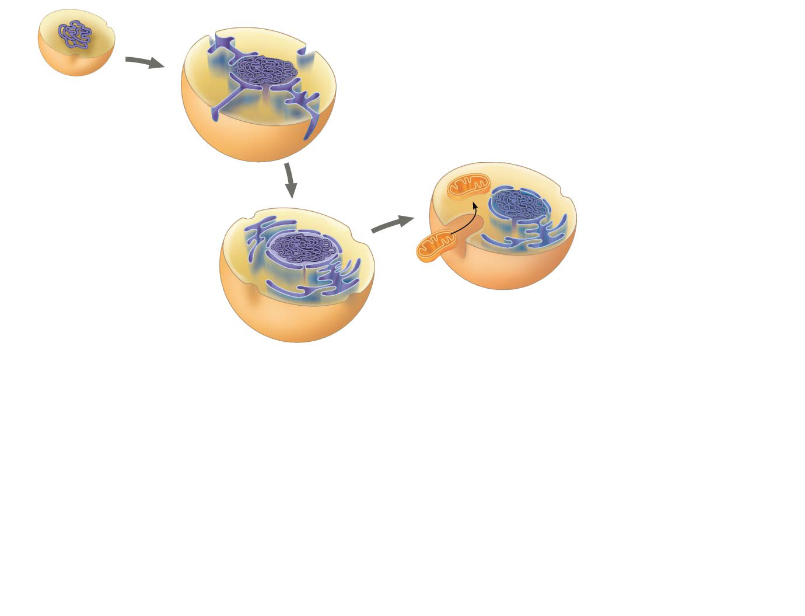
Figure 25.10-2
Cytoplasm
DNA
Ancestral
prokaryote
Engulfed
aerobic
bacterium
Plasma
membrane
Nucleus
Endoplasmic
reticulum
Nuclear
envelope
Notes:
Figure 25.10-2 A hypothesis for the origin of eukaryotes through serial endosymbiosis (step 2)

Slide 29
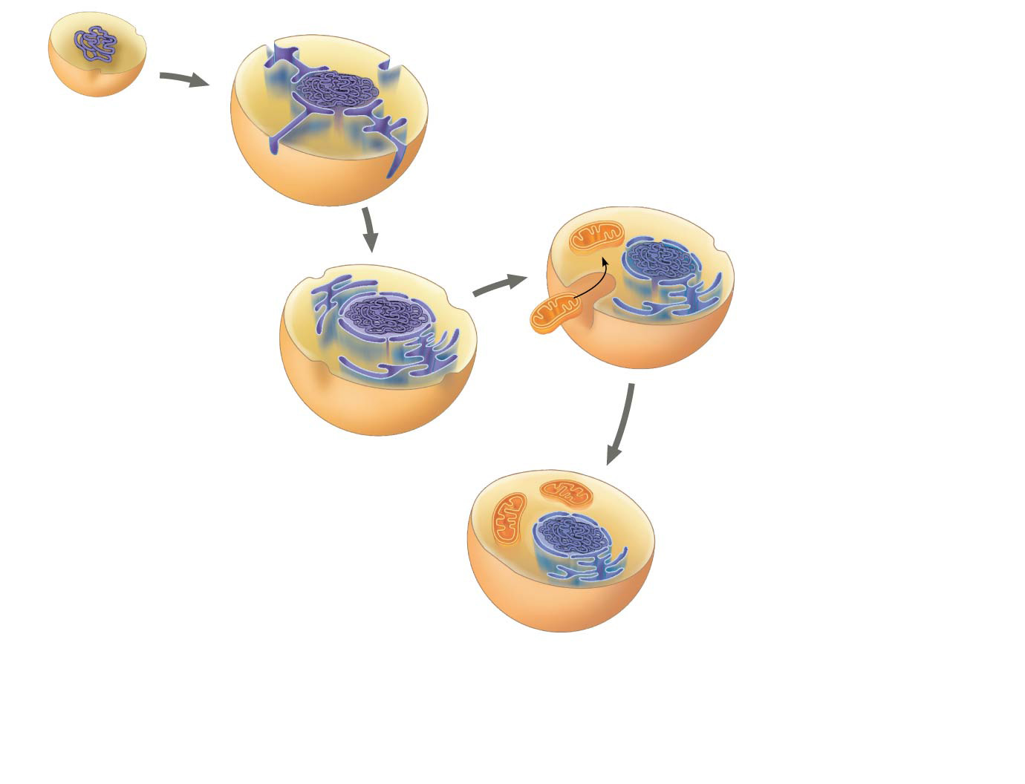
Figure 25.10-3
Cytoplasm
DNA
Ancestral
prokaryote
Engulfed
aerobic
bacterium
Plasma
membrane
Nucleus
Endoplasmic
reticulum
Nuclear
envelope
Mitochondrion
Ancestral
heterotrophic
eukaryote
Notes:
Figure 25.10-3 A hypothesis for the origin of eukaryotes through serial endosymbiosis (step 3)

Slide 30
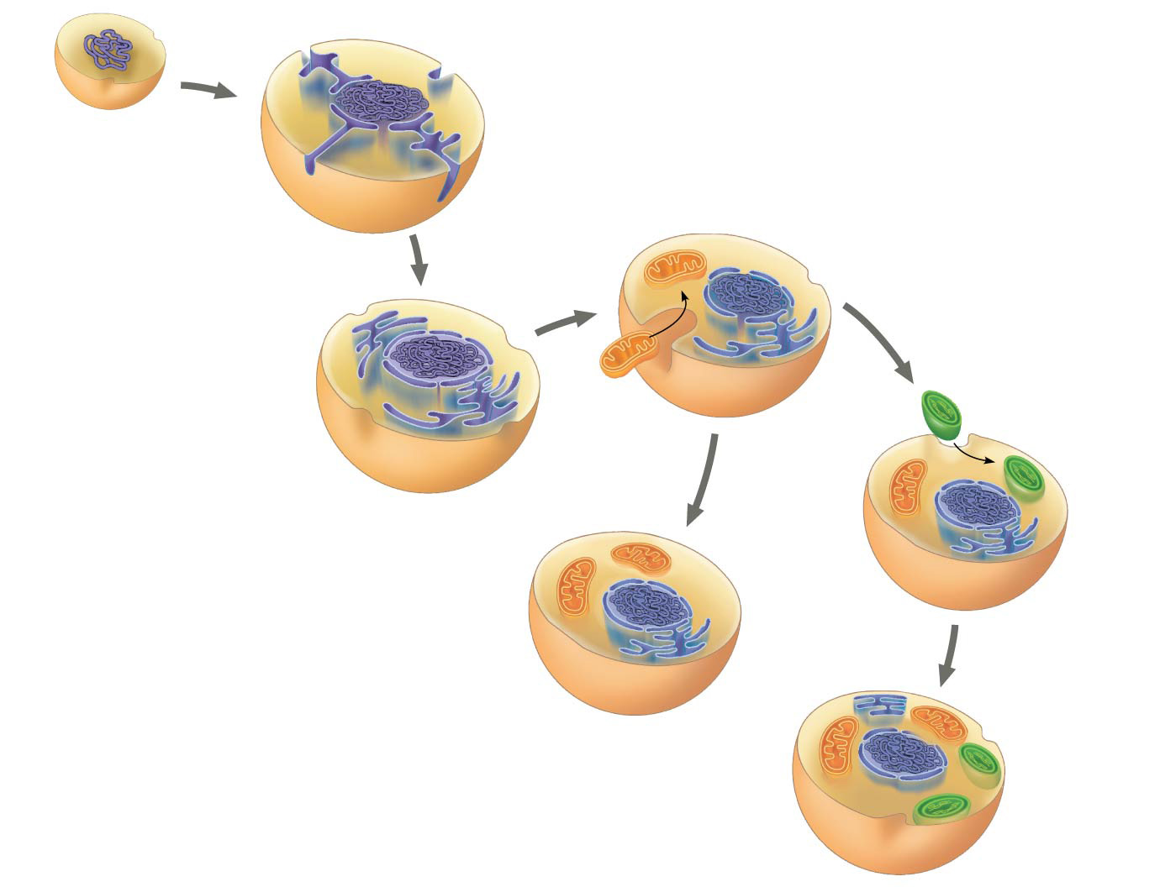
Figure 25.10-4
Cytoplasm
DNA
Ancestral
prokaryote
Engulfed
aerobic
bacterium
Plasma
membrane
Nucleus
Endoplasmic
reticulum
Engulfed
photo-
synthetic
bacterium
Nuclear
envelope
Mitochondrion
Mito- chondrion
Ancestral
heterotrophic
eukaryote
Plastid
Ancestral
photosynthetic
eukaryote
Notes:
Figure 25.10-4 A hypothesis for the origin of eukaryotes through serial endosymbiosis (step 4)

Slide 31
Concept 25.3: Key events in life’s history include the origins of eukaryotes
Key evidence supports the endosymbiotic origin of mitochondria and plastids
Inner membranes are similar to plasma membranes of prokaryotes
Division and DNA structure is similar in these organelles and some prokaryotes
These organelles transcribe and translate their own DNA
Their ribosomes are more similar to prokaryotic than eukaryotic ribosomes

Slide 33
Concept 25.3: Key events in life’s history include the origins of multicellularity
The evolution of eukaryotic cells allowed for a greater range of unicellular forms
A second wave of diversification occurred when multicellularity evolved and gave rise to algae, plants, fungi, and animals about 1.2 billion years ago
The Cambrian explosion refers to the sudden appearance of fossils resembling modern animal phyla in the Cambrian period (535 to 525 million years ago)

Slide 34
Concept 25.3: Key events in life’s history include the colonization of land
Fungi, plants, and animals began to colonize land about 500 million years ago
Plants and fungi likely colonized land together
Arthropods and tetrapods are the most widespread and diverse land animals
Tetrapods evolved from lobe-finned fishes around 365 million years ago
The human lineage of tetrapods evolved around 6–7 million years ago, and modern humans originated only 195,000 years ago

Slide 35
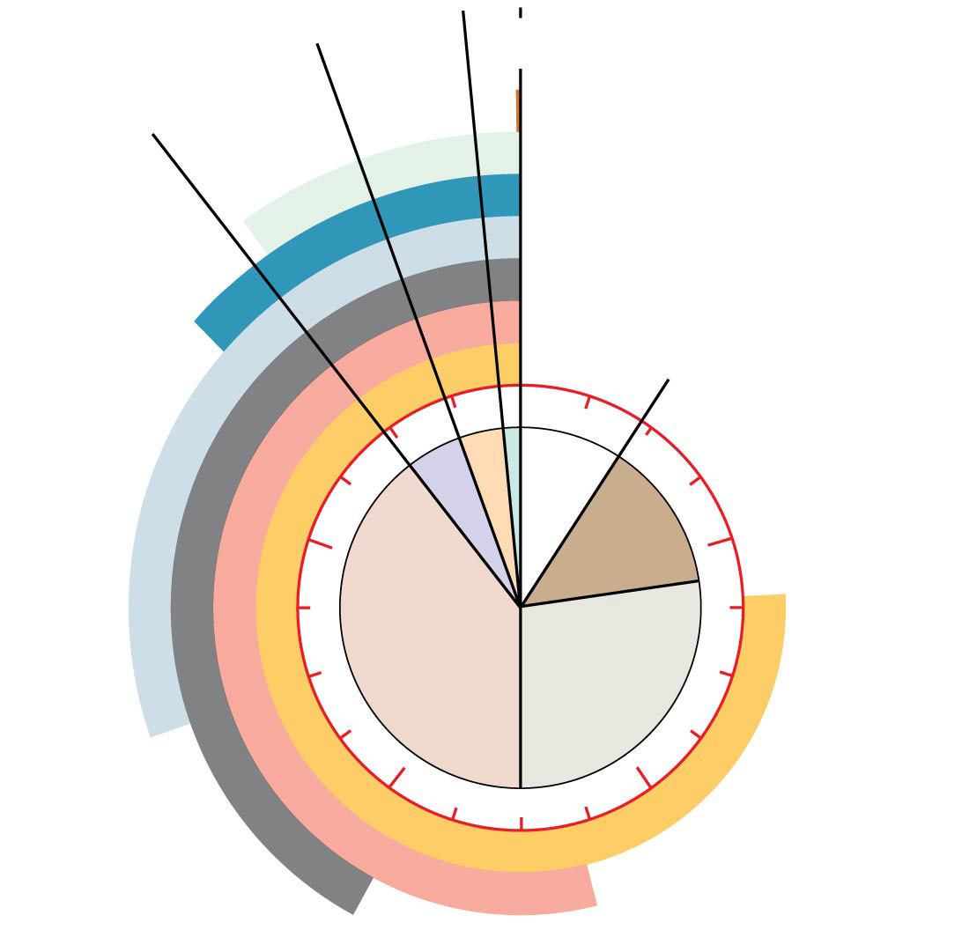
Major boundaries between eras correspond to major extinction events in the fossil record
Humans
Colonization
of land
Animals
Origin of solar
system and
Earth
1
4
Hadean
Proterozoic
Archaean
2
3
Multicellular
eukaryotes
Prokaryotes
Single-celled
eukaryotes
Atmospheric oxygen
Notes:
Figure 25.8-3 Clock analogy for some key events in Earth’s history (step 3)

Slide 36
Notes:
What is thought to be the correct sequence of these events, from earliest to most recent, in the evolution of life on Earth? 1. origin of mitochondria 2. origin of multicellular eukaryotes 3. origin of chloroplasts 4. origin of cyanobacteria 5. origin of fungal-plant symbioses
https://www.polleverywhere.com/multiple_choice_polls/R0167L11SyFgleB

Slide 37
Notes:
Which of these observations gives the most support to the endosymbiotic theory for the origin of eukaryotic cells?
https://www.polleverywhere.com/multiple_choice_polls/i4c3yjvWOIIjWcS

Slide 38
Overview
Concept 25.1: Conditions on early Earth made the origin of life possible
Concept 25.2: The fossil record documents the history of life
Concept 25.3: Key events in life’s history include the origins of unicellular and multicellular organisms and the colonization of land
Concept 25.4: The rise and fall of groups of organisms reflect differences in speciation and extinction rates

Slide 39
Concept 25.4: The rise and fall of groups of organisms reflect differences in speciation and extinction rates
The history of life on Earth has seen the rise and fall of many groups of organisms
The rise and fall of groups depends on speciation and extinction rates within the group

Slide 40
Concept 25.4: The rise and fall of groups of organisms reflect differences in speciation and extinction rates
Mass Extinctions
The fossil record shows that most species that have ever lived are now extinct
Extinction can be caused by changes to a species’ environment
At times, the rate of extinction has increased dramatically and caused a mass extinction
Mass extinction is the result of disruptive global environmental changes

Slide 41
Concept 25.4: The rise and fall of groups of organisms reflect differences in speciation and extinction rates
Adaptive radiation is the rapid evolution of diversely adapted species from a common ancestor
Adaptive radiations may arise after…
Mass extinctions
The evolution of novel characteristics
The colonization of new regions

Slide 42
Concept 25.4: The rise and fall of groups of organisms reflect differences in speciation and extinction rates
Mammals underwent an adaptive radiation after the extinction of terrestrial dinosaurs
The disappearance of dinosaurs (except birbs) allowed for the expansion of mammals in diversity and size
Other notable radiations include photosynthetic prokaryotes, large predators in the Cambrian, land plants, insects, and tetrapods

Slide 43
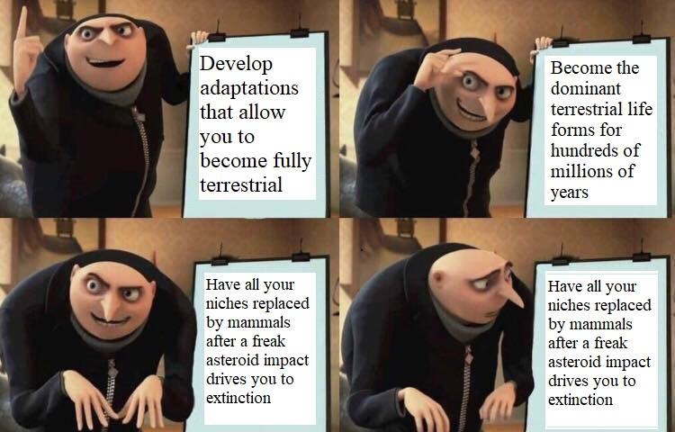

Slide 44
Overview
Concept 25.1: Conditions on early Earth made the origin of life possible
Concept 25.2: The fossil record documents the history of life
Concept 25.3: Key events in life’s history include the origins of unicellular and multicellular organisms and the colonization of land
Concept 25.4: The rise and fall of groups of organisms reflect differences in speciation and extinction rates

Slide 45
WATCH
https://www.youtube.com/watch?v=xuCn8ux2gbs
https://www.youtube.com/watch?v=sjE-Pkjp3u4
https://www.youtube.com/watch?v=VYQQD0KNOis
https://www.youtube.com/watch?v=9i7kAt97XYU
https://www.youtube.com/watch?v=dO2xx-aeZ4w

Slide 46
Summary: There are several hypotheses about the natural origin of life on Earth, each with supporting scientific evidence.
Early earth provided inorganic (abiotic) precursors from which organic molecules could have been synthesized due to the presence of available free energy and the ABSENCE of a significant quantity of oxygen (aka reducing atmosphere).
In turn, these organic molecules served as monomers or building blocks for the formation of more complex macromolecules, including amino acids and nucleotides.

Slide 47
Summary: There are several hypotheses about the natural origin of life on Earth, each with supporting scientific evidence.
The joining of these monomers produced polymers with the ability to self-replicate, store and transfer information.
These complex reaction sets could have occurred in solution (organic soup model) or as reactions on solid reactive surfaces like clay.
The RNA World hypothesis proposes that RNA could have been the earliest genetic material, not DNA.

Slide 48
Summary: Scientific evidence from many different disciplines supports models of the origin of life.
Geological evidence provides support for models of the origin of life on Earth.
The Earth formed approximately 4.6 billion years ago (bya), and the environment was too hostile for life until 3.9 bya, while the earliest fossil evidence for life dates to 3.5 bya.
Taken together, this evidence provides a plausible range of dates when the origin of life could have occurred.
Chemical experiments have shown that it is possible to form complex organic molecules from inorganic molecules in the absence of life (abiotic synthesis).

Slide 49
Summary: Scientific evidence from many different disciplines supports models of the origin of life.
Molecular and genetic evidence from extant and extinct organisms indicates that all organisms on Earth share a common ancestral origin of life.
Scientific evidence includes molecular building blocks that are common to all life forms.
Scientific evidence includes a common genetic code.

Slide 50
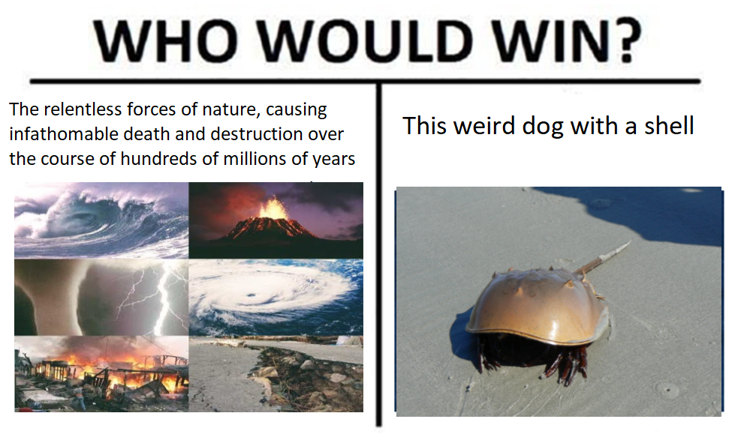
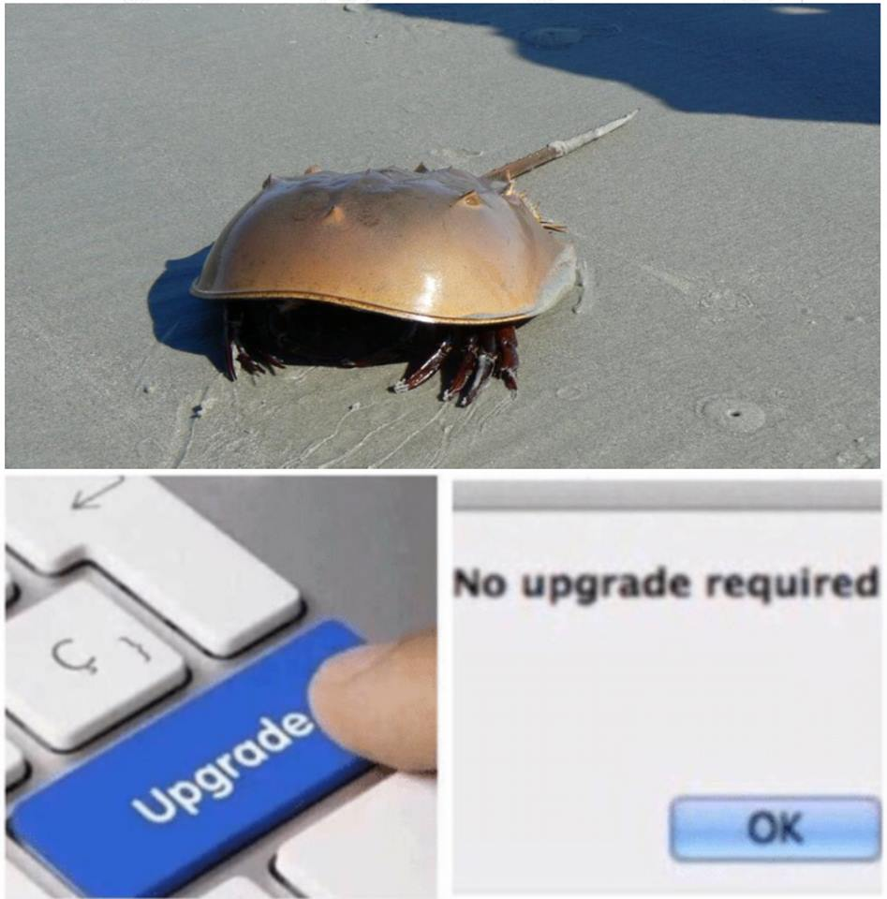

Slide 51
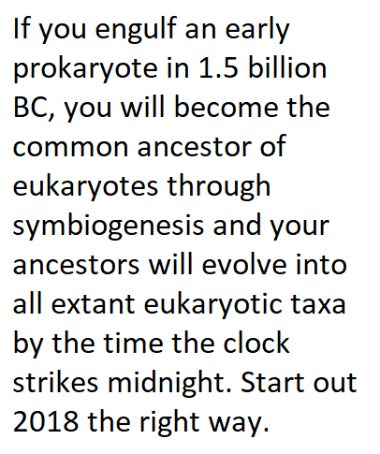
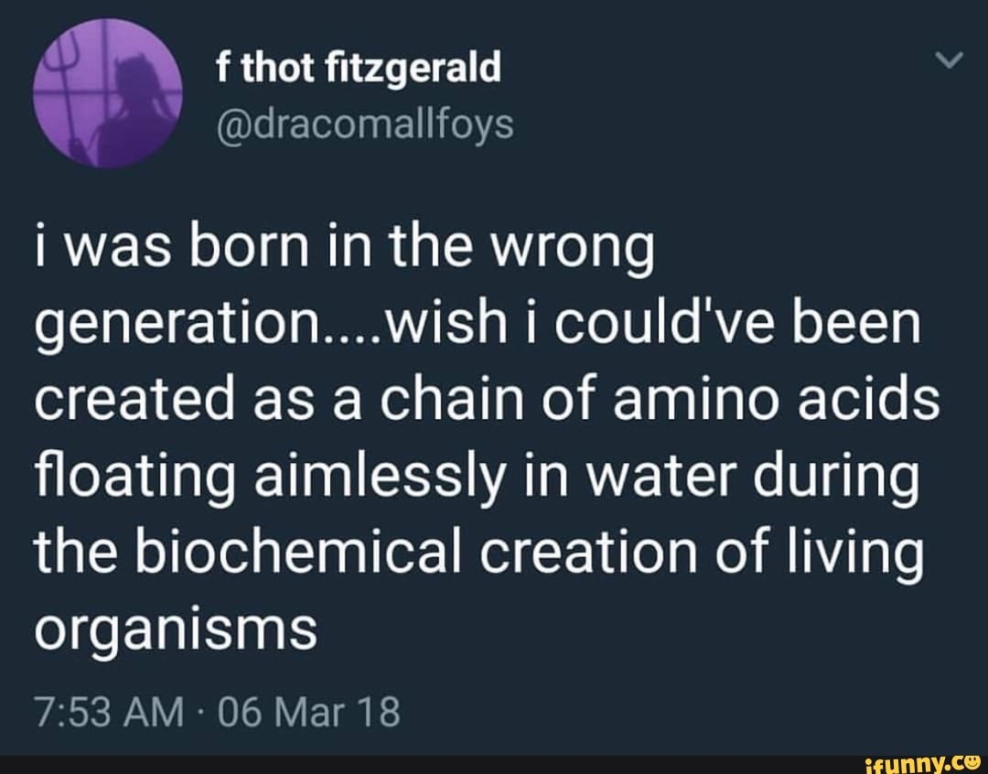

Slide 52
