Slide 1
27
Bacteria and Archaea

Slide 2
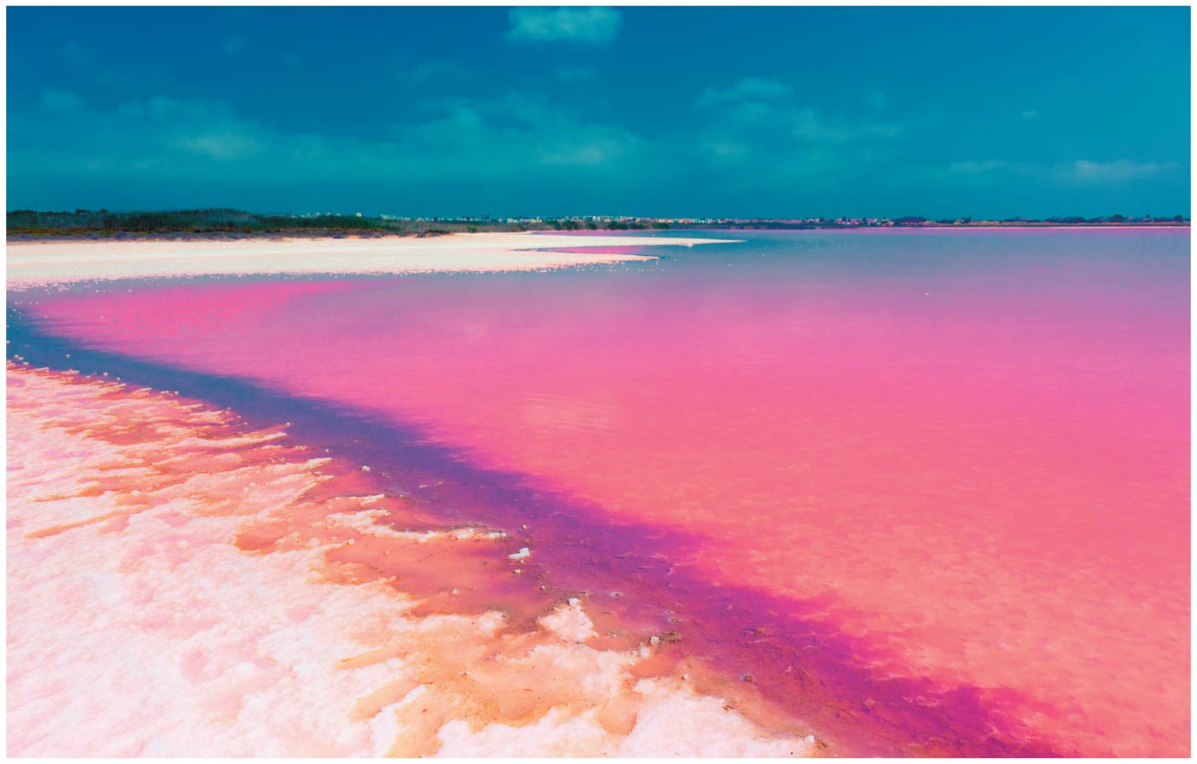
Why is this lake’s water pink?
Notes:
Figure 27.1 Why is this lake’s water pink? Utah’s Great Salt Lake can reach a salt concentration of 32% → its pink color comes from living prokaryotes

Slide 3
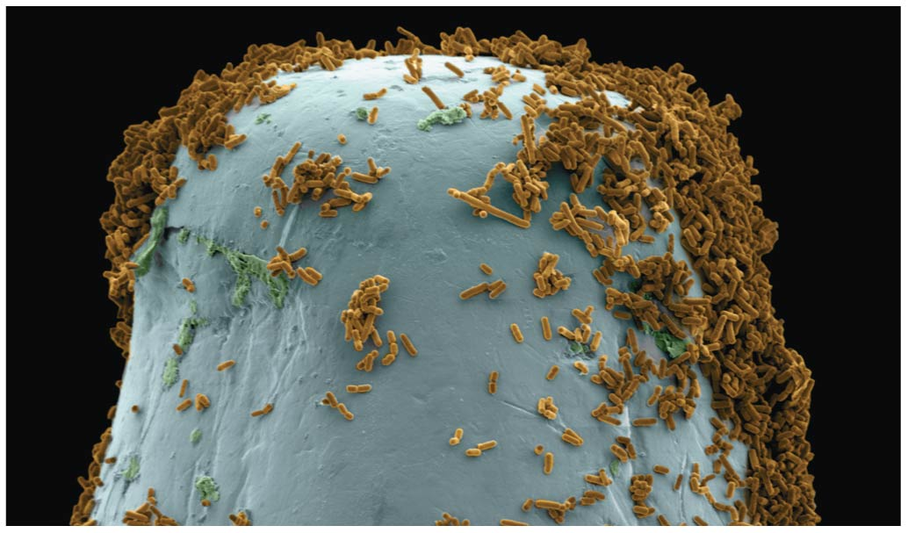
Bacteria on head of pin
Notes:
Figure 27.UN06 Test your understanding, question 10 (head of a pin)

Slide 4
Prokaryotes…Masters of Adaptation
Utah’s Great Salt Lake can reach a salt concentration of 32% → its pink color comes from living prokaryotes
Prokaryotes thrive almost EVERYWHERE, including places too acidic, salty, cold, or hot for most other organisms
Most prokaryotes are microscopic, but what they lack in size, they make up for in numbers
There are more in a handful of fertile soil than the number of people who have EVER lived! (WOW)
Prokaryotes are divided into two domains: bacteria and archaea

Slide 5
Overview
Concept 27.1: Structural and functional adaptations contribute to prokaryotic success
Concept 27.2: Rapid reproduction, mutation, and genetic recombination promote genetic diversity in prokaryotes
Concept 27.3: Diverse nutritional and metabolic adaptations have evolved in prokaryotes
Concept 27.4: Prokaryotes have radiated into a diverse set of lineages
Concept 27.5: Prokaryotes play crucial roles in the biosphere
Concept 27.6: Prokaryotes have both beneficial and harmful impacts on humans

Slide 6
Overview
Concept 27.1: Structural and functional adaptations contribute to prokaryotic success
Concept 27.2: Rapid reproduction, mutation, and genetic recombination promote genetic diversity in prokaryotes
Concept 27.3: Diverse nutritional and metabolic adaptations have evolved in prokaryotes
Concept 27.4: Prokaryotes have radiated into a diverse set of lineages
Concept 27.5: Prokaryotes play crucial roles in the biosphere
Concept 27.6: Prokaryotes have both beneficial and harmful impacts on humans

Slide 7
Concept 27.1: Structural and functional adaptations contribute to prokaryotic success
Earth’s first organisms were likely prokaryotes
Most prokaryotes are unicellular, although some species form colonies
Most prokaryotic cells are 0.5–5 µm, much smaller than the 10–100 µm of many eukaryotic cells
Prokaryotic cells have a variety of shapes
The three most common shapes are spheres (cocci), rods (bacilli), and spirals

Slide 8
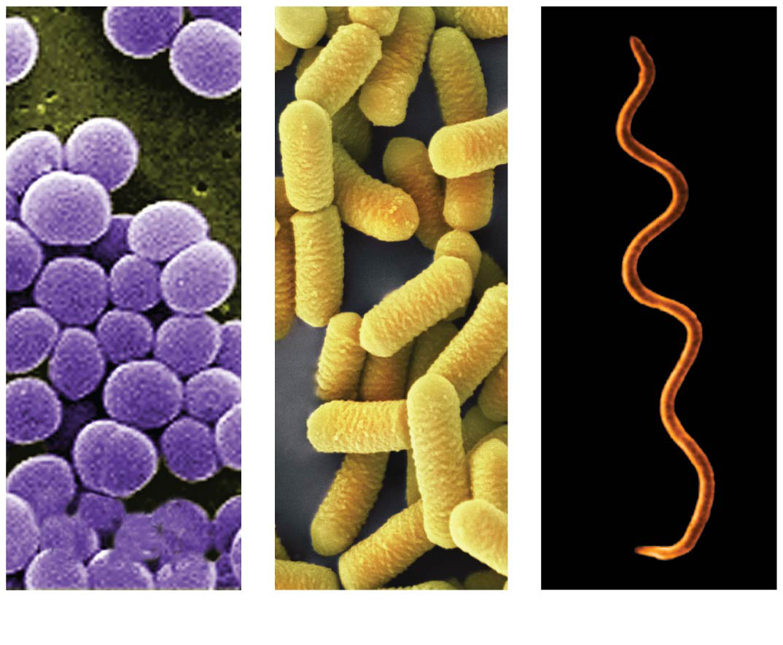
Figure 27.2
1 µm
1 µm
3 µm
(a)
Spherical
(b)
Rod-shaped
(c)
Spiral
Notes:
Figure 27.2 The most common shapes of prokaryotes

Slide 9
Concept 27.1: Structural and functional adaptations contribute to prokaryotic success
Motility (movement)
Many bacteria exhibit taxis, the ability to move toward or away from a stimulus
Chemotaxis is the movement toward or away from a CHEMICAL stimulus
Most motile bacteria propel themselves by flagella scattered about the surface or concentrated at one or both ends

Slide 10
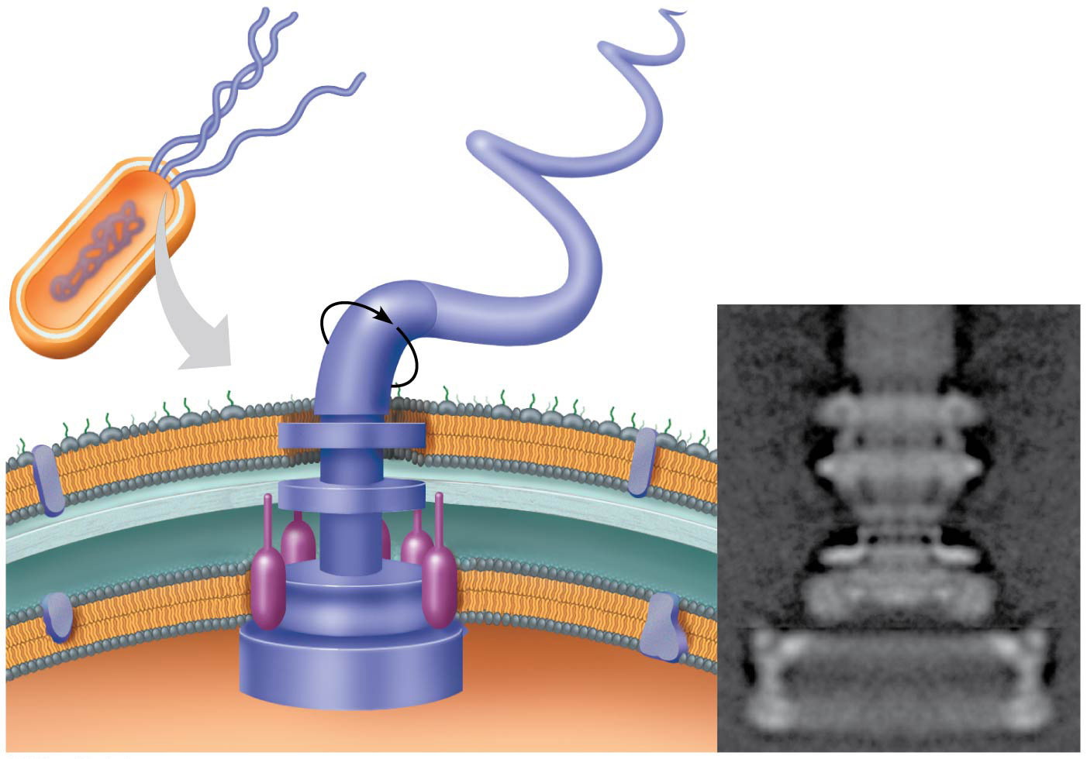
Figure 27.7
Flagellum
Filament
20 nm
Hook
Cell wall
Motor
Plasma
membrane
Peptidoglycan
layer
Rod
Notes:
Figure 27.7 A prokaryotic flagellum

Slide 11
Concept 27.1: Structural and functional adaptations contribute to prokaryotic success
Internal Organization
Prokaryotic cells usually LACK complex compartmentalization
Some prokaryotes have specialized membranes that perform metabolic functions
These are usually infoldings of the plasma membrane (sort of like cristae in mitochondria)

Slide 12
Concept 27.1: Structural and functional adaptations contribute to prokaryotic success
Prokaryotic Genomes
The prokaryotic genome has LESS DNA than the eukaryotic genome
Most of the genome consists of a CIRCULAR chromosome
The chromosome is NOT surrounded by a membrane; it is located in the nucleoid region
Some species of bacteria also have smaller rings of DNA called plasmids

Slide 13
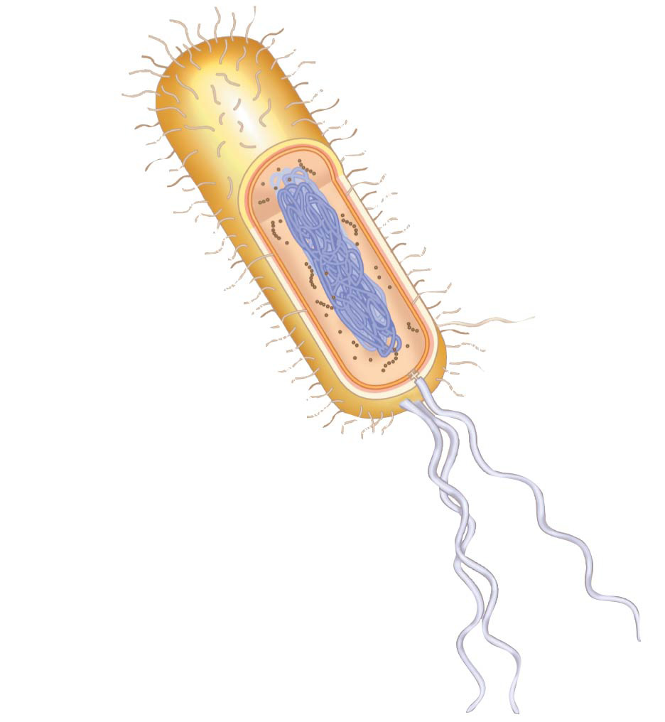
Fimbriae
Cell wall
Circular
chromosome
Capsule
Sex pilus
Internal
organization
Flagella
Notes:
Figure 27.UN04 Summary of key concepts: prokaryote adaptations

Slide 14
Overview
Concept 27.1: Structural and functional adaptations contribute to prokaryotic success
Concept 27.2: Rapid reproduction, mutation, and genetic recombination promote genetic diversity in prokaryotes
Concept 27.3: Diverse nutritional and metabolic adaptations have evolved in prokaryotes
Concept 27.4: Prokaryotes have radiated into a diverse set of lineages
Concept 27.5: Prokaryotes play crucial roles in the biosphere
Concept 27.6: Prokaryotes have both beneficial and harmful impacts on humans

Slide 15
Concept 27.2: Rapid reproduction, mutation, and genetic recombination promote genetic diversity in prokaryotes
Prokaryotes reproduce quickly by binary fission and can divide EXPONENTIALLY every 1–3 hours
Key features of prokaryotic reproduction
Offspring are small
They reproduce by binary fission
They have short generation times

Slide 16
Concept 27.2: Rapid reproduction, mutation, and genetic recombination promote genetic diversity in prokaryotes
Prokaryotes have considerable genetic variation
Three factors contribute to this genetic diversity
Rapid reproduction
Mutation
Genetic recombination

Slide 17
Concept 27.2: Rapid reproduction and mutation promote genetic diversity in prokaryotes
Prokaryotes asexually reproduce by binary fission
Offspring cells are generally IDENTICAL
Mutation rates during binary fission are low, but because of RAPID reproduction, mutations can ACCUMULATE rapidly in a population
Combine mutation rates with short generation times and you get PROLIFIC prokaryotic evolution
Prokaryotes are NOT “primitive”… they are HIGHLY evolved over BILLIONS of years!!!

Slide 18
Concept 27.2: Genetic recombination promotes genetic diversity in prokaryotes
Genetic recombination = COMBINING of DNA from two sources leads to widespread genetic diversity amongst prokaryotes
Movement of genes among individuals from different species = horizontal gene transfer (HGT)

Slide 19
Concept 27.2: Genetic recombination promotes genetic diversity in prokaryotes
Prokaryotic DNA from DIFFERENT individuals can be brought together by different types of HGT:
Transformation = prokaryotic cell takes up and incorporates foreign DNA from the surrounding environment
Transduction = the movement of genes between bacteria by bacteriophages (viruses that infect bacteria)
Conjugation = one-way transfer of genetic material between prokaryotic cells via sex pillus

Slide 20
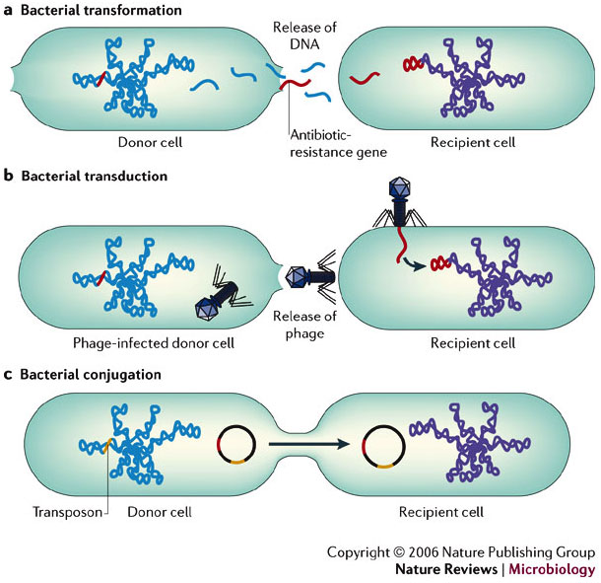
HGT
Sex pilus
1 µm
Notes:
Figure 27.12 Bacterial conjugation

Slide 21
Notes:
In a hypothetical situation, the genes for sex pilus construction and for tetracycline resistance are located on the same plasmid within a particular bacterium. If this bacterium readily performs conjugation involving a copy of this plasmid, then the result should be the _____.
https://www.polleverywhere.com/multiple_choice_polls/n4ku9cMmdIBVlFe

Slide 22
Notes:
Which of the following is LEAST associated with the others?
https://www.polleverywhere.com/multiple_choice_polls/U9ZyvZtdXKGEdCZ

Slide 23
Overview
Concept 27.1: Structural and functional adaptations contribute to prokaryotic success
Concept 27.2: Rapid reproduction, mutation, and genetic recombination promote genetic diversity in prokaryotes
Concept 27.3: Diverse nutritional and metabolic adaptations have evolved in prokaryotes
Concept 27.4: Prokaryotes have radiated into a diverse set of lineages
Concept 27.5: Prokaryotes play crucial roles in the biosphere
Concept 27.6: Prokaryotes have both beneficial and harmful impacts on humans

Slide 24
Concept 27.3: Diverse nutritional and metabolic adaptations have evolved in prokaryotes
Prokaryotes can be categorized by how they obtain energy and carbon
Phototrophs obtain energy from LIGHT
Chemotrophs obtain energy from CHEMICALS
Autotrophs require CO₂ as a carbon source
Heterotrophs require an ORGANIC NUTRIENT (ex. glucose) to make organic compounds

Slide 25
Notes:
Biologists sometimes divide living organisms into two groups: autotrophs and heterotrophs. These two groups differ in _____.
https://www.polleverywhere.com/multiple_choice_polls/mh5DeCeDybxjoKC

Slide 26
Overview
Concept 27.1: Structural and functional adaptations contribute to prokaryotic success
Concept 27.2: Rapid reproduction, mutation, and genetic recombination promote genetic diversity in prokaryotes
Concept 27.3: Diverse nutritional and metabolic adaptations have evolved in prokaryotes
Concept 27.4: Prokaryotes have radiated into a diverse set of lineages
Concept 27.5: Prokaryotes play crucial roles in the biosphere
Concept 27.6: Prokaryotes have both beneficial and harmful impacts on humans

Slide 27
Concept 27.4: Prokaryotes have radiated into a diverse set of lineages
Prokaryotes inhabit EVERY environment known to support life (WOW)
Advances in genomics are beginning to reveal the extent of prokaryotic diversity
Genetic analysis lead to the division of prokaryotes into two domains, bacteria and archaea
Molecular systematists continue to work on the phylogeny of prokaryotes (remember, phylogenies are DYNAMIC!)

Slide 28
Concept 27.4: Prokaryotes have radiated into a diverse set of lineages – Archaea
Archaea share certain traits with bacteria and other traits with eukaryotes
Some archaea live in extreme environments and are called extremophiles
Extreme halophiles live in highly saline environments
Extreme thermophiles thrive in very hot environments

Slide 29
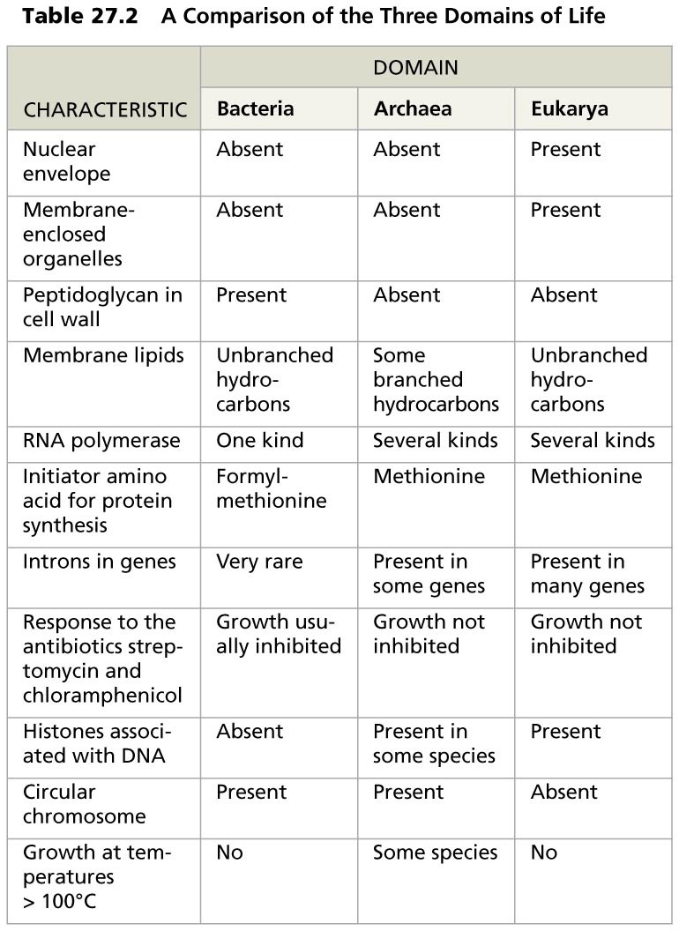
Table 27.2
Notes:
Table 27.2 A comparison of the three domains of life

Slide 30
Notes:
Which of the following describe all existing bacteria?
https://www.polleverywhere.com/multiple_choice_polls/VtRZ8KQEqXvTGio

Slide 31
Notes:
Which of the following traits do archaeans and bacteria share?
https://www.polleverywhere.com/multiple_choice_polls/8tY0ifczRqs5qCl

Slide 32
Notes:
Assuming that each of these possesses a cell wall, which prokaryotes should be expected to be most strongly resistant to plasmolysis in hypertonic environments?
https://www.polleverywhere.com/multiple_choice_polls/xbtIkrLr8SGhZyE

Slide 33
Overview
Concept 27.1: Structural and functional adaptations contribute to prokaryotic success
Concept 27.2: Rapid reproduction, mutation, and genetic recombination promote genetic diversity in prokaryotes
Concept 27.3: Diverse nutritional and metabolic adaptations have evolved in prokaryotes
Concept 27.4: Prokaryotes have radiated into a diverse set of lineages
Concept 27.5: Prokaryotes play crucial roles in the biosphere
Concept 27.6: Prokaryotes have both beneficial and harmful impacts on humans

Slide 34
Concept 27.5: Prokaryotes play crucial roles in the biosphere – Universal Recyclers
If prokaryotes were to disappear, the prospects for ANY other life surviving would be slim-to-none! #thanksprokaryotes
Prokaryotes play a major role in the recycling of chemical elements between the living and nonliving components of ecosystems
Chemoheterotrophic prokaryotes function as decomposers → break down dead organisms and waste products
This is why the earth isn’t just full of stacks of dead organisms and waste everywhere!

Slide 35
Concept 27.5: Prokaryotes play crucial roles in the biosphere – Ecological Interactions
Symbiosis = ecological relationship in which two species live in close contact: a larger host and smaller symbiont → Prokaryotes often form symbiotic relationships with larger organisms…
Mutualism = both symbiotic organisms benefit
Commensalism = one organism benefits while neither harming nor helping the other in any significant way
Parasitism = an organism called a parasite harms but does NOT kill its host (that’s its home!)
Parasites that cause disease are called pathogens

Slide 36
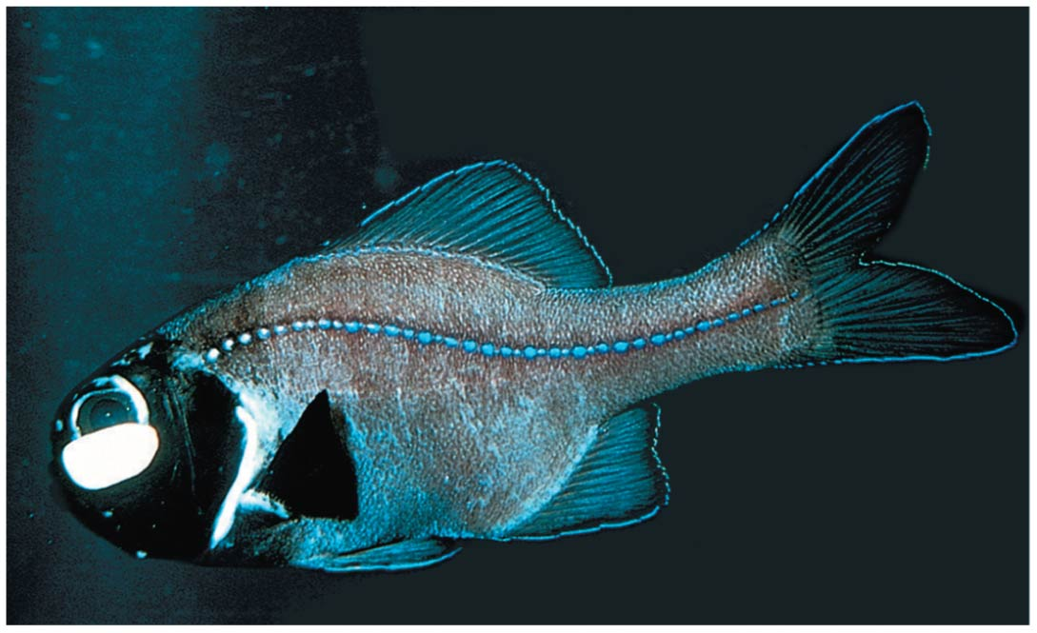
Mutualism: bacterial “headlights” !!!
Notes:
Figure 27.19 Mutualism: bacterial “headlights”

Slide 37
Notes:
If all prokaryotes on Earth suddenly vanished, which of the following would be the most likely and most direct result?
https://www.polleverywhere.com/multiple_choice_polls/Ct7KEL75W336Aud

Slide 38
Overview
Concept 27.1: Structural and functional adaptations contribute to prokaryotic success
Concept 27.2: Rapid reproduction, mutation, and genetic recombination promote genetic diversity in prokaryotes
Concept 27.3: Diverse nutritional and metabolic adaptations have evolved in prokaryotes
Concept 27.4: Prokaryotes have radiated into a diverse set of lineages
Concept 27.5: Prokaryotes play crucial roles in the biosphere
Concept 27.6: Prokaryotes have both beneficial and harmful impacts on humans

Slide 39
Concept 27.6: Prokaryotes have both beneficial and harmful impacts on humans
Some prokaryotes are human pathogens, but others have positive interactions with humans
Pathogenic bacteria cause about half of all human diseases
Human intestines are home to about 500–1,000 species of mostly mutualistic bacteria
Ex: break down food that is undigested by our own digestive system

Slide 40
Concept 27.6: Prokaryotes have both beneficial and harmful impacts on humans – Biotech
E. coli is used in gene cloning
Bacteria can be used to make natural plastics
Prokaryotes are the principal agents in bioremediation, the use of organisms to remove pollutants from the environment
Bacteria can be engineered to produce vitamins, antibiotics, and hormones
Bacteria are also being engineered to produce ethanol from agricultural and municipal waste biomass, switchgrass, and corn

Slide 41
Overview
Concept 27.1: Structural and functional adaptations contribute to prokaryotic success
Concept 27.2: Rapid reproduction, mutation, and genetic recombination promote genetic diversity in prokaryotes
Concept 27.3: Diverse nutritional and metabolic adaptations have evolved in prokaryotes
Concept 27.4: Prokaryotes have radiated into a diverse set of lineages
Concept 27.5: Prokaryotes play crucial roles in the biosphere
Concept 27.6: Prokaryotes have both beneficial and harmful impacts on humans

Slide 42
WATCH
https://www.youtube.com/watch?v=h-z9-9OOWC4
https://www.youtube.com/watch?v=wGVgIcTpZkk
https://www.youtube.com/watch?v=8Cw-NrnT5ic
https://www.youtube.com/watch?v=vAR47-g6tlA

Slide 43
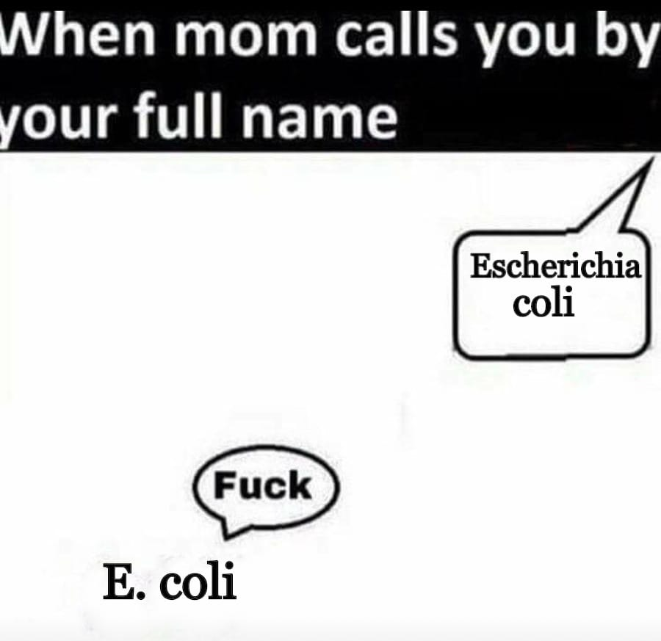
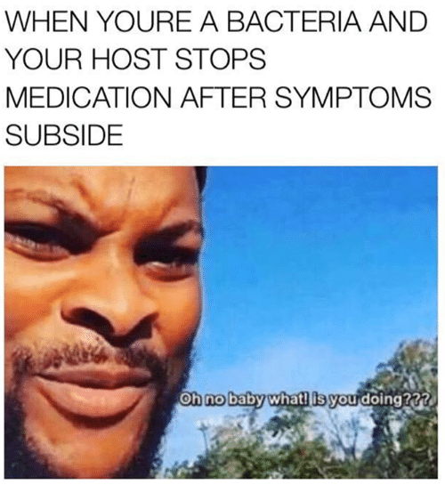
Oh boi

Slide 44
