Slide 1
Unit 6 Review Gene Activity and Biotechnology
AP Bio – Ch. 16-21

Slide 2
Unit 6 – Overview
Ch. 16 – The Molecular Basis of Inheritance (DNA)
Ch. 17 – Gene Expression: From Gene to Protein
Ch. 18 – Regulation of Gene Expression
Ch. 19 – Viruses
Ch. 20 – DNA Tools and Biotechnology
Ch. 21 – Genomes and Their Evolution

Slide 3
Unit 6 – Overview
Ch. 16 – The Molecular Basis of Inheritance (DNA)
Ch. 17 – Gene Expression: From Gene to Protein
Ch. 18 – Regulation of Gene Expression
Ch. 19 – Viruses
Ch. 20 – DNA Tools and Biotechnology
Ch. 21 – Genomes and Their Evolution

Slide 4
DNA – YOU MUST KNOW
The structural components of DNA
The knowledge about DNA gained from the work of Griffith, Avery+MacLeod+McCarty, Hershey+Chase, Chargaff, Wilkins+Franklin, and Watson+Crick
Replication is semiconservative and occurs 5’→3’
The roles of the key players (polymerase, ligase, helicase, topoisomerase, etc.)
The general differences between bacterial DNA replication/chromosomes and eukaryotic DNA replication/chromosomes

Slide 5
DNA – 16.1
DNA is the genetic material
Experiments with bacteria and with phages provided the first strong evidence that the genetic material is DNA.
Watson and Crick deduced that DNA is a double helix and built a structural model.
Two antiparallel sugar-phosphate chains wind around the outside of the molecule; the nitrogenous bases project into the interior, where they hydrogen-bond in specific pairs—A with T, G with C.

Slide 6
DNA – 16.2
Many proteins work together in DNA replication
DNA replication is semiconservative: The parental molecule unwinds, and each strand then serves as a template for the synthesis of a new strand according to base-pairing rules.
DNA replication at one replication fork is summarized in the next slide

Slide 7
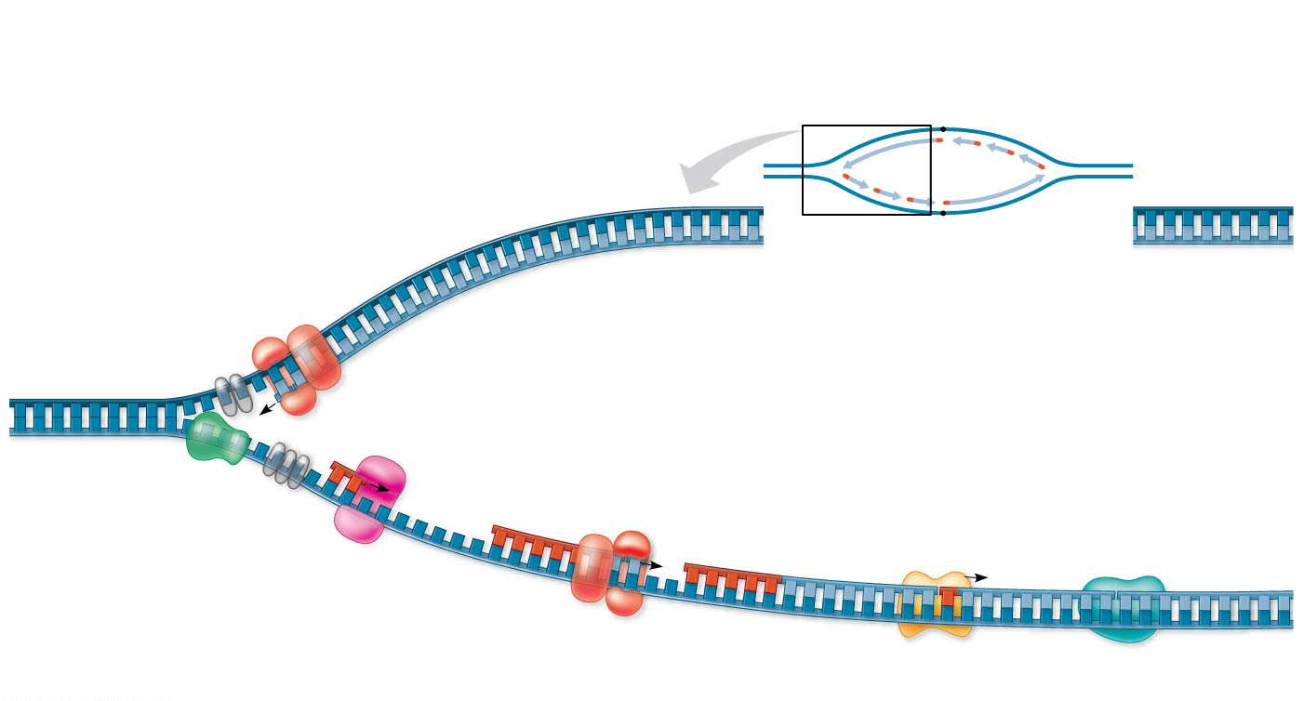
Figure 16.17
Overview
Leading strand
Origin of replication
Lagging strand
Leading strand template
3′
Lagging strand
Leading strand
Single-strand binding proteins
5′
Leading strand
Overall directions of replication
Helicase
5′
DNA pol III
3′
Primer
3′
5′
3′
Primase
Parental DNA
5
DNA pol III
Lagging strand
5′
3′
DNA pol I
DNA ligase
4
5′
3
2
1
3′
Lagging strand template
5′
Notes:
Figure 16.17 A summary of bacterial DNA replication

Slide 8
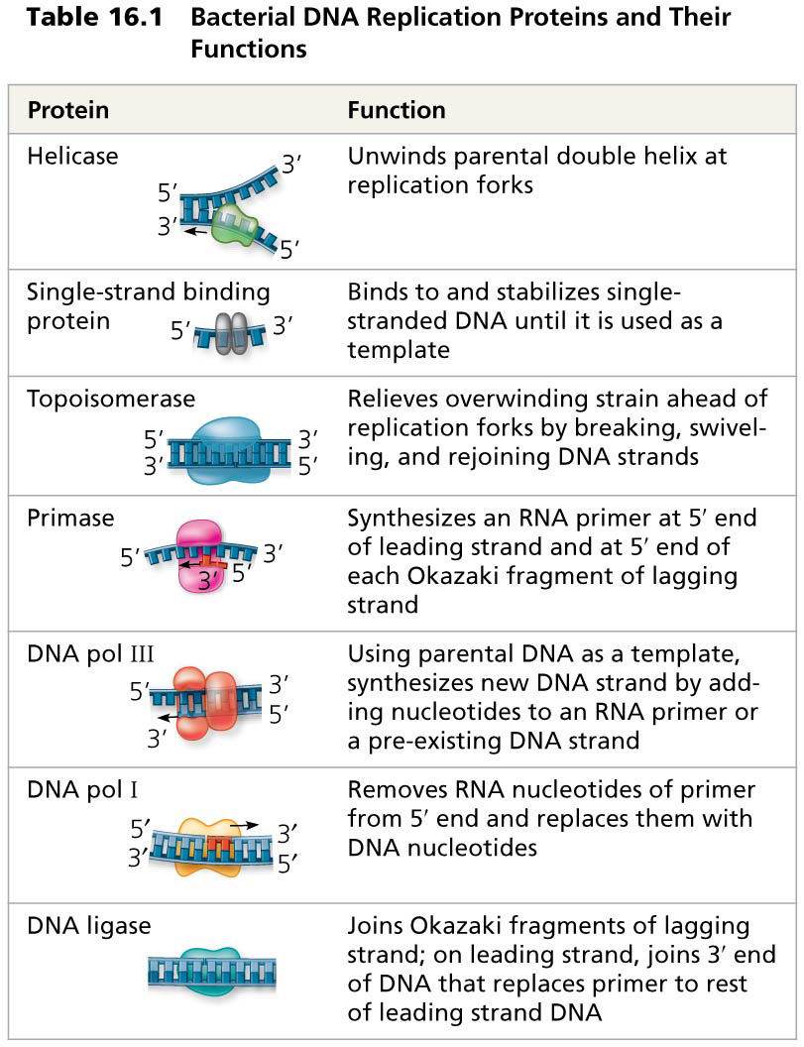
Table 16.1
Notes:
Table 16.1 Bacterial DNA replication proteins and their functions

Slide 9
DNA – 16.3
A chromosome consists of a DNA molecule packed together with proteins
The chromosome of most bacterial species is a circular DNA molecule with some associated proteins, making up the nucleoid.
The chromatin making up a eukaryotic chromosome is composed of DNA, histones, and other proteins.
The histones bind to each other and to the DNA to form nucleosomes, the most basic units of DNA packing.
Additional coiling and folding lead ultimately to the highly condensed chromatin of the metaphase chromosome.
In interphase cells, most chromatin is less compacted (euchromatin), but some remains highly condensed (heterochromatin).
Euchromatin, but not heterochromatin, is generally accessible for transcription of genes.

Slide 10
Unit 6 – Overview
Ch. 16 – The Molecular Basis of Inheritance (DNA)
Ch. 17 – Gene Expression: From Gene to Protein
Ch. 18 – Regulation of Gene Expression
Ch. 19 – Viruses
Ch. 20 – DNA Tools and Biotechnology
Ch. 21 – Genomes and Their Evolution

Slide 11
Gene Expression – YOU MUST KNOW
How RNA and DNA are similar and different, and how this defines their roles
The differences between replication, transcription, and translation and the role of DNA and RNA in each process
The key steps/events of transcription AND translation
How eukaryotic cells modify RNA after transcription
How mutations can change the amino acid sequence—be able to predict how a mutation can result in changes in gene expression
How to transcribe a given DNA sequence
How to translate a given mRNA sequence using a given genetic code table (amino acid table)

Slide 12
Gene Expression – 17.1
Genes specify proteins via transcription and translation
During gene expression, the information encoded in genes is used to make specific polypeptide chains (enzymes and other proteins) or RNA molecules.
Transcription is the synthesis of RNA complementary to a template strand of DNA.
Translation is the synthesis of a polypeptide whose amino acid sequence is specified by the nucleotide sequence in mRNA.
Genetic information is encoded as a sequence of nonoverlapping nucleotide triplets, or codons.
A codon in messenger RNA (mRNA) either is translated into an amino acid (61 of the 64 codons) or serves as a stop signal (3 codons).
Codons must be read in the correct reading frame.

Slide 13
Gene Expression – 17.2
Transcription is the DNA-directed synthesis of RNA
RNA synthesis is catalyzed by RNA polymerase, which links together RNA nucleotides complementary to a DNA template strand.
This process follows the same base-pairing rules as DNA replication, except that in RNA, uracil substitutes for thymine.
The three stages of transcription are initiation, elongation, and termination.
A promoter, often including a TATA box in eukaryotes, establishes where RNA synthesis is initiated.
Transcription factors help eukaryotic RNA polymerase recognize promoter sequences, forming a transcription initiation complex.

Slide 14
Gene Expression – 17.3
Eukaryotic cells modify RNA after transcription
Eukaryotic mRNAs undergo RNA processing, which includes RNA splicing, the addition of a modified nucleotide 5’ cap to the 5’ end, and the addition of a poly-A tail to the 3’ end.
Most eukaryotic genes are split into segments:
They have introns interspersed among the exons (the regions included in the mRNA).
In RNA splicing, introns are removed and exons joined. RNA splicing is typically carried out by spliceosomes.
The presence of introns allows for alternative RNA splicing.

Slide 15
Gene Expression – 17.4
Translation is the RNA-directed synthesis of a polypeptide
A cell translates an mRNA message into protein using transfer RNAs (tRNAs).
After being bound to a specific amino acid by an aminoacyl-tRNA synthetase, a tRNA lines up via its anticodon at the complementary codon on mRNA.
A ribosome, made up of ribosomal RNAs (rRNAs) and proteins, facilitates this coupling with binding sites for mRNA and tRNA.
Ribosomes coordinate the three stages of translation: initiation, elongation, and termination.
The formation of peptide bonds between amino acids is catalyzed by rRNA as tRNAs move through the A and P sites and exit through the E site.

Slide 16
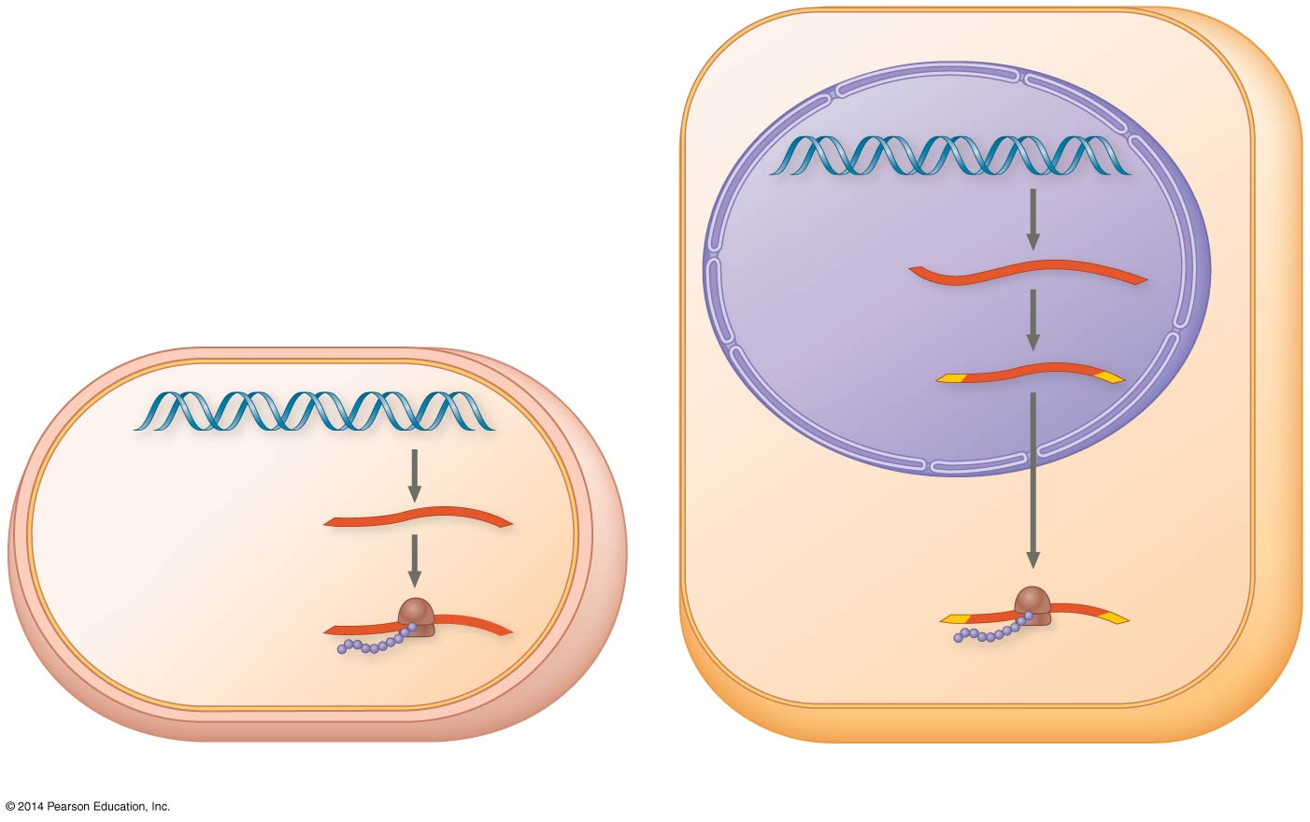
Figure 17.3
Nuclear
envelope
TRANSCRIPTION
DNA
Pre-mRNA
RNA PROCESSING
NUCLEUS
mRNA
TRANSCRIPTION
DNA
CYTOPLASM
CYTOPLASM
mRNA
Ribosome
TRANSLATION
Ribosome
TRANSLATION
Polypeptide
Polypeptide
(a) Bacterial cell
(b) Eukaryotic cell
Notes:
Figure 17.3 Overview: the roles of transcription and translation in the flow of genetic information

Slide 17
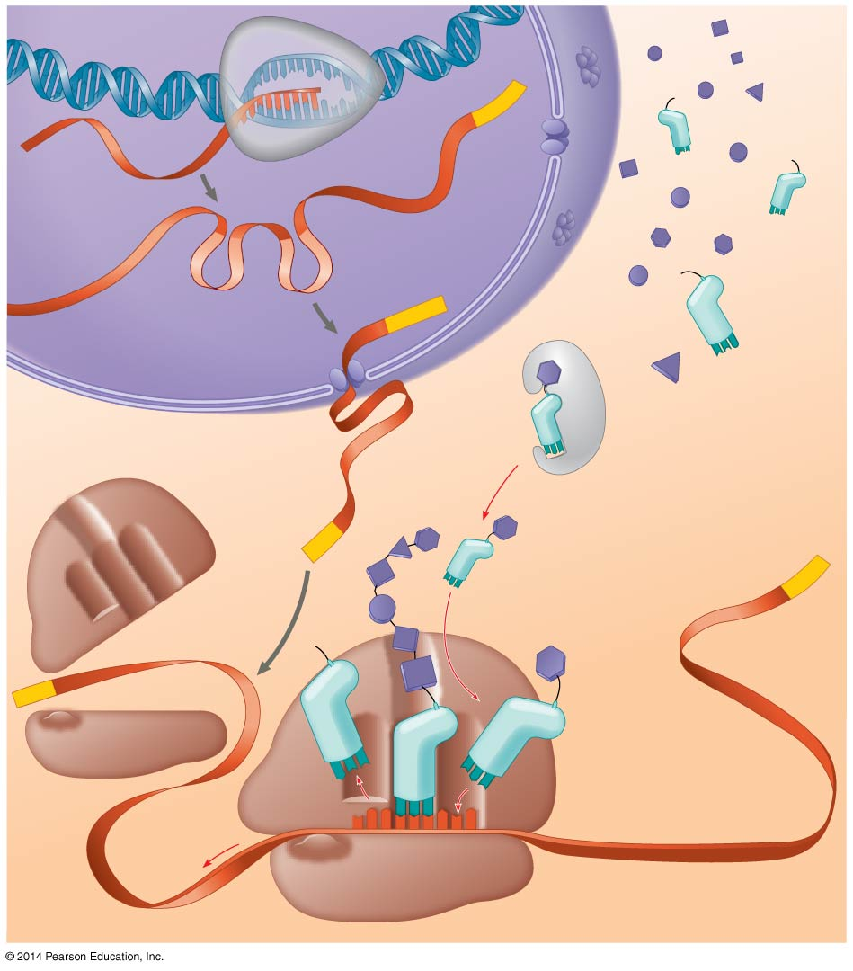
Figure 17.24
DNA
TRANSCRIPTION
3′
Poly-A
5′
RNA
polymerase
RNA
transcript
Exon
RNA PROCESSING
RNA transcript
(pre-mRNA)
Intron
Poly-A
Aminoacyl-tRNA
synthetase
NUCLEUS
Amino
acid
CYTOPLASM
AMINO ACID ACTIVATION
tRNA
mRNA
5′ Cap
3′
P
A
Aminoacyl
(charged)
tRNA
Poly-A
E
Ribosomal
subunits
5′ Cap
C
C
U
TRANSLATION
A
E
A
A
C
A
A
A
A
Anticodon
U
G
G
U
U
U
U
G
Codon
Ribosome
Notes:
Figure 17.24 A summary of transcription and translation in a eukaryotic cell

Slide 18
Unit 6 – Overview
Ch. 16 – The Molecular Basis of Inheritance (DNA)
Ch. 17 – Gene Expression: From Gene to Protein
Ch. 18 – Regulation of Gene Expression
Ch. 19 – Viruses
Ch. 20 – DNA Tools and Biotechnology
Ch. 21 – Genomes and Their Evolution

Slide 19
Gene Regulation – YOU MUST KNOW
The differences between prokaryotic and eukaryotic gene regulation
Genes can be activated by inducer molecules, or they can be inhibited by the presence of a repressor as they interact with regulatory proteins or sequences
A regulatory gene is a sequence of DNA that codes for a regulatory protein such as a repressor protein
How the components of an operon function to regulate gene expression in both repressible and inducible operons
How positive and negative control function in gene expression
The impact of DNA methylation and histone acetylation on gene expression
The role of microRNAs in control of cellular functions
The role of induction in eukaryotic development

Slide 20
Gene Regulation – 18.1
Bacteria often respond to environmental change by regulating transcription
Cells control metabolism by regulating enzyme activity or the expression of genes coding for enzymes.
In bacteria, genes are often clustered into operons, with one promoter serving several adjacent genes. An operator site on the DNA switches the operon on or off, resulting in coordinate regulation of the genes.

Slide 21
Gene Regulation – 18.1
Bacteria often respond to environmental change by regulating transcription
Both repressible and inducible operons are examples of negative gene regulation. In either type of operon, binding of a specific repressor protein to the operator shuts off transcription. The repressor is encoded by a separate regulatory gene.
In a repressible operon, the repressor is active when bound to a corepressor, usually the end product of an anabolic pathway.
In an inducible operon, binding of an inducer to an innately active repressor inactivates the repressor and turns on transcription. Inducible enzymes usually function in catabolic pathways.
Some operons are also subject to positive gene regulation via a stimulatory activator protein, such as catabolite activator protein (CAP), which, when activated by cyclic AMP, binds to a site within the promoter and stimulates transcription.

Slide 22
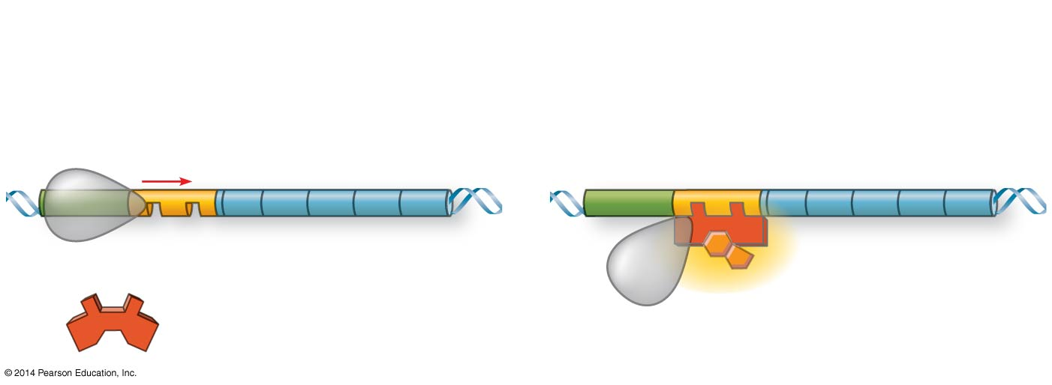
Figure 18.UN07
Repressible operon:
Genes expressed
Genes not expressed
Promoter
Genes
Operator
Active repressor: corepressor bound
Inactive repressor: no corepressor present
Corepressor
The “Norm”
The “Regulated”
Notes:
Figure 18.UN07 Summary of key concepts: operon, repressible

Slide 23
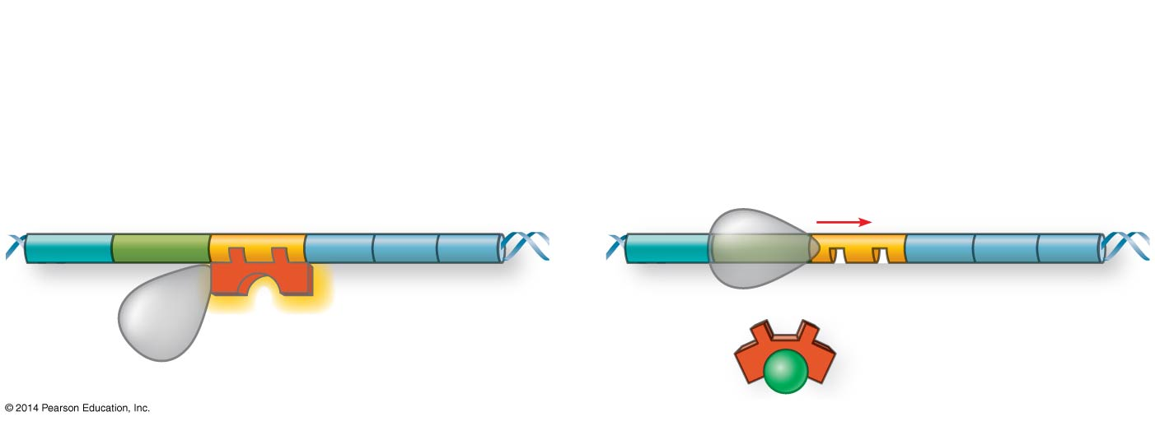
Figure 18.UN08
Inducible operon:
Genes not expressed
Genes expressed
Promoter
Operator
Genes
Active repressor: no inducer present
Inactive repressor: inducer bound
Inducer
The “Norm”
The “Regulated”
Notes:
Figure 18.UN08 Summary of key concepts: operon, inducible

Slide 24
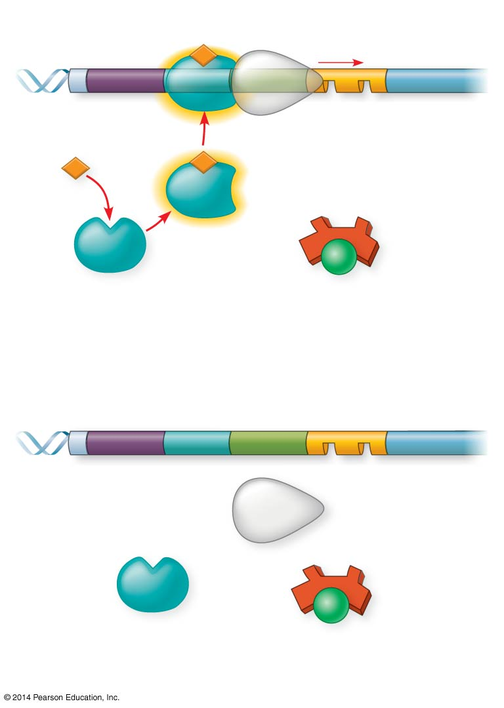
Figure 18.5
Promoter
DNA
Operator
lac
I
lacZ
CAP-binding site
RNA polymerase binds and transcribes
Active
CAP
cAMP
Inactive lac repressor
Inactive
CAP
Allolactose
(a) Lactose present, glucose scarce (cAMP level high): abundant lac mRNA synthesized
Promoter
DNA
lac
I
lacZ
CAP-binding site
Operator
RNA polymerase less likely to bind
Inactive
CAP
Inactive lac repressor
(b) Lactose present, glucose present (cAMP level low): little lac mRNA synthesized
Notes:
Figure 18.5 Positive control of the lac operon by catabolite activator protein (CAP)

Slide 25
Gene Regulation – 18.2
Eukaryotic gene expression is regulated at many stages
Summary figure on next slide

Slide 26
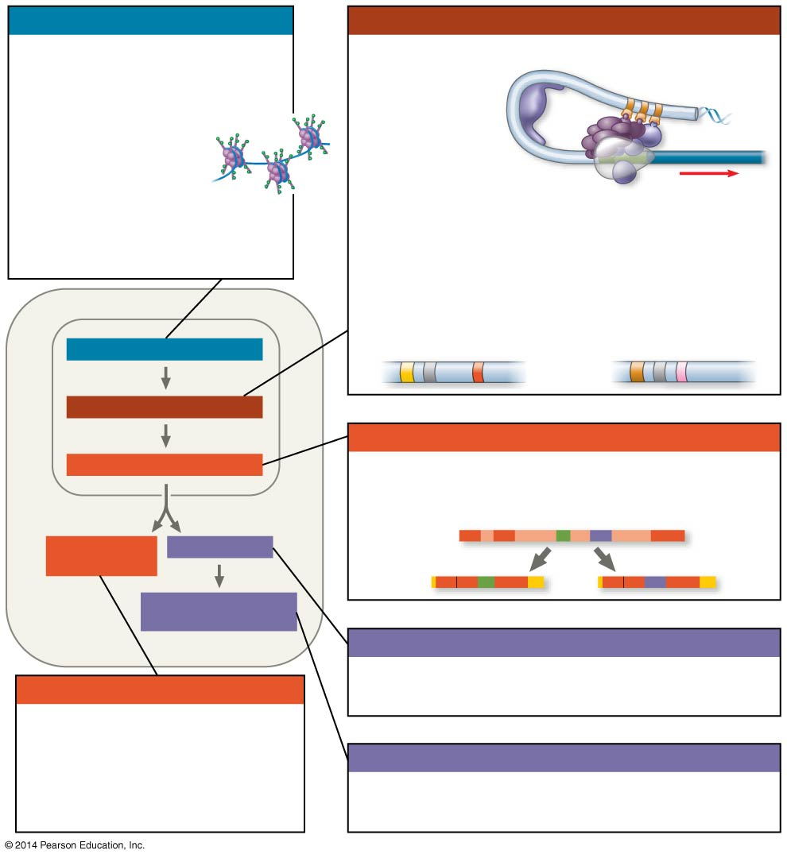
Figure 18.UN09
Chromatin modification
Transcription
• Genes in highly compacted chromatin are generally not transcribed.
• Histone acetylation
seems to loosen
chromatin structure,
enhancing transcription.
• DNA methylation generally
reduces transcripton.
• Regulation of transcription initiation: DNA control elements in enhancers bind specific tran- scription factors. Bending of the DNA enables activators to contact proteins at the promoter, initiating transcription.
• Coordinate regulation:
Enhancer for liver-specific genes
Enhancer for lens-specific genes
CHROMATIN MODIFICATION
TRANSCRIPTION
RNA processing
RNA PROCESSING
• Alternative RNA splicing:
Primary RNA transcript
mRNA DEGRADATION
TRANSLATION
mRNA
OR
PROTEIN PROCESSING AND DEGRADATION
Translation
mRNA degradation
• Initiation of translation can be controlled via regulation of initiation factors.
• Each mRNA has a characteristic life span, determined in part by sequences in the 5′ and 3′ UTRs.
Protein processing and degradation
• Protein processing and degradation are subject to regulation.
Notes:
Figure 18.UN09 Summary of key concepts: eukaryotic regulation of gene expression

Slide 27
Gene Regulation – 18.3
Noncoding RNAs play multiple roles in controlling gene expression
MicroRNAs (miRNAs) are small single-stranded RNA molecules that can bind to and degrade mRNA or block its translation (~50% of human genes are regulated by these btw)
Small interfering RNAs (siRNAs) are similar to miRNAs in size and function
The blocking of gene expression by siRNAs is called RNA interference (RNAi)

Slide 28
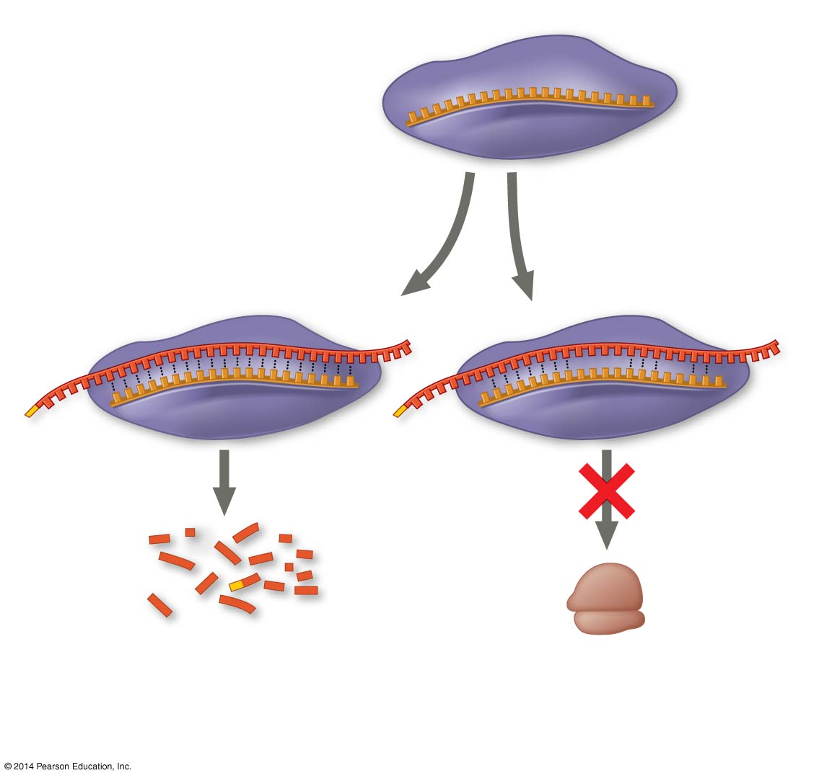
Figure 18.14
miRNA
miRNA- protein complex
1
The miRNA binds to a target mRNA.
OR
mRNA degraded
Translation blocked
2
If bases are completely complementary, mRNA is degraded. If match is less than complete, translation is blocked.
Notes:
Figure 18.14 Regulation of gene expression by miRNAs

Slide 29
Gene Regulation – 18.4
A program of differential gene expression leads to the different cell types in a multicellular organism
Embryonic cells become committed to a certain fate (determination), and undergo differentiation, becoming specialized in structure and function for their determined fate.
Cells have different structures and functions not because they contain different genomes but because they express different genes.
Morphogenesis encompasses the processes that give shape to the organism and its various structures.
In the process called induction, signaling molecules from embryonic cells cause transcriptional changes in nearby target cells.

Slide 30
Unit 6 – Overview
Ch. 16 – The Molecular Basis of Inheritance (DNA)
Ch. 17 – Gene Expression: From Gene to Protein
Ch. 18 – Regulation of Gene Expression
Ch. 19 – Viruses
Ch. 20 – DNA Tools and Biotechnology
Ch. 21 – Genomes and Their Evolution

Slide 31
Viruses – YOU MUST KNOW
The components of a virus
The differences between lytic and lysogenic cycles of replication
The goals of all viruses—infect and replicate
How viruses influence genetic variation in organisms and in themselves

Slide 32
Viruses – 19.1
A virus consists of a nucleic acid surrounded by a protein coat
A virus is a small nucleic acid genome enclosed in a protein capsid and sometimes a membranous viral envelope.
The genome may be single- or double-stranded DNA or RNA.

Slide 33
Viruses – 19.2
Viruses replicate only in host cells
Viruses hijack enzymes, ribosomes, and small molecules of host cells to synthesize progeny viruses during replication.
Each type of virus has a characteristic host range.
Phages (viruses that infect bacteria) can replicate by two alternative mechanisms: the lytic cycle and the lysogenic cycle.

Slide 34
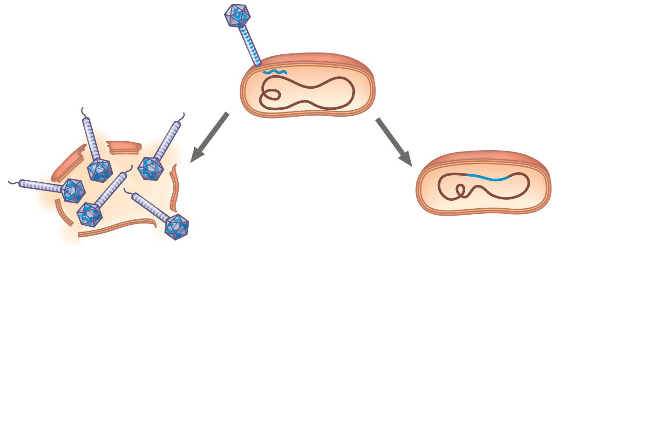
Figure 19.UN03
The phage attaches to a
host cell and injects its DNA.
Phage DNA
Prophage
Bacterial
chromosome
Lytic cycle
Lysogenic cycle
• Virulent or temperate phage
• Destruction of host DNA
• Production of new phages
• Lysis of host cell causes
releases of progeny phages
• Temperate phage only
• Genome integrates into bacterial
chromosome as prophage, which
(1) is replicated and passed on to
daughter cells and
(2) can be induced to leave the
chromosome and initiate a lytic
cycle
Notes:
Figure 19.UN03 Summary of key concepts: lytic and lysogenic cycles

Slide 35
Viruses – 19.2
Viruses replicate only in host cells
Many animal viruses have an envelope.
Retroviruses (such as HIV) use the enzyme reverse transcriptase to copy their RNA genome into DNA, which can be integrated into the host genome as a provirus.
Since viruses can replicate only within cells, they probably evolved after the first cells appeared, perhaps as packaged fragments of cellular nucleic acid.

Slide 36
Unit 6 – Overview
Ch. 16 – The Molecular Basis of Inheritance (DNA)
Ch. 17 – Gene Expression: From Gene to Protein
Ch. 18 – Regulation of Gene Expression
Ch. 19 – Viruses
Ch. 20 – DNA Tools and Biotechnology
Ch. 21 – Genomes and Their Evolution

Slide 37
Biotechnology – YOU MUST KNOW
The terminology of biotechnology
The steps of bacterial transformation
How plasmids are used in bacterial transformation to clone genes
How gel electrophoresis can be used to separate DNA fragments
Information that can be determined from DNA gel results, such as fragment sizes
The steps of PCR

Slide 38
Biotechnology – 20.1
DNA cloning is a valuable tool for genetic engineering
Nucleic acid hybridization, the base pairing of one strand of a nucleic acid to the complementary sequence on a strand from another nucleic acid molecule, is widely used in DNA technology.
Gene cloning (or DNA cloning) produces multiple copies of a gene (or DNA fragment) that can be used in analyzing and manipulating DNA and can yield useful new products or organisms with beneficial traits.

Slide 39
Biotechnology – 20.1 (cont.)
DNA cloning is a valuable tool for genetic engineering
In genetic engineering, bacterial restriction enzymes are used to cut DNA molecules within short, specific nucleotide sequences (restriction sites), yielding a set of double-stranded restriction fragments with single-stranded sticky ends
The sticky ends on restriction fragments from one DNA source can base-pair with complementary sticky ends on fragments from other DNA molecules.
Sealing the base-paired fragments with DNA ligase produces recombinant DNA molecules.
DNA restriction fragments of different lengths can be separated by gel electrophoresis.
To clone a eukaryotic gene, recombinant plasmids are returned to host cells, each of which divides to form a clone of cells.

Slide 40
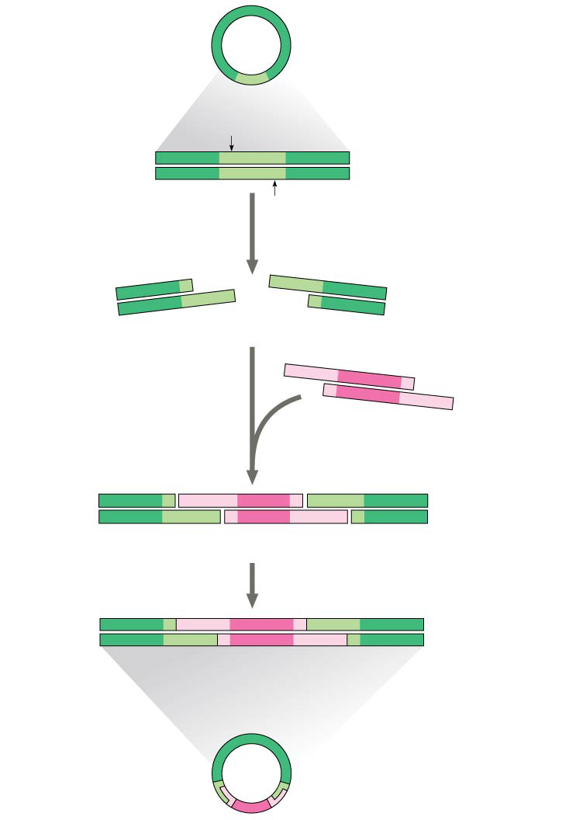
Figure 20.6
Bacterial plasmid
Restriction site
5′
GAATTC
3′
DNA
CTTAAG
3′
5′
1
Restriction enzyme cuts the sugar-phosphate backbones at each arrow.
5′
3′
5′
3′
G
AATTC
CTTAA
G
3′
5′
3′
5′
Sticky end
5′
3′
2
Base pairing of sticky ends produces various combinations.
AATTC
G
G
CTTAA
3′
5′
Fragment from different DNA molecule cut by the same restriction enzyme
5′
3′
5′
3′
5′
T
3′
G
A
A
T
T
C
G
A
A
T
C
C
T
T
A
A
G
C
T
T
A
A
G
3′
5′
3′
5′
3′
5′
3
DNA ligase seals the strands.
One possible combination
5′
3′
3′
Recombinant DNA molecule
5′
Recombinant plasmid
Notes:
Figure 20.6 Using a restriction enzyme DNA ligase to make a recombinant DNA plasmid

Slide 41
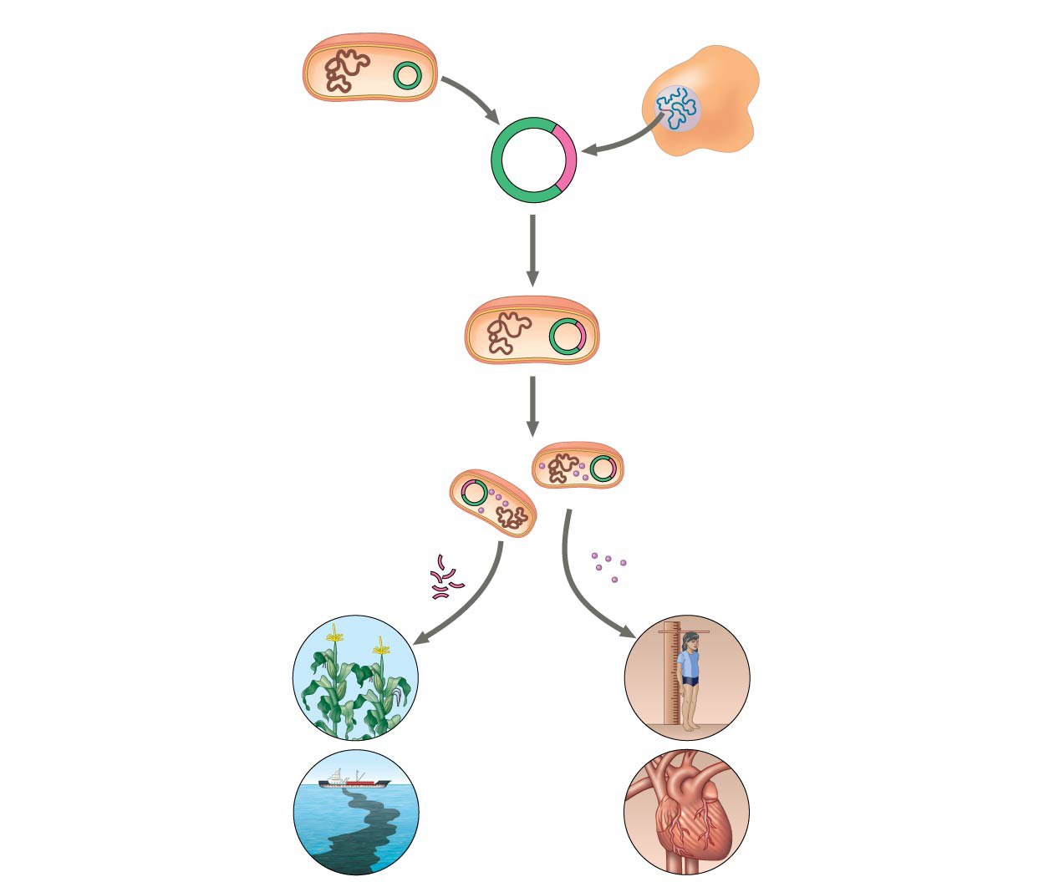
Figure 20.5
Bacterium
Cell containing gene of interest
1
Gene inserted into plasmid
Bacterial chromosome
Plasmid
DNA of chromosome (“foreign” DNA)
Recombinant DNA (plasmid)
Gene of interest
2
Plasmid put into bacterial cell
Recombinant bacterium
3
Host cell grown in culture to form a clone of cells containing the “cloned” gene of interest
Gene of interest
Protein expressed from gene of interest
Copies of gene
Protein harvested
Gene for pest resistance inserted into plants
4
Basic research and various applications
Human growth hormone treats stunted growth
Gene used to alter bacteria for cleaning up toxic waste
Protein dissolves blood clots in heart attack therapy
Notes:
Figure 20.5 Gene cloning and some uses of cloned genes

Slide 42
Biotechnology – 20.1 (cont.)
DNA cloning is a valuable tool for genetic engineering
The polymerase chain reaction (PCR) can produce many copies of (amplify) a specific target segment of DNA in vitro, using primers that bracket the desired sequence and a heat-resistant DNA polymerase.

Slide 43
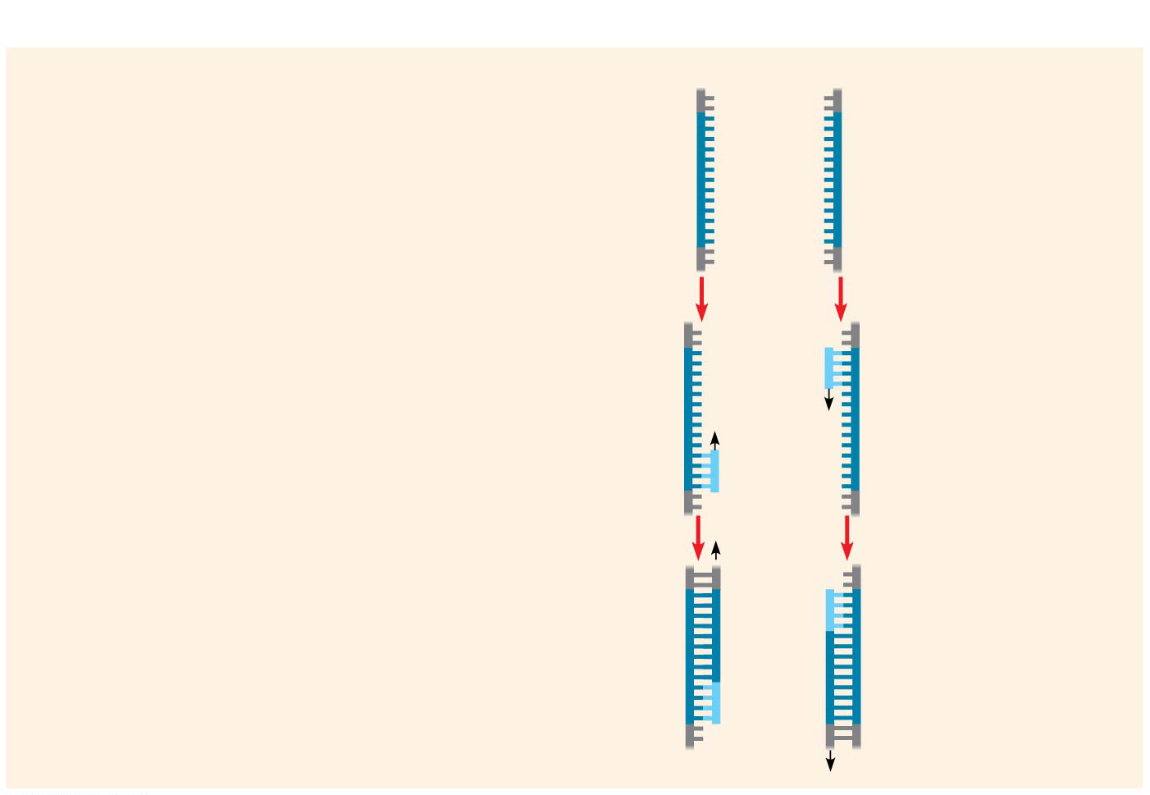
Figure 20.8b-3
Technique
1
Denaturation
5′
3′
3′
5′
2
Annealing
Cycle 1 yields 2 molecules
Primers
3
Extension
New nucleotides
Notes:
Figure 20.8b-3 Research method: the polymerase chain reaction (PCR) (part 2, step 3)

Slide 44
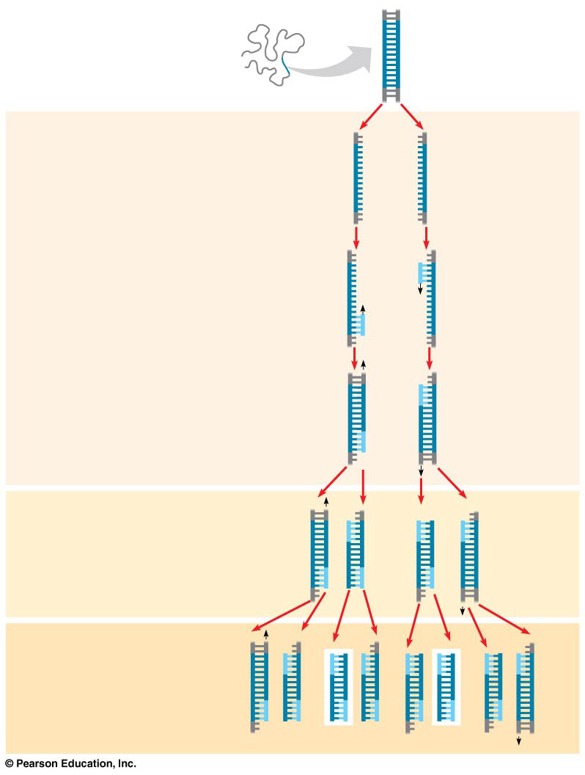
Figure 20.8
Technique
5′
3′
Target sequence
Genomic DNA
3′
5′
1
Denaturation
5′
3′
3′
5′
2
Annealing
Cycle 1 yields 2 molecules
Primers
3
Extension
New
nucleotides
Cycle 2 yields 4 molecules
Cycle 3 yields 8 molecules; 2 molecules (in white boxes) match target sequence
Notes:
Figure 20.8 Research method: the polymerase chain reaction (PCR)

Slide 45
Biotechnology – 20.4
The practical applications of DNA-based biotechnology affect our lives in many ways
Many fields benefit from DNA technology and genetic engineering
Medical Applications
Pharmaceutical Products
Forensic Evidence and Genetic Profiles
Environmental Cleanup
Agricultural Applications
Potential benefits of genetic engineering must be weighed against potential hazards of creating harmful products or procedures

Slide 46
Unit 6 – Overview
Ch. 16 – The Molecular Basis of Inheritance (DNA)
Ch. 17 – Gene Expression: From Gene to Protein
Ch. 18 – Regulation of Gene Expression
Ch. 19 – Viruses
Ch. 20 – DNA Tools and Biotechnology
Ch. 21 – Genomes and Their Evolution

Slide 47
Genomes – YOU MUST KNOW
How prokaryotic genomes compare to eukaryotic genomes
The activity and role of transposable elements in generating genetic diversity
The conclusions related to gene density in humans
The conclusions related to noncoding DNA in humans

Slide 48
Genomes – 21.2
Scientists use bioinformatics to analyze genomes and their functions
In systems biology, scientists use the computer-based tools of bioinformatics to compare genomes and study sets of genes and proteins as whole systems

Slide 49
Genomes – 21.3
Genomes vary in size, number of genes, and gene density (DO NOT MEMORIZE…just have a general idea)
 | Bacteria | Eukaraya
Genome Size | 1-6 Mb | 10-4000 Mb
Number of Genes | 1500-1700 | 5000-40000
Gene Density | Higher than in eukaryotes | Lower than in eukaryotes
Introns | None in protein-coding genes | Present in most genes of multicellular eukaryotes
Other noncoding DNA | Very little | Can exist in large amounts, lots of repetitive DNA

Slide 50
Genomes – 21.4
Multicellular eukaryotes have much noncoding DNA
Only 1.5% of the human genome codes for proteins or gives rise to rRNAs or tRNAs; the rest is noncoding DNA, including pseudogenes and repetitive DNA of unknown function.
The most abundant type of repetitive DNA in multicellular eukaryotes consists of transposable elements and related sequences.
Ex: Transposons: move via a DNA intermediate

Slide 51
Genomes – 21.5
Duplication, rearrangement, and mutation of DNA contribute to genome evolution
Rearrangement of exons within and between genes during evolution has led to genes containing multiple copies of similar exons and/or several different exons derived from other genes.
Movement of transposable elements or recombination between copies of the same element can generate new sequence combinations that are beneficial to the organism. These may alter the functions of genes or their patterns of expression and regulation.

Slide 52
Genomes – 21.6
Comparing genome sequences provides clues to evolution and development
Comparisons of genomes from widely divergent and closely related species provide valuable information about ancient and more recent evolutionary history, respectively.

Slide 53
Unit 6 – Overview
Ch. 16 – The Molecular Basis of Inheritance (DNA)
Ch. 17 – Gene Expression: From Gene to Protein
Ch. 18 – Regulation of Gene Expression
Ch. 19 – Viruses
Ch. 20 – DNA Tools and Biotechnology
Ch. 21 – Genomes and Their Evolution

